Slide 1
Data Visualization
Ravi Kumar
Puneet Mittal

Slide 2
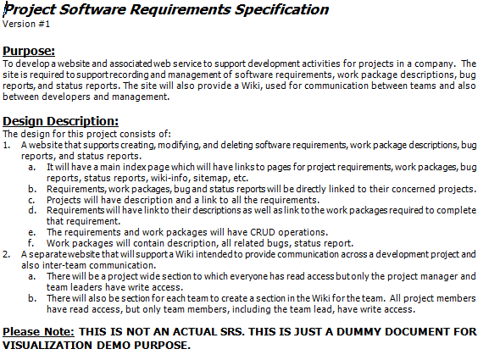

Slide 3

After some time…

Slide 4
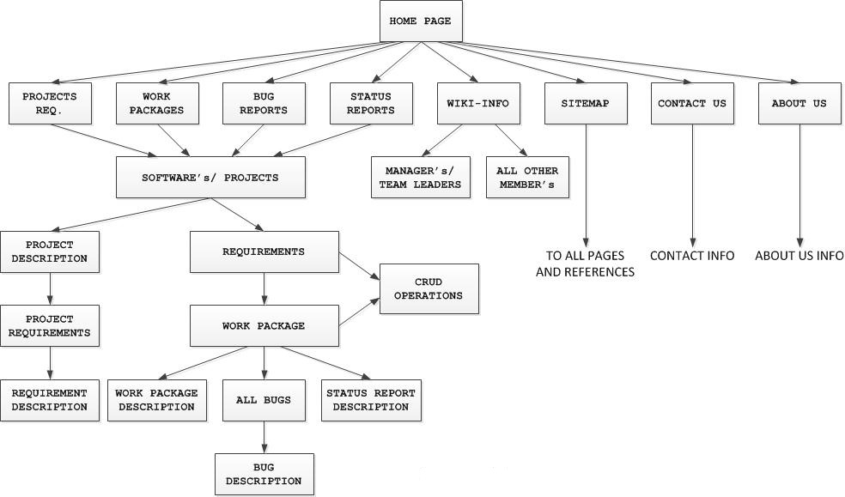
Instead!

Slide 5
Demo
http://raravamu.mysite.syr.edu

Slide 6
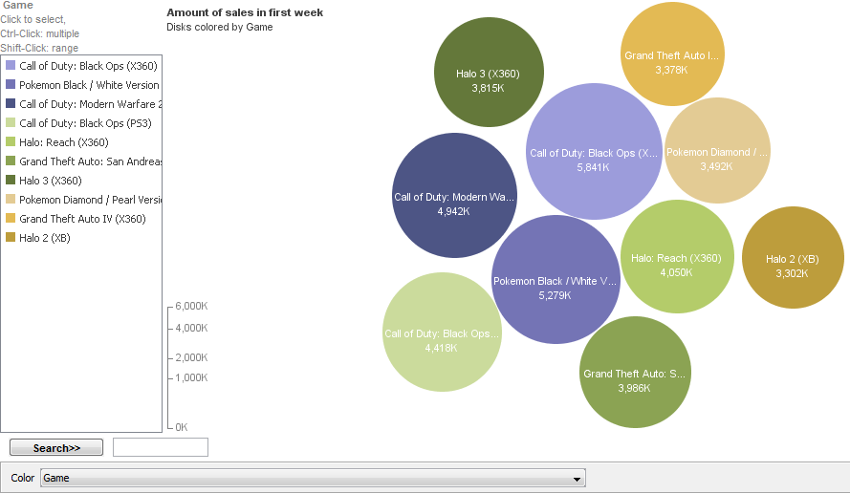
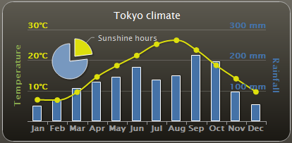
Some other tools
Many Eyes :
  Free & easy to use.
  Provides suggestions on visual representation.
Highcharts :
  Easy to use
  Just need to import the Javascript library.

Slide 7
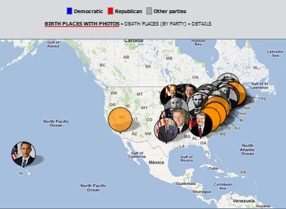
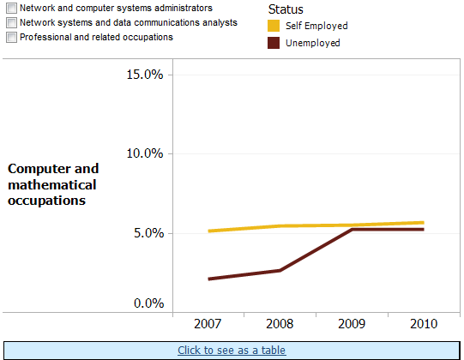
Some other tools
Exhibit:
  Free, but requires more hand coding.
  Provides several views like time plots, calendars, customized lenses, facets.
Tableau:
  Lots of visualization options with suggestions for visual representation.
  Large number of databases like MS Access, DB2, Oracle, etc. & connecting two visualizations

Slide 8
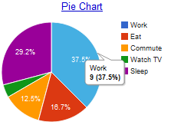
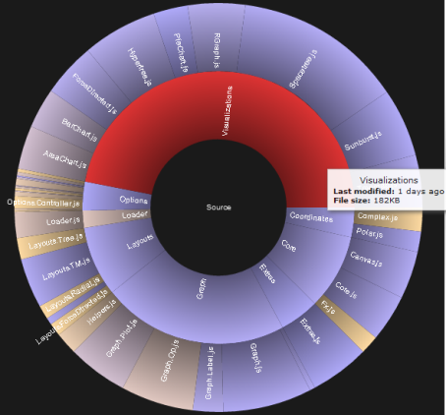
Some other tools
Google Charts :
  Free visualization of data residing elsewhere.
  Offers a wizard and API for creating web graphics.
Javascript InfoVis Toolkit :
  Free but requires input data to be in JSON format only.

Slide 9
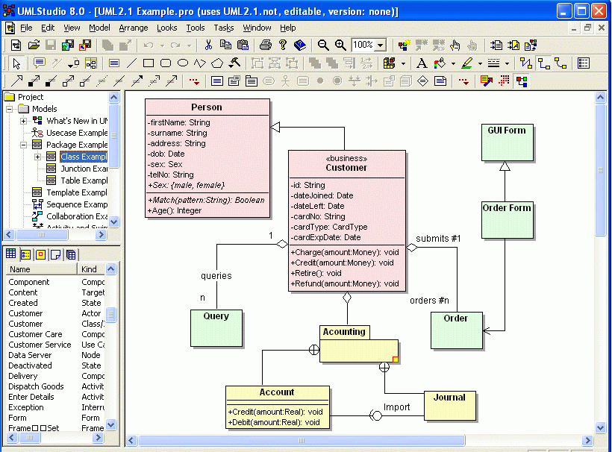
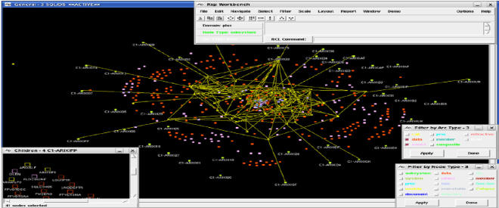
Some other tools
UML Studio :
  Object oriented tool that helps in creating class, use-case, state, activity, etc. diagrams to visualize software.
Rigi :
  Used to extract information from source code and then visualize it as graphs.

Slide 10
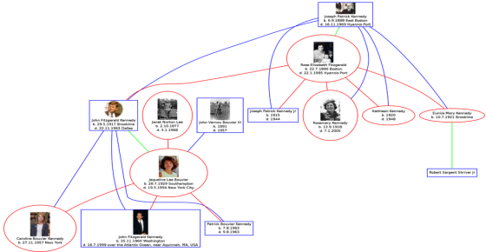
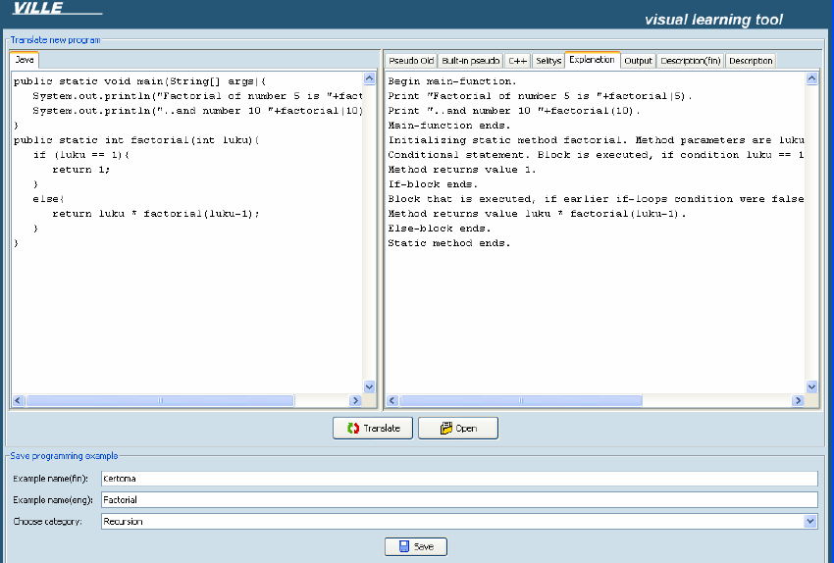
Some other tools
GraphViz :
  Takes simple text file as input and outputs graphs in formats like images, SVG, PDF, etc.
VILLE :
  Language independent program visualization tool.
  Allows parallel view of programs in different languages, tracing execution and monitor output.

Slide 11
References
http://www.pragsoft.com/
http://www.sciencedirect.com/science/article/pii/S016764230900149X
http://www.adp-gmbh.ch/misc/tools/graphviz/index.html
http://thejit.org/
http://code.google.com/apis/chart/
http://www.highcharts.com/
http://www.tableausoftware.com/

Slide 12

Last Class?
We learnt something this semester

