Slide 1
Visualization
Four groups
  Design pattern for information visualization
  Interface Design pattern and visual complexity
  Google API and Other related tools
  Pivot

Slide 2
Software Design Patterns for Information Visualization
Mubarek K.
Priyank H.
Yu Chi Jen

Slide 3
Content
Introduction
Categories of SDP for IV
Patterns
Patterns working together

Slide 4
Introduction
Diverse software architectures supporting information visualization
However it is difficult to identify, evaluate and re-apply the design solutions
Capture successful solutions in design patterns
The pattern discussion follow software design pattern format

Slide 5
Categories
The Information visualization patterns lie in one or more of the following groups
  Data representation
  Graphics
  Interaction

Slide 6
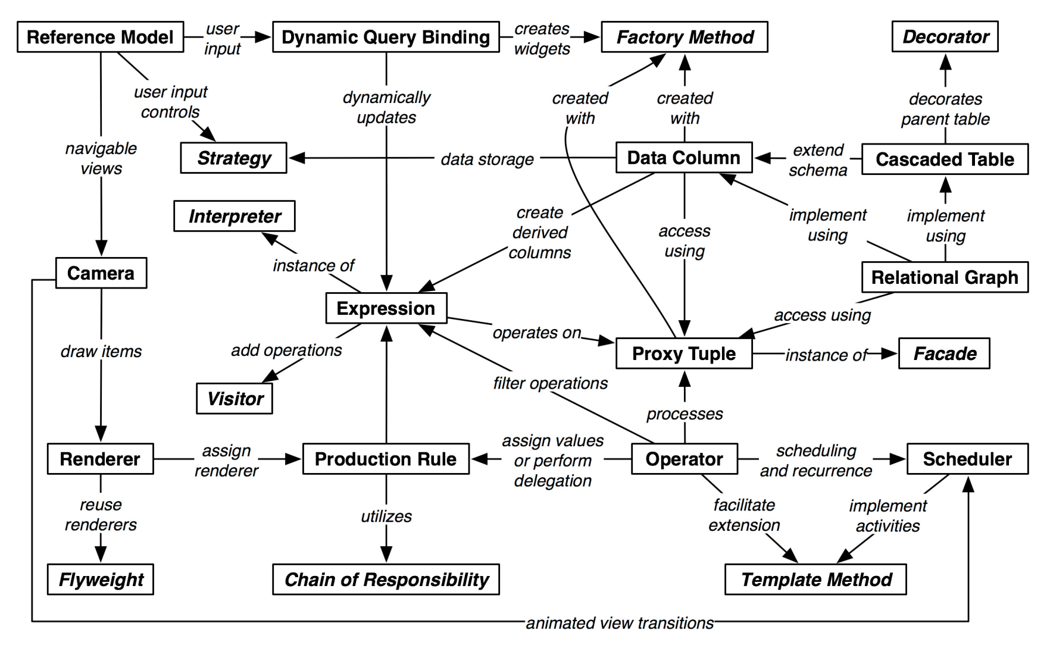
Design Patterns Relationships

Slide 7
Reference Model
“Provides a general template for structuring visualization applications that separates data models, visual models, views and interactive controls.”
Right separation of concerns reflects the complexity, extensibility and reusability of software architectures.
Provides a high-level template for application design whose implementation can be informed by other patterns.

Slide 8
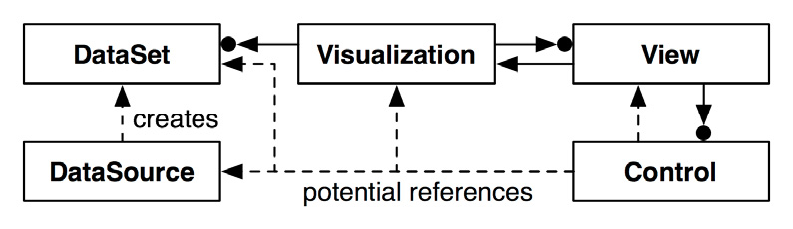
Structure of Reference Model

Slide 9
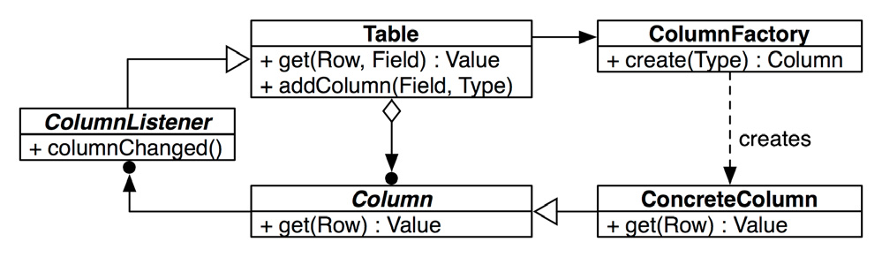
Data Column
“Organize relational data into data columns providing flexible data representations and extensible data schemas.”

Slide 10
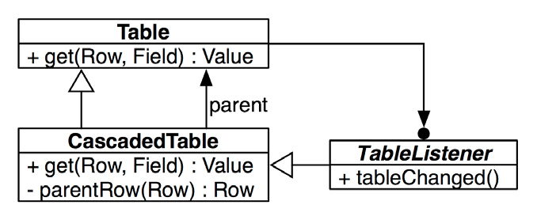
Cascaded Table
“Allow relational data tables to inherit data from parent tables, efficiently supporting derived tables.”

Slide 11
Relational Graph
“Use relational data tables to represent network structures, facilitating data reuse and efficient data processing.”
For optimized query processing, network structures are implemented using relational data tables to represent node and edge data.
Each table stores various data attributes of nodes and edges in network.

Slide 12
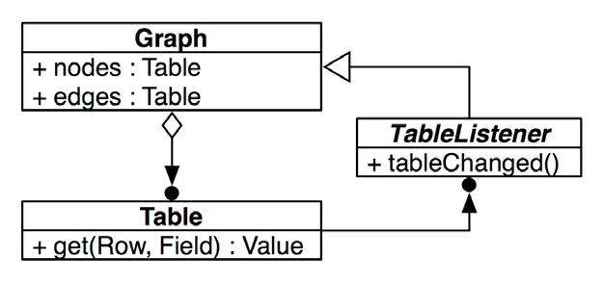
Relational Graph
Advantage: Helps unify data representation issues i.e. one can easily swap in and out edge data or node table can be reused across multiple graphs.
Issue: Performance, in case of traversing graph with an unacceptable overhead.

Slide 13
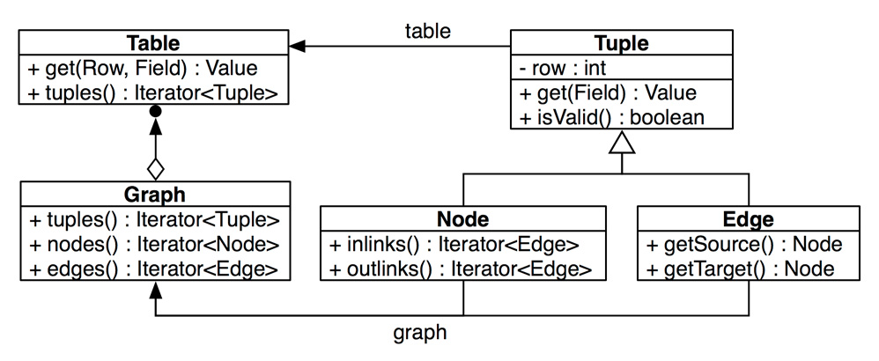
Proxy Tuple
“Use an object relational mapping for accessing, manipulating, grouping and reordering table and graph data.” Instead of accessing graph and table data directly, a proxy object is created to access them.

Slide 14
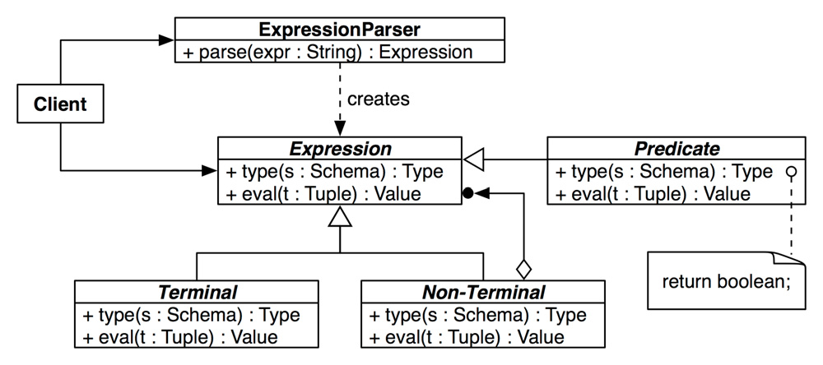
Expression
“Provides an expression language for data processing tasks such as specifying queries and computing derived values.”
Language statements are represented as tree of expression objects for data processing.

Slide 15
Scheduler
“Provide schedulable activities for implementing time-sensitive, potentially recurring operations. “
Includes animations and time-sensitive responses to user input.

Slide 16
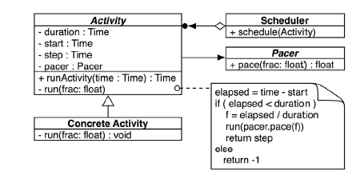
Structure of Scheduler
Pacer is used to adjust the scheduler : slow, fast

Slide 17
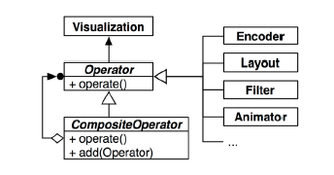
Operator
“Decompose visual data processing into a series of composable operators, enabling flexible and reconfigurable visual mappings.”
We will have granular control on the visualization and other operators can be applied easily

Slide 18
Renderer
“Separate visual components from their rendering methods, allowing dynamic determination of visual appearances”
Avoids creating sub-classing to change appearance
Renderer de-couples the representation of a visual item from its rendering
  item’s visual attributes into actual “pixels”
  Dedicated and re-usable module for renderer

Slide 19
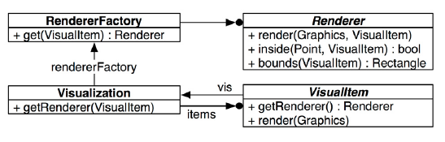
Structure of renderer
Application
  Java swing interface
  Prefuse visualization toolkit uses RendererFactory
Related patterns
  Production Rule
  Flyweight

Slide 20
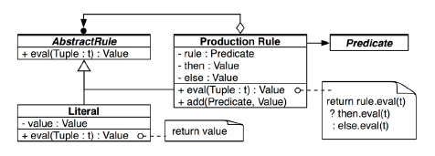
Production Rule
“Use a chain of if-then-else rules to dynamically determine visual properties using rule-based assignment or delegation.”
E.g. Default color encoding but overriding in special cases

Slide 21
Camera
“Provide a transformable camera view onto a visualization, supporting multiple views and spatial navigation of data displays.”
Panning and zooming arise in large data sets
Multiple views - overview+detail
Treat the data view as camera
  Moving, zooming, or rotating the camera accordingly changes the viewpoint

Slide 22
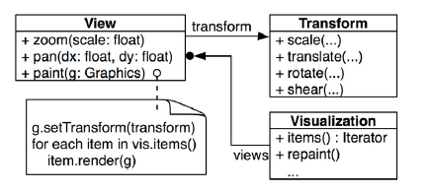
Structure of Camera pattern
Known uses
  OpenGL - camera in 3D graphics
Related Patterns
  Renderer
  Scheduler

Slide 23
Dynamic Query Binding
“Allow data selection and filtering criteria to be specified dynamically using direct manipulation interface components. “
Refining a data view through direct manipulation
Sliders, range sliders, checkboxes and textboxes may be used for user input

Slide 24
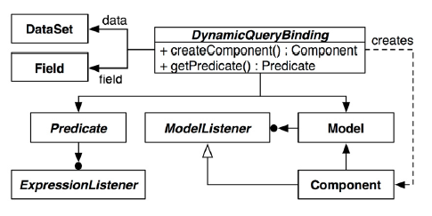
Structure
Known uses
  InfoVis
Related Patterns
  Factory Method
  Expression

Slide 25
Conclusion
Most of the patterns can be used in isolation
Their relationship gives the greatest value
  E.g Scheduler and Operator => animation
  Relational graph and Proxy Tuple
The patterns are not static and other related pattern may be created

Slide 26
Design Patterns Relationships

Slide 27
References
[1] J. Heer and M. Agrawala, Software Design Patterns for Information Visualization, IEEE Transactions on Visualization and Computer Graphics, Vol. 12 No. 5, Setp/Oct 2006
[2] Gamma and et al , Software Design Pattern

