Slide 1
Facade Pattern
Bohao Li
Vishvesh Shah
Prof. Jim Fawcett

Slide 2
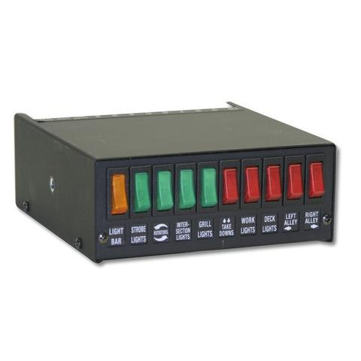
Think about a situation of our real life

Slide 3
Intent
Provide a unified interface to a set of interfaces in a subsystem.
-Define a high-level interface that makes the subsystem easier to use

Slide 4
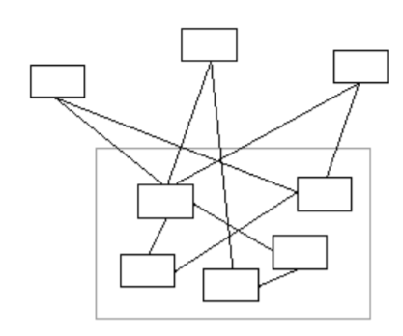
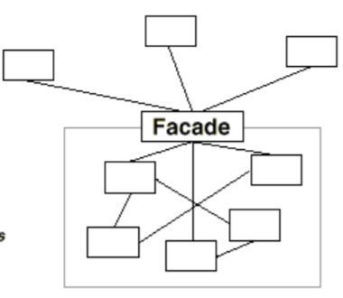
Motivations
To reduce the dependency and coupling between client classes and subsystem classes

Slide 5
Motivations
To improve the encapsulation of subsystem
(inner interaction)
To manage input and output easily, the data goes in and out from the exactly same interface
To be easier to use a subsystem
do not care about details in subsystem

Slide 6
Applicability
When there are many dependencies between clients and the classes of subsystem
Decouple the subsystem from client and other subsystem
When you want to provide a simple and unified interface to a complex subsystem
Requests replace invoking functions of subsystem (dictionary)
Just send a request to facade class, and it will take care of the rest
When you want to shield subsystems from Clients for the sake of code safety
When you want to layer your system, use a façade to define an entry point (extend or combine your system with other subsystems)

Slide 7
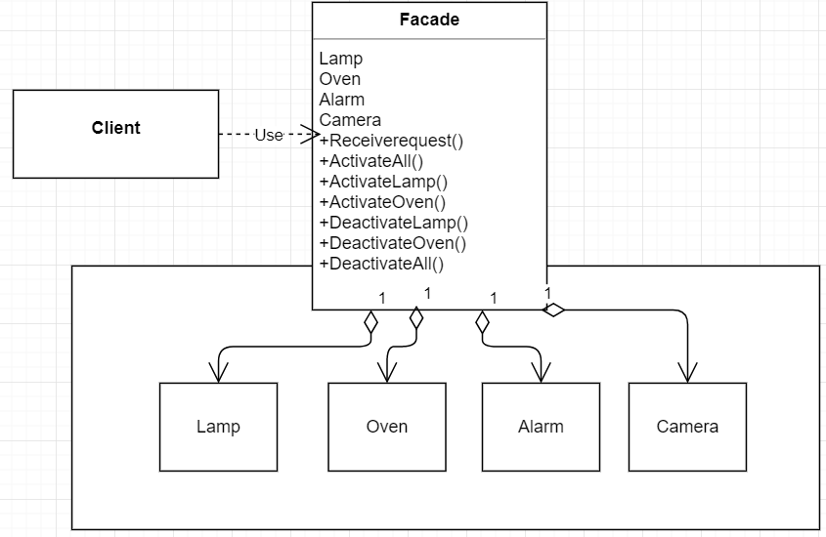
Structure

Slide 8
Participant
Facade class
- knows which subsystem classes are responsible for a request
- delegate client requests to appropriate subsystem objects
Subsystem class (Lamp, Oven, Alarm, Camera)
- implement subsystem functionality
- handle work assigned by the Facade object
- have no knowledge of the facade

Slide 9
Collaborations
Client Communications.
Facade-Sub-system communication.
Clients that use facade don’t have to use it’s sub-system objects directly.

Slide 10
Consequences
Simplification of the use of sub-system.
Facade can be used to create a simpler interface in terms of method calls and it also helps reduce the number of object calls that a client must deal with.

Slide 11
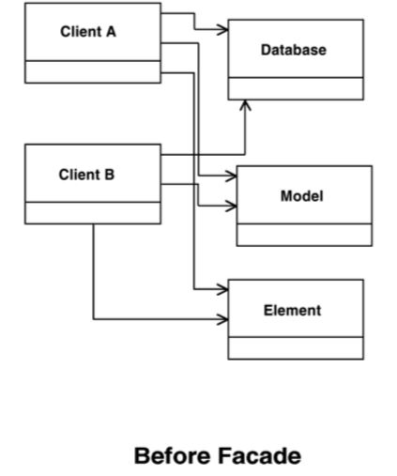
Source: catalogue.pearsoned.co.uk

Slide 12
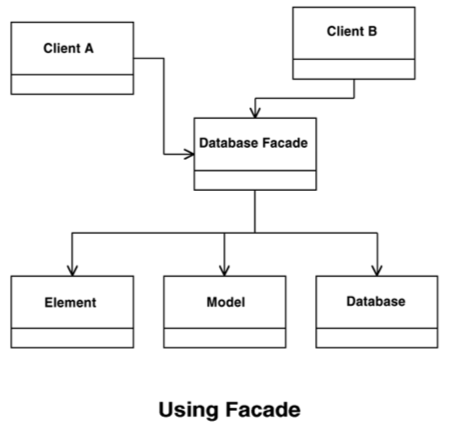
Source: catalogue.pearsoned.co.uk

Slide 13
Consequences
It wraps a complicated sub-system with a simpler interface.
It promotes weak coupling between the clients and the sub-system.
Often the components in the sub-system are strongly coupled.
Can eliminate complex or circular dependencies.

Slide 14
Consequences
Add new functionality to the original functionality.
Cost of writing the new class will be reduced.
Maintenance can be easier in the future.

Slide 15
Consequences
Reasons to encapsulate the system
Monitor system usage.
Swap-out systems.

Slide 16
Known Uses
ET++ application.
The Choices operating system.

Slide 17
Related Patterns
ABSTRACT FACTORY
MEDIATOR

