Slide 1
DO CSE-775
Microservices
Kunal Paliwal &
Arpit Shah
Instructor: Dr. James Fawcett

Slide 2
Competing with LinkedIn!

Slide 3
What are MicroServices?
Its an architectural style
To structures an application as a collection of loosely coupled services, which implement business capabilities.
How to decompose?
Decompose by business capability – define services corresponding to business capabilities
Decompose by subdomain – define services corresponding to DDD subdomains

Slide 4
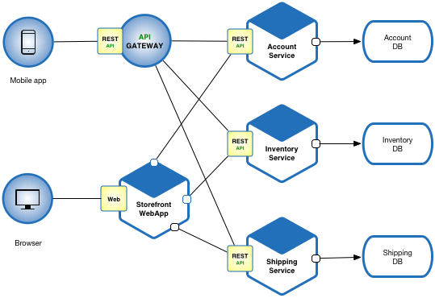
Relationships and Cross-platform support

Slide 5
Why? & How?
Forces
How to get Database consistency?
Communication style

Slide 6
Deployment patterns
Multiple service instances per host
Service instance per host
Service instance per VM
Service instance per Container
Serverless deployment
Service deployment platform

Slide 7
Our Model: Single Service Instance per Host
Services are written using a variety of languages, frameworks, and framework versions
Each service consists of multiple service instances for throughput and availability
Service must be independently deployable and scalable
Service instances need to be isolated from one another
You need to be able to quickly build and deploy a service
You need to be able to constrain the resources (CPU and memory) consumed by a service
You need to monitor the behavior of each service instance
You want deployment to reliable
You must deploy the application as cost-effectively as possible

Slide 8
Benefits
Enables the continuous delivery and deployment of large, complex applications.
Each microservice is relatively small
Improved fault isolation.
Eliminates any long-term commitment to a technology stack

Slide 9
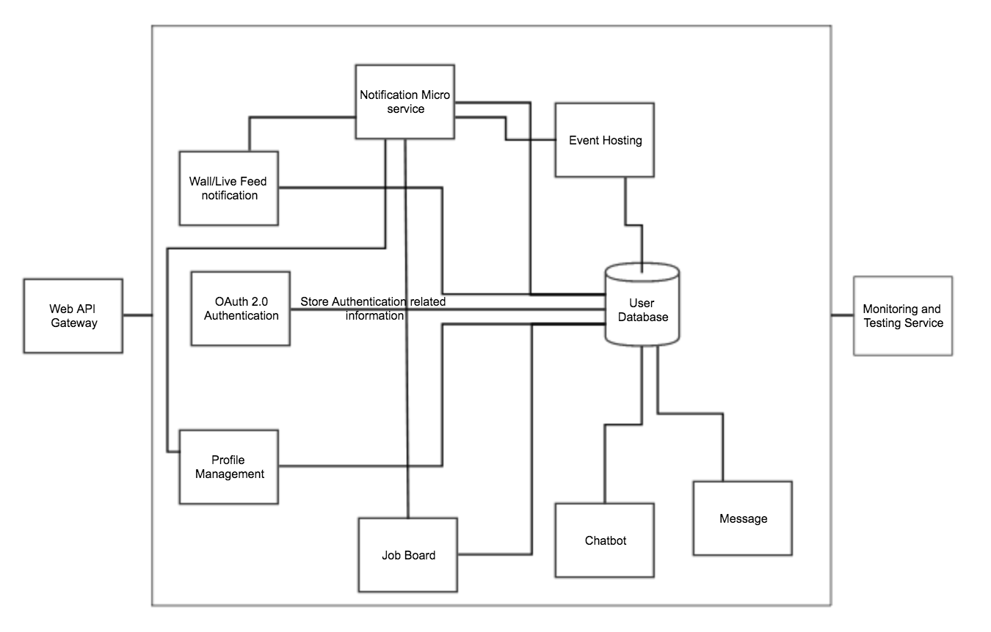
Project Design and Tasks

Slide 10
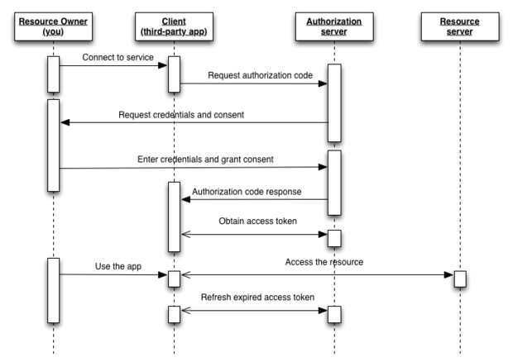
OAuth 2.0

Slide 11
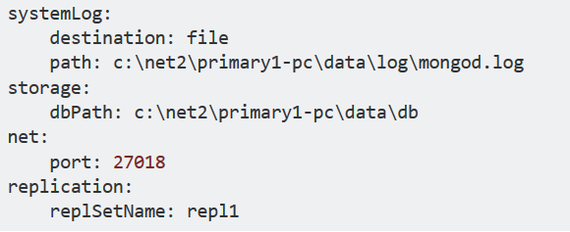
Messaging Service
Node JS and MongoDB backend
For each user - user conversation, we will create different collection which stores the whole conversation .
Name of the collection will be combination of sender and receivers unique id.
Body contains messages, timestamps, status(seen/unseen)

Slide 12
Wall / Live Feed Service
Techstack
Python programming language
Flask library
Subproblems
Data model: We need some schema to store user and feed object. More importantly, there are lots of trade-offs when we try to optimize the system on read/write. I’ll explain in details next.
Feed ranking: Facebook is doing more than ranking chronologically.
Feed publishing: Publishing can be trivial when there are only few hundreds of users. But it can be costly when there are millions or even billions of users. So there’s a scale problem here.

Slide 13
Tools and technologies used:
Python - Flask, Pandas, csv file generator. Flask is a micro web framework written in Python and based on the Werkzeug toolkit and Jinja2 template engine.
Node.js is an open-source, cross-platform JavaScript run-time environment for executing JavaScript code server-side
C++ tiny http server
MongoDB is a free and open-source cross-platform document-oriented database program. Classified as a NoSQL database program, MongoDB uses JSON-like documents with schemas. MongoDB supports field, range queries, regular expression searches.

Slide 14
Monitoring/Visualization Service
Framework:
Backend will be a C++ Tiny Http Server
C++ NoSqL DB /MongoDB
Services:
Health check : test all services by executing test cases for each service
Network data : Bytes received/sent & memory usage of a process
Visualization : Wrapper for database visualization tools
Logging : Tracing a request for error detection

Slide 15
Need for monitoring as a service?
Microservices architecture has brought up new challenges in regards to observability.
Monitoring gives us observability in our system and helps us to discover, understand, and address issues to minimize their impact on the business.

Slide 16
Approach: Distributed tracing/Logging
One of the new debugging methodologies is distributed tracing.
It propagates transactions from distributed services and gains information from cross-process communication.
To be able to track operations between applications, our instrumentation needs to share contextual information (like transaction ID’s) between processes in a standardized way
For example, when we create an RPC request to another service, it should share certain tracing information in meta headers to enable reverse engineering the transaction later
By collecting spans (events) with error flags, we can have an error tracker with only one instrumentation and multiple Tracer backends. In this way, we don’t have to deal with the performance overhead.

Slide 17
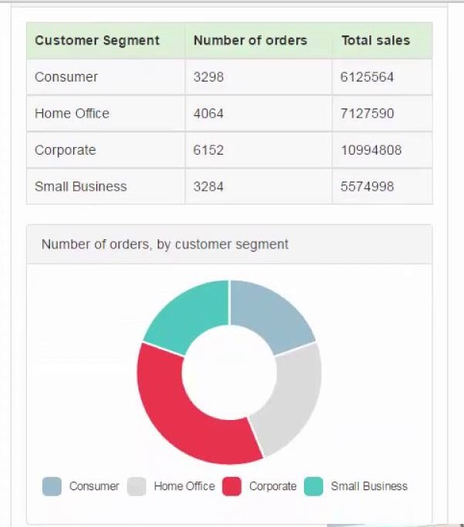
Database visualization using Chart.js and D3.js
D3.js is a javascript based visualization engine that will render interactive charts and graphs based on the data
Dc.js is a wrapper for D3.js
Crossfilter.js is a data manipulation library
We will get the dataset and will try to create an informative analysis on the basis of data attributes

Slide 18
Profile creation service
First step when user signs up for the first time
Java Spring MVC + Mongodb
Creates a user and adds it to the DB
Message JSON attributes:
User Name
Image url
Email
Contact
Links

Slide 19
Job board service
Create a job entry and fill all the attributes
Nodejs + SQL db
SQL makes it easy to do search with filters
Message JSON attributes:
Job designation
Company Name
Description
URL
Contact info

Slide 20
Push notification service
Python Flask library and MongoDB to build backend
Notify observers about other user activity (if you subscribe)
Suggestions involve natural language processing tasks like mapping certain words based on past user activity. So we decided to use python.
Pythons pandas and csv library will allow us to process our data and perform mapping
Flask library to host the service
Message JSON attributes:
Observer
Notification

Slide 21
Tech event organizer service
NodeJS backend with MongoDB
Create events and fill all the attributes such as venue, time and type
Invite people to the event
Location based recommendations using google-maps-services
Message JSON attributes:
Event Name
Location
Time
Type/Category

Slide 22
Tasks & Milestones:
Arpit:
OAuth2 / Authentication Server : JAVA (Kunal) - 04/30
Message service: Message other registers users : Python/NodeJS - 04/08
Live feed/Main page - Events/wall posts (ordering based on timestamps) - 04/20
Profile creation/manage connections - submit form + db update => SQL - 04/15
Kunal:
Monitoring tool - Test Harness, performance, visualization tools : C++ - 04/20
Notifications - capture db updates for specific users from other microservices/ user will get notifications from other users he follows : NodeJS - 04/4
Job boards/listings - create job / filtering - 04/13
Tech Events organizer / Attendees / invites - 04/17

Slide 23
Thank you

