Slide 1
Directory Synchronization
Technical Presentation
Lin zHang
CSE775 – Distributed Objects, Spring 2017

Slide 2
What, how, when
What does Directory Synchronization do?
  Update files in the target directory from newer files in a source directory on another machine.
How will it be implemented?
  Implemented using GO 1.8
  Using net package for communication
  Using Sftp package for file transferring
  Using filepath package for file managing
When will it be completed?
  This semester

Slide 3
Why is this interesting?
Explore Go language
  Communication channel
  Concurrency model
  Go syntax
  Handle OOD without class
It would be useful for me
  Manage projects on multi computers
  Back up important documents

Slide 4
Go language
Created by Robert Griesemer, Rob Pike, and Ken Thompson in 2007
compiled, statically typed language in the tradition of Algol and C

Slide 5
Golang features
be statically typed, scalable to large systems (as Java and C++)
be productive and readable, without too many mandatory keywords and repetition ("light on the page" like dynamic languages)
not require integrated development environments, but support them well
support networking and multiprocessing

Slide 6




variables
Declare a variable
Initialize a variable
const

Slide 7

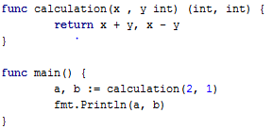

Functions
Type comes after the variable name
Can return any number of results.
Named return value

Slide 8
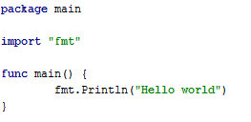
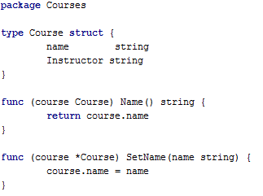
Packages
Every Go program is made up of packages
Programs start running in package main
Exported/Internal identifier

Slide 9

For, if else, switch, defer
A defer statement defers the execution of
a function until the surrounding function returns.
The deferred call's arguments are evaluated immediately, but the function call is not executed until the surrounding function returns.
Deferred function calls are pushed onto a stack. When a function returns, its deferred calls are executed in last-in-first-out order.

Slide 10
Data structures
Pointer
Struct
Array, slices, list, ring, heap
Map (hash table)
Function value (Go function pointer)

Slide 11
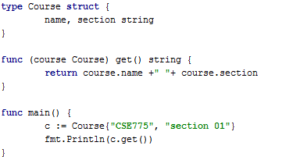
Method
Go does not have classes
A method is a function with a receiver argument
Methods are defined on types
Pointer receiver

Slide 12
interface
An interface type is defined as a set of method signatures
interface type value can hold any value that implements those methods
Interfaces are implemented implicitly (no implements keyword)

Slide 13
interface
interface values can be thought of as a tuple of a value and a concrete type
An interface value holds a value of a specific underlying concrete type.
Calling a method on an interface value executes the method of the same name on its underlying type

Slide 14
channel
Like a pipe
Blocking queue

Slide 15
Concurrency model
A goroutine is a lightweight thread managed by the Go runtime
A goroutine is not a thread
Goroutines run in the same address space, so access to shared memory must be synchronized

Slide 16
Usual threading models
1:N
1:1
M:N

Slide 17
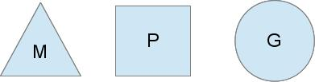
Go Scheduler
M: OS thread
P: context for scheduling
G: goroutine

Slide 18
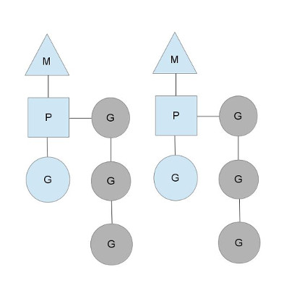
Go Scheduler
Check goroutine status
Push G to runqueue
Pup runqueue and run

Slide 19
Go Scheduler
Hand goroutine off
Stealing work

Slide 20
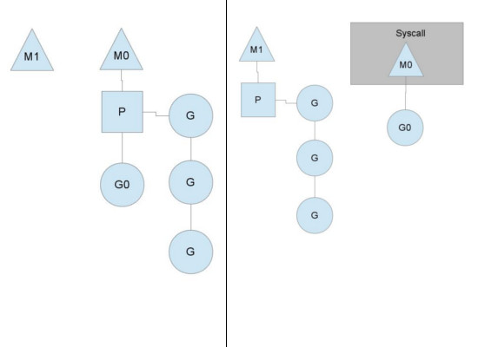
Hand goroutine off to other threads if the running thread needs to block

Slide 21
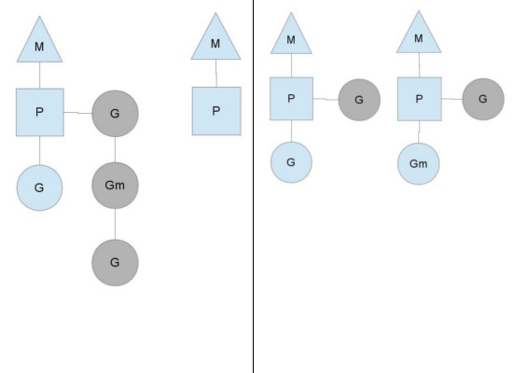
Stealing work

Slide 22
Plan
Server (file source)
  Sender
    Send file list (name & time)
    Send file
  Receiver
    Receive requests
Client (needed to update)
  Request file list
    Send requested file list
    Update file
  Receiver
    Guarantee valid files

Slide 23
CHALLENGING
Studying a new language
Policy
File trees

