Slide 1
Opinion Analysis
Xamarin Technology By: Ammar Salman
Instructor: Dr. Jim Fawcett

Slide 2
Concept
Opinion Analysis.
Harvest data from Twitter about user-specified topic(s).
Classify … Produce statistics.
Initially targeting Universal Windows Platform (UWP) – Win10 and Win10Mobile.
Using Xamarin.Forms.

Slide 3
Why is it interesting?
Twitter is a huge social network.
Twitter represents a large margin of people.
Different topics… Everyday.
Different people, different interests.
Everyone deserves to build his own knowledge.

Slide 4
Why Xamarin?
The application is intended to reach everyone.
Xamarin.Forms provides cross-platform applications with minimal changes.
Xamarin performance is pretty impressive.

Slide 5
Brief History
Microsoft built MSJVM which won the best performance for Java.
Sun sued Microsoft for implementing Java 1.1 standard.
They both settled the lawsuit.
Microsoft created C# and then .NET Framework.
Mono built its own Virtual Machine for C# and .NET Framework.

Slide 6
Mono
Started in 2004. Ximian, Novell, and then Microsoft.
Free and Open-Source.
Includes: C# Compiler and Common Language Runtime (CLR).
Cross-platform .NET services.
Partially limited: could have been a target for patent infringement. lawsuits. Microsoft Community Promise gave it some freedom.
Currently supports almost all pure managed code in .NET.

Slide 7
Xamarin
Applying Mono for Mac, iOS and Android.
MonoTouch (iOS) started in 2009.
Xamarin was founded in 2011.
Mono for Android started in 2011.
MonoTouch became Xamarin.iOS.
Mono for Android became Xamarin.Android.
Proved successful in 2014 with the release of Xamarin.Forms.
Acquired by Microsoft in 2016.

Slide 8
So… How?
.NET Framework
Common Intermediate Language (CIL, or MSIL).. Similar to Java Bytecode, but more powerful as it can work with native code in “mixed-mode”.
.NET assemblies are also written in CIL, but many depend on Win32.
Requires Common Language Runtime (CLR) to run.
CLR uses Just-In-Time (JIT) to compile CIL to native code.. On runtime.
Windows cannot understand it without Portable Executable (PE) header.
Managed C++, or its successor… the ECMA standard, C++/CLI.

Slide 9
Managed and Unmanaged Code
Using the PInvoke features of .NET
  Everything is compiled to CIL.. Even the unmanaged imported code.
Using Managed C++ or C++/CLI
  You have a choice…
  Either compile everything to CIL …
  OR …

Slide 10
Managed C++, C++/CLI - “Mixed-Mode”
 | .NET Assemblies
Unmanaged C++ | Managed C++ or C++/CLI
Native Machine Code | Common Intermediate Language (CIL)
 | Common Language Runtime (CLR)
Operating System (Windows)
The EXE ->

Slide 11
Mono
Implements its own .NET Virtual Execution System (i.e. CLR).
Has its own C# compiler.
Implements new CIL assemblies to keep-up with native Win32 assemblies (for example, GDI+ API).
Can run ‘almost’ all pure-managed code …
Support for Windows Communication Foundation (WCF).
Mono assemblies (which are also CIL) are cross-platform.

Slide 12
Xamarin
Apply Mono for everything!
Xamarin.Android.
Xamarin.iOS.
Xamarin.Mac.
And …
Xamarin.Forms.

Slide 13
Xamarin.Android
Not much different from Java applications in principle.
No need to worry about Oracle lawsuits over its precious Java patents.
Support for using native libraries.. PInvoke does the trick.
Even Java libraries can be consumed (might need license):
  Binding library: everything is automatically wrapped with C# wrappers.. Managed Callable Wrappers (MCW) which is a bridge for..
  Java Native Interface (JNI): bind it manually.
  The process is reversible (Java can call .NET) using Android RunTime (ART) bridge.

Slide 14
Xamarin.iOS
Support for using native libraries
Support for linking to native Objective-C libraries (might need license)
  Compile Objective-C library into static library.
  Objective Sharpie: command line tool that helps creating API definitions.
  Normalize what Objective Sharpie failed to translate correctly.
  Xamarin.iOS binding library is ready.
Everything seems fine, right? Not so much…
Apple decided to prevent JITers from running on iOS.. Dynamic Code is NOT allowed. Compile everything to static code.. So…?

Slide 15
Xamarin.iOS – Some Limitations
The System.Reflection.Emit is not available.
No support for System.Runtime.Remoting.
No support for creating types dynamically (no Type.GetType ("MyType`1")), although looking up existing types (Type.GetType ("System.String") for example, works just fine).
Reverse callbacks must be registered with the runtime at compile time.
And most importantly:
Generics are REALLY limited.

Slide 16
Xamarin.Forms
Suitable for:
  Data entry apps.
  Prototypes and proofs-of-concept.
  Apps that require little platform-specific functionality.
  Apps where code sharing is more important than custom UI.
Managed code shared across all supported platforms.
Powerful for Universal Windows Platform (UWP) apps.
A big downside is its inability to call native APIs.

Slide 17
The best part… BENCHMARK WAR
How does Xamarin stand against native and “native” applications?
Obviously, nothing can top the real native C++ apps in performance.
Our target of comparison will be basically Objective-C and Swift for iOS. And Java for Android.
There are three groups of benchmark tests..
Let the war begin!

Slide 18
First Test Group
Done by Harry Cheung from Medium.com.
Can be found at: https://medium.com/@harrycheung/mobile-app-performance-redux-e512be94f976#.r0zaxyav9.
The test is processing GPS readings and recording them to points.
The test compares only performance on runtime.
The test was performed 10 times. The figures show the average time.

Slide 19
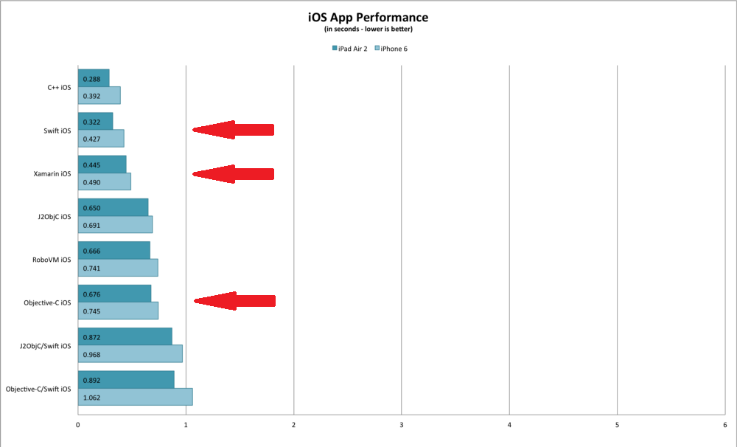

Slide 20
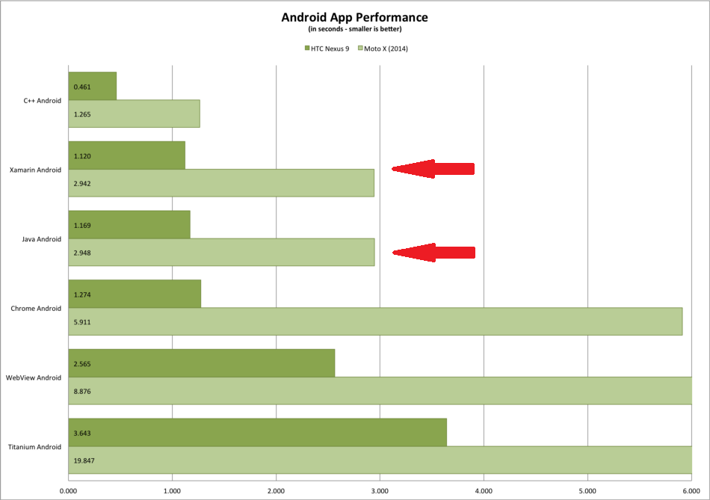

Slide 21
Second Test Group
By Kevin Ford on Magenic.com.
Can be found at: https://magenic.com/thinking/mobile-development-platform-performance
The test compares memory usage, load time and performance.

Slide 22
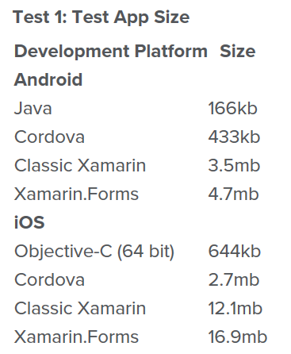
Xamarin affected by .NET Framework assemblies sizes.
The tester claims this huge margin is only for small projects and for larger projects, the margin gets much smaller.

Slide 23
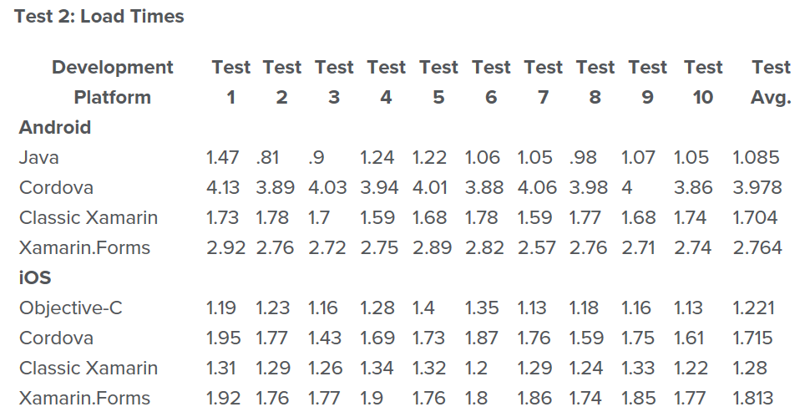

Slide 24
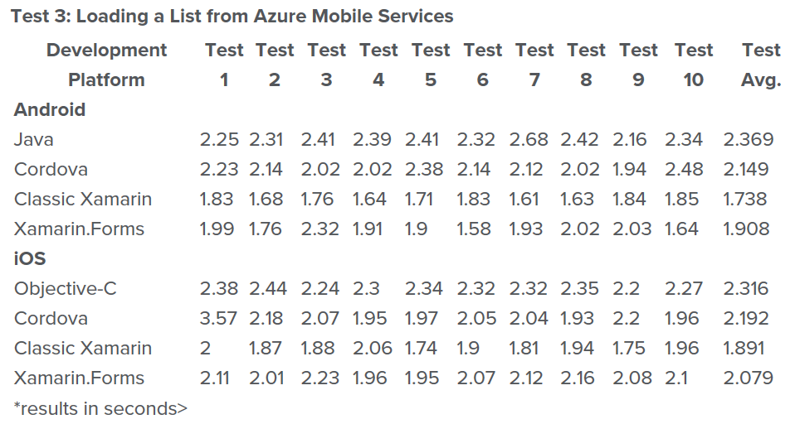

Slide 25
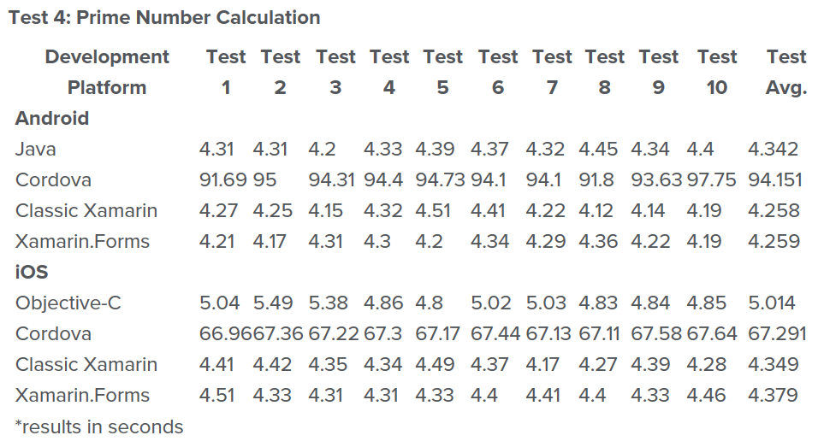

Slide 26
Third Test Group
Also by Kevin Ford on Magenic.com.
Can be found at: https://magenic.com/thinking/mobile-development-platform-performance-part-2-native-cordova-classic-xamarin-xamarin-forms
The test focuses on IO-based applications performance
  SqlLite operations.
  File IO operations.

Slide 27
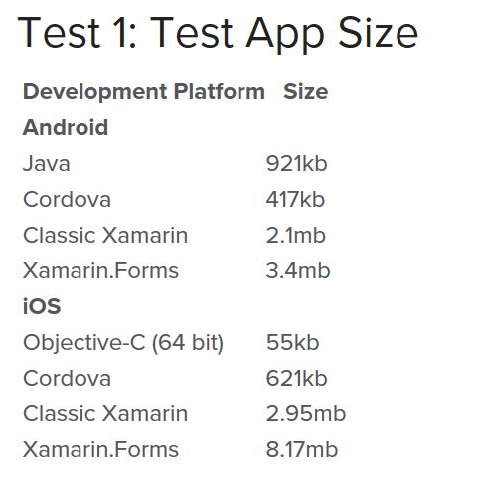
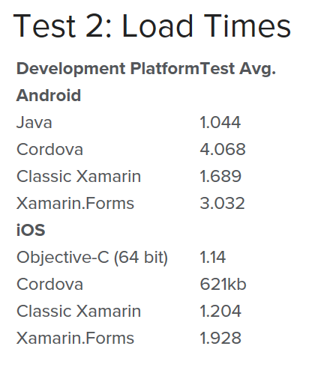

Slide 28
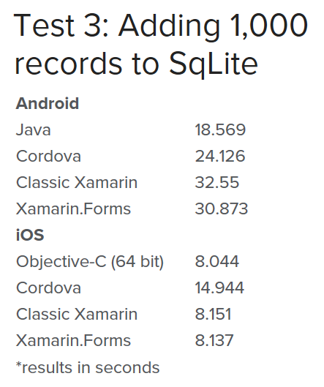
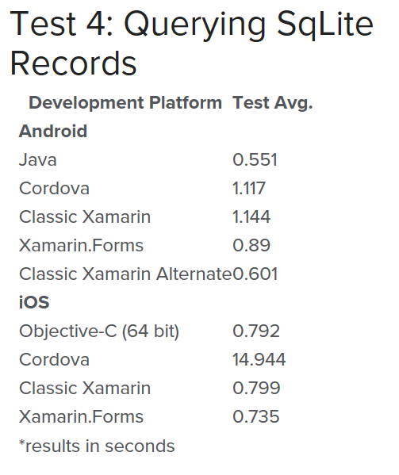

Slide 29
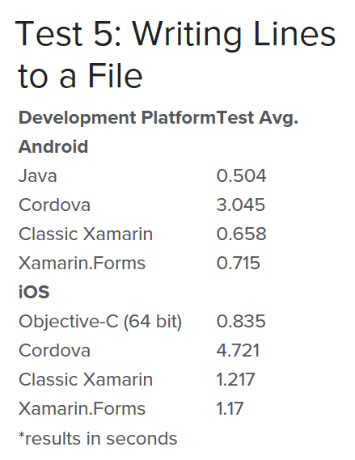
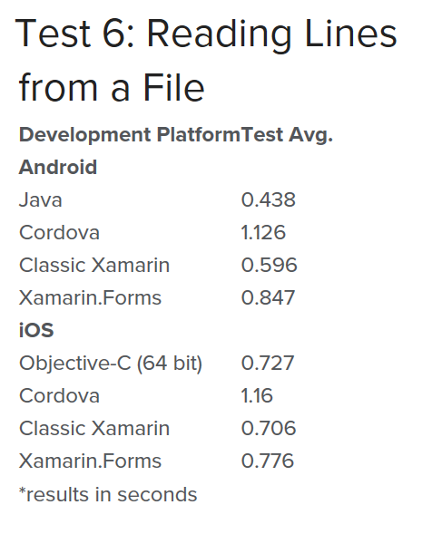

Slide 30
Notes & Conclusion
Notes:
Benchmark tests are NOT everything.
They still tell something.
Conclusion:
Xamarin compares very well against Google Dalvik.
Xamarin compares very well against Objective-C and Swift.

Slide 31
Cool.. What’s the plan?
Sentiment analysis.
Using Rocchio’s algorithm for classification.
Using LinqToTwitter .NET API.

Slide 32
Sentiment Analysis?
“The process of computationally identifying and categorizing opinions expressed in a piece of text, especially in order to determine whether the writer's attitude towards a particular topic, product, etc., is positive, negative, or neutral”
A lot to consider?
  A lot of people tweet.
  Followers numbers differ from user to another.
  Tweets have likes and retweets.

Slide 33
Some Measures
Needs internet… A lot.
Needs computational power
  PC serves the need.
  Mobile might suffer, which leads to…
Possible need for Cloud computing… Or a server.
Highly likely it would not have the fanciest UI.

Slide 34
Why not Classic Xamarin?
The application will not need platform-specific APIs.
Xamarin.Forms compares well to Xamarin in computational performance. The traditional overhead can be neglected.
Xamarin.Forms produces code to share on multiple platforms.
Easier for deployment on Mac, iOS and Android.

Slide 35
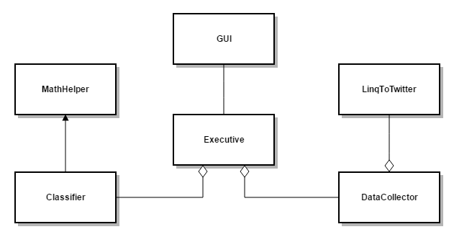
Possible Package Diagram

Slide 36
Possible Extensions
Deployment on Android, iOS and Mac.
Cloud computing… Maybe Azure?
OR .. Server.
Addition of WCF services:
  Mobile sends signal to the server.
  Server makes all the needed processing.
  Server sends the mobile the results.
  Mobile’s power does not affect performance!

Slide 37
Summary
The project concept: opinion analysis using Twitter & sentiment analysis
.NET Framework.
Mono.
Xamarin:
  Xamarin.Android
  Xamarin.iOS
  Xamarin.Mac
The project plan.
Possible extensions.

Slide 38
References
Mono (Wiki): https://en.wikipedia.org/wiki/Mono_(software)
Mono (StackOverflow): http://stackoverflow.com/questions/216841/how-does-mono-work
Managed C++: http://stackoverflow.com/questions/42465843/understanding-of-managed-c
Xamarin (Wiki): https://en.wikipedia.org/wiki/Xamarin
Xamarin.Android Native Libraries: https://developer.xamarin.com/guides/android/advanced_topics/using_native_libraries/
Xamarin.iOS Native Libraries: https://developer.xamarin.com/guides/ios/advanced_topics/binding_objective-c/walkthrough/

Slide 39
References
Xamarin.iOS Limitations: https://developer.xamarin.com/guides/ios/advanced_topics/limitations/
Mobile App Performance Redux: https://medium.com/@harrycheung/mobile-app-performance-redux-e512be94f976#.pg50pn59g
Mobile Development Platform Performance: https://magenic.com/thinking/mobile-development-platform-performance
Mobile Development Platform Performance Part2: https://magenic.com/thinking/mobile-development-platform-performance-part-2-native-cordova-classic-xamarin-xamarin-forms
Sentiment Analysis definition: http://dastornews.com/2016/12/sentiment-analysis/

