Slide 1
CROSS PLATFORM
(LIBRARIES AND GUI) AND TINY HTTP SERVER
AISHWARYA KHAIRE
SHWETA MOHOLKAR
SNEHA PATIL

Slide 2
AGENDA
Cross Platform Library
Cross Platform GUI
Tiny HTTP Server
Project Plan

Slide 3
CROSS PLATFORM LIBRARIES
AISHWARYA KHAIRE

Slide 4

INTRODUCTION
Cross-platform software is computer software that is implemented on multiple computing platforms.
Requires individual building or compilation for each platform that it supports.
Must be able to function on more than one computer architecture or operating system.

Slide 5
WHY CROSS PLATFORM?
50%-80% code reuse can be realized across-platforms.
Cross-platform development provides more benefits during the maintenance period.
Unit tests are required to be written only once for the common code.

Slide 6
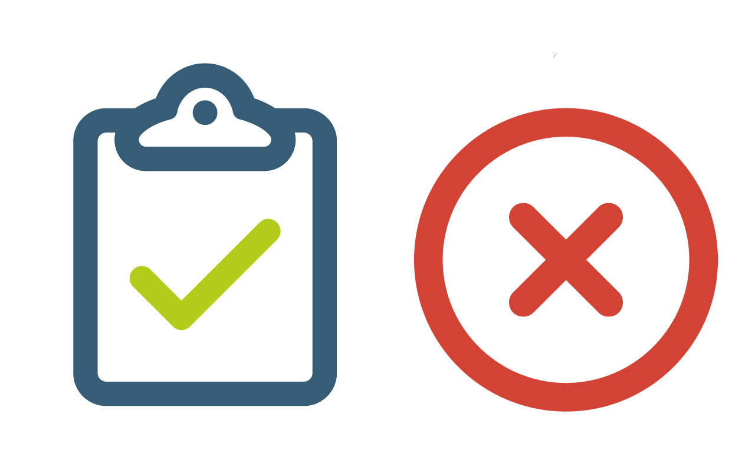
RULES FOR CROSS PLATFORM DEVELOPMENT
Simultaneously develop – don’t “port” it later.
Use standard ‘C’ types, not platform specific types.
Use only built in #ifdef compiler flags, do not invent your own

Slide 7
RULES FOR CROSS PLATFORM DEVELOPMENT
Don’t use 3rd party “Application Frameworks” or “Runtime Environments”.
Use Unicode (specifically UTF-8) for all APIs
Factor out the GUI into non-reusable code – then develop a cross-platform library for the underlying logic.

Slide 8
PROJECT PLAN
FILE SYSTEM
SOCKETS
PROCESS
THREADPOOL
COMMUNICATION
GRAPHICAL USER INTERFACE

Slide 9
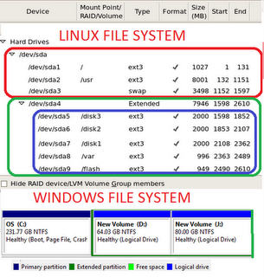
FILE SYSTEM- WINDOWS AND LINUX
Directory Structure
Case Sensitivity
Backslashes vs. Forward Slashes
No Drive Letters – It’s All Under /

Slide 10
FILE SYSTEM- WINDOWS AND LINUX
Everything is a File
You Can Delete or Modify Open Files

Slide 11
SOCKETS: WINSOCK
Technical specification that defines how Windows network software should access network services, especially TCP/IP.
Defines a standard interface between a Windows TCP/IP client application (such as an FTP client or a web browser) and the underlying TCP/IP protocol stack.

Slide 12
PROCESS
In general, a computer system process consists of (or is said to own) the following resources:
An image of the executable machine code associated with a program.
Memory (typically some region of virtual memory)
Operating system descriptors of resources that are allocated to the process
Security attributes.
Processor state.

Slide 13
Process
In Linux, if the parent process is closed then all the associated child process are forced to exit along with their parent.
In Windows, even when you close a parent process the child processes will be continuing with what they were doing.

Slide 14
THREADPOOL
A thread pool is a collection of worker threads that efficiently execute asynchronous callbacks on behalf of the application.
In application that creates and destroys a large number of threads that each run for a short time, using the thread pool can reduce the complexity of thread management and the overhead involved in thread creation and destruction.

Slide 15
THREADPOOL
In Windows, the thread is the basic execution unit, and the process is a container that holds this thread.
In Linux, the basic execution unit is the process

Slide 16
COMMUNICATION
SOCKETS
NAMED PIPES
MESSAGE PASSING

Slide 17
CROSS PLATFORM GUI
SHWETA MOHOLKAR

Slide 18
Rich Internet Applications
Web application that has many of the characteristics of desktop application software
Typical Way
HTML5/JavaScript-based
Users generally need to install a software framework using the computer's operating system before launching the application, which typically downloads, updates, verifies and executes the RIA.
e.g. Adobe Flash, JavaFX, and Microsoft Silverlight
Use built-in browser functionality to implement comparable interfaces

Slide 19
Google trends shows (as of September 2012) that frameworks based on a plug-in are in the process of being replaced by HTML5/JavaScript-based alternatives.
Source : https://en.wikipedia.org/wiki/Rich_Internet_application
Aim of project :
GUI built from Chrome using HTML5 and Tiny HTTPServer that will run on Windows and Linux with no changes other than recompiling the C++ HTTPServer.

Slide 20
Technologies
HTML5 – Hyper Text Markup Language
JavaScript
DOM – Document Object Model
AJAX – Asynchronous JavaScript And XML

Slide 21
HTML5
HTML5 is a markup language used for structuring and presenting content on the World Wide Web.
Published in October 2014 by the World Wide Web Consortium (W3C)
Improved the language with support for the latest multimedia
Easily readable by humans and consistently understood by computers and devices such as web browsers, parsers, etc.

Slide 22
HTML5 Features
Markup
HTML5 introduces elements and attributes that reflect typical usage on modern websites.
It has been designed to be backward compatible with common parsing of older versions of HTML
New semantic elements like <header>, <footer>, <article>, and <section>.
New form control attributes like number, date, time, calendar, and range.
New graphic elements: <svg> and <canvas>.
New multimedia elements: <audio> and <video>.
New APIs: Geolocation, Drag and Drop, Local Storage, Application Cache, Web Workers, SSE

Slide 23
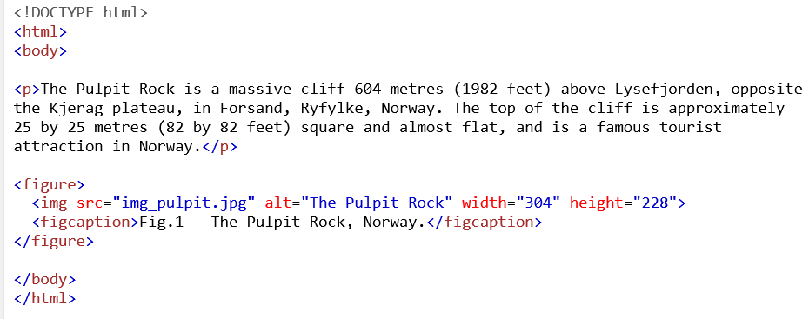

Slide 24
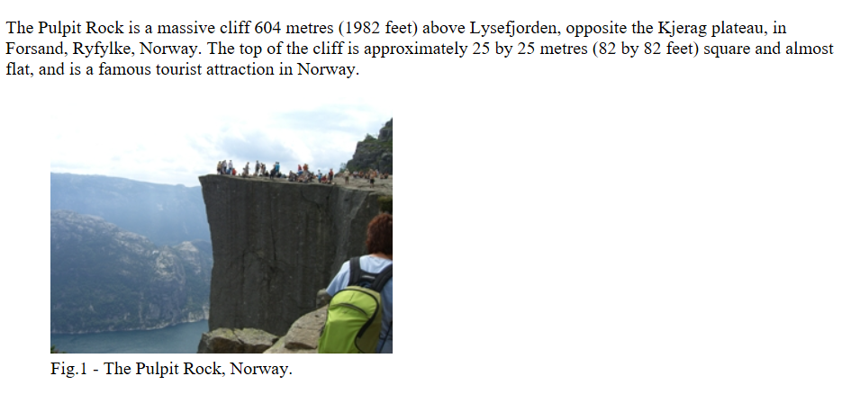

Slide 25
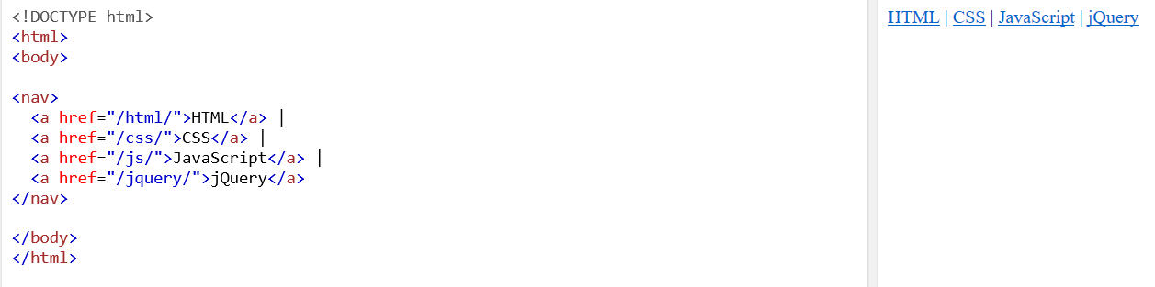

Slide 26
HTML5 Features
New APIs
In addition to specifying markup, HTML5 specifies scripting application programming interfaces (APIs) that can be used with JavaScript

Slide 27
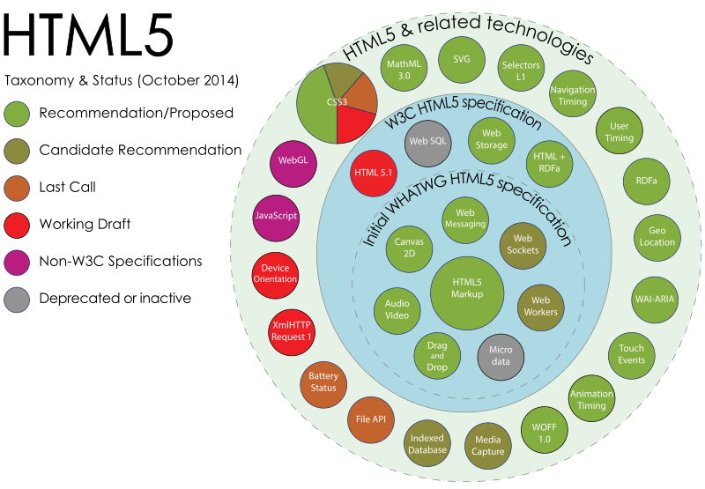
Source: https://en.wikipedia.org/wiki/HTML5

Slide 28
Document Object Model
The Document Object Model is a platform and language-neutral interface that will allow programs and scripts to dynamically access and update the content, structure and style of documents. The document can be further processed and the results of that processing can be incorporated back into the presented page.
Example: HTML, XML

Slide 29
What is the HTML DOM?
The HTML DOM is a standard object model and programming interface for HTML. It defines:
The HTML elements as objects
The properties of all HTML elements
The methods to access all HTML elements
The events for all HTML elements
In other words: The HTML DOM is a standard for how to get, change, add, or delete HTML elements.

Slide 30
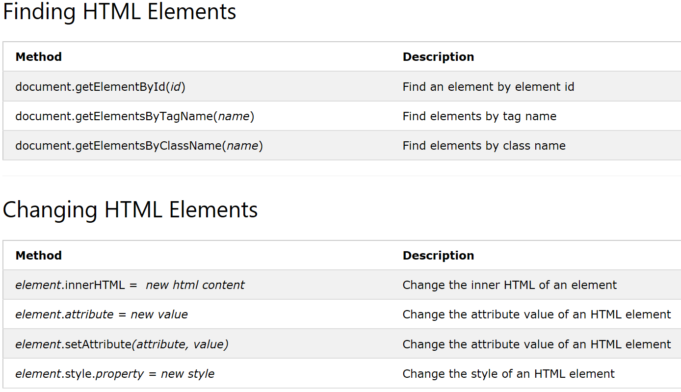

Slide 31
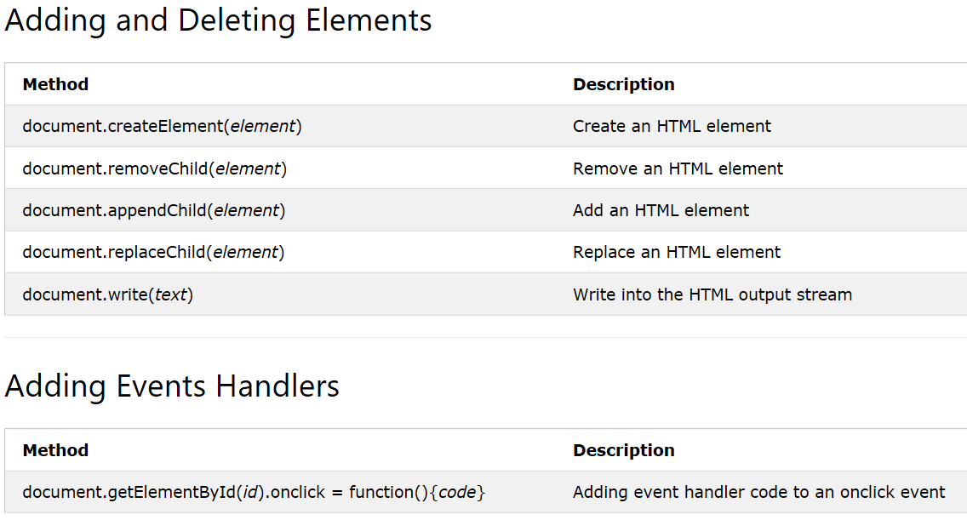

Slide 32
JavaScript
One of the three core technologies of World Wide Web content production along with HTML and CSS
Programming language of HTML and the Web
Makes HTML pages more dynamic and interactive
The most common use of JavaScript is to add client-side behavior to HTML pages, also known as Dynamic HTML (DHTML). Scripts are embedded in or included from HTML pages and interact with the Document Object Model (DOM) of the page.

Slide 33
Use in Web Pages
Loading new page content or submitting data to the server via Ajax without reloading the page (for example, a social network might allow the user to post status updates without leaving the page).
Animation of page elements, fading them in and out, resizing them, moving them, etc.
Interactive content, for example games, and playing audio and video.
Validating input values of a Web form to make sure that they are acceptable before being submitted to the server.

Slide 34
Advantages of using JavaScript
JavaScript code can run locally in a user's browser (rather than on a remote server)
The browser can respond to user actions quickly, making an application more responsive.
JavaScript code can detect user actions that HTML alone cannot, such as individual keystrokes.
e.g. Gmail uses this feature to create a server request to send email message

Slide 35
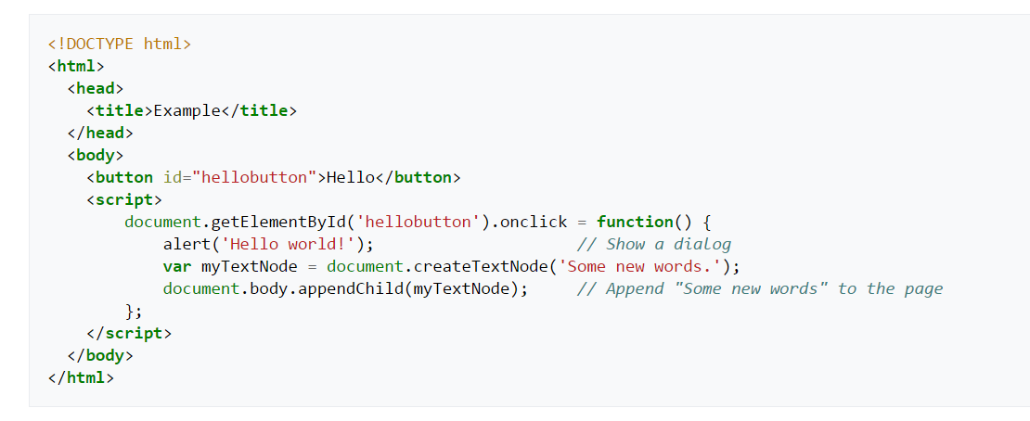
Sample HTML code containing JavaScript

Slide 36
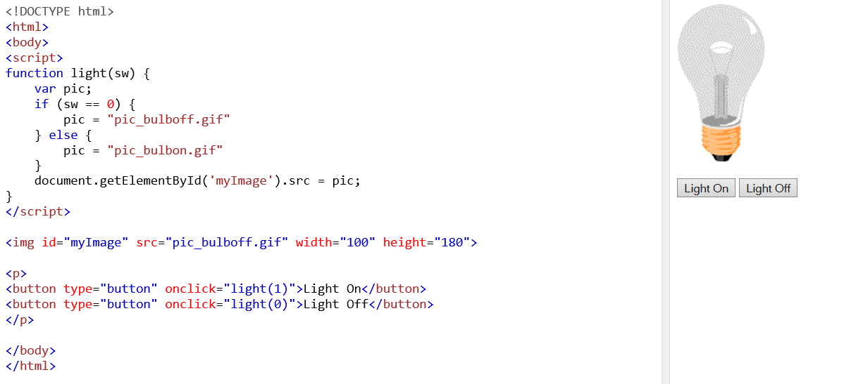
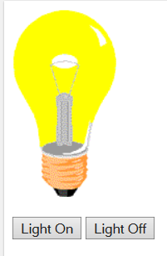

Slide 37
JavaScript Window - The Browser Object Model
The Browser Object Model (BOM) allows JavaScript to "talk to" the browser.
Objects for :
Window
Screen
Location History
Navigator

Slide 38
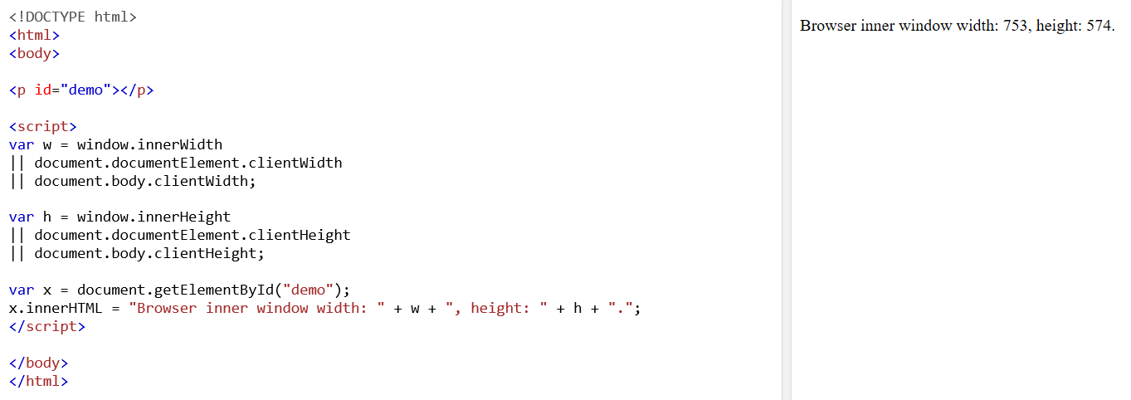

Slide 39
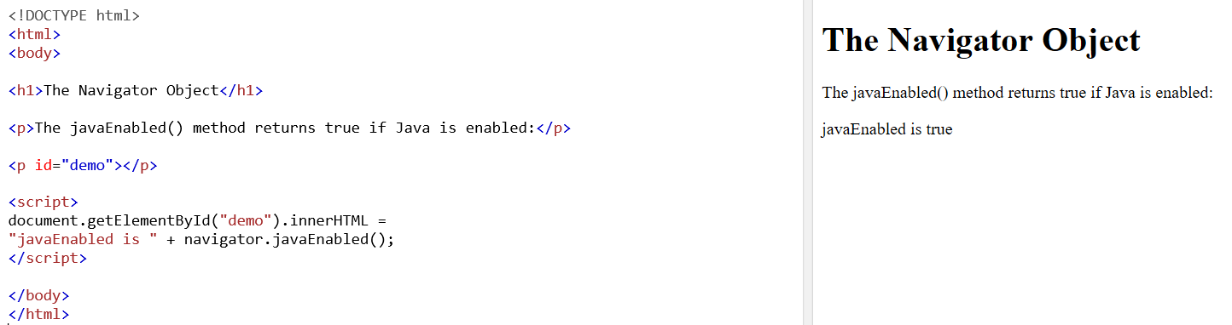

Slide 40
AJAX – Asynchronous JavaScript And XML
A technique for creating fast and dynamic web pages
AJAX can be used to :
Update a web page without reloading the page
Request data from a server - after the page has loaded
Receive data from a server - after the page has loaded
Send data to a server - in the background

Slide 41
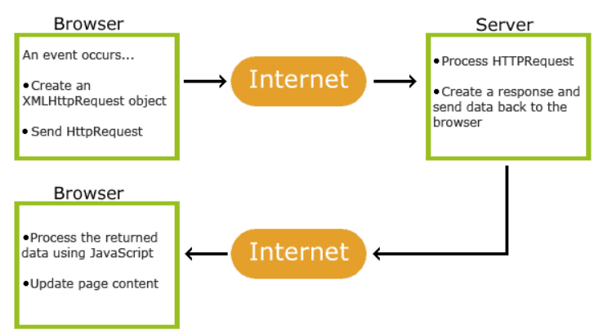
How AJAX works
1. An event occurs in a web page (the page is loaded, a button is clicked)
2. An XMLHttpRequest object is created by JavaScript
3. The XMLHttpRequest object sends a request to a web server
4. The server processes the request
5. The server sends a response back to the web page
6. The response is read by JavaScript
7. Proper action (like page update) is performed by JavaScript

Slide 42
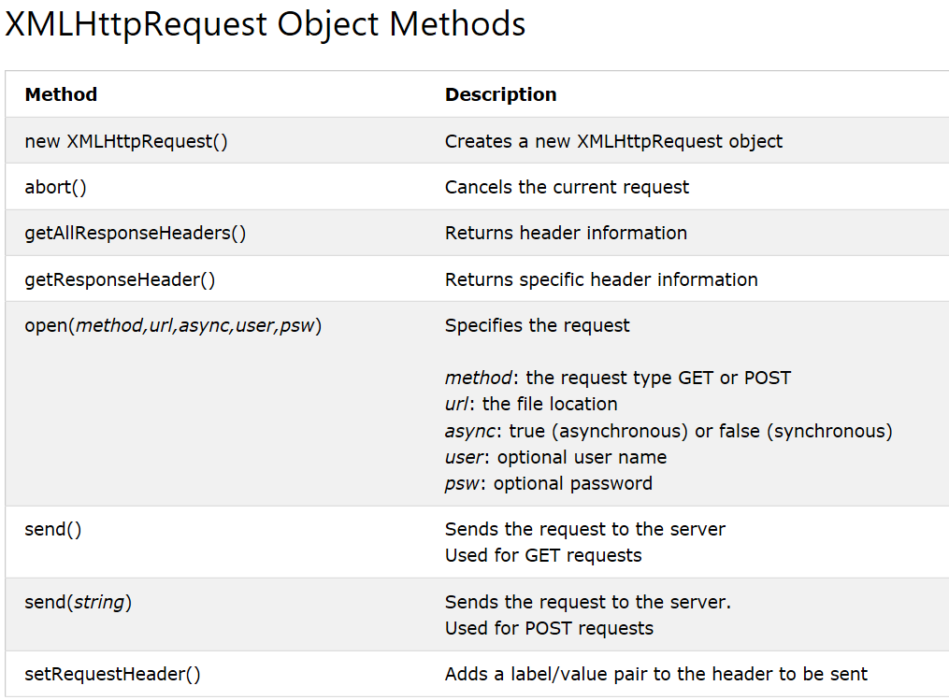

Slide 43
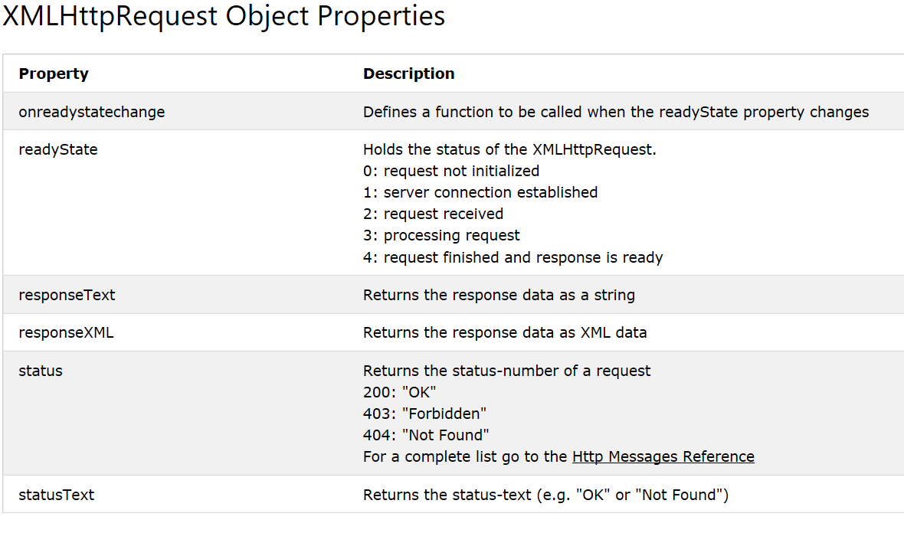

Slide 44
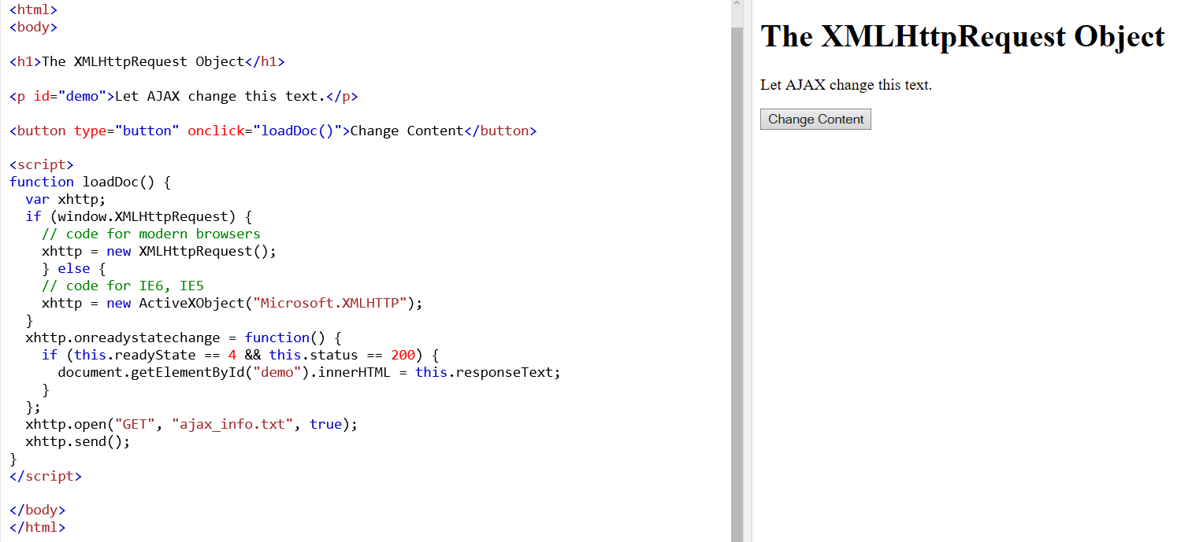

Slide 45
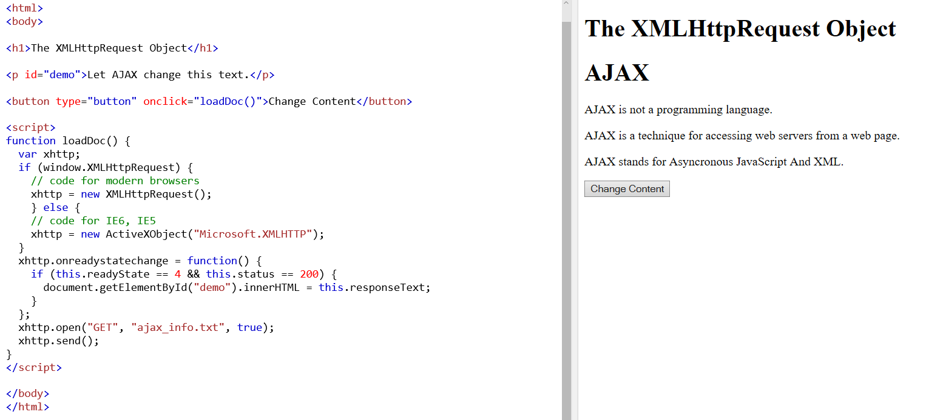

Slide 46
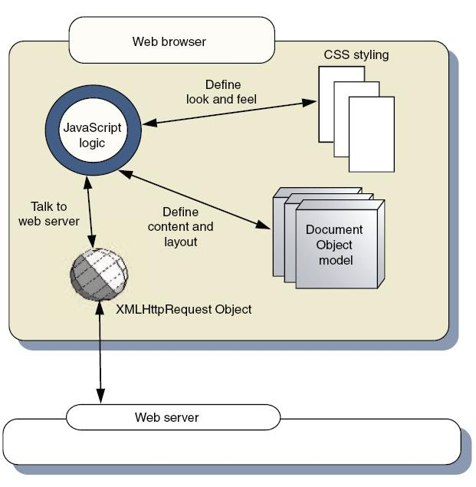
Cross Platform GUI Components

Slide 47
References
https://en.wikipedia.org/wiki/Platform-independent_GUI_library
https://en.wikipedia.org/wiki/HTML5
https://en.wikipedia.org/wiki/Rich_Internet_application
https://en.wikipedia.org/wiki/Cross-platform
https://www.w3schools.com/html/html5_semantic_elements.asp
https://www.w3schools.com/xml/ajax_xmlhttprequest_create.asp
https://www.w3schools.com/js/js_cookies.asp

Slide 48
HTTTP SERVER
SNEHA PATIL

Slide 49
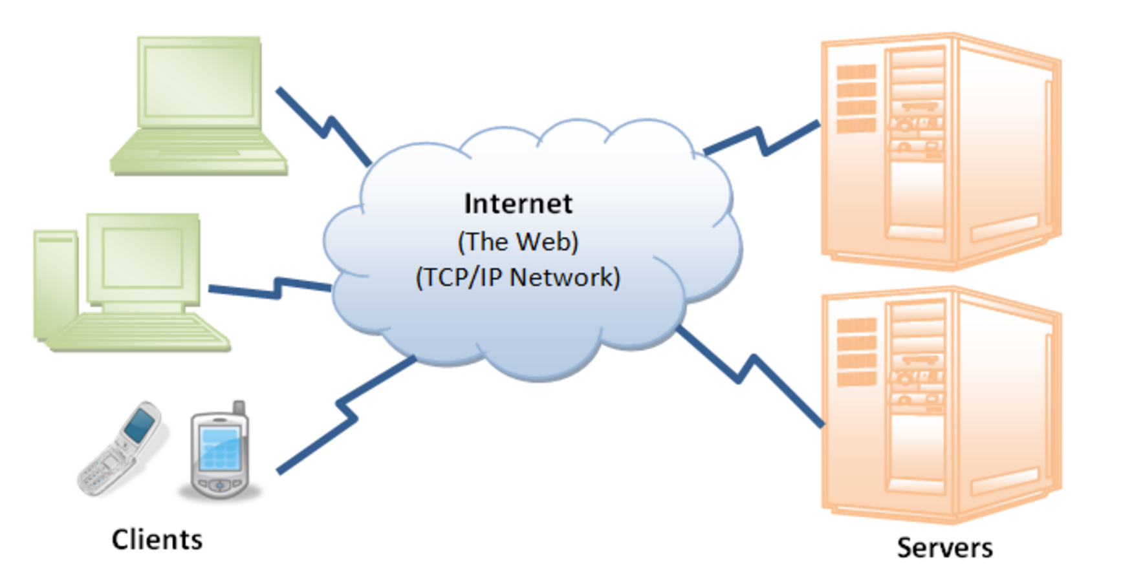
Overview
Internet is a massive distributed client/server information system.
For proper communication between the client and the server, applications must agree on a specific application-level protocol such as HTTP, FTP, SMTP, POP, and etc.

Slide 50
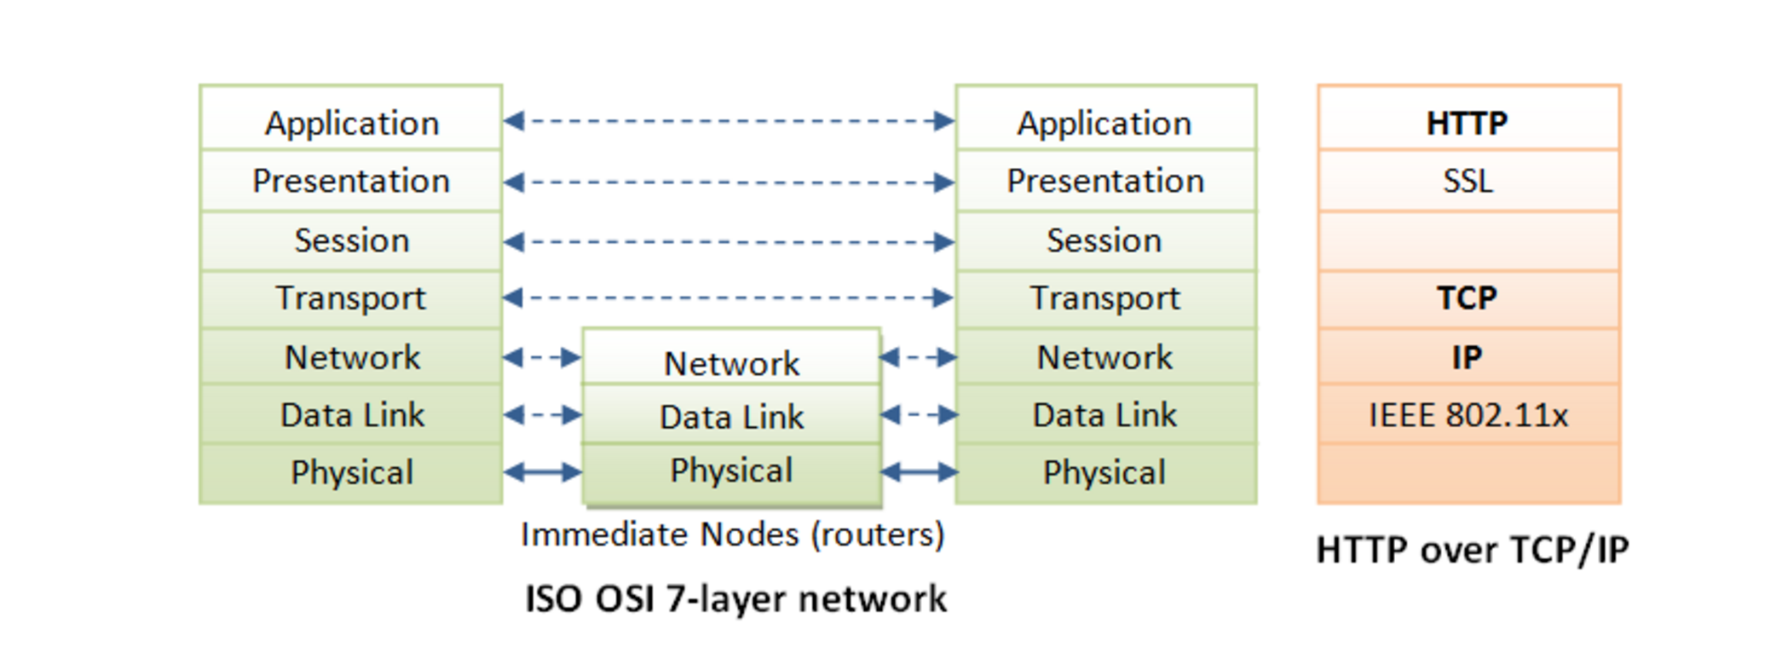
OSI 7 layer Network
Physical layer provides the hardware means of sending and receiving data on a carrier network.
Data Link layer is the Ethernet layer.
IP (Internet Protocol) is a network-layer protocol, deals with network addressing and routing.
TCP is reliable, each packet has a sequence number, and an acknowledgement is expected
TCP supports (multiplexes) up to 65536 ports (or sockets)

Slide 51
The HTTP
HTTP is a TCP/IP based communication protocol that is used to deliver data (HTML files, image files, query results, etc.) on the World Wide Web. Http presumes reliable network.
Port 80 is default HTTP port number, HTTP server can run at other user-assigned port number (1024-65535)
The HTTP protocol is a request/response protocol based on the client/server based architecture where web browsers, robots and search engines, etc. act like HTTP clients, and the Web server acts as a server.
HTTP is a stateless protocol.

Slide 52
HTTP version
HTTP 1.0
Host header is optional
Opens a new connection for each transaction. And after each response closes the connection.
HTTP 1.1
Host header is a must
Supports persistent connection which means that there can be more than one request/response on the same HTTP connection
Extra new status codes
Chunked transfer encoding
Enhanced compression support

Slide 53
Uniform Resource Locator (URL)
protocol://hostname:port/path-and-file-name
There are 4 parts in a URL:
Protocol: The application-level protocol used by the client and server, e.g., HTTP, FTP, and telnet.
Hostname: The DNS domain name (e.g., www.nowhere123.com) or IP address (e.g., 192.128.1.2) of the server.
Port: The TCP port number that the server is listening for incoming requests from the clients.
Path-and-file-name: The name and location of the requested resource, under the server document base directory.

Slide 54
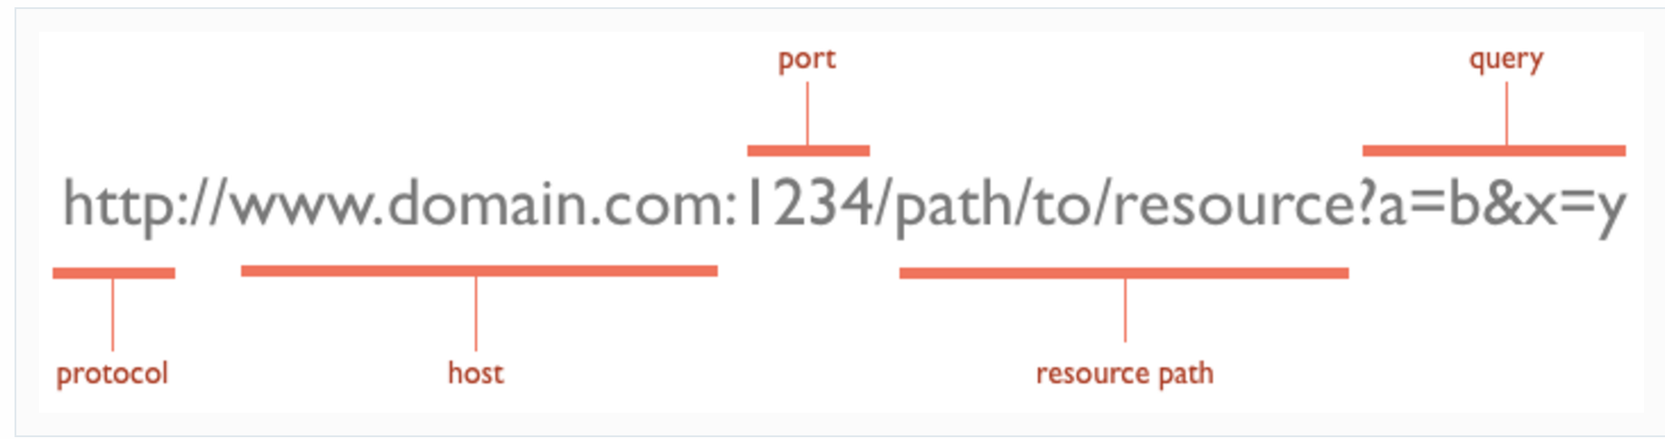
Example

Slide 55
Status codes
The status code is generated by the server to indicate the outcome of the request; the first digit identifies the general category of response:
  1xx indicates an informational message only
  2xx indicates success of some kind
  3xx redirects the client to another URL
  4xx indicates an error on the client's part
  5xx indicates an error on the server's part
  Example
  200- OK
  404- Not Found

Slide 56
Http Request Methods
GET Retrieve a resource
POST Update a resource
PUT Store a resource
DELETE Remove a resource
HEAD Get just the header that a GET request would have obtained

Slide 57
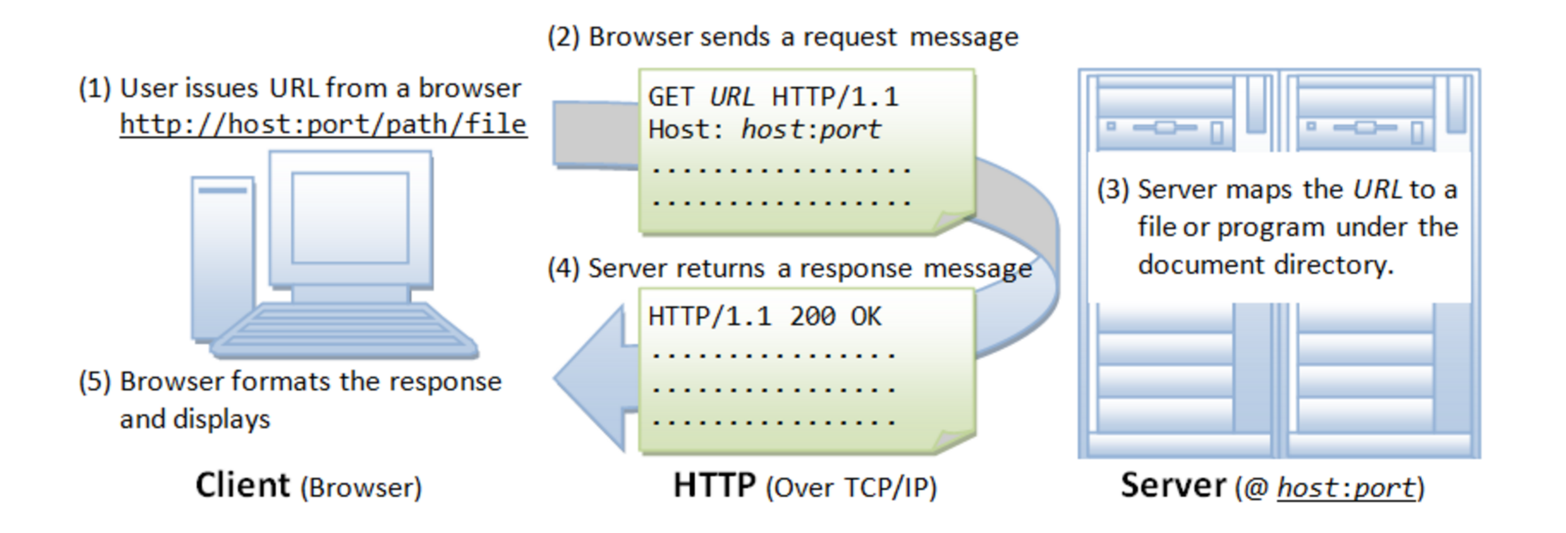
In a nutshell

Slide 58
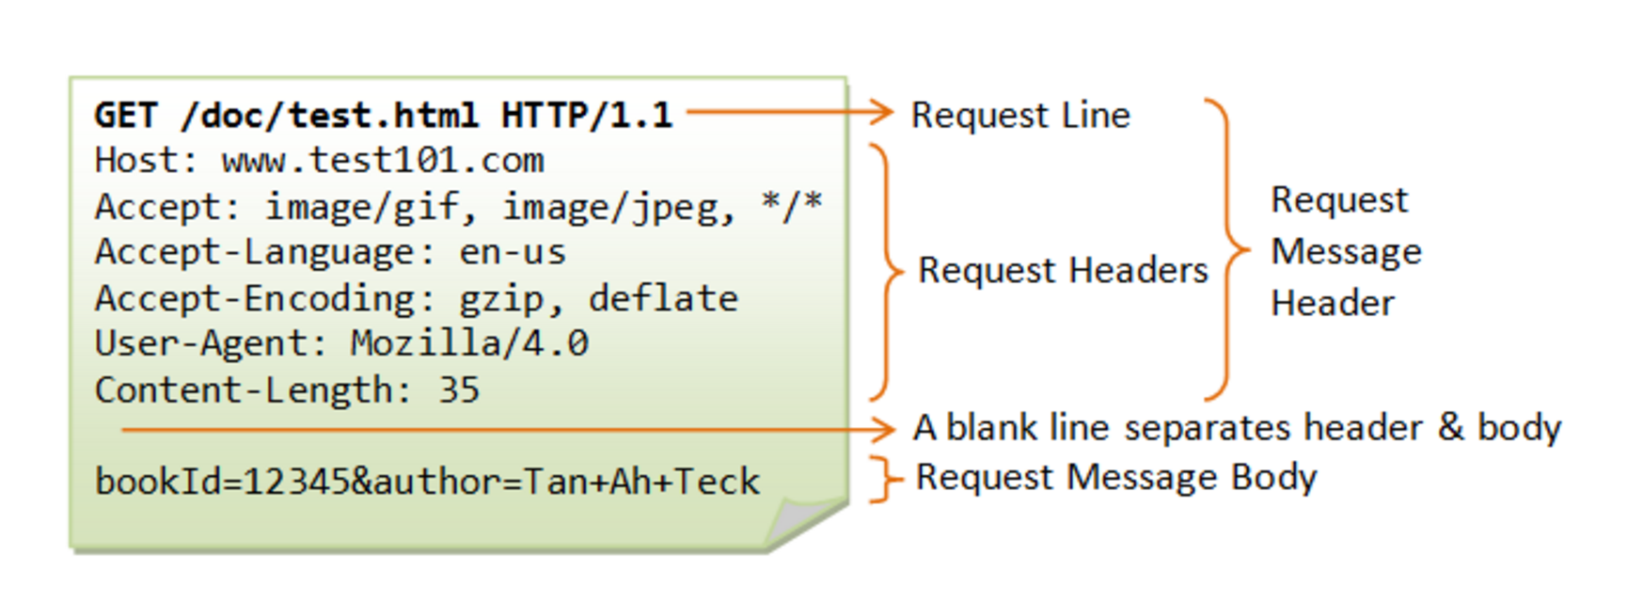
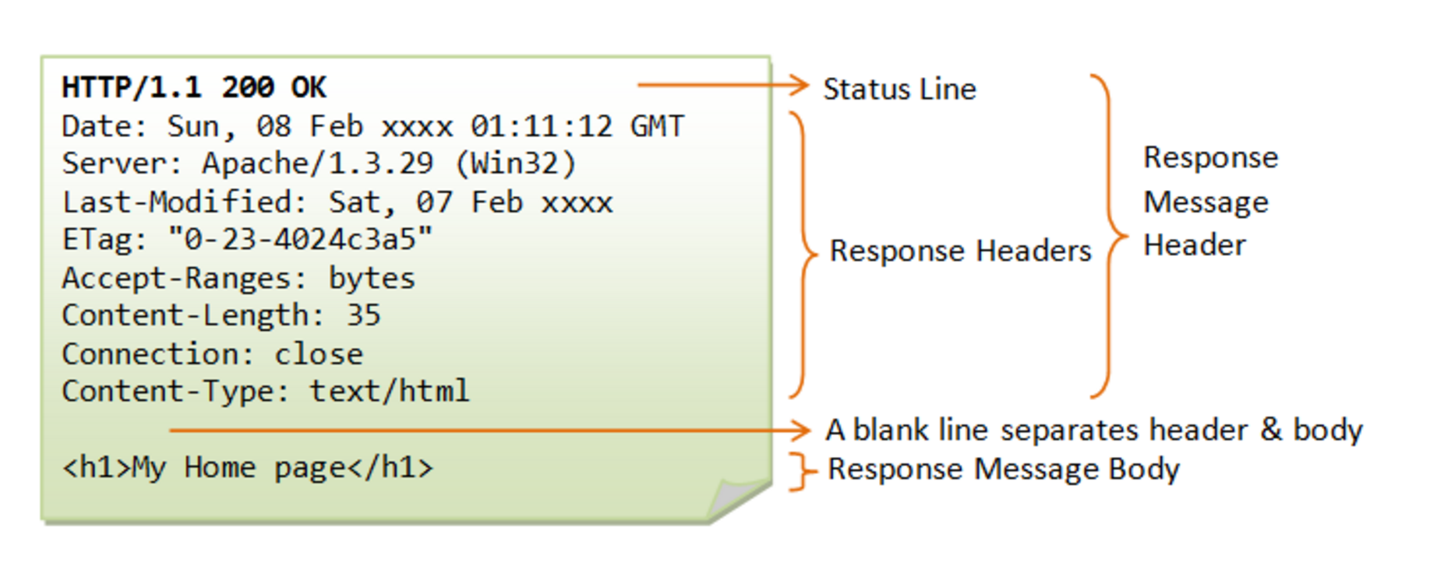
Messages
Request
Response

Slide 59
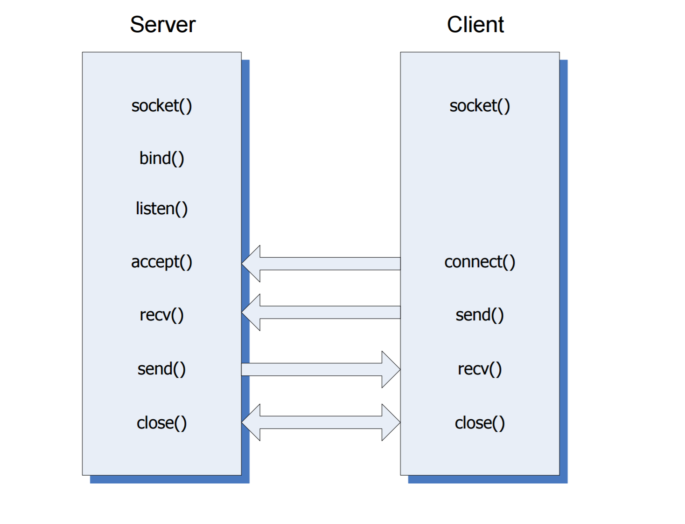
Http client server processing

Slide 60
General Socket API
Server
Client
create socket object – socket()
bind server socket to address/port – bind()
request server to listen for connection requests – listen()
server accepts a client connection - accept()
collect data from remote socket – recv()
Send data to remote socket – send()
create socket object – socket()
Connect the socket to the address of the server - connect()
Send data to remote socket – send()
collect data from remote socket – recv()

Slide 61
Project Plan
Cross platform library
The socket packages shall be developed for both Linux and Windows, providing the same external interfaces in both environments.
Cross platform GUI
Chrome browser with HTML5 page and JavaScript library. Communication will be AJAX and XMLHttpRequest objects will be created by javascript

Slide 62
Tiny http server
Build HttpServer code which would use either of the socket (linux or windows) packages and otherwise be identical for both environment.
Use the HTTP 1.0 protocol basic features
The server shall accept a function or functor that defines its response to the standard HTTP request message types: GET, POST, PUT, DELETE, and HEAD. That may be a message of type: 2xx success, 3xx redirection, 4xx not found, but may be something else, appropriate for a specific application.
Proper interface to process the requests received from the Browser.

Slide 63
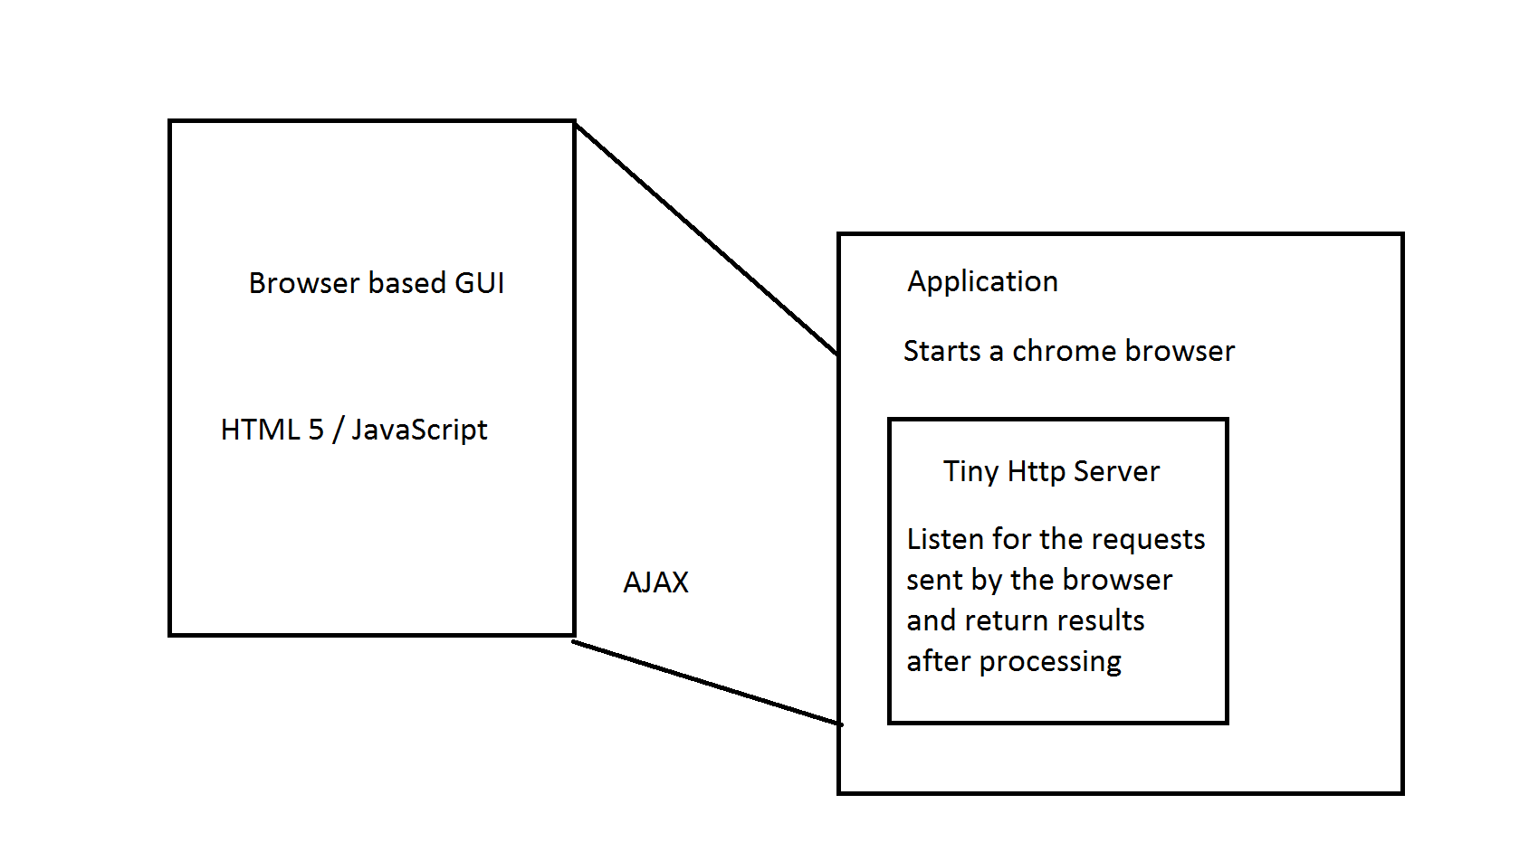
Project Overview

Slide 64
Application Idea/Tasks
Remote Cross Platform Repository
Support multiple clients simultaneously
Use the threadpool , sockets Communication library packages developed by Aishwarya for linux and Windows
Use the Browser based Cross platform GUI developed by Shweta
Enable communication using the HTTP Server developed by Sneha
Develop the additional modules and functionalities to make the complete application function properly in sync.

Slide 65
Team
Cross Platform library – Aishwarya Khaire
Cross Platform GUI – Shweta Moholkar
Tiny HTTP server – Sneha Patil

Slide 66
References
http://www.ecs.syr.edu/faculty/fawcett/handouts/CoreTechnologies/SocketsAndRemoting/Presentations/Win32Sockets.pdf
http://ecs.syr.edu/faculty/fawcett/handouts/CSE775/Projects/Pr2S14a.pdf
https://www.ntu.edu.sg/home/ehchua/programming/webprogramming/HTTP_Basics.html
http://searchnetworking.techtarget.com/definition/OSI

Slide 67
THANK YOU

