Slide 1
Cross-platform Libraries
Probing Examples
Distributed Objects
Cunyang Shui

Slide 2
Topics
Inter-process Communication
Shared Memory
Implementation
Demo

Slide 3
Inter-process Communication
File
  Using file as intermedia, two processes access a same file.
Sockets
    Using local network intermedia, sending and receiving data packets
Pipe
      Inter-process tunnel.
      Only fit in 2 processes.

Slide 4
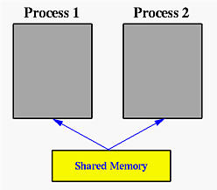
Shared Memory
One block of physical memory that map to multiple processes
http://www.csl.mtu.edu/cs4411.ck/www/NOTES/process/shm/what-is-shm.html

Slide 5
Shared Memory
Allocate/get memory block from OS
  Windows: file mapping
  Linux: ipc allocation (“shmget” syscall)
Get access of this block in current process
  Windows: get map of file
  Linux: “shmat” syscall

Slide 6
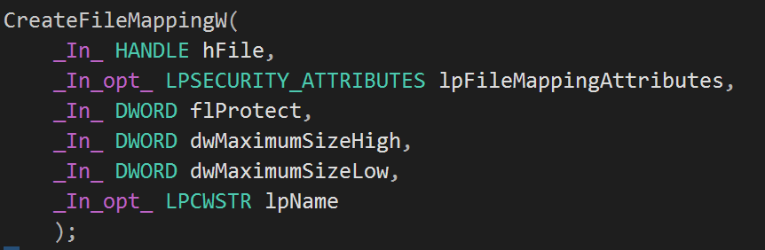
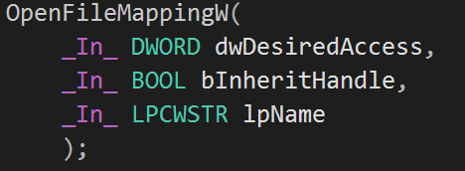
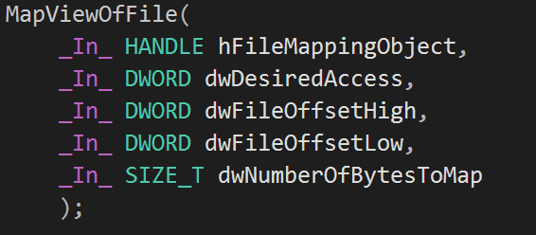
Shared Memory-Windows
Allocate/get memory block from OS
Get access of this block in current process

Slide 7
Shared Memory-Linux
Allocate/get memory block from OS
    int shmget(key_t key, size_t size, int shmflg);
Get access of this block in current process
  void *shmat(int shmid, const void *shmaddr, int shmflg);

Slide 8
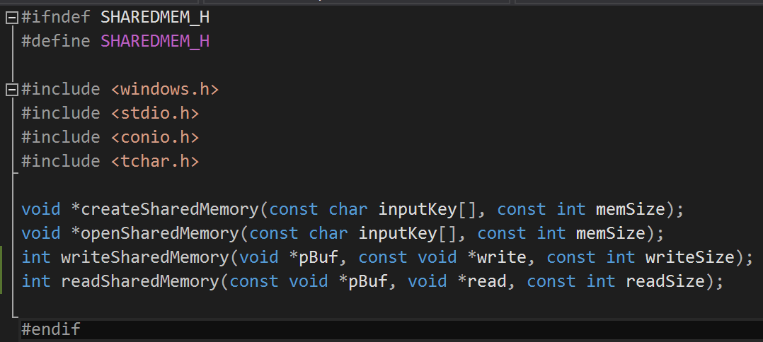
Shared Memory - C Implementation

Slide 9
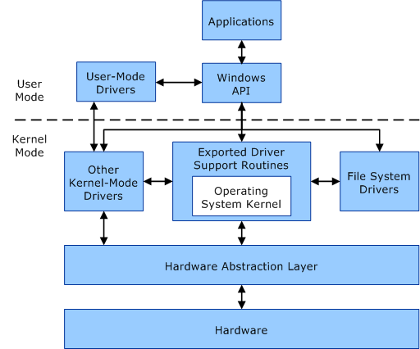
Windows
Born in 1985
Windows NT kernel after Windows 2000
Working on some specific platforms
Not free & not open source
https://msdn.microsoft.com/en-us/windows/hardware/drivers/gettingstarted/user-mode-and-kernel-mode
Notes:
Born in 1985, not most use, over 90% personal computer installed Windows
Windows 9x kernel before Windows 2000,
Since 2000, MS use Windows NT as its kernel
Working on some specific platforms,
Since it is not open source, you cannot modify it by yourself.
But if you really want Windows works for some specific architecture,
You can pay for MS and let them do it for you.
Windows Architecture -> introduce some
Another specific thing I want to mention is:
Graphic process are in the kernel space.
One factor that why it is more suitable for gaming.

Slide 10
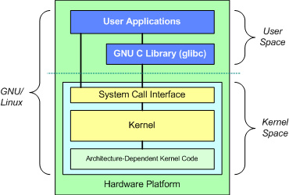
Linux
“Linux” means Kernel, but more refers OS build on Linux kernel today.
Born in 1991, hobby by Linus Torvalds
Working on almost every platforms (x86, ARM … )
Free to use & open source
https://www.ibm.com/developerworks/library/l-linux-kernel/
Notes:
Linux in fact means kernel, but I am using Linux refer OS build over Linux kernel, like Ubuntu.
It is Unix like OS, most popular in server.
Nowadays, diverse devices like tablets, smartphones use Linux kernel. Android.
Issued by GNU, free license
1991 hobby by Linus Torvalds.
Now, developed by whole community.
He still over watch the last process --- merge.
Decide put the code in or not in the release version
Since open source, working on almost every platforms (x86, ARM … )
Open source means high customized,
you can cut any code away when you don’t need it to improve efficiency.
E.x. for server, you don’t need graphic user interface
Similar as structure in Windows. 3 layer.
Four main parts in Linux kernel middle layer:
1. character devices, terminal.
2. network devices, sockets and protocols.
3. Manage storage system. Not file system.
-> disk device drivers, page and buffer caches, file systems, virtual memory.
4. Scheduling. dispatching, process scheduling.

Slide 11
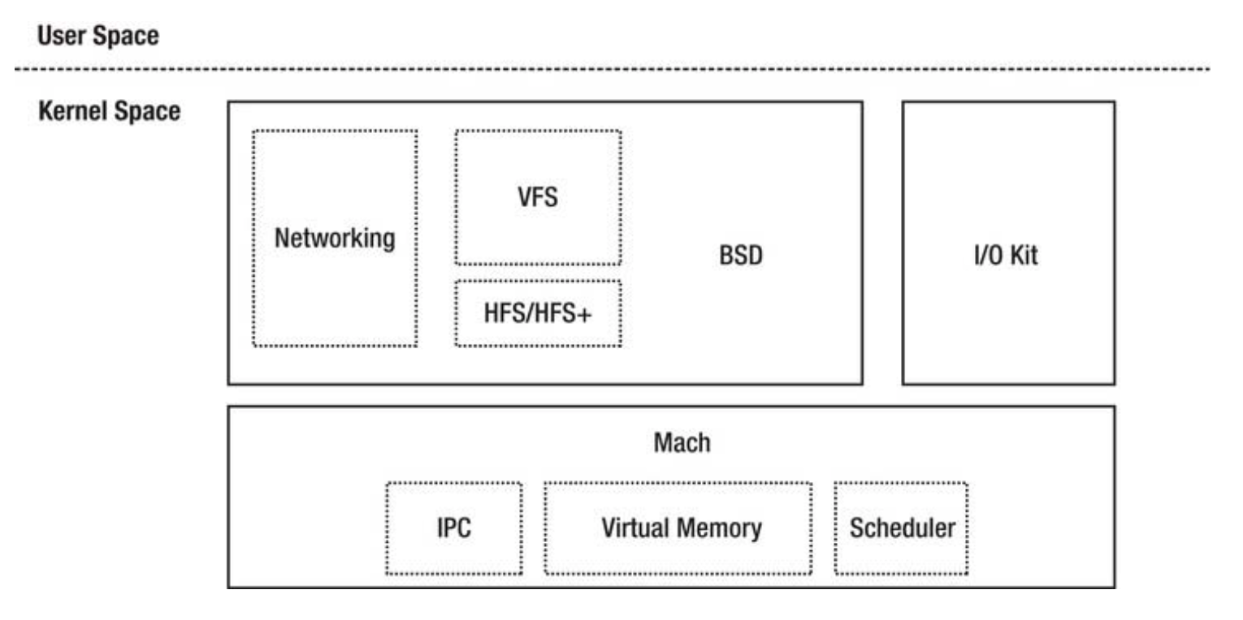
Mac OS
Born in 1984
Working on PowerPC and x86
“Darwin” Kernel, from NeXTUP OS
Free or not free ???
Open source
Fewer viruses
Reference: OS X and iOS kernel programming
Notes:
Was Born in 1984, using XNU license
Working on PowerPC and x86 architecture,
OS 10.4.4 first x86
since 10.6, it is not support powerPC anymore.
OS 10.5 become Unix based OS
Diagram shown here is kernel structure, called “Darwin”, from NeXTUP OS
Mach 3.0 from CMU, BSD, IOKit
Free or not free ???
Open source
Fewer viruses, in mu opinion, because of fewer user, hacker don’t want to waste time in these fewer users.
Another things, Graphical OS at the beginning, so early date, it is more human friendly.

Slide 12
Memory Management
Requirements
  Protection
  Sharing
  Relocation
  Organization
Notes:
4 main requirements:
protection,
sharing,
Relocation: paging
Organization: when and what to store in RAM & when and what to back up it to paging files.
Virtual memory
For each platform, 4 GB for each process. 2G for kernel space in Win, 1G for kernel space in Linux.
Share Memory
Share memory is not allowed at early Mac OS, but later with extension framworks, we can do it now.
Share memory -> segments.
“ipcs -m”
Four kind of Memory in Mac OS
Free
Wired -> kernel memory
Active -> currently be used memory
Inactive -> recently accessed, named cached. -> that is why RAM is critical in Mac OS
Organization
Mac OS’s virtual memory address is always on.
In Linux and Windows, the virtual address is created based on the size needed by the user.

Slide 13
Process Management
Windows
  A task request a process.
  Process assign a security token.
Linux
  Hierarchy mechanism to create process.
  First process is init process.
  Tasks are handled in a data structure.
Mac OS
  Use Grand Central Dispatch to control process.
  Program create blocks.
  Run-queue to schedule them
Notes:
W
Process started when a task request.
Task is the unit of resource ownership.
To be simple, code can create a process in Windows, by syscall
Process assign a security access token.
This token contains information about this process.
For token, process object are attributes, actions or the services.
L
Hierarchy mechanism to create process, all process come from parent process.
And first process is init
Tasks are handled in a data structure, similarly, contains information about each process, states, running, waiting …
Another specification is that Linux takes user level threads for the task,
and can mapping them to kernel level with the same group id, that allows shared memory in Linux
M
Use Grand Central Dispatch to control process, which contains a pool of available threads.
Program create blocks, which contains code and data.
Mac OS use a data structure called run-queue to store the blocks, using first in first out processing

Slide 14
File Management
 | Windows | Linux | Mac OS
Manager | Windows Explorer | Folder | Finder
Format | FAT or NTFS | Ext | HFS+
Structure | Partition based and \ | All files under /
Case sensitivity | Yes | No | Yes
Exclusive access | No | Yes

Slide 15
Inter-process Communication (IPC)
File
Sockets
Shared memory
Pipe

Slide 16
Project plan
File system library
Thread pool library
Sockets library
Shared memory library

Slide 17
Questions

Slide 18
Thank you !

Slide 19
Topics
Why do we need cross-platform library?
Difference in Windows, Linux and Mac OS(kernel and file system)
Inter-process Communication
My project plan (file system, thread pool, sockets, shared memory, pipe)

