Slide 1
Opinion Analysis
Xamarin Technology By: Ammar Salman
Instructor: Dr. Jim Fawcett

Slide 2
Introduction
The project:
  Opinion Analysis.
  Twitter API (LinqToTwitter…).
  Sentiment Analysis.
  Xamarin.Forms.

Slide 3
What’s Done?
Xamarin.Forms:
  Android.
  Windows 8.1.
  Windows Phone 8.1.
  iOS – unable to test.
What about…?
  Universal Windows Platform – Not so friendly with LinqToTwitter

Slide 4
LinqToTwitter
Authorization to use Twitter:
  Through IAuthorizer
    SingleUserAuthorizer
    ApplicationOnlyAuthorizer
  Works well on most platforms
Not on UWP…

Slide 5
UWP <-|-> LinqToTwitter
LinqToTwitter v.4.x finally added support to UWP.
Still, not good news.
Special type of authorization for UWP.
  UniversalAuthorization.

Slide 6
Still, What Does It Mean?
UWP Apps cannot use Xamarin.Forms Portable TweetCollector
UWP Apps cannot use the same interface.
They need special treatment.
Is it still worth targeting UWP using Xamarin.Forms?
  Absolutely NOT!

Slide 7
So… Move On?
Not so fast..
Dramatic differences in the behavior of LinqToTwitter (yes, I’m still there) in different environments.
Normal C#? Perfect.
Xamarin? Nope.

Slide 8
More Limitations? Yup.
Targeting specified user tweets wasn’t possible.
However, it worked well in a console app.
What’s left?
  Collecting Tweets based on query words.

Slide 9
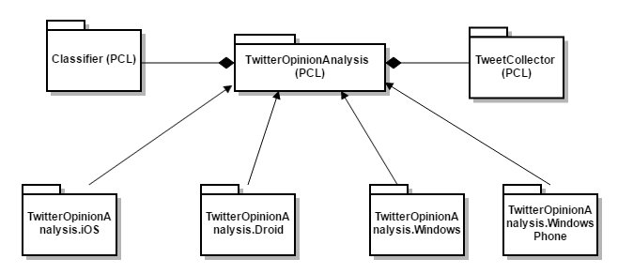
The Structure – Package Diagram

Slide 10
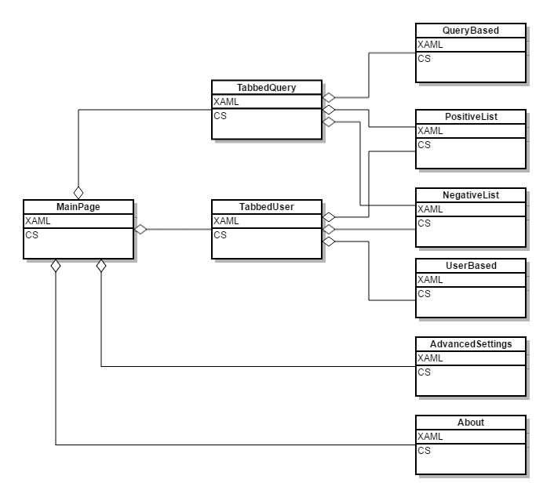
The Structure
– Main Package

Slide 11

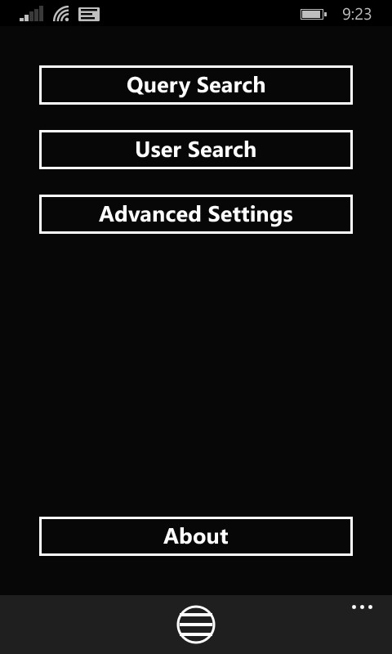
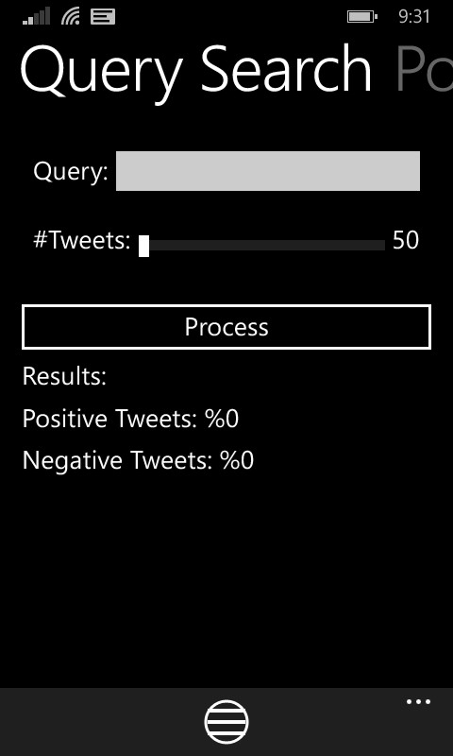
Okay, Some Results?

Slide 12
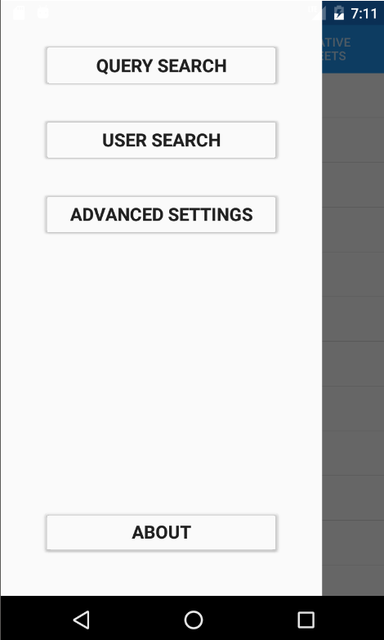
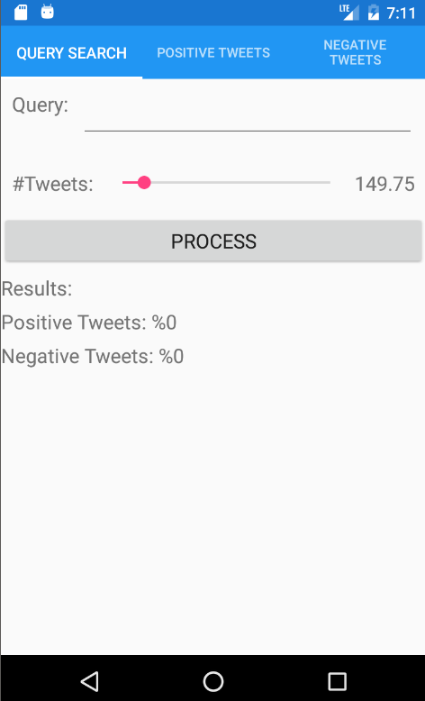
On Android

Slide 13

On Windows Phone
<ListView x:Name="list">
<ListView.ItemTemplate>
<DataTemplate>
<ViewCell>
<Frame OutlineColor="Gray">
<StackLayout Orientation="Horizontal">
<Image Source="{Binding Path=User.ProfileImageUrl}"/>
<StackLayout>
<Label Text="{Binding Path=User.Name}"/>
<Label Text="{Binding Text}" LineBreakMode="WordWrap"/>
</StackLayout>
</StackLayout>
</Frame>
</ViewCell>
</DataTemplate>
</ListView.ItemTemplate>
</ListView>

Slide 14
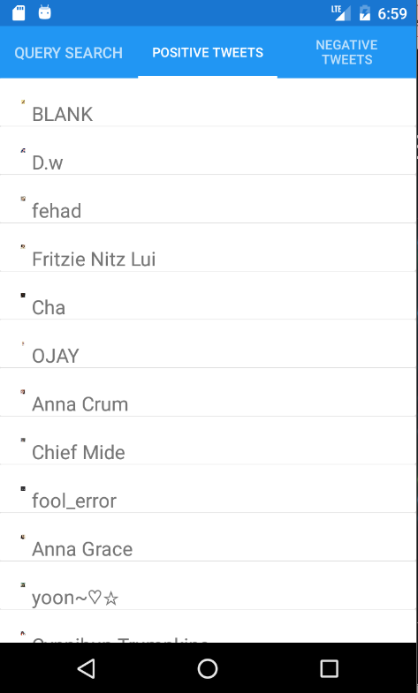
Then on Android

Slide 15
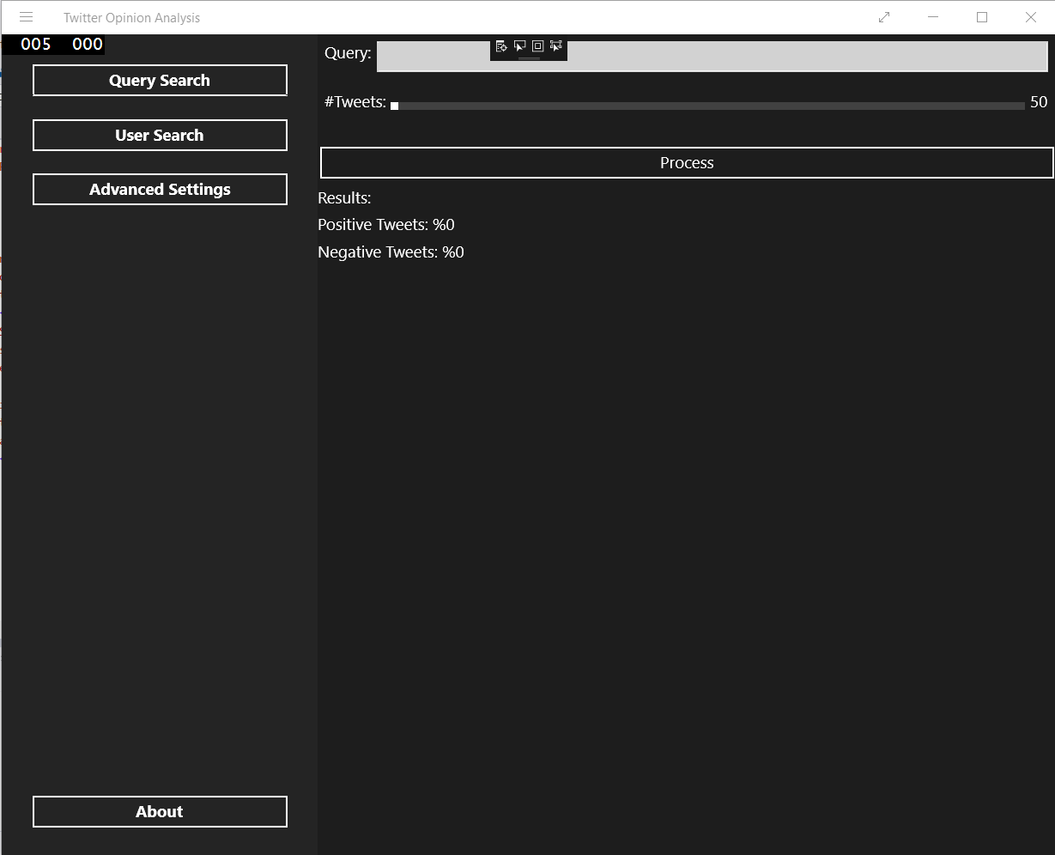
Then on Win8.1

Slide 16
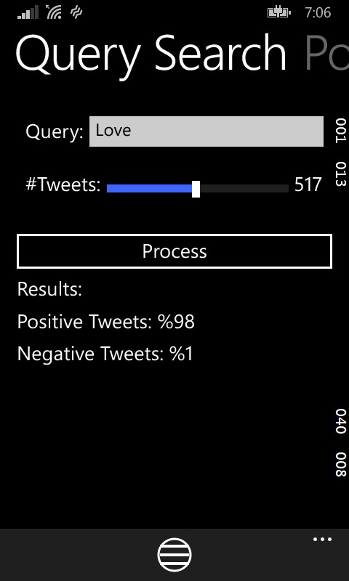
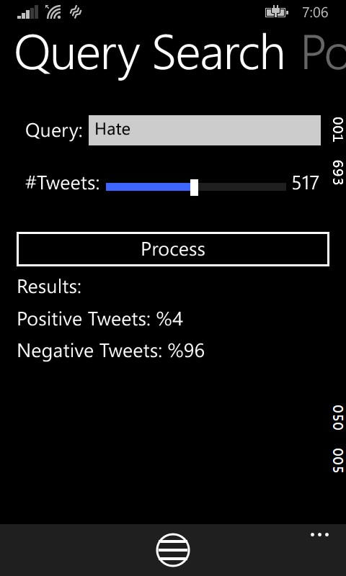
Some Queries

Slide 17
Xamarin.Forms … Where to Start…
Pros:
  Is in fact “cross-platform”.
  XAML … Style.
  Write once, deploy a lot.
Cons:
  XAML. (yes, a con)
  Chaotic.
  Kills productivity.
  Documentation.

Slide 18
In The End…
Xamarin.Forms still has a long journey to go through
It needs some refactoring and re-organization
Having completely independent cross-platform libraries isn’t possible
Personally, I would prefer following pure UWP development
UWP can also be done using XAML and C++ as well as C#

Slide 19
Thank You

