Slide 1
Fancy Image Repository
(Cross Platform Distributed App)
Pallavi Iyengar Tarun Rajput
Course: Distributed Objects Instructor: Dr. James Fawcett

Slide 2
Introduction – Fancy Image Repository
Allows users to use their Google credentials for authentication
Provides rich Graphical User Interface for functionalities
  Fancy Image Repository
Facility to tag people and store the tags in the Database system
User can store and retrieve various photographs securely from server
Automatic Face detection mechanism in the photographs

Slide 3
Application Flow
Google
Authentication API
Authentication
Using Google Credentials
Authentication
Using Google
Credentials
Java REST
Service
Client
Image upload/download requests
Serving client
Requests for upload/download images, metadata and
So on
Face Identification
Metadata files creation
Storing image metadata into Database
Face Detection
Library
Database

Slide 4
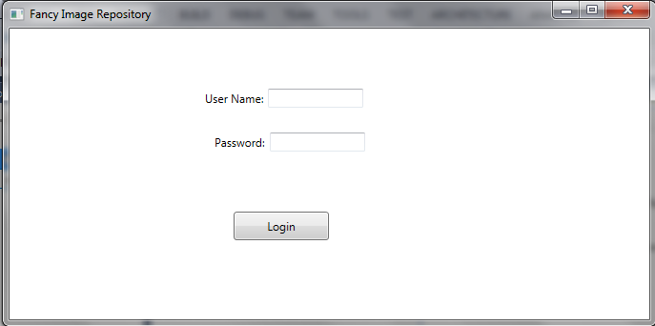
User Interface - Authentication

Slide 5
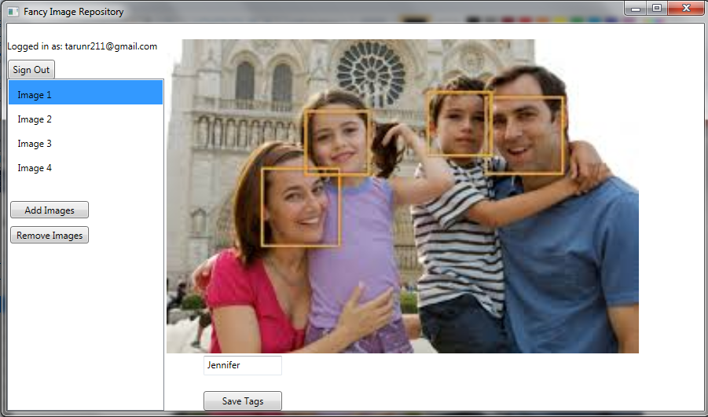
User Interface – Face Identification in Images

Slide 6
Technologies
RDBMS MySQL for Data storage
Java Swing API for Client Application
Java REST services
Google Authentication API
OpenCV Face Detection library

Slide 7
My SQL

Slide 8
My SQL - Introduction
MySQL is a relational database management system and ships with no GUI tools to administer MySQL databases or manage data contained within the databases.
Users may use the included command line tools use MySQL "front-ends", desktop software and web applications that create and manage MySQL databases, build database structures, back up data, inspect status, and work with data records.
The official set of MySQL front-end tools, MySQL Workbench is actively developed by Oracle, and is freely available for use.

Slide 9
My SQL Editions
MySQL Community Edition
MySQL Standard Edition
MySQL Enterprise Edition
MySQL Cluster Carrier Grade Edition

Slide 10
Command for accessing MySQL
My SQL example:
Enter password: *****
Welcome to the MySQL monitor. Commands end with ; or \g.
Your MySQL connection id is 241 to server version: 3.23.49
Type 'help;' or '\h' for help. Type '\c' to clear the buffer.
mysql>
To exit the MySQL Shell, just type QUIT or EXIT:
mysql> QUIT
mysql> exit

Slide 11
My SQL- Basic Queries
mysql> SELECT VERSION(), CURRENT_DATE;
+-----------+--------------+
| VERSION() | CURRENT_DATE |
+-----------+--------------+
| 3.23.49 | 2002-05-26 |
+-----------+--------------+
1 row in set (0.00 sec)
Most MySQL commands end with a semicolon (;)
MySQL returns the total number of rows found, and the total time to execute the query

Slide 12
Java Swing API

Slide 13
Java Swing API
Swing is a GUI widget toolkit for Java. It is part of Oracle's Java Foundation Classes (JFC) — an API for providing a graphical user interface (GUI) for Java programs. Swing was developed to provide a more sophisticated set of GUI components than the earlier Abstract Window Toolkit (AWT).
JApplet, Jframe, JLabel, JButton, JPanel, Jslider, JColorChooser, JInternalFrame, JOptionPane, JToolBar, JEditorPane, JCheckBox, JRadioButton, JTextField, JTextArea, JFileChoose

Slide 14
Java Swing API - Features
Many more built-in controls - Image buttons, tabbed panes, sliders, toolbars, color choosers, HTML text areas, lists, trees, and tables.
Increased customization of components
  Border styles, text alignments, and basic drawing features. Images can be added to almost any control.
A pluggable “look and feel”
  Not limited to “native” look.
Many miscellaneous small features
  Built-in double buffering, tool-tips, dockable toolbars, keyboard accelerators, custom cursors, etc.
Model-view-controller architecture
  Can change internal representation of trees, lists, tables.

Slide 15
Java Swing API - Features
Lightweight components
  Most Swing components are lightweight: formed by drawing in the underlying window.
Use of paintComponent for drawing
  Custom drawing code is in paintComponent, not paint.

Slide 16
REST Services

Slide 17
REST Introduction
REST is a set of architectural principles to develop web services.
REST web services have the following properties:
  Resources are identified as URIs
  Standard set of operations on resources – PUT, GET, POST, DELETE
  Resources exchanged as JSON, XML, text, PDF, JPEG and so on
  Resources typically accessed via stateless protocols such as HTTP

Slide 18
RESTful Web Service in JAVA
JAXRS is a set of APIS provided by JAVA for development of RESTful Web services.
It makes use of Java annotations to describe resources, operations, input/output format, and so on.

Slide 19
JAXRS ANNOTATIONS
Some of the main annotations used are:
  @Path
  @GET, @PUT, @POST, @DELETE
  @Consumes
  @Produces

Slide 20
Sample Server Code
@Path("/file")
public class File{
@POST
@Path("/upload")
@Consumes(MediaType.MULTIPART_FORM_DATA)
public Response upload(
@FormDataParam("filename") String filename,
@FormDataParam("file") InputStream inputStream) {
String result = saveFile(inputStream);
return Response.status(SUCCESS_CODE).entity(result).build();
}
}

Slide 21
Sample Client Code
String URL = “http://localhost:8080/Album/file/upload";
HttpClient httpclient = new DefaultHttpClient();
HttpPost httppost = new HttpPost(URL);
File img = new File(“myimg.jpg”);
FileInputStream fis = new FileInputStream(img);
MultipartEntity entity = new MultipartEntity();
entity.addPart("filename", new StringBody(img.getName()));
entity.addPart("file", new InputStreamBody(new FileInputStream(img), img.getName()));
httppost.setEntity(entity);
HttpResponse response = httpclient.execute(httppost);
int serverRespCode = response.getStatusLine().getStatusCode();

Slide 22
OpenCV for FaceDetection

Slide 23
WHAT IS OPENCV?
OpenCV is a library of multiple computer vision algorithms. It has modules for image processing, object detection, video analysis, 3D reconstruction, machine learning etc. [7]

Slide 24
Face Detection Basics
Face Detection in OpenCV is based on Haar feature-based cascade classifiers ( proposed by Paul Viola and Michael Jones in their paper, “Rapid Object Detection using a Boosted Cascade of Simple Features” in 2001). [7]

Slide 25
OpenCV APIs
Load the native library
  System.loadLibrary(Core.NATIVE_LIBRARY_NAME); [7]

Slide 26
OpenCV APIs
OpenCV contains many pre-trained classifiers for face, eye, smile etc found as XML files under opencv/data/haarcascades/. Load the required classifier.
  CascadeClassifier faceDetector =
  new CascadeClassifier(
  getClass().getResource("/lbpcascade_frontalface.xml").getPath()
  ); [7]

Slide 27
OpenCV APIs
  Load the image. Mat is C++ n-dimensional dense array class[5].
  Mat image = Highgui.imread(
  getClass().getResource("/lena.png").getPath()
  ); [7]

Slide 28
OpenCV APIs
  Call face detection API of the classifier passing it the image and the result to be stored in.
  MatOfRect faceDetections = new MatOfRect(); [7]
  faceDetector.detectMultiScale(image, faceDetections); [7]

Slide 29
OpenCV APIs
  MatOfRect holds each of the detected face represented as a rectangle of type “Rect” containing top left x, y co-ordinates, width and height as rect.x, rect.y, rect.width, rect.height respectively.[7]

Slide 30
Google Authentication

Slide 31
OAUTH – The Authorization Protocol
OAuth is an open standard for authorization. OAuth provides client applications a 'secure delegated access' to server resources on behalf of a resource owner. [9]

Slide 32
OAuth2.0
OAuth 2.0 is the next evolution of the Oauth protocol [9]. Google supports OAuth 2.0 as the recommended authentication mechanism for all of its APIs [12].

Slide 33
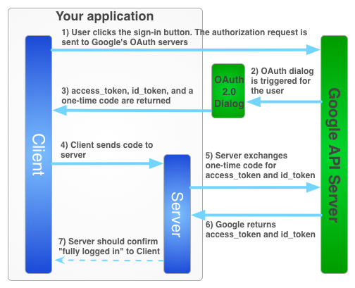
OAUTH 2.0 Flow
The sign-in flow for obtaining an access token for your server-side application is illustrated below.[11]
Figure: Google Authentication Flow[11]

Slide 34
Project Plan
TASKS | OWNER
Client Functionalities
Display list of images, faces and tags | Tarun
Displaying image, faces and tags | Tarun
Open CV integration | Pallavi
Upload/download images, face and tag metadata | Tarun/Pallavi
Image Album Creation | Tarun/Pallavi
Server Functionalities
Database design and Integration | Tarun
Authentication | Pallavi
REST service for list images and Metadata | Pallavi
REST service for Upload/download images and metadata | Pallavi/Tarun

Slide 35
REFERENCES
http://docs.oracle.com/javaee/6/tutorial/doc/gijqy.html [1]
http://opencv.org/ [2]
http://docs.opencv.org/modules/core/doc/intro.html [3]
http://www.vogella.com/tutorials/REST/article.html [4]
http://docs.opencv.org/modules/core/doc/basic_structures.html [5]
http://docs.opencv.org/doc/tutorials/introduction/desktop_java/java_dev_intro.html [6]
http://docs.opencv.org/trunk/doc/py_tutorials/py_objdetect/py_face_detection/py_face_detection.html [7]
http://docs.opencv.org/trunk/doc/tutorials/introduction/java_eclipse/java_eclipse.html [8]
http://en.wikipedia.org/wiki/OAuth [9]
http://tools.ietf.org/html/rfc6749 [10]
https://developers.google.com/+/web/signin/server-side-flow [11]
"Google Accounts Authentication and Authorization". [12]
https://blog.openshift.com/day-12-opencv-face-detection-for-java-developers/ [13]

Slide 36
REFERENCES
http://www.cs.kent.edu/~mabuata/DB10_lab/
http://docs.oracle.com/javase/tutorial/uiswing/

Slide 37
Thank You

