Slide 1
Code Analysis using
Compiler Front-ends
(Clang)
CSE 775 – Project # 2
Technology presentation
Instructor : Dr. Jim Fawcett
February 26, 2015
PRADNYA KHALATE
Spring 2015

Slide 2
Agenda
Project idea
Need of code analysis
Compilation steps
Compiler front-ends
Introduction to Clang
Clang libraries
Clang AST
Project plan

Slide 3
Project Idea
Intent :
    Explore a potentially effective way of building static code analysis tool
    Study APIs provided in libClang
    Replace the analysis engine based on our Parser with that of libclang

Slide 4
Project Requirements
Aim :
  Analyze the scope structure of set of C++ source code files
  Identify and display all the scope types
  (namespace, class, struct, enum etc.)
  Display size and complexity of each function definition in each analyzed file

Slide 5
Static Code Analysis
Analyzing code without executing it
Catches lexical, syntactic and some semantic errors
  Lexical – malformed name e.g. int 12qz;
  Syntactic – missing semicolon or unbalanced braces
  Semantic – valid code but doesn’t do intended action e.g. if (x=1)
Maintain code quality

Slide 6
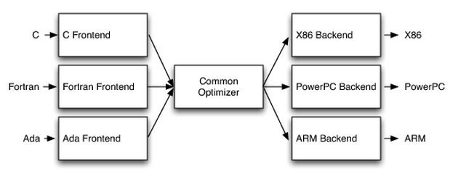
Compiler Architecture
n*m problem -> n+m solution
Intermediate Representation (IR)
Front-end tasks :
      Scanning
      Parsing
      Semantic analysis
Back-end tasks :
      Instruction selection
      Code optimization
      Code emission
Fig: Compiler design

Slide 7
Lexical Analysis / Tokenization
A scanner groups the characters into tokens
Ignores whitespace
Contiguous strings are part of one token
Tokens are separated by punctuation characters or whitespace or line break
  e.g. For x = x * (y + 1) ;
  tokens generated will be
  id(x), =, id(x), *, (, id(y),+, num(1),), ;
  where,
  ‘id’ - identifier
  ‘num’ - integer literal

Slide 8
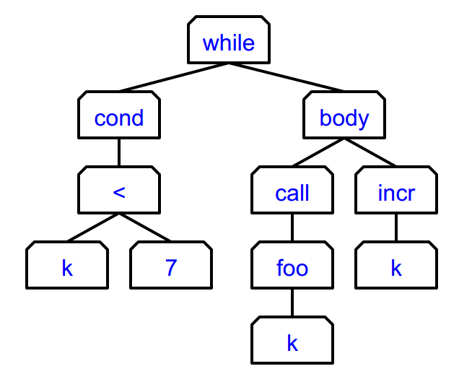
Abstract Syntax Tree (AST)
Representation of source code as a tree of nodes representing constants or variables (leaves) and operators or statements (inner nodes)
“Abstract" because it doesn’t represent every detail appearing in the real syntax
Example
  while (k < 7)
  {
  foo(k);
  k++;
  }

Slide 9

The LLVM project
Collection of modular and reusable compiler and toolchain technologies
Began as a research project at the University of Illinois in 2000
Languages with compilers that use LLVM include – Common Lisp,, Ada, D, Fortran, OpenGL Shading Language, Go, Haskell, Java bytecode, Julia, Objective-C, Swift, Python, Ruby, Rust, Scala, Lua
Later development at Apple
Sub-projects include – LLVM core, Clang, LLDB, libc++, libcl,

Slide 10
What’s Clang?
C language family frontend for LLVM
Designed to offer a complete replacement to the GCC
Developed by Apple, along with involvement of Google, ARM, Sony, Intel
Current status
  A production quality C, Objective-C, C++ and Objective-C++ compiler when targeting X86-32, X86-64, and ARM
  Great for source analysis
  Supports C++11

Slide 11
Clang features
End-user features
Utility & Applications
Internals
Fast compile and low memory use
Library based architecture
Real world production quality compiler
Expressive diagnostics
Support diverse clients
Simple and hackable code base
GCC compatibility
Use of LLVM BSD license
Single unified parser for C, C++, Objective-C

Slide 12
Clang libraries
Various parts of can be cleanly divided into separate libraries
Clang is divided into the following libraries and tool:
  libsupport - Basic support library, from LLVM.
  libsystem - System abstraction library, from LLVM.
  libbasic - Diagnostics, SourceLocations, SourceBuffer abstraction, file system caching for input source files.
  libast - Provides classes to represent the C AST, the C type system, builtin functions, and various helpers for analyzing and manipulating the AST (visitors, pretty printers, etc).

Slide 13
Clang libraries (cont.)
liblex - Lexing and preprocessing, identifier hash table, pragma handling, tokens, macro expansion.
libparse - Parsing. This library invokes coarse-grained 'Actions' provided by the client (e.g. libsema builds ASTs) but knows nothing about ASTs or other client-specific data structures.
libsema - Semantic Analysis. This provides a set of parser actions to build a standardized AST for programs.
libcodegen - Lower the AST to LLVM IR for optimization & code generation.
librewrite - Editing of text buffers (important for code rewriting transformation, like refactoring).
libanalysis - Static analysis support.
clang - A driver program, client of the libraries at various levels.

Slide 14
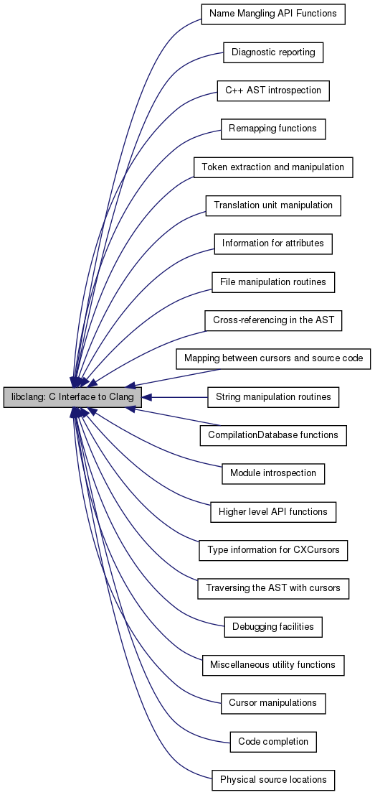
libClang
Collaboration diagram for libclang: C Interface to Clang:
C interface to Clang

Slide 15
Clang AST
Command
clang –cc1 –ast-dump [filename]
#include <iostream>
int main()
{
std::cout << "Hello world!\n" << std::endl;
return 0;
}
TranslationUnitDecl 0x67b5120 <<invalid sloc>> <invalid sloc>
|-TypedefDecl 0x67b5410 <<invalid sloc>> <invalid sloc> implicit __builtin_va_li
st 'char *'
`-FunctionDecl 0x67b5480 <helloWorld.cpp:4:1, line:8:1> line:4:5 main 'int (void
)'
`-CompoundStmt 0x67b55c8 <line:5:1, line:8:1>
`-ReturnStmt 0x67b55b8 <line:7:2, col:9>
`-IntegerLiteral 0x67b5598 <col:9> 'int' 0

Slide 16
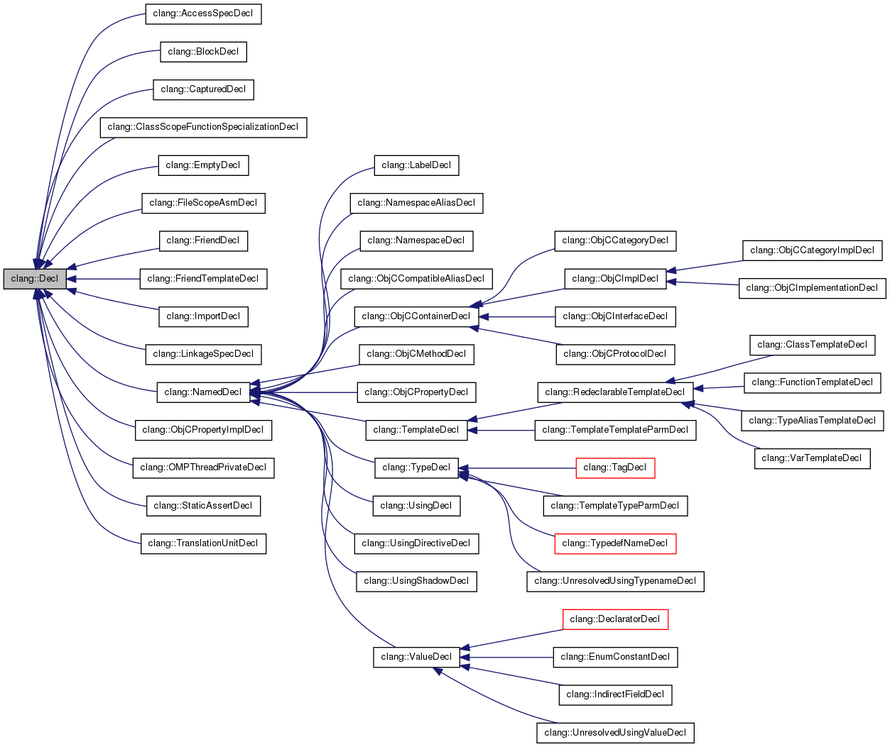
Classes
Inheritance diagram for clang::Decl:
Core classes –
  Decl
  Stmt
  Type
Glue classes
Figure : Inheritance diagram for Decl class

Slide 17
Planned Tasks
Setting up Clang
Study of APIs provided in Clang libraries
Understand Clang AST
Develop a parser program with clean interfaces which can be integrated in any other program
Implement scope analysis project with the new parser

Slide 18
References
Compiler Architecture :
https://lambda.uta.edu/cse5317/notes/node5.html
Source Code Parsing:
http://ecs.syr.edu/faculty/fawcett/handouts/webpages/BlogParser.htm
Clang homepage:
http://clang.llvm.org/index.html
Clang API documentation:
http://clang.llvm.org/doxygen/index.html
The Clang AST:
http://llvm.org/devmtg/2013-04/klimek-slides.pdf

Slide 19
Questions / Suggestions / Feedback ?

Slide 20
Thank you!

