Slide 1
RESTful Sevices
Distributed Objects
Presented by:
Shivank Malik
Kunal Shrivastava
Distributed Objects

Slide 2
Agenda
-REST
  Why REST?
  What is a RESTful Services?
Our project- Feedster
  Introduction
  Twitter, Facebook, Instagram services
  Web service
  Queries
  Tech used
  Algorithm
  Client- Browser and Mobile
      Wireframes
      Slideshow, animations, video
Delegation of work
References

Slide 3
REST
Stands for (Re)presentational (S)tate (T)ransfer
Based on Roy Fielding’s thesis on Network-based Software Architecture
Is an architectural style
Notes:
Architectural style is an abstraction as opposed to a concrete thing
References:
https://www.youtube.com/watch?v=YCcAE2SCQ6k

Slide 4

What is an architectural style?
Second Empire
architectural style
Notes:
This architectural style would tell us about the characteristics of a house or a building built ON this architectural style
References:
http://en.wikipedia.org/wiki/Hall_of_Languages,_Syracuse_University

Slide 5
REST architectural style
HTTP
REST
architectural style
Notes:
In the same way, REST architectural style is a set of rules and architectural constraints that you would see in a protocol like HTTP, built in that style.
HTTP is one such protocol(house) that has been built on this architectural style.
References:
http://en.wikipedia.org/wiki/Hall_of_Languages,_Syracuse_University
http://www.ics.uci.edu/~fielding/pubs/dissertation/top.htm

Slide 6
When am I RESTful?
Resources
  URI
  Uniform Interface
    Methods
    Representation
Protocol
  Client-Server
  Layered
  Cacheable
  Stateless
Notes:
URL- Uniquely addressable using a universal syntax
The resources share a common interface for interaction with the client
This interface defines a well-defined set of methods (GET, PUT, POST, DELETE, HEAD)
Representations are identified through content-types
References:
- https://www.youtube.com/watch?v=YCcAE2SCQ6k

Slide 7
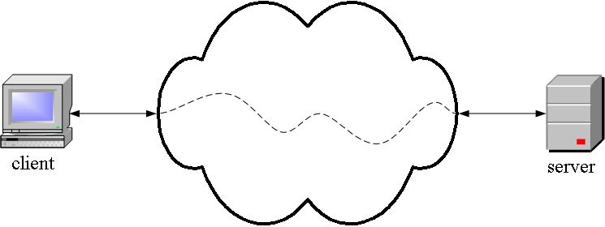
When am I RESTful?
Protocol
    Client-Server
  Stateless
  Cacheable
  Layered
Notes:
- HTTP is a client server protocol

Slide 8
When am I RESTful?
Protocol
  Client-Server
    Layered
  Stateless
  Cacheable
Origin
Server
Intermediaries
User
Agent
Notes:
Intermediaries add the layers in the request-response path and this happens without changing the interface
They may do translation or improve performance by caching

Slide 9
When am I RESTful?
Protocol
  Client-Server
  Layered
    Stateless
  Cacheable
Origin
Server
Intermediaries
User
Agent
Notes:
This is also important why the the interaction between requests are stateless
This allows intermediaries to work on a single interaction without worrying about the entire topology

Slide 10
When am I RESTful?
Protocol
  Client-Server
  Layered
  Stateless
    Cacheable
Origin
Server
Intermediaries
Proxies
Gateways
User
Agent
Notes:
Intermediaries are basically proxies and gateways
Proxies are chosen by the clients while gateways are chosen by the server
There may be several proxies and gateways between the user agent and the server

Slide 11
When am I RESTful?
Protocol
  Client-Server
  Layered
  Stateless
    Cacheable
Origin
Server
Intermediaries
Proxies
Gateways
User
Agent
Cache
Cache
Notes:
With caches, we cover all the characteristics for being RESTful.
Benefits REST:
Efficiency
Scalability
User perceived performance
Computation can be moved close to client or server based on the requirements
Code-on-demand
Javascript validation example

Slide 12
Why REST?
Social networking APIs are RESTful
Support for JSON
Effective encoding/decoding tools for JSON present on server and client side
Notes:
References:
- http://blog.smartbear.com/apis/understanding-soap-and-rest-basics/

Slide 13
Final Project
Feedster
Web and mobile (iOS) application
Display feeds from Instagram, Twitter and Facebook based on hashtags
Real-time feeds including pictures and text
Run Slideshow for feeds
Creating slideshow video from feeds
User profile, history and video storage

Slide 14
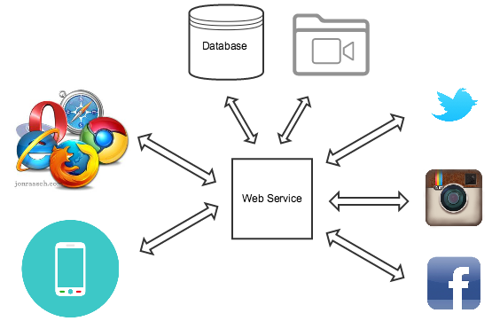
Architecture

Slide 15
Web Service
Server side service
Receives requests from clients
Interacts with social media API’s to fetch data
Interacts with the database
Sends back data to the client

Slide 16
Database and Video Storage
Stores User details and login information
Stores User history (hashtags used, slideshows played, etc.)
Stores videos made by the user

Slide 17
User Registration and Login
Registration form
Google Authentication
Facebook Authentication
Twitter Authentication

Slide 18
Instagram Tags Search API
Query Instagram’s tags search API with the hashtag and access token
Returns information of all the images containing the hashtag
Can be queried with min_id to get latest posts

Slide 19
Twitter Search API
Query Twitter’s search API with the hashtag text and access token
Returns information of all the tweets containing the hashtag
Can be queried with since_id to get latest posts

Slide 20
Facebook Graph Search
Query Facebook’s Graph Search for public posts containing hashtag text with access token
Returns information of all the public posts containing the hashtag
Latest posts can be calculated using the maximum id the client had received

Slide 21
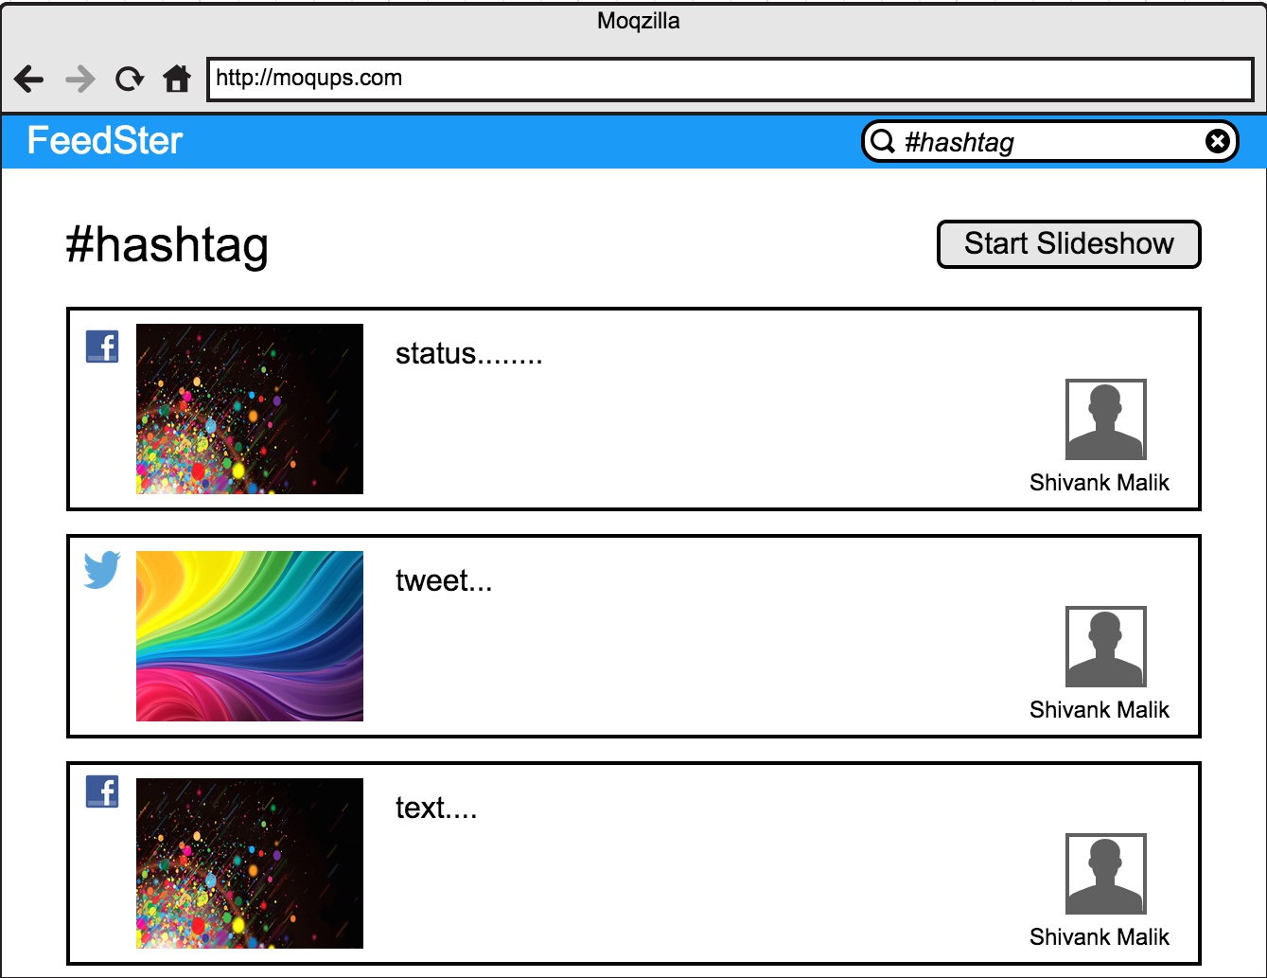
Clients - Browser

Slide 22
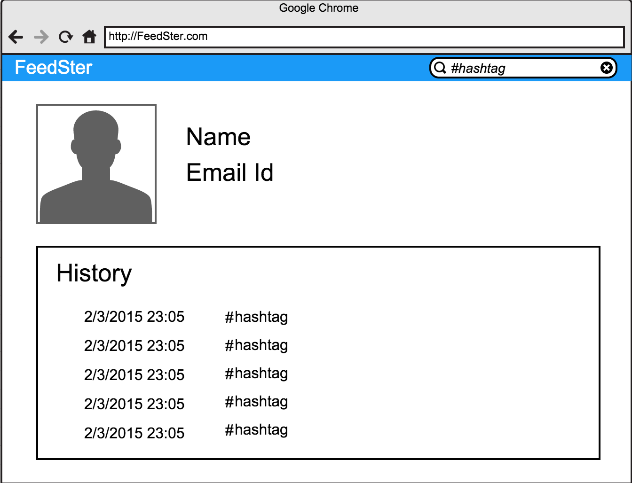
Clients - Browser

Slide 23
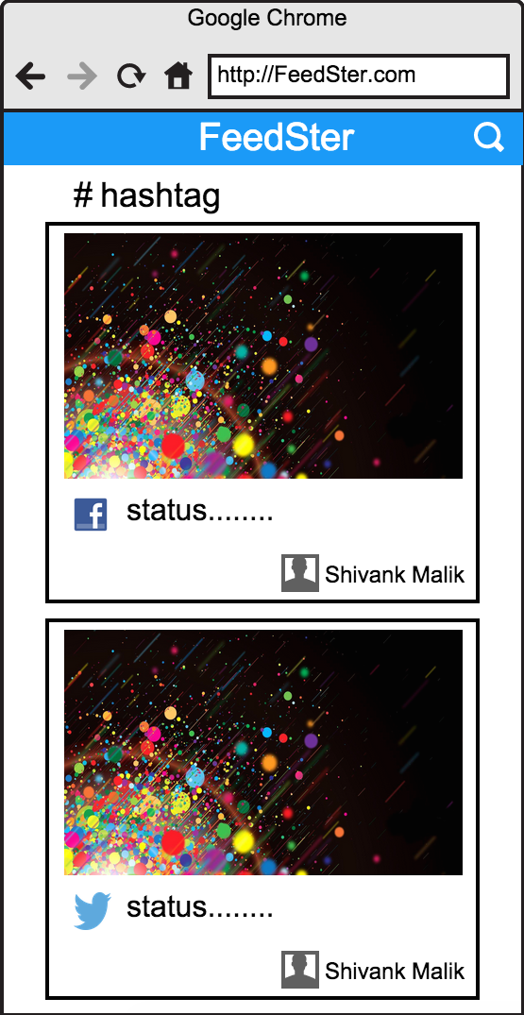
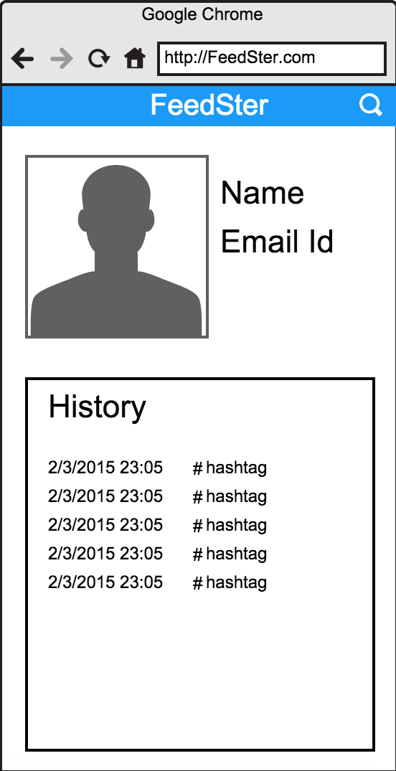
Clients - Browser

Slide 24
Slideshow animations
HTML5 and CSS3 transitions
JavaScript and jQuery animations
GSAP from GreenSock (HTML5 animations library)
PicoVico for creating slideshow videos

Slide 25
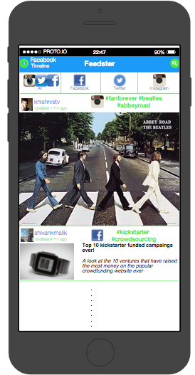
iOS Client
Frameworks to be used-
  Cocoa Touch
  Foundation
  Core Image
  AFNetworking
    Caching of photos
  CocoaPods
  iCarousal
Notes:
References:
- https://github.com/AFNetworking/AFNetworking

Slide 26
Technologies to be used
PHP
MySQL
SQLite
Twitter, Facebook and Instagram APIs
Javascript
Objective C

Slide 27

Algorithm for the slideshow
Display Screen
FeedItem
{
feedType
feedImage
feedText
userImage
userName
}
Photo Queue
Scheduler
-Randomly choose from the queues
-Randomly photograph from chosen queue
-Download photo from the service
-Enqueue loaded object in Photo Queue
nodeOfQ01
{
url
counter
}
Queue 0
Queue 1
Web service
Queue
manager
High priority
Low priority

Slide 28
Delegation of work
Interaction with social networking APIs- Shivank
Building our own REST API- Shivank, Kunal
Work on the algorithm- Shivank, Kunal
Web client- Shivank
iOS client- Kunal

Slide 29
Thank you!
if (questions)
askQuestions();
else
break;

Slide 30
References
Google developers- REST- https://www.youtube.com/watch?v=YCcAE2SCQ6k
Roy Fielding’s dissertation- http://www.ics.uci.edu/~fielding/pubs/dissertation/top.htm
A good blog on REST- http://blog.smartbear.com/apis/understanding-soap-and-rest-basics/
AFNetworking Git- https://github.com/AFNetworking/AFNetworking
Twitter Developer Site- https://dev.twitter.com/rest/public
Facebook Developer Site- https://developers.facebook.com/
Instagram Developer Site- https://instagram.com/developer/
Picovico Developer Site- http://picovico.readthedocs.org/

