Slide 1
BIG DATA Project
CSE 775 – Distributed Objects
Bekir Turkkan & Habib Kaya

Slide 2
Project Details
Research on new database trends
Comparisons of the systems
Implementations of a project on MongoDB

Slide 3
Outline
History of database management systems
What does NoSQL mean?
Why NoSQL database systems?
Types of NoSQL database systems
Data models for widely used NoSQL dbs
Query models of NoSQL
MongoDB Demo

Slide 4
History
1970s SQL is invented
1990s Object oriented databases tried to take place
2000s NoSQL databases came to market (Google’s Big Table, Amazon’s Dynamo)

Slide 5
Current Estimated Usage
Number of mentions of the system on websites
General interest in the system
Frequency of technical discussions about the system
Number of job offers, in which the system is mentioned
Number of profiles in professional networks, in which the system is mentioned
Relevance in social networks
Rankings

Slide 6
What Does NoSQL mean?
Not Only SQL, implying that there are more than one storage mechanism to design a software product or solution
Common observations
  Not using the relational model
  Running well on clusters (Scalable)
  Mostly open source
  Built for the 21st century web estates
  Schema-less

Slide 7
Why NoSQL?

Slide 8
Pros and Cons of SQL
Pros | Cons
Persistent Data Concurrency Integration (Mostly) Standard Model Relation | Certain model Scalability Performance Clustering

Slide 9
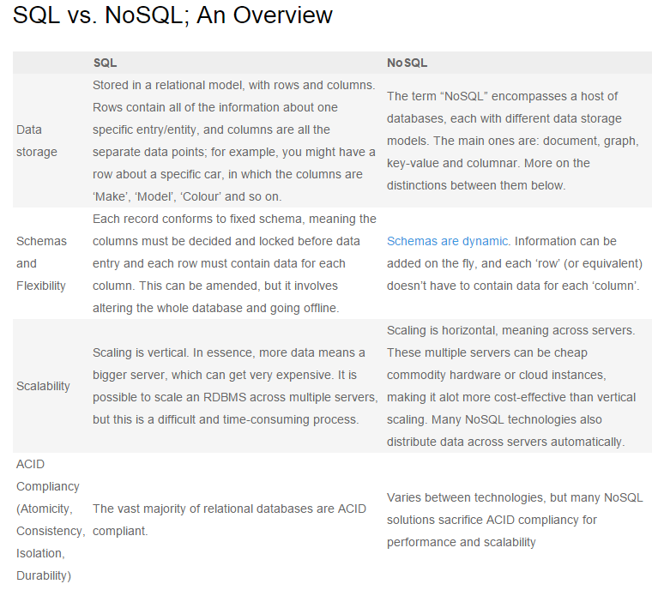

Slide 10
Scalability for SQL systems
Scale up – use a more powerful SQL Server
Scale out – use more SQL Servers
Scale up Options
Replacing server with a faster one or having more memory
Switching from 2 socket to 4 socket server: Doubles the licensing cost
Switching from 4 to 8 socket server: Prices get serious
Switching from 8 to 16 or more: Need to change the license which cost around $60000 for each socket
Scale out Options
Using bidirectional or merge replication
Putting several read-only SQL Servers behind a load balancer
Using third-party scale-out products

Slide 11
Advantages of NoSQL DBs
Cost effective for technical infrastructure
  Scalable (Good for massive data)
  Good scale out architectures (Uses Commodity Servers)
  Better performance (Suitable for clustering)
Suitable for agile development
  No need to waterfall method for development
  Object oriented programming is the norm

Slide 12
NoSQL DB System Types
4 Major models are widely used.
Wide Column Store / Column Families
Hadoop/Hbase (Java), Cassandra (CQL), MapR (type of Hadoop)
Document Store
MongoDB(BSON), CouchDB(JSON)
Key Value / Tuple Store
Riak(JSON), DynamoDB(Auto Scalable)
Graph Databases
Neo4j(Many APIs), Infinite Graph (Java)
More

Slide 13
Data Model
Document Model
  Store data in documents (JSON type of documents)
  Simply each record and associated data is stored in same document
  Each document can contain different fields which helps for modeling unstructured and polymorphic data
  Provides to query on any field and the natural mapping of the document data model to objects in modern programming languages.
  Useful for a wide variety of applications due to the flexibility of the data model

Slide 14
Graph Model
  Use graph structures with nodes, edges and properties to represent data.
  Data is modeled as a network of relationships between specific elements
  Useful for the systems that relations is the core to the database like social networks

Slide 15
Key Value Model
  Most basic type of NoSQL database systems
  Every item in the database is stored as an attribute name, or key, together with its value.
  The value of the item is opaque to the database but some of the tools can provide metadata sets and enables searching like Riak
  Does not enforce a set schema across key-value pairs.
  Useful for representing polymorphic and unstructured data

Slide 16
Wide Column Stores / Column families
  Uses distributed multi-dimensional sorted map to store data
  Each record can vary in the number of columns that are stored, and columns can be nested inside other columns called super columns
  Columns can be grouped together for access in column families
  Data is retrieved by primary key per column family
  Useful for a narrow set of applications that only query data by a single key value

Slide 17
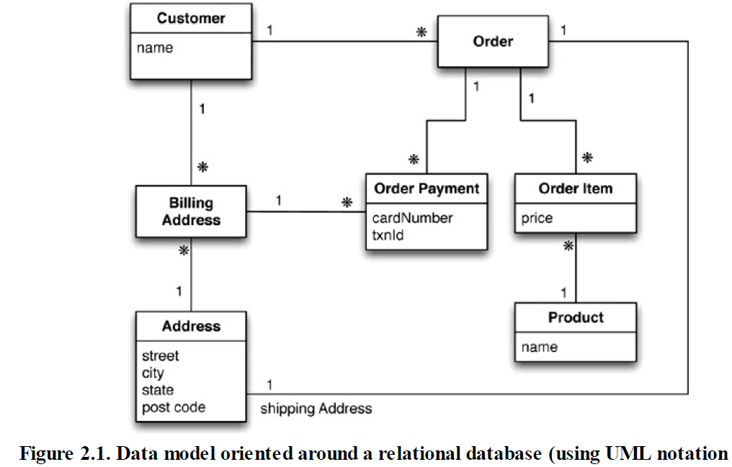
Examples for Data Models

Slide 18
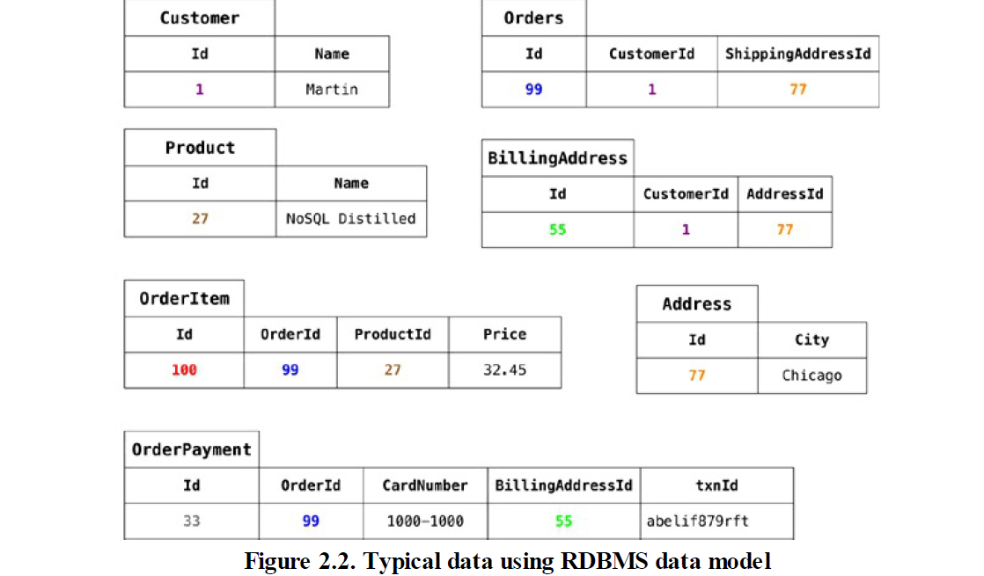

Slide 19
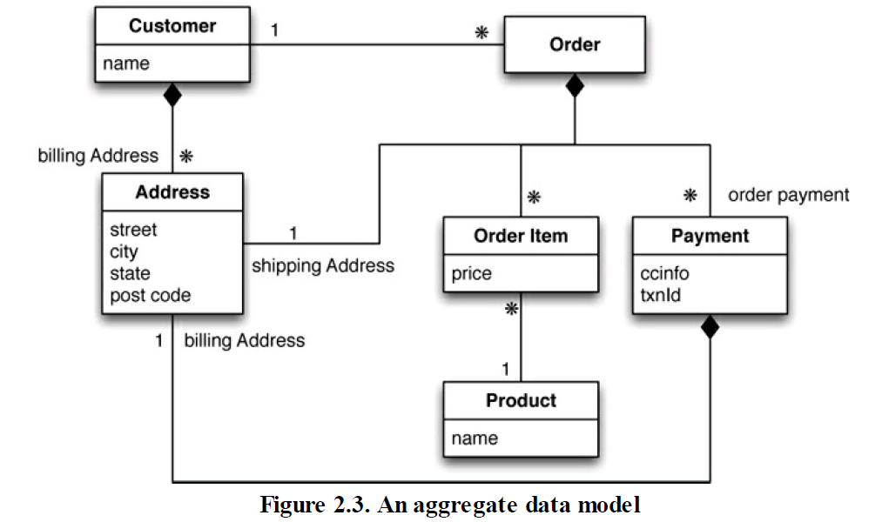

Slide 20
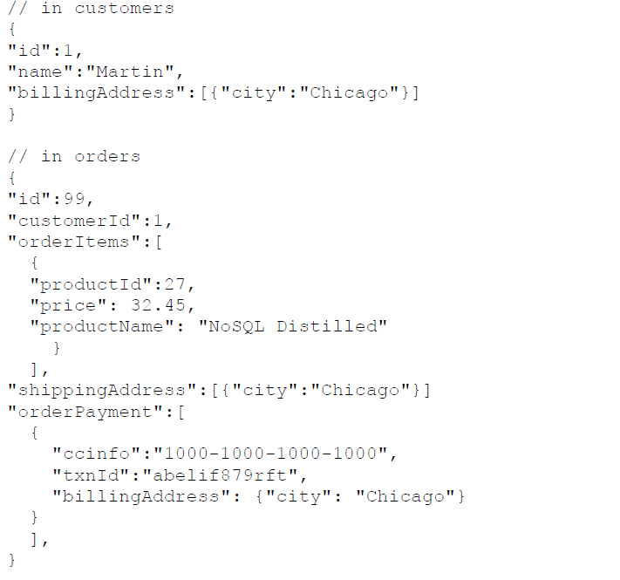

Slide 21
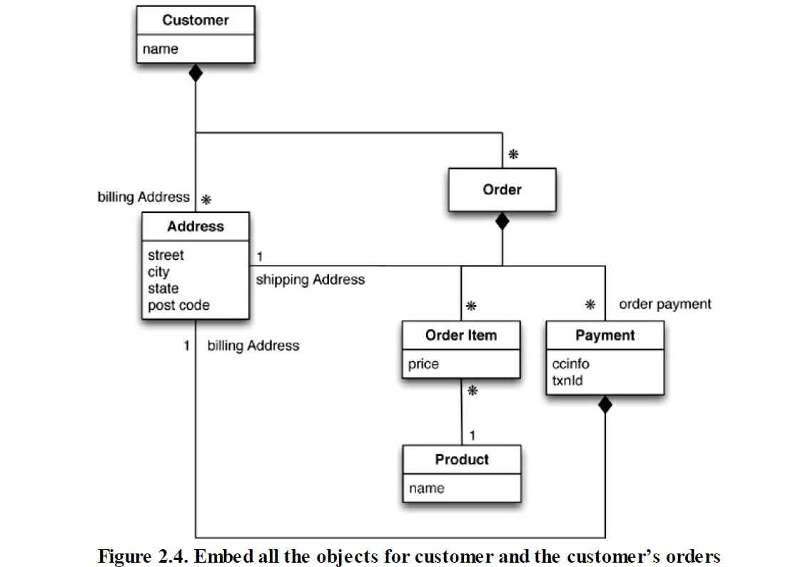

Slide 22
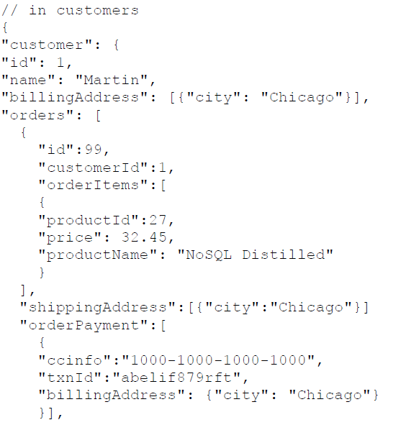


Slide 23
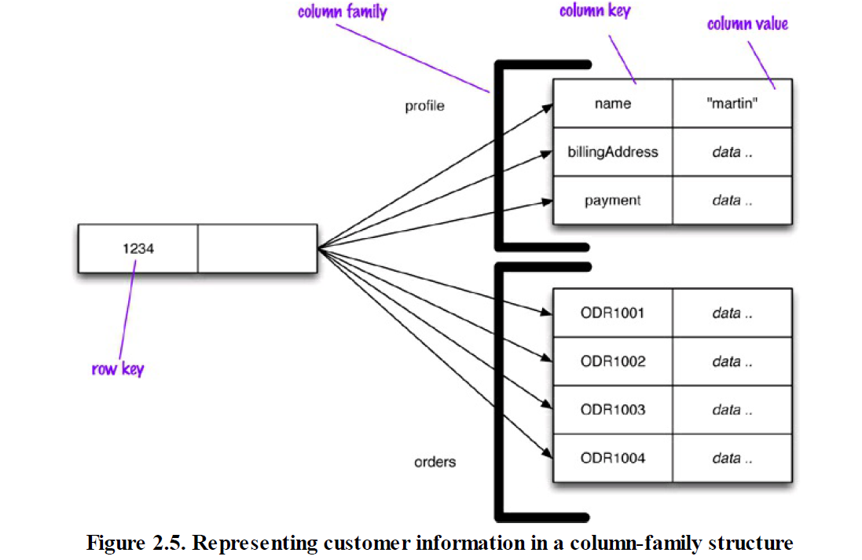

Slide 24
Query Model
Document Database
  provides the ability to query on any field within a document
  provides the ability to analyze data in place (like sql group by)
  Regarding updates, some of them provide find and modify capabilities so that values in documents can be updated in a single statement

Slide 25
Graph Database
  These systems tend to provide rich query models where simple and complex relationships can be interrogated to make direct and indirect inferences about the data in the system.
  Relationship-type analysis tends to be very efficient in these systems, whereas other types of analysis may be less optimal.

Slide 26
Key Value and Wide Column databases
  These systems provide the ability to retrieve and update data based only on a primary key.
  Some products provide limited support for secondary indexes
  To perform an update in these systems, two round trips may be necessary: first find the record, then update it.
  In the systems, the update may be implemented as a complete rewrite of the record whether a few bytes have changed or the entire record.

Slide 27
Consistency Model
NoSQL systems typically maintain multiple copies of the data for availability and scalability purposes
Consistent Systems: writes by the application are immediately visible in subsequent queries
Eventually Consistent Systems: Writes are not immediately visible.
Most applications and development teams expect consistent systems.
Different consistency models pose different trade-offs for applications in the areas of consistency and availability.
Eventually consistent systems provide some advantages for writes at the cost of making reads and updates more complex.

Slide 28
APIs
There is no standard for interfacing with NoSQL systems.
The maturity of the API can have major implications for the time and cost required to develop and maintain the underlying NoSQL system.
Idiomatic drivers minimize onboarding time for new developers and simplify application development.

Slide 29
Commercial Support and Community Strength
Choosing a database is a major investment and difficult to change
No standard and too many systems in the market
Need to find the best fit for the needs
Support is an important part of evaluating NoSQL products

Slide 30
MongoDB
Demo

Slide 31
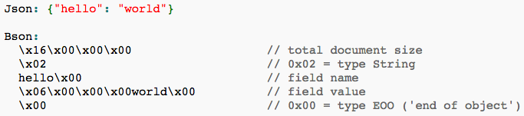
MongoDB File Storage
MongoDB uses BSON format to store files.
BSON is short for Binary JSON
MongoDB deals with 4MB files so BSON files are chunked into 4MB files using GridFS.

Slide 32
References
http://www.mongodb.com/nosql-explained
http://docs.mongodb.org/manual/tutorial/getting-started/
http://nosql-database.org/
http://db-engines.com/en/ranking
http://nosqlguide.com/column-store/nosql-databases-explained-wide-column-stores/
http://bi-bigdata.com/2013/01/13/what-is-wide-column-stores/
http://news.dice.com/2012/07/16/sql-vs-nosql-which-is-better/
http://dataconomy.com/sql-vs-nosql-need-know/
http://www.thoughtworks.com/insights/blog/nosql-databases-overview
http://www.tutorialspoint.com/data_mining/dm_cluster_analysis.htm
http://www.brentozar.com/archive/2011/02/scaling-up-or-scaling-out/
http://planetcassandra.org/what-is-nosql/#nosql-database-types
http://www.sas.com/en_us/insights/big-data/what-is-big-data.html
https://www.digitalocean.com/community/tutorials/understanding-sql-and-nosql-databases-and-different-database-models
http://www.webopedia.com/quick_ref/important-big-data-facts-for-it-professionals.html
https://blog.udemy.com/nosql-vs-sql-2/
http://www.thegeekstuff.com/2014/01/sql-vs-nosql-db/
http://www.couchbase.com/nosql-resources/what-is-no-sql
http://www.w3schools.com/json/json_intro.asp

Slide 33
Thanks for Listening

