Slide 1
Node.js | GO
CSE 775 – Distributed Objects
Submitted by: Arpit Kothari

Slide 2
I/O Need to be done differently

Slide 3
I/O Cycles
I/0 LATENCY :
          L1 : 3 Cycles
          L2 : 14 Cycles
          RAM : 250 Cycles
          Disk : 41,000,000 Cycles
          NETWORK : 240,000,000 Cycles

Slide 4
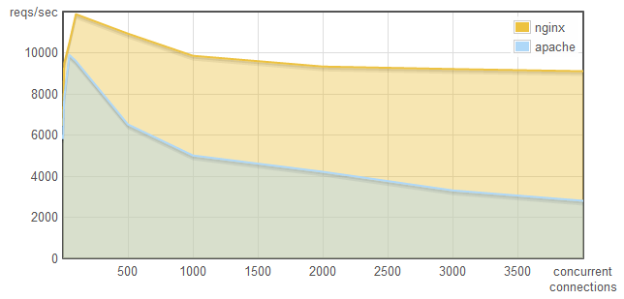
Concurrency (A Comparison)

Slide 5
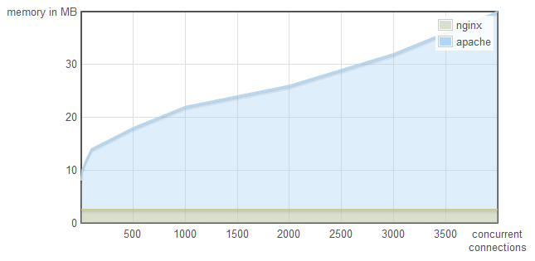
Concurrency (A Comparison)

Slide 6
Concurrency (continued)
  “BETTER SOFTWARES CAN MULTITASK”
  Q1. ) Is threading the only way?
  Q2. ) What is NGINX doing differently?

Slide 7
Concurrency (continued)
  “BETTER SOFTWARES CAN MULTITASK”
  Q1. ) Is threading the only way?
  - Context switching is not free
  - Each thread needs memory

Slide 8
Concurrency (continued)
  “BETTER SOFTWARES CAN MULTITASK”
  Q1. ) Is threading the only way?
  - Context switching is not free
  - Each thread needs memory
  Q2. ) What is NGINX doing differently?
  - Single thread & Event Loop

Slide 9
Node works on single thread Event loop with a “Non-Blocking I/O”

Slide 10
Understanding Node
Can Build Scalable “Network” Applications using JavaScript on “Server”-side
Fast processing – written in C
Structure :
Node.JS
Google Chrome V8 JavaScript Runtime

Slide 11
Understanding Node
What its not !
  Its not a web framework
  Its not a multi-thread Application
What it is
  It is a low level communication network
  Single threaded Application
  Works with a non-blocking code (why ?)

Slide 12
Simple Blocking/ Non-Blocking
Blocking :
  var contents= fs.readFileSync (‘filePath’);
  console.log(contents);
  console.log(“Hmm…This takes time”);
Non-Blocking :
  fs.readFile(‘filePath’,function(err,contents){
  console.log(contents);
  });
  console.log(“hey..i can be executed before!”);
  Question :
  What happens with two Files ?

Slide 13
The Event Loop
// This is why JavaScript is used
var http=require (‘http’);
http.createServer(function(request,response) {
……………
}).listen(8080);
EVENT LOOP
KNOWN EVENTS
Request

Slide 14
Event Loop Continued
EVENT LOOP
KNOWN EVENTS
Request
EVENTS QUEUE
Connection
Close
Close
Request

Slide 15
What if it was blocking code ?

Slide 16
Node.js Events

Slide 17
Events In Detail
Imagine DOM (Document Object model)
  Triggers events (we can listen to those events and work on them eg. With jQuery!)
Objects in Nodes also emit events, which inherit from the Event Emitter Constructor
net Server
Request Event
EventEmitter
FileRead
Data Event
EventEmitter

Slide 18

Example
createServer Event :
How does it attach to the event emitter ?
  http://nodejs.org/api/http.html

Slide 19
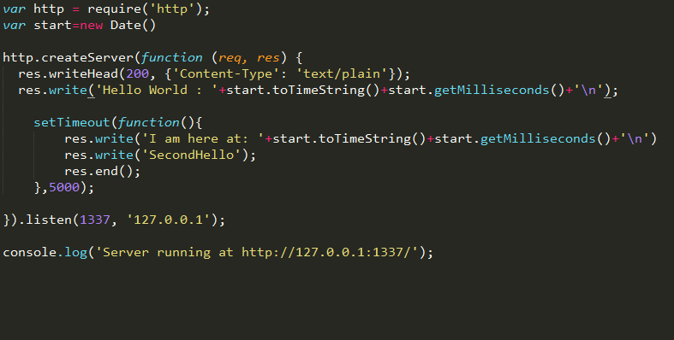
Node Examples
RUN

Slide 20
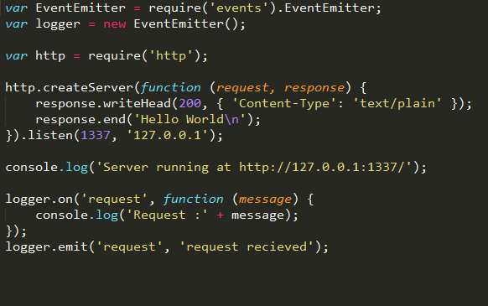
Node Examples
RUN

Slide 21
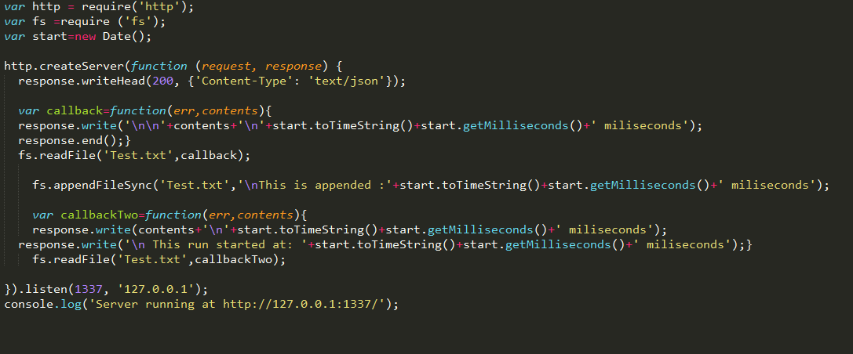
Node Examples
RUN

Slide 22
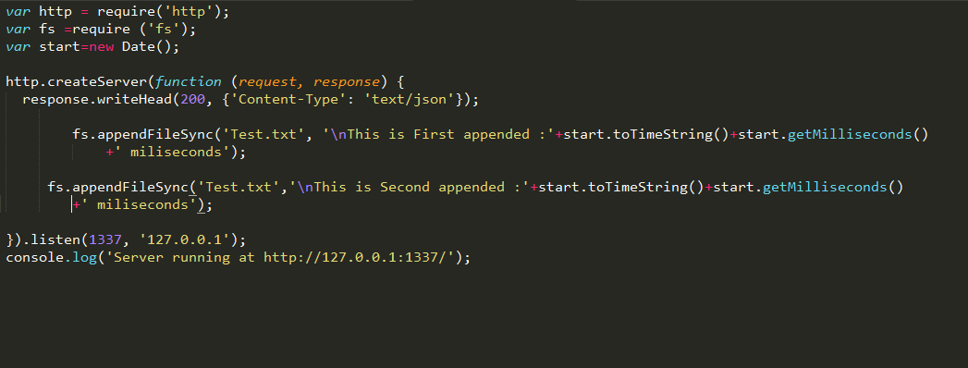
Node Examples
RUN

Slide 23

Go Language
______________________________
______________________________

Slide 24
GO
Go is an open source programming language that makes it easy to build simple, reliable, and efficient software.
Go is a “Concurrent” language not “Parallel” language
Concurrent Programming is structuring the program to deal with the real world problems.
Concurrent Programming : composition of independently executing computations

Slide 25
A Simple Go Program
package main
import "fmt"
func main() {
fmt.Printf("hello, world\n")
fmt.Printf("This works")
}
RUN

Slide 26
Concurrency in GO
GO Routines
Channels
Select

Slide 27
GO ROUTINES

Slide 28
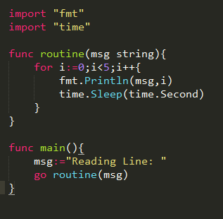
Go Routines
RUN
Independently Executing Functions
It has its own call stack
Very cheap thread

Slide 29
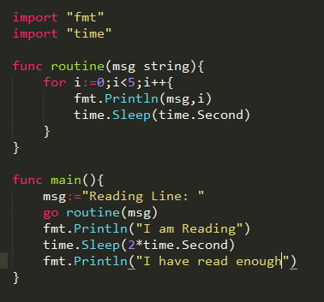
Go Routines (continued)
RUN
Independently Executing Functions
It has its own call stack
Very cheap thread

Slide 30
CHANNELS

Slide 31
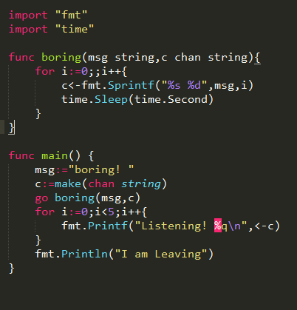
Go Channels
A Channel in GO provides a connection between two go routines, allowing them to communicate
It is a Synchronization operation
Buffer Channels
RUN

Slide 32
“Don’t communicate by sharing memory, Share memory by communicating”

Slide 33
SELECT

Slide 34
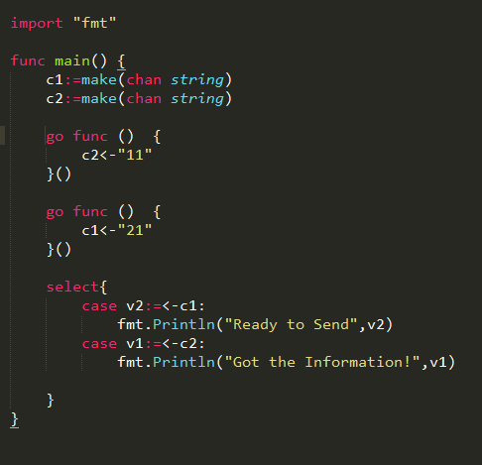
Go Select
It is a control structure that allows you control the behavior of a program
RUN

Slide 35
My Final Project
Remote Document Vault
  Front end Go and Back end Node.js
Compare performance of back end Go | Node.js (REST api)| WCF
Stress Test the back end server
View my project works : https://github.com/Dhappi/NodeWebService

Slide 36
References
Node.js official document - http://nodejs.org/
Express official document - http://expressjs.com/
Go official document - https://golang.org/

Slide 37
Thank You
www.bugzio.com

