Slide 1
Dependency GRAPH ANALYZER
Aabid Ali Mohammed

Slide 2


Server
User Role
WCF Service
Access/ Retrieve / Modify Repository
Document Repository
Root
Sub Folder

Slide 3
Client
Server
Get / Update Dependencies
Client
File 1
Node ➔ File
Dependency
Cyclic
Dependency
File 2
File 3

Slide 4
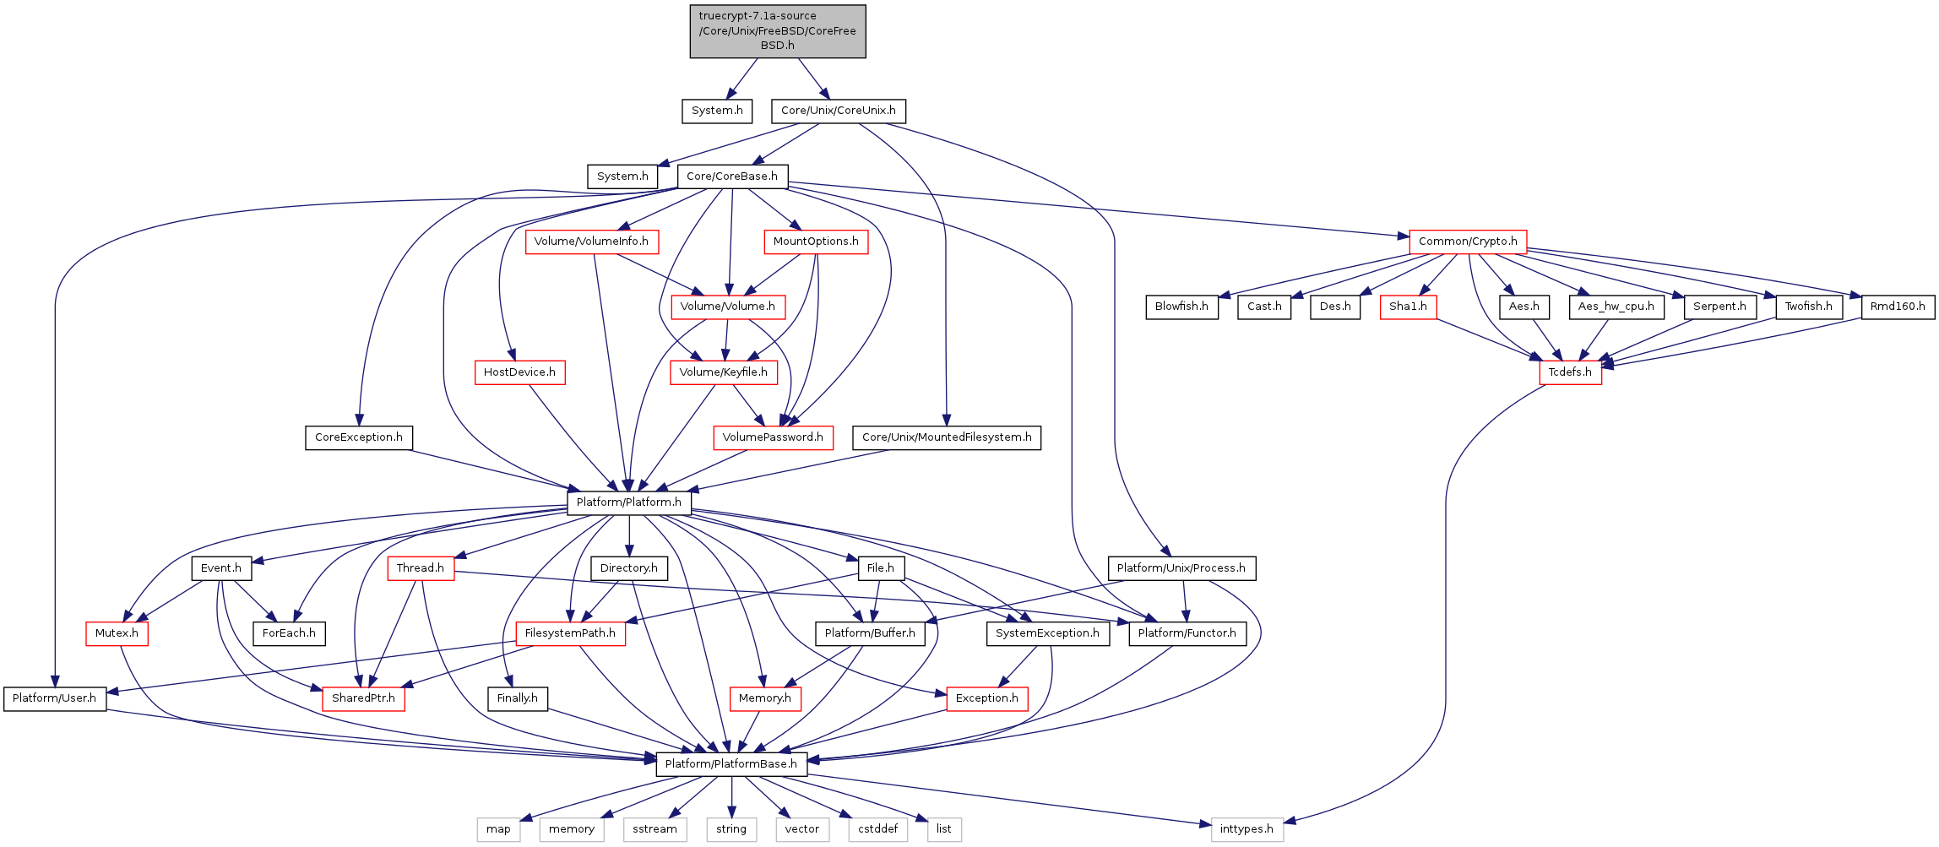
Example

Slide 5
Technologies Used
Server :
C#
WCF
XML
Client :
C++
OpenGL

Slide 6

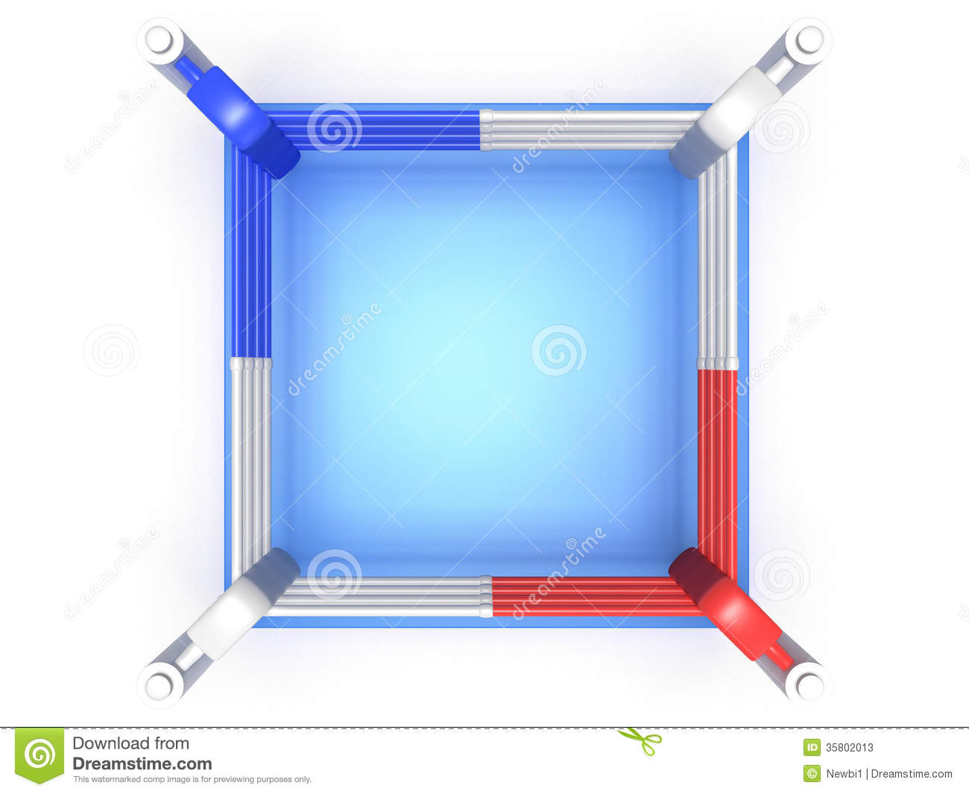



OpenGL VS DirectX VS XNA – FIGHT !!!!!

Slide 7






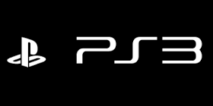
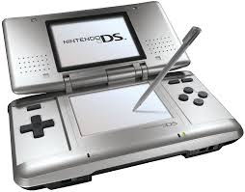
Why Did OpenGL Win ?
OpenGL – ES ( Embedded Systems)

Slide 8
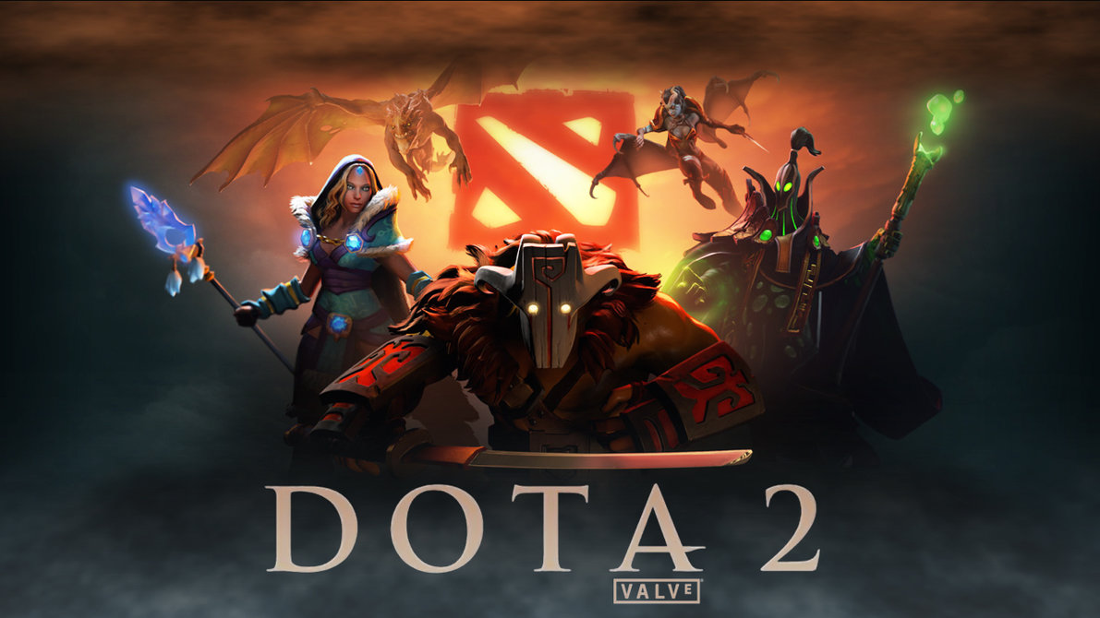


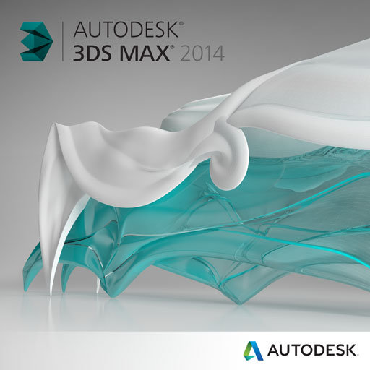

Show Case

Slide 9
What is Open GL?
OpenGL stands for Open Graphics Library. It is a specification of an API for rendering 2D and 3D graphics.
It is a cross – language , multi platform application programming interface.
OpenGL implementations are libraries that implement the API defined by the specification and are usually present in the graphics cards.
OpenGL API only deals with rendering graphics. OpenGL does not provide functions for animations, timing, file IO, image file format processing GUI etc.

Slide 10
How can I use it ?
To run OpenGL applications -
Windows – Ensure you have graphics card drivers installed since most of them define and use their own implementations of the openGL specification for efficiency. There is a default library defined in the OpenGL32.dll under system folder
Mac – Ships with xCode development. Also updating your OS lets you get the latest version of OpenGL enabling you to run graphical applications.
Linux – Mesa 3d graphics library provides an OpenGL implementation for linux.
To Develop :
Choose your programming language. I chose C++
Write or install appropriate windowing toolkits. I chose Glut
You can use IDE such as Xcode , Visual Studio

Slide 11
What is Glut ?
GLUT is the OpenGL Utility Toolkit, a window system independent toolkit (Cross platform again wooohooo) for writing OpenGL programs. It implements a simple windowing application programming interface (API) for OpenGL.
It offers:
Multiple windows for OpenGL rendering
Callback driven event processing
Support for input devices
An 'idle' routine and timers
A simple, cascading pop-up menu facility
Utility routines to generate various solid and wire frame objects
Support for bitmap and stroke fonts
Miscellaneous window management functions

Slide 12
Callbacks
-> Window ( Resize, Visibility) -> Menu (Menu selection) -> Input (Mouse / KB)
-> Global (Idle function / timers)
void glutMainLoop() {
while (true) {
if (content of the window has changed)
call display callback function
if (keyboard or mouse event)
call input callback function
if (nothing has to be done)
call idle call back function
// ...
}
}
void myMouseMotionEventHandler(int x, int y) {
// your code
}
int main (...) {
// ...
glutMotionFunc(myMouseMotionEventHandler); // register function
glutMainLoop(); //enters event processing loop
return 0;
}

Slide 13
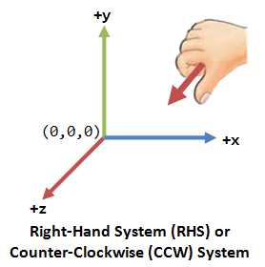
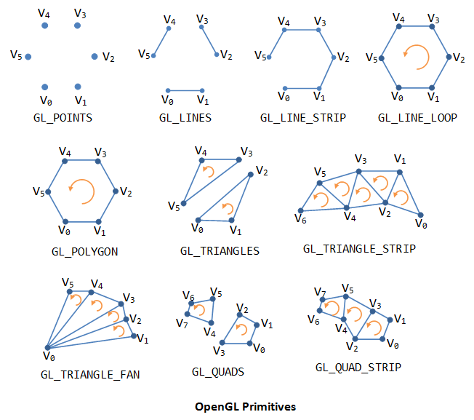
Enough glut !!! More OpenGL
Co-ordinate Systems and primitives.
Three main primitive classes :
Points
Lines
Polygons
Lets draw a triangle :
glBegin(GL_TRIANGLES); // Begin drawing a primitive
glColor3f(0.1, 0.2, 0.3); // glColor3f(R, G ,B) color values;
glVertex3f(0, 0, 0); // glVertex3f(X, Y, Z) co-ordinate values;
glVertex3f(1, 0, 0);
glVertex3f(0, 1, 0);
glEnd();

Slide 14
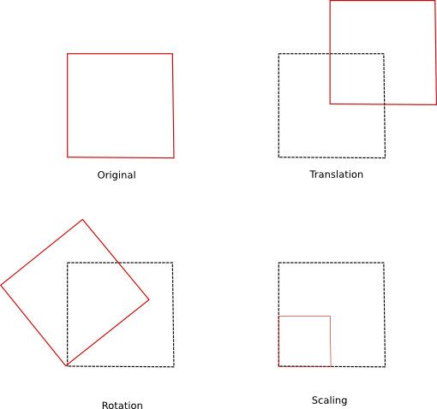
Matrices in OpenGL
Model Matrix
Objects in OpenGL are positioned using their x,y,z vertices.
The model matrix represents all transformations that can be applicable to the currently drawn scene.
By performing geometric transformations on this matrix, we can move , rotate and scale the objects in the scene.
Translation – glTranslate/glTranslatef(x,y,z) Translates the object by the specified x,y,z distances.
Rotation – glRotate/glRotatef(angle,x,y,z) Rotates the object by the specified object by angle degrees about a vector specified by x,y,z.
Scaling – glScaled/glScalef(x,y,z) Scales the object according to values specified in x,y,z . A value of 1 implies original size or (100%)
All these transformations are done based on matrix multiplication. Important thing to note here is that when matrix multiplication is concerned , A x B != B x A i.e it is not commutative.

Slide 15
Matrix Stacks
OpenGL is a finite state machine, as it has a predetermined and countable number of different states. It stays in its current state until it receives messages to change.
Using OpenGL matrix stack functions, you can ‘save’ and ‘load’ previous matrices.
glPushMatrix() copies the top of the stack, so directly after a push the top two entries of the stack are identical, equating to a ‘save and continue.’
glPopMatrix() would be the equivalent of ‘load’. This gets rid of the top matrix in the stack, and sets the matrix underneath it as the new current matrix.
Example :
glTranslatef(x,y,z); // 1) position for drawing torso
DrawTorso(); // 2) draw torso
glPushMatrix(); // 3) save torso matrix
glTranslatef(x,y,z); // 4) position for drawing arm
DrawArm(); // 5) draw arm
glPushMatrix(); // 6) save arm matrix
glTranslatef(x,y,z); // 7) position for drawing hand
DrawHand(); // 8) draw hand
glPushMatrix(); // 9) save hand matrix
glTranslatef(x,y,z); // 10) position for drawing first finger
DrawFinger(); // 11) draw first finger
glPopMatrix(); // 12) load hand matrix
glPushMatrix(); // 13) save hand matrix again
glTranslatef(x,y,z); // 14) position for drawing second finger
DrawFinger(); // 15) draw second finger
glPopMatrix(); // 16) load hand matrix
glPushMatrix(); // 17) save hand matrix again
glTranslatef(x,y,z); // 18) position for drawing third finger
DrawFinger(); // 19) draw third finger
glPopMatrix(); // 20) load hand matrix
glPopMatrix(); // 21) load arm matrix
glPopMatrix(); // 22) load torso matrix

Slide 16
State Machine
OpenGL allows modifications to its state and preserves it till any changes are made .
A variety of state changes take place using the following :
glEnable(Glenum cap);
glDisable(Glenum cap);
Examples of features which can be turned on and off are Lighting, Textures, Fog etc.
Also changes to other features such as color to draw in , point size also apply globally and remain the same unless changed.

Slide 17
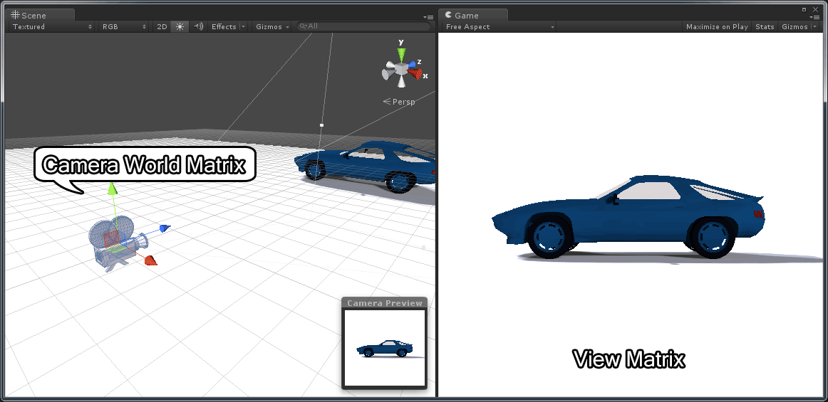
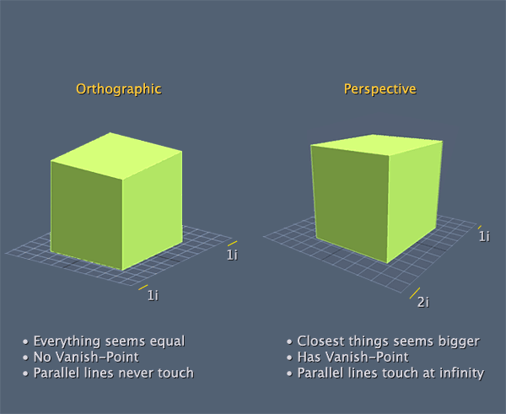
View and Projection Matrix
View Matrix
View matrix helps control how we can look at the screen.
Modified by calling void gluLookAt(eyeX, eyeY, eyeZ, centerX, centerY, centerZ, upX, upY,)
Projection Matrix
A 2D/3D scene rendered by OpenGL must be projected onto the computer screen as a 2D image. The Projection matrix is used for this projection transformation.
Projection Modes :
Orthographic - glOrtho(left,right,bottom,top,near,far);
Perspective - gluPerspective(fovy,aspect,zNear,zFar);
Frustum – Similar to ortho in specification.

Slide 18
Tasks
Server :
Create a server offering operations on the document repository
Implement WCF service to do the following operations :
Validate users .
Upload /Delete files in repository.
Get dependency information .
Update Dependency information.

Slide 19
Tasks - Continued
Client :
Create a C++ client which communicates with the WCF service to get/update repository
Interfacing with WCF :
Rest - Casablanca library by Microsoft is a C++ Rest SDK.
SOAP - gSoap for c++.
Windows Web Services API.
C++ Wrapper class

Slide 20
Tasks – The last few
Client
Build graph based on dependency information from wcf.
Route the graph using Dijkstras algorithm used in Link state routing.
Draw the graph using OpenGL primitives in C++ . 2D / 3D or both ? .
Allow operations such as remove dependency / add dependency on files owned by user.
Update the server with latest dependencies.
Allow user to move graph nodes to prevent clustering .

Slide 21

Task Distribution

Slide 22
References and Useful Links
Vulkan - https://www.khronos.org/vulkan
OpenGL – What is it and where to download https://www.opengl.org/wiki/FAQ
OpenGL – Red Book (Online) - http://www.glprogramming.com/red/
OpenGL – (3D Engine) - http://www.ntu.edu.sg/home/ehchua/programming/opengl/cg_basicstheory.html
Wikibook - http://en.wikibooks.org/wiki/Category:OpenGL_Programming
Glut - https://www.opengl.org/resources/libraries/glut/
Matrices - http://content.gpwiki.org/index.php/OpenGL:Tutorials:Theory
Tutorials :
http://www.opengl-tutorial.org/
http://nehe.gamedev.net/

