Slide 1
Interactive Big-Data Visualization
Lu Han
Zilong Jiao
Zhi Xing

Slide 2
Outline
Project Overview
Twitter APIs
Redis Database
OpenCV Library
Cinder Library
Task Assignments

Slide 3
Overview
Data science plays an important role in big-data era
Visualization is a crucial part of data science
Some challenges in data visualization
- overview vs. details
- data interactions
- intuition & attraction

Slide 4




Data Buffer/Storage
Twitter APIs
Interactive Rendering
Machine Learning Algorithm

Slide 5
Twitter APIs
REST APIs
- Provide programmatic access to read and write Twitter data.
- e.g. post Tweets, read profile and follower data.
Streaming APIs
- continuously deliver new responses over a long-lived HTTP connection.
- e.g. get latest Tweets matching a search query.
OAuth identification for applications and users
JSON-format responses
Rate limit for requests

Slide 6
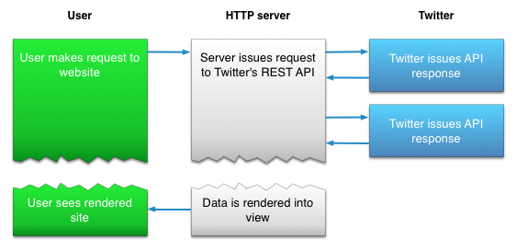
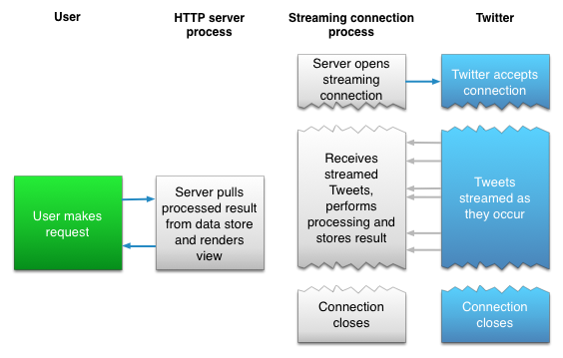
REST
Streaming

Slide 7
Twitter APIs
Example request (REST APIs)
GET
https://api.twitter.com/1.1/trends/closest.json?lat=37.781157&long=-122.400612831116
Example result
[
{
"country": "Australia",
"countryCode": "AU",
"name": "Australia",
"parentid": 1,
"placeType": {
"code": 12,
"name": "Country"
},
"url": "http://where.yahooapis.com/v1/place/23424748",
"woeid": 23424748
}
]

Slide 8
Twitter APIs
Example requests (Streaming APIs)
GET
https://stream.twitter.com/1.1/statuses/sample.json
POST
https://stream.twitter.com/1.1/statuses/filter.json?track=twitter
Twitcurl
- a C++ library for Twitter APIs
- uses cURL for HTTP requests and responses

Slide 9
Data Buffer/Storage
Twitter APIs
Interactive Rendering
Machine Learning Algorithm

Slide 10
Redis
Redis Example:
#include <stdio.h>
#include "credis.h"
int main(int argc, char **argv)
{
REDIS rh;
char *val;
/* create handle to a Redis server running on localhost, port 6789, with a 2 second response timeout */
rh = credis_connect(NULL, 6789, 2000);
/* ping server */
credis_ping(rh);
/* set value of key "kalle" to "kula" */
credis_set(rh, "kalle", "kula");
/* get value of key "kalle" */
credis_get(rh, "kalle", &val);
printf("get kalle returned: %s\n", val);
/* close connection to redis server */
credis_close(rh);
return 0;
}
In memory database implemented by C with key-value mechanism
- often referred as “data structure sever”
Support query as set, list, or hash
- list: a list of values associated to a given key
- set: a list of distinct values associated to a given key
- hash: dictionary, a group of key-value pairs

Slide 11
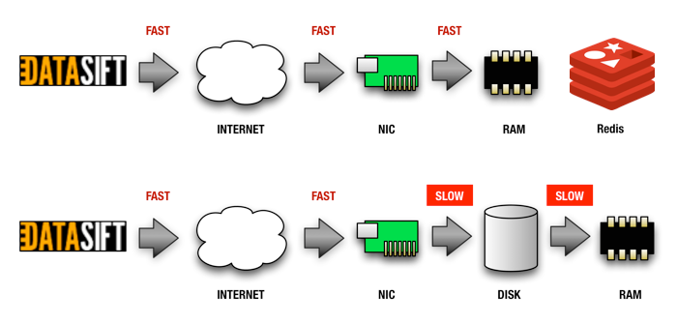
Pros & Cons
Without considering durability, Redis works blazing fast
- directly accesses data from memory without disk I/O
Persistency Issue
- data only exist as long as database is running
- data may be lost when system crashes

Slide 12
Persistency Solution
RDB: periodically write dataset within corresponding time interval back to disk
- Database still runs fast
- RDB file is independent from Redis, and it can be moved while Redis is running
- Last-minute dataset may be lost, when system crashes
AOF: log commands, which has been performed
- Synchronization time can be set as every second, every query, no synchronization
- Every-query synchronization makes Redis’ response slow
- Log file is larger than RDB file for some Redis database instances
RDB & AOF: After system crashes, original dataset can be reconstructed from RDB file according to the AOF log

Slide 13
Why Redis
Redis can perform as a buffer for Big Data
- Big-Data property: high volume, high velocity, high variety
- Redis can output more stable data stream
Redis is suitable for real-time query

Slide 14
Data Buffer/Storage
Twitter APIs
Interactive Rendering
Machine Learning Algorithm

Slide 15
OpenCV
A infrastructure library developed by Intel for real-time computer vision
- contains full set of general purpose machine learning functionalities for data processing and analysis
Implemented in CUDA (extended C) and runs on Intel processor
- accelerated by GPU
- supports parallel computing on multicore intel processor

Slide 16
Why OpenCV
We are simulating realtime data stream visualization in our project, so data processing should be done in real-time
Since Redis runs on CPU, processing data on GPU can greatly relieve the computation pressure of CPU and increase the overall performance of the system
- CPU still needs to transfer the data from main memory to video memory

Slide 17
Data Buffer/Storage
Twitter APIs
Interactive Rendering
Machine Learning Algorithm

Slide 18
What is it?

Slide 19
What is it?
Community-developed, free and open source library for professional-quality creative coding in C++
Programming graphics, audio, video, networking, image processing and computational geometry.

Slide 20

What is it?

Slide 21
What does Cinder have?

Slide 22
What does Cinder have?
Platform Core
      Full I/O Abstraction, C++ Core, iOS Support,
      UI Events, MultiTouch, XML Dom Parser
2D & 3D Graphics
      OpenGL Classes, GUI Parameters
Mathematics
      Math Primitives, Utilities
Media
      Video Capture, Full-featured QuickTime, Audio Support

Slide 23
Basic Example

Slide 24
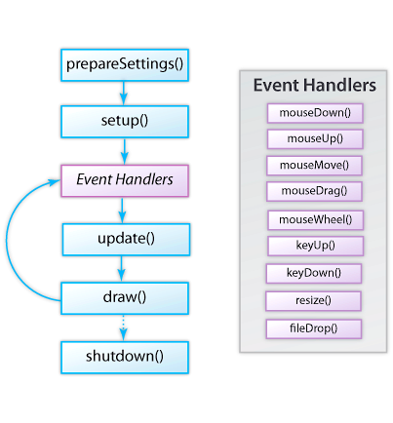
Basic Example
prepareSettings()
    void PreApp::prepareSettings( Settings *settings )
    {
      settings->setWindowSize( 800, 600 );
      settings->setFrameRate( 60.0f );
    }
setup()
    void PreApp::setup()
    {
      Url url( "http://libcinder.org/media/tutorial/paris.jpg" );
      mImage = gl::Texture( loadImage( loadUrl( url ) ) );
    }

Slide 25
Basic Example
update()
    void PreApp::update()
    {
      mLoc += mDir * mVel;
    }
draw()
    void PreApp::draw()
    {
      gl::drawSolidCircle( mLoc, mRadius );
    }
shutdown()
    void PreApp::shutDown()
    {
      XmlTree doc = XmlTree::createDoc();
      XmlTree settings = XmlTree( "Settings", "" );
    doc.push_back( settings );
      doc.write( writeFile( "Settings.xml" ) );
    }

Slide 26
Zhi Xing
Lu Han
ALL!
Zilong Jiao

Slide 27
References
Twitter APIs: https://dev.twitter.com/overview/documentation
Twitter Libraries: https://dev.twitter.com/overview/api/twitter-libraries
Twitcurl: https://code.google.com/p/twitcurl/
Redis code example: https://code.google.com/p/credis/wiki/Examples
Real time computer vision with OpenCV by Kari Pulli, Anatoly Baksheev, Krill Kornyakov, and Victor Eruhimov
Learning OpenCV by Gary Bradski and Adrian Kaehler
Redis: Zero to Master in 30 minutes: http://openmymind.net/2011/11/8/Redis-Zero-To-Master-In-30-Minutes-Part-1/
Redis basic: http://try.redis.io/
Cinder Introduction: http://libcinder.org/
Cinder video: https://vimeo.com/68615444
Cinder basic: Cinder Creative Coding Cookbook

Slide 28
Q & A

