Slide 1
Design Strategies
CSE687 – Object Oriented Design Class Notes
Jim Fawcett
CSE687 – Object Oriented Design
Spring 2015

Slide 2
Strategies
Top down design
  Task oriented decomposition
  Uses successive refinement to define lower layers
Bottoms up design
  Focus on encapsulating an abstraction
  Provides a language for higher layers to use.
Object oriented design
  Partitions program activities into object interactions
  Defines objects as members of families using inheritance and composition.

Slide 3
Classical Structure Chart
The terms “Top Down” and “Bottoms Up” refer to the classical form of a structure chart.
  This form puts logical, executive, processing at the top and low level, physical, processing on the bottom.
  The classical form puts inputs on the left side and outputs on the right, leading to terms like left-to-right design and right-to-left design.
  Left-to-right design focuses on program input
  Right-to-left design is concerned with program output.

Slide 4
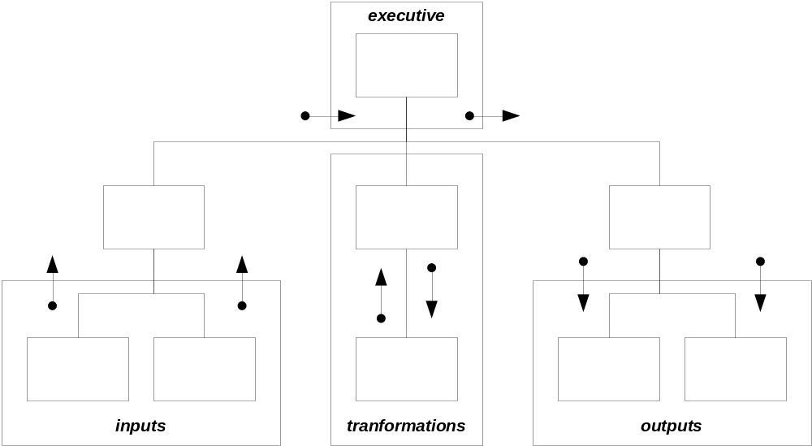
Classical Structure Chart

Slide 5
Top Down Design
Make task list
Decompose tasks into packages
  Executive interfaces and servers
Proceed from top-level logical model to lower-level, more physical models
  Process of successive refinement
  Only effective for a very few layers

Slide 6
Top Down Design
Advantages:
  Focus on satisfying requirements.
  Doesn’t invent things not needed for this project
Disadvantages:
  Generates non-reusable parts
  Makes tightly coupled structure

Slide 7
Bottoms Up Design
Identify useful data structures and operations.
Encapsulate and provide operations to manage them.
Essentially the same process for either packages or classes.
Usually start by specifying the package, then populating with classes.

Slide 8
Bottoms Up Design
Advantages:
  Makes reusable parts.
  Abstractions you develop here makes higher level implementation much easier.
Disadvantages:
  May invent a lot of function-ality not needed for the project.
  Starting with bottoms up design often leads to poorly structured over-all design.

Slide 9
Object Oriented Design
Partitions project activities into interactions of class objects.
Defines families of classes and their relationships:
  Using
  Aggregation
  Composition
  Inheritance
  Template based pluggability
Object Oriented Design is used during both top-down and bottoms-up design
  Top-Down: define class hierarchies
  Bottoms-Up: define each class’s implementation

Slide 10
OOD Strategies
Define an abstraction and encapsulate its implementation.
  Very often centers on encapsulating a data structure and managing its transformations
Layer implementation using composition.
Extend an abstraction through inheritance.
Loosely couple interacting objects using polymorphism.
  Between programs with late design binding.
  Within programs using run-time binding.

Slide 11
Binding
To bind is to associate a reference to an object or global function with a specific implementation:
  May statically bind by providing a name and type.
    Early design time – conventional class design
    Late design time – provide an application specific instantiation of a template-based class
  May dynamically bind at run-time by creating an object on the heap bound through a pointer or C++ reference.
    Pointers or C++ references are essential because we can provide names only at design time, not at run time.

Slide 12
Template Example
vector<T> is bound only when T is specified during the client’s design.
  This is late design time binding, e.g., after the design of the template class.
  The STL library provides the vector<T> container type, unbound to any specific type (early design time).
  Your design binds to a type, e.g., vector<int> vint;
  (late design time).

Slide 13
Inheritance Example
The catalog program uses an instance of the navig class that communicates through a base class, defProc, pointer to a derived class, userProc, object.
  The defProc class is an early design time artifact, developed before application requirements are known.
  The userProc class is a late design time artifact, developed when the application requirements are known.
  Explicit binding of userProc to navig occurs at run-time when executive registers userProc object with an instance of the navig class.

Slide 14
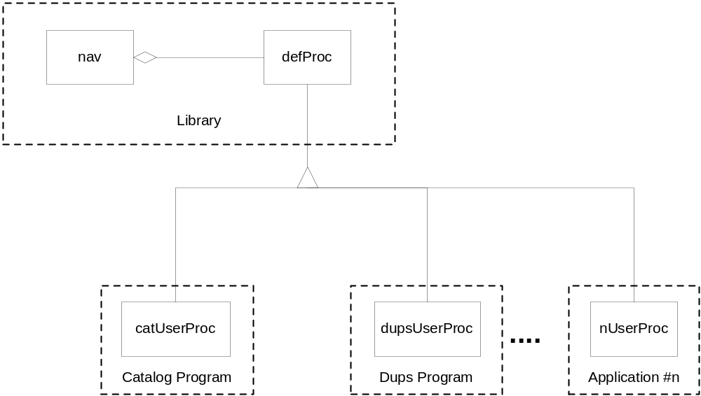
Inheritance Example

Slide 15
Inheritance Example
Note that in this example we have a relatively unusual situation:
  The library code makes calls into the application’s code.
  To do this with a reusable library component it is essential that binding is deferred until late design time, e.g., after the library is implemented.

Slide 16
Another Inheritance Example
The graphics editor example uses run-time binding to loosely couple a client from the implementation being used.
The drawlist client and all other clients of the graphicObj hierarchy use only the base class protocol provided by the graphicObj class to draw(), move(), or erase() derived objects.
Thus, drawlist and lots of other code in the editor are blissfully ignorant of the details that distinguish one derived class from another, e.g., a line from a box from a title, etc.
Only the tool palette needs to know the details that distinguish one derived class from another, in this case, simply because palette needs to create instances of specific classes to place on the editor’s drawlist.

Slide 17
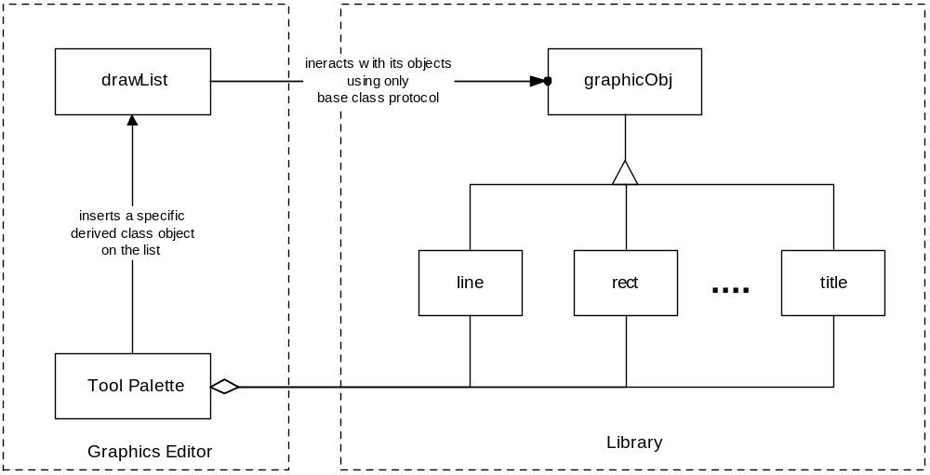
Graphics Editor Example

Slide 18
Graphics Editor Summary
The drawList, and almost all the other components in the Graphics Editor use the library though its base class protocol, so they have no compile dependencies on the library. Should we add another derived type, their designs do not break, nor do we even have to recompile them.
Very small parts of the Graphics Editor, like the Tool Palette, may need to know more, and bind more tightly, by using the specific names of the derived classes via a dynamic_cast operation. Such components will have design dependencies on the derived classes.
Note that the Tool Palette acts as an object factory for the other Graphics Editor components. It is, in fact, the use of protocol classes and object factories that result in compile independence between clients and the graphicObj hierarchy.

Slide 19
OOD Strategies Revisited
Encapsulate the implementation of an abstraction with a class.
Layer implementation using composition.
Extend an abstraction through inheritance.
Loosely couple interacting objects using polymorphism.
  Between programs with late design binding.
  Within programs using run-time binding.

Slide 20
OOD Strategies
Encapsulation and composition are essentially bottoms up design tools.
Using inheritance and polymorphism are not. They are something new and powerful, unique to OOD.

Slide 21
OOD Principles
We will discuss three principles that all focus on inheritance and late binding:
  Open/Closed Principle says that we should not modify objects, we extend them, as in the catalog program example.
  Liskov Subsitution Principle says that we must design class families so that derived objects have the syntax and semantics to be used wherever base class objects are expected.
  Dependency Inversion Principle says that we should separate large volatile partitions with abstract interfaces (which uses inheritance).

Slide 22
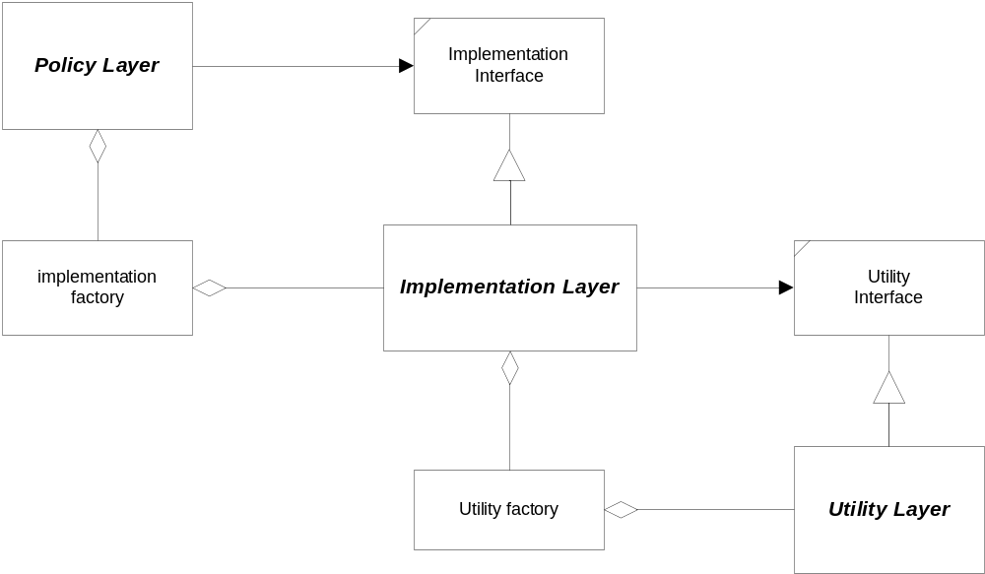
Breaking Dependency

Slide 23
Design Layers
It is very typical that the OOD strategies map in different ways onto the three layers shown on the previous slide.
  Top down design determines a policy layer and top-level partitions of the implementation layer – very little OOD at this level. Here we use modules to partition responsibilities.
  Classes and class relationships dominate the implementation layer. Polymorphism is an important tool to minimize coupling between components of this layer and with the utility layer.
  Class encapsulation of data and operating system services, using bottoms up design, determines the utility layer.

Slide 24
OOD Strategies Revisited
Encapsulate the implementation of an abstraction with a class.
Layer implementation using composition.
Extend an abstraction through inheritance.
Loosely couple interacting objects using polymorphism.
  Between programs with late design binding.
  Within programs using run-time binding.

Slide 25
Parting Comments
Try not to bind to things that change:
  Platform specific code
  Code in the midst of development
Early design (potential library) must try not to bind to late design (application specific details)
  Otherwise the early designs can never be reusable.
  Satisfying this rule without polymorphism or templates would force all reusable design to be bottoms up.

Slide 26
End of Presentation

