Slide 1
C++\CLI
.Net managed language with
C++ like syntax

Slide 2
References
C++/CLI
  A Design Rationale for C++/CLI, Herb Sutter, http://www.gotw.ca/publications/C++CLIRationale.pdf
  Moving C++ Applications to the Common Language Runtime, Kate Gregory, http://www.gregcons.com/KateBlog/CategoryView.aspx?category=C++#a7dfd6ea3-138a-404e-b3e9-55534ba84f22
Managed extensions
  C++/CLI in Action, Nishant Sivakumar, Manning, 2007

Slide 3
Why C++\CLI
C++\CLI interoperates with native C++ easily.
  You can even use C++\CLI code and native C++ code in the same source file.
C++\CLI compiles to MSIL, so C# code can interoperate with any C++\CLI code compiled as a dynamic link library.
These two characteristics of C++\CLI allow us to build a C++\CLI shim between an C# WPF application and native C++ code.
  That’s exactly what you will do in Projects #3 and #4.

Slide 4
Comparison of Object Models
Standard C++ Object Model
  All objects share a rich memory model:
    Static, stack, and heap
  Rich object life-time model:
    Static objects live for the duration of the program
    Objects on stack live within a scope defined by { and }
    Objects on heap live at the designer’s discretion
.Net Managed Object Model
  More Spartan memory model:
    Value types are stack-based only
    Reference types (all user-defined types and library types) live on the managed heap
  Non-deterministic life-time model:
    All reference types are garbage collected
    That’s the good news
    That’s the bad news

Slide 5
Comparison of Object Models (cont.)
Standard C++ Object Model
  Semantics based on deep copy model:
    That’s the good news.
    That’s the bad news.
  For compilation, a source file must include information about all the types it uses.
    That’s definitely bad news.
    But it has a work-around; e.g., design to interface not implementation. Use object factories.
.Net Managed Object Model
  Semantics based on a shallow reference model
  For compilation, a source file is type checked with metadata provided by the types it uses.
    That is great news.
    It is this property that makes .Net components so simple.

Slide 6
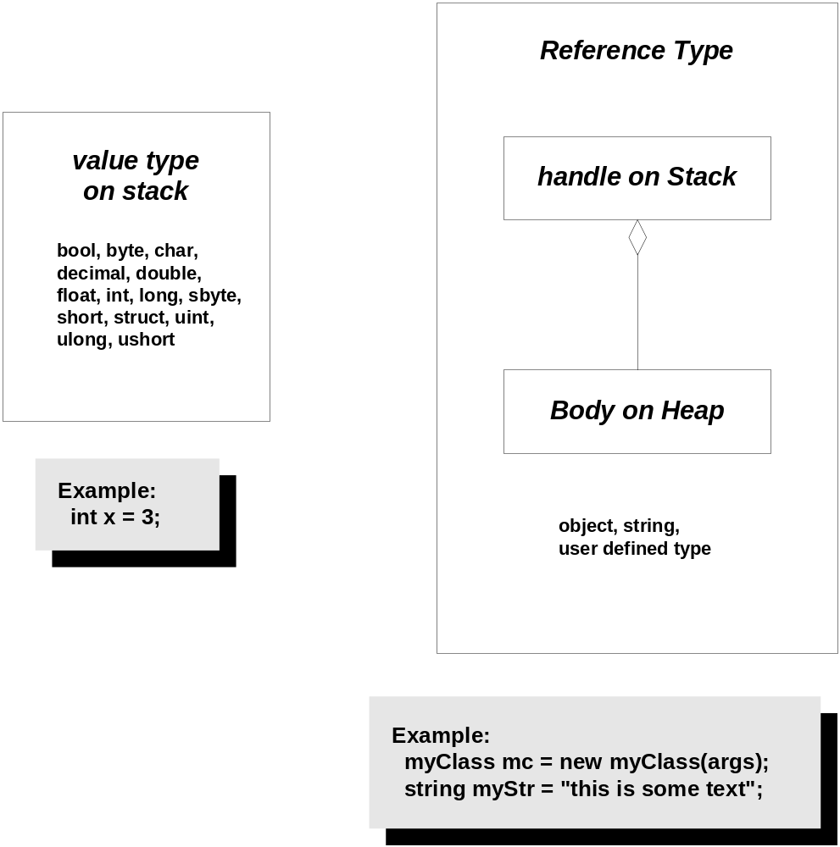
.Net Object Model

Slide 7
Language Comparison
Standard C++
  Is an ANSI and ISO standard
  Has a standard library
  Universally available
    Windows, UNIX, MAC
  Well known
    Large developer base
    Lots of books and articles
  Programming models supported:
    Objects
    Procedural
    Generic
.Net C#, Managed C++, …
  Is an ECMA standard, becoming an ISO standard
  Has defined an ECMA library
  Mono project porting to UNIX
  New, but gaining a lot of popularity
    Developer base growing quickly
    Lots of books and articles
  Programming models supported:
    Objects

Slide 8
Language Comparison (cont.)
Standard C++
  Separation of interface from implementation:
    Syntactically excellent
      Implementation is separate from class declaration
    Semantically poor
      See object model comparison
.Net C#, Managed C++, …
  Separation of interface from implementation:
    Syntactically poor
      Implementation forced in class declaration
    Semantically excellent
      See object model comparison

Slide 9
Library Comparison
Standard C++ Library
  Portable across most platforms with good standards conformance
  I/O support is stream-based
    Console, files, and strings
  Flexible container facility using Standard Template Library (STL)
    But no hash-table containers
  No support for paths and directories
.Net Framework Class Library
  Windows only but porting efforts underway
  I/O support is function-based
    Console and files
  Fixed set of containers that are not very type safe
    Has hash-table containers
  Strong support for paths and directories

Slide 10
Library Comparison (cont.)
  Standard C++ Library
  Strings, no regular expressions
  No support for threads
  No support for inter-process and distributed processing
  No support for XML
  Platform agnostic
  .Net Framework Class Library
  Strings and regular expressions
  Thread support
  Rich set of inter-process and distributed processing constructs
  Support for XML processing
  Deep support for Windows but very dependent on windows services like COM

Slide 11
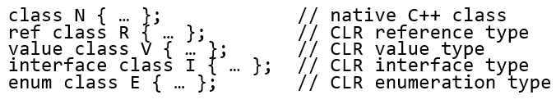
Managed Classes
Syntax:
  N is a standard C++ class. None of the rules have changed.
  R is a managed class of reference type. It lives on the managed heap and is referenced by a handle:
    R^ rh = gcnew R;
    delete rh; [optional: calls destructor which calls Dispose() to release unmanaged resources]

Slide 12
Managed Classes (cont.)
      Reference types may also be declared as local variables. They still live on the managed heap, but their destructors are called when the thread of execution leaves the local scope.
    V is a managed class of value type. It lives in its scope of declaration.
      Value types must be bit-wise copyable. They have no constructors, destructors, or virtual functions.
      Value types may be boxed to become objects on the managed heap.

Slide 13
Managed Classes (cont.)
  I is a managed interface. You do not declare its methods virtual. You qualify an implementing class’s methods with override (or new if you want to hide the interface’s method).
  E is a managed enumeration.
N can hold “values,” handles, and references to managed types.
N can hold values, handles, and references to value types.
N can call methods of managed types.
R can call global functions and members of unmanaged classes without marshaling.
R can hold a pointer to an unmanaged object but is responsible for creating it on the C++ heap and eventually destroying it.

Slide 14
Comparison of Library Functionality
Functionality | .Net Framework Libraries | Standard C++ Library
Extendable I/O | Weak | Strong
Strings | Strong | Strong
Composable Containers | Moderately good | Strong
Paths and Directories | Strong | No
Threads | Strong | Strong
Sockets | Moderately good | No
XML | Strong | No
Forms, WPF | Strong | No
Reflection | Strong | No

Slide 15
Comparison of Library Functionality
Functionality | Support Provided in Code from Website | Support Provided by You in Projects S’09
Extendable I/O | - | -
Strings | - | -
Composable Containers | HashTable | No
Paths and Directories | FileInfo, FileSystem | No
Threads | Thread, Lock classes | No
Sockets | SocketCommunicator | No
XML | Reader, Writer, no DOM | XMLDOM class
Forms | - | -
Reflection | No | No

Slide 16
Managed C++ Syntax
Include system dlls from the Global Assembly Cache (GAC):
  #include < System.Data.dll>
Include standard library modules in the usual way:
  #include <iostream>
Use scope resolution operator to define namespaces
  using namespace System::Text;
Declare .Net value types on stack
Declare .Net reference types as pointers to managed heap
  String^ str = gcnew String(”Hello World”);

Slide 17
From Kate Gregory’s Presentation
(see references)
 | Native | Managed
Pointer / Handle | * | ^
Reference | & | %
Allocate | new | gcnew
Free | delete | delete¹
Use Native Heap | ✓ | ✓²
Use Managed Heap | ✗ | ✓ 
Use Stack | ✓ | ✓
Verifiability | * and & never | ^ and % always
¹ Optional ² Value types only

Slide 18
Mixing Pointers and Arrays
Managed classes hold handles to reference types:
  ref class R 2{ … private: String^ rStr; };
Managed classes can also hold pointers to native types:
  ref class R1 { … private: std::string* pStr; };
Unmanaged classes can hold managed handles to managed types:
  class N { … private: gcroot<String^> rStr; };

Slide 19
Mixing Pointers and Arrays (cont.)
Using these handles and references, they can make calls on each other’s methods.
Managed arrays are declared like this:
  Array<String^>^ ssarr = gcnew array<String^>(5);
  ssarr[i] = String::Concat(“Number”, i.ToString()); 0<= i <= 4
Managed arrays of value types are declared like this:
  array<int>^ strarray = gcnew array<int>(5);
  Siarr[i] = i; 0<=i<=4;

Slide 20
Type Conversions
C++ Type | CTS Signed Type | CTS Unsigned Type
char | Sbyte | Byte
short int | Int16 | UInt16
int, __int32 | Int32 | UInt32
long int | Int32 | UInt32
__int64 | Int64 | UInt64
float | Single | N/A
double | Double | N/A
long double | Double | N/A
bool | Boolean | N/A

Slide 21
Extensions to Standard C++
Managed classes may have the qualifiers:
  Abstract
  Sealed
A managed class may have a constructor qualified as static used to initialize static data members.
Managed classes may have properties:
  property int Length
  {
  int get() { return _len; }
  void set(int value) { _len = value; }
  }
A managed class may declare a delegate:
  delegate void someFunc(int anArg);

Slide 22
Managed Exceptions
A C++ exception that has a managed type is a managed exception.
Application-defined exceptions are expected to derive from System::Exception.
Managed exceptions may use a finally clause:
  try { … } catch(myExcept &me) { … } __finally { … }
The finally clause always executes, whether the catch handler was invoked or not.
Only reference types, including boxed value types, can be thrown.

Slide 23
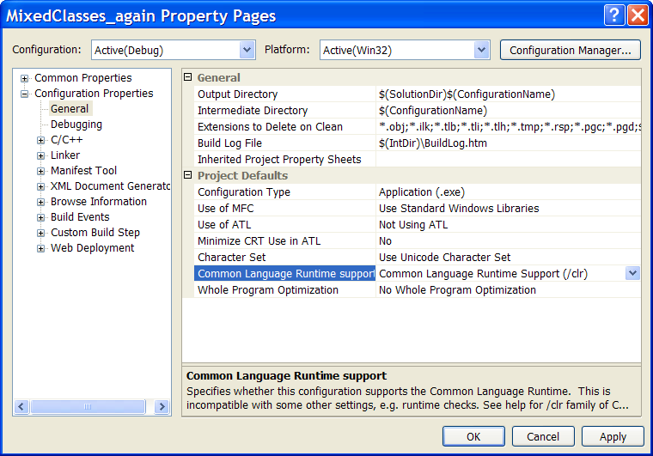
Code Targets
An unmanaged C++ program can be compiled to generate managed code using the /clr option.
You can mix managed and unmanaged C++ code in the same file.
Managed C++ can call C# code in a separate library and vice versa.

Slide 24
Mixing Managed and Unmanaged Code
You may freely mix unmanaged and managed C++ classes in the same compilation unit.
  Managed classes may hold pointers to unmanaged objects.
  Unmanaged classes may hold handles to managed objects wrapped in gcroot:
    #include <vcclr.h>
    Declare: gcroot<System::String^> pStr;
  That helps the garbage collector track the pStr pointer.
  Calls between the managed and unmanaged domains are more expensive than within either domain.
Note, all of the above means that you can use .Net Framework Class Libraries with unmanaged code, and you can use the C++ Standard Library with managed code.

Slide 25
Using Frameworks in MFC from Kate Gregory’s Presentation
Visual C++ 2005 allows you to use new Frameworks libraries in MFC applications.
MFC includes many integration points.
  MFC views can host Windows Forms controls
  Use your own Windows Forms dialog boxes
  MFC lets you use Windows Forms as CView
  Data exchange and eventing translation handled by MFC
  MFC handles command routing
MFC applications will be able to take advantage of current and future libraries directly, with ease.

Slide 26
Limitations of Managed Classes
Only single inheritance of implementation is allowed.
Managed classes cannot inherit from unmanaged classes and vice versa. This may be a future addition.
No copy constructors or assignment operators are allowed.
Member functions may not have default arguments.
Friend functions and friend classes are not allowed.
const and volatile qualifiers on member functions are currently not allowed.

Slide 27
Platform Invocation—PInvoke
Call Win32 API functions like this:
  [DllImport(“kernel32.dll”)]
  extern “C” bool Beep(Int32,Int32);
  In which documented signature is:
  BOOL Beep(DWORD,DWORD)
  Or, you can call native C++ which then calls the Win32 API
Can call member functions of an exported class

Slide 28
Additions to Managed C++ in VS 2005
Generics
  Syntactically like templates but bind at run time
  No specializations
  Uses constraints to support calling functions on parameter type
Iterators
  Support for each construct
Anonymous methods
  Essentially an inline delegate
Partial types, new to C#, were always a part of C++
  Class declarations can be separate from implementation
  Now, can parse declaration into parts, packaged in separate files

