Slide 1
WPF Features

Slide 2
Panels
Layouts, like the previous page, can use:
  Canvas
    Simplest, placement relative to two edges
  StackPanel
    Horizontal or vertical stacking
  Grid
    Uses rows and columns
  DockPanel
    Dock to top, right, bottom, left, and all else fills remaining space
  WrapPanel
    Horizontal stacking with wrap on overflow
  All of these can be nested, any one in another

Slide 3
Vector Graphics
In WPF there is only (usually) one window
  Controls are not windows!
  There are no handles—really, no handles.
  A button is a shape with border, fill, text, animation, and events, like click.
  There is a Button class, but it is not a .Net control in the traditional sense nor an ActiveX control.
    Just markup, lines, fills, and events

Slide 4
Parse Tree
XAML gets rendered into a parse tree, just like XML—it is XML.
  Inherited properties are based on parent-child relationships in the markup tree.
  Events bubble is based on those relationships as well.
  You have direct and simple control over that structure.
    The world is yours!

Slide 5
What Makes WPF Unique?
Vector graphics with parse-tree structure derived from markup
Routed events bubble up the parse tree
Pervasive publish-and-subscribe model
  Data binding
  Dependency properties
Layered on top of DirectX
  Strong 2D and 3D graphics
  Animation
Layout and styles model similar to the best of the web

Slide 6
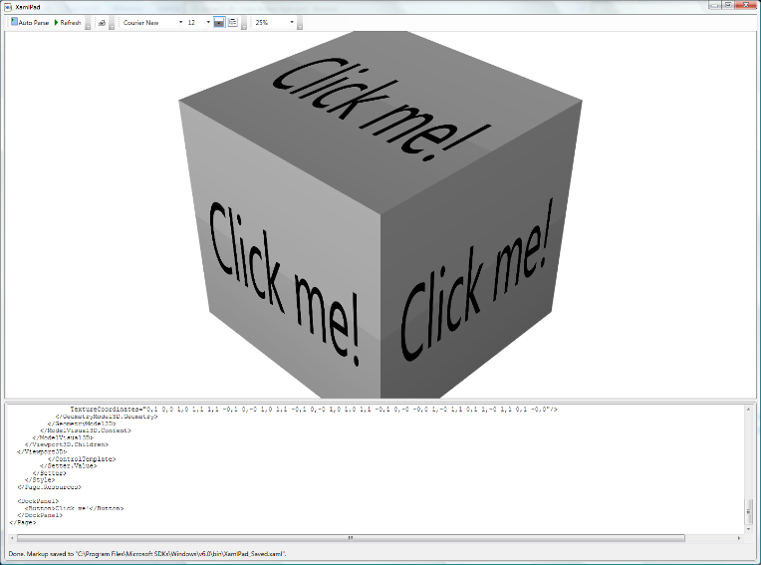

Slide 7
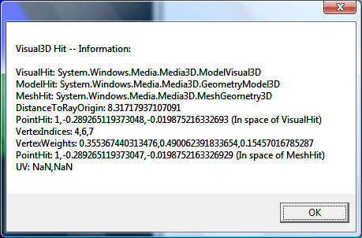
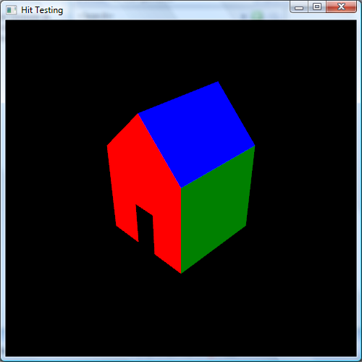
3D Hit Testing

Slide 8
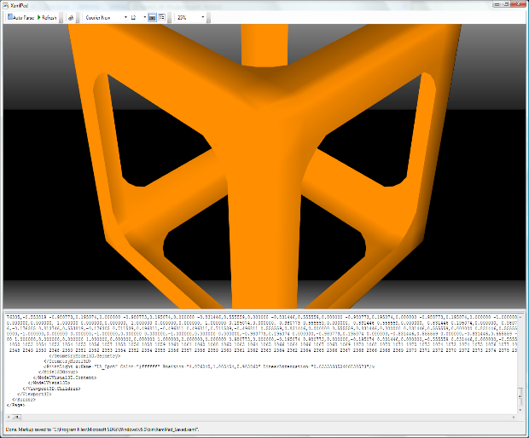
3D Perspective Camera

Slide 9
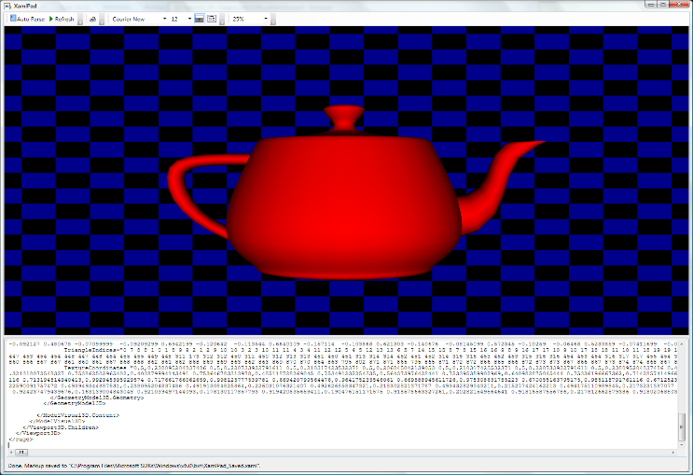
Famous Teapot

Slide 10
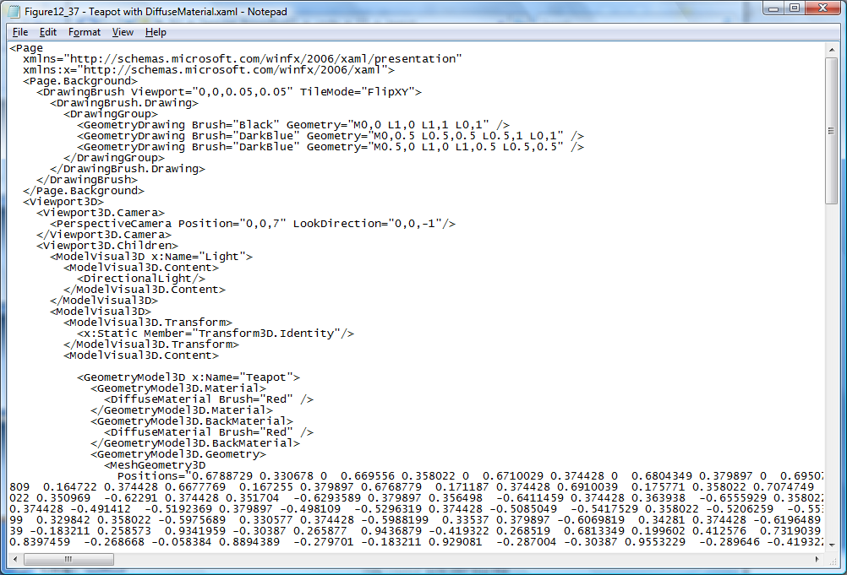

Slide 11
Routed Events
WPF maps markup elements to UIElements, which derive from ContentControl.
  That means that almost everything can hold content—only one thing unless it’s a panel.
  How does a mouse click event on any one of a control’s content elements get routed to the control?
    By walking the XAML parse tree until it finds a parent that handles that event.

Slide 12
Adding Event Handlers
You will find that property sheets show events as well as properties.
  Click on the lightning bolt to see the event sheet.
  You subscribe by clicking on an event entry.
You can also add event handlers quickly in XAML:
  Go to the XAML, then type a space after the tag for the element you want to handle the event.
    That gets you a context menu (via IntelliSense) and you just double-click on the desired event, which adds an event attribute.

Slide 13
Attached Properties
Buttons, ListBoxes, Images, etc., do not have Dock properties.
However, when you place one of these in a DockPanel, you find that it has had Dock properties attached.
<Image Source="./help.png"
DockPanel.Dock="Top" Height="213"
ImageFailed="Image_ImageFailed" />

Slide 14
DependencyObject Class
Attached properties work because all WPF controls derive from the DependencyObject class.
  DependencyObject class supports adding an arbitrary number of dependency properties.

Slide 15
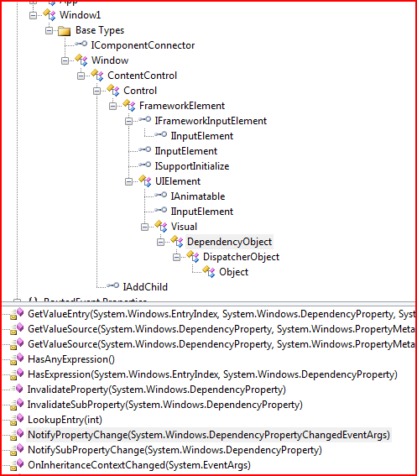

Slide 16
Dependency Properties
A dependency property is a property that is registered with the WPF dependency property system. Two uses:
  Backing an object property with a dependency property, provides support for data binding, styling, and animation. Examples include Background and FontSize properties.
  Creating attached properties. Attached properties are properties that can be set on any DependencyObject types. An example is the Dock property.
You can find an example of the definition and use of a custom dependency property here.
Dependency properties are a publish-and-subscribe system.

Slide 17
Dependency Property Links
Josh Smith's Blog
Switch on the Code Blog
Learn WPF site

Slide 18
Property Syntax
Two syntax forms:
  XAML attribute:
  <button ToolTip=“Button Tip />
  Property element syntax:
  <Button>
  <Button.Background>
  <SolidColorBrush Color=“#FF4444FF” />
  </Button.Background>
  Some Button Text
  </Button>

Slide 19
Markup Extensions
Sometimes you need to assign a property from some source at run-time. For that you use markup extensions:
<Button Foreground=“{x:static
SystemColors.ActiveCaptionBrush}” >
Some text
</Button>

Slide 20
Inline Styles
Collections of property values:
  <Button.Style>
  <Style>
  <Setter Property=“Button.FontSize” Value=“32pt” />
  <Setter Property=“Button.FontWeight” Value=“Bold” />
  </Style>
  </Button.Style>

Slide 21
Named Styles
Collections of property values:
  <Window.Resources>
  <Style x:Key=“myStyle” TargetType=“{x:Type Control}”>
  <Setter Property=“FontSize” Value=“32pt” />
  <Setter Property=“FontWeight” Value=“Bold” />
  </Style>
  </Window>

Slide 22
Binding
Binding infrastructure allows you to set up a one-way or two-way updating of property values that happens when the source changes.
This requires two things:
  A dependency object
    Has its own dispatcher thread
  Support for INotifyPropertyChanged interface

Slide 23
Binding
Objects that implement INotifyPropertyChanged interface raise events when the property has changed.
Data binding is the process of registering two properties with the data-binding engine and letting the engine keep them synchronized.
You will find an example in the Wpf_AttachedProperties demo code.

Slide 24
Binding Links
MSDN Article by John Papa
CodeProject article by Josh Smith (part of a tutorial series)
Bea (Costa) Stollnitz

Slide 25
Control Templates
With control templates you can change the look and feel of existing controls and support making your own controls:
  <Button.Template>
  <ControlTemplate>
  <Grid><Rectangle /></Grid>
  </ControlTemplate>
  </Button.Template>

Slide 26
Navigation
You can use instances of the Page and Frame classes to set up a navigation structure resembling web applications.
  Pages go in NavigationWindow instances and Frames go in Windows and Pages.
  This is a good alternative to tabbed displays.

Slide 27
Special Classes
ContentControl
  All UIElements derive from this
  Content can be text, a tree of elements, or a .Net object which can be displayed using a data template
Dependency object
  Derives from DispatcherObject
  Supports data binding, styling, animation, property inheritance, and property change notifications
WindowsFormsHost
  Supports hosting controls based on HWNDs

Slide 28
Special UI Elements
ViewBox
  Resizes content to fit available space
UserControl
  Way to build custom controls as collections of elements on a panel
Animatable
  Provides hooks for DirectX to change elements properties over time; e.g., position, size, color, …
FlowDocument
  FlowDocumentScrollViewer
  FlowDocumentPageViewer
MediaElement
  Play media on load or on request; e.g., wma, wmv, mp3, …

