Slide 1
Sockets Interface
Berkley Sockets API

Slide 2
Creating Sockets
Socket connections are based on:
  Domains—network connection or IPC pipe
    AF_INET for IPv4 protocol
    AF_INET6 for IPv6 protocol
  Type—stream, datagram, raw IP packets, …
    SOCK_STREAM → TCP packets
    SOCK_DGRAM → UDP packets

Slide 3
Creating Sockets (cont.)
Protocol—TCP, UDP, …
  0 → default, e.g., TCP for SOCK_STREAM
Example:
HANDLE sock = socket(AF_INET,SOCK_STREAM,0);
Note: we will focus on the IP4 interface, since it is simpler than IP6. Our Socket Library handles both.

Slide 4
Connecting Sockets
Socket addresses
struct SOCKADDR_IN {
sin_family // AF_INET
sin_address.s_addr // inet_addr(“127.0.0.1”);
sin_port // htons(8000);
} addr;
Bind server listener to port:
int err = bind(sock, (SOCKADDR_IN*)&addr,sizeof(addr));
Connect client to server:
HANDLE connect(sock, (SOCKADDR_IN*)&addr,sizeof(addr))

Slide 5
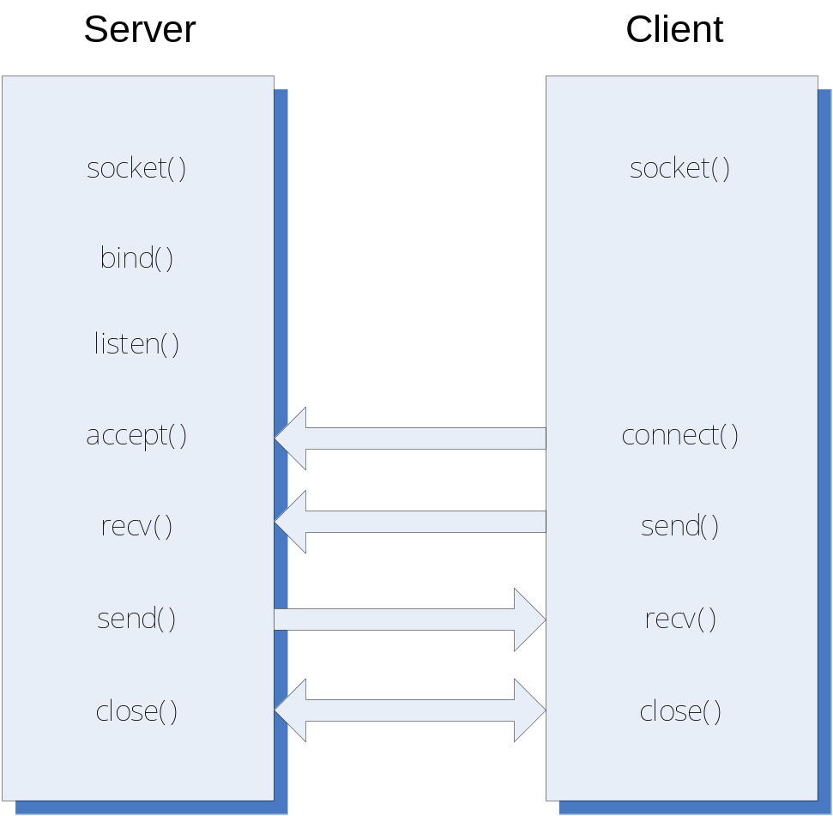
Client/Server Processing

Slide 6
Accessing Sockets Library
#include <winsock2.h>
Link with wsock32.lib
To build a server for multiple clients you will need to use threads; e.g.:
#include <process.h> // Win32 threads
or
#include<threads> // C++11 threads
and use the Project Settings:
C/C++ language\category=code generation\debug multithreaded

Slide 7
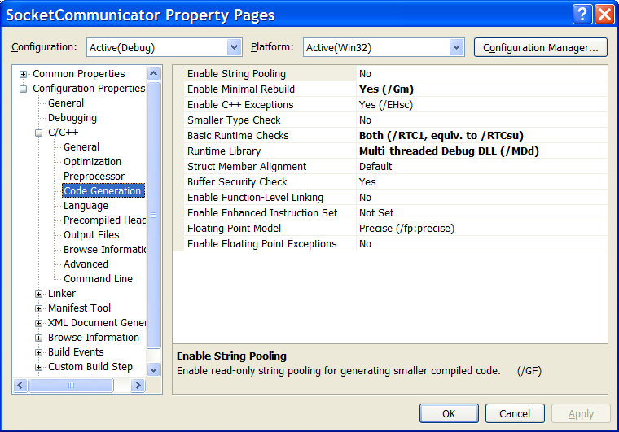
Project Settings

Slide 8
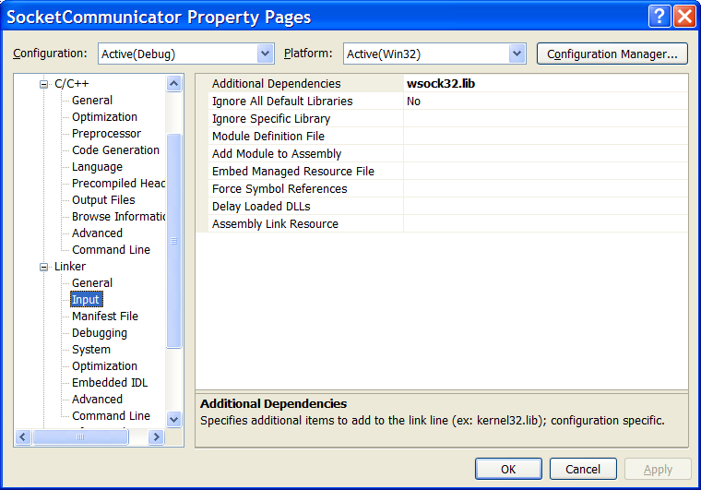
Project Settings

Slide 9
Sockets API
WSAStartup — loads WS2_32.dll
WSACleanup — unloads dll
socket — create socket object
connect — connect client to server
bind — bind server socket to address/port
listen — request server to listen for connection requests
accept — server accepts a client connection
send — send data to remote socket
recv — collect data from remote socket
shutdown — close connection
closesocket — closes socket handle

Slide 10
Sequence of Server Calls
WSAStartup
socket (create listener socket)
bind
listen
accept
  create new socket so listener can continue listening
  create new thread for socket
  send and recv
  closesocket (on new socket)
  terminate thread
shutdown
closesocket (on listener socket)
WSACleanup

Slide 11
WSAStartup
  wVersionRequested = MAKEWORD(1,1);
  WSAData wData;
  lpWSAData = &wData
  int WSAStartup(
  WORD wVersionRequested,
  LPWSADATA lpWSAData
  )
  Loads WS2_32.dll

Slide 12
TCP/IP Socket
  af = AF_INET
  type = SOCK_STREAM
  protocol = IPPROTO_IP
  SOCKET socket(int af, int type, int protocol)
  Creates a socket object and returns handle to socket.

Slide 13
Bind Socket
struct sockaddr_in local;
… define fields of local …
name = (sockaddr*)&local
namelen = sizeof(local)
int bind(
SOCKET s,
const struct sockaddr *name,
int namelen
)
  Bind listener socket to network card and port

Slide 14
Listen for Incoming Requests
int listen(SOCKET s, int backlog)
  Backlog is the number of incoming connections queued (pending)
  for acceptance.
  Puts socket in listening mode, waiting for requests for service
  from remote clients.

Slide 15
Accept Incoming Connection
SOCKET accept(
SOCKET s,
struct sockaddr *addr,
int *addrLen
)
  Blocking call, accepts a pending request for service and returns a
  socket bound to a new port for communication with new client.
  Usually server will spawn a new thread to manage the socket
  returned by accept, often using a thread pool.

Slide 16
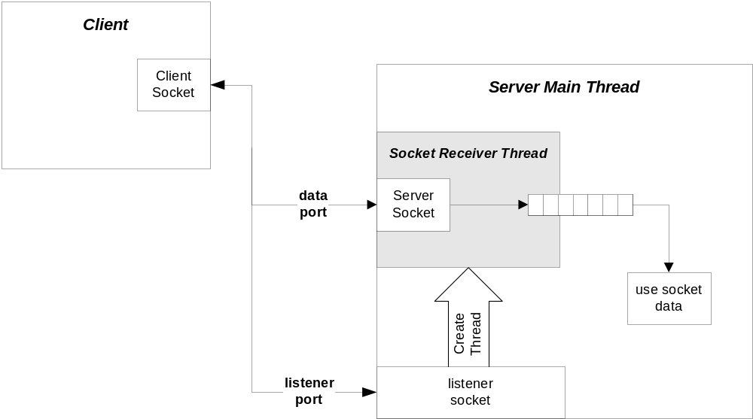
Client/Server Configuration

Slide 17
recv
int recv(
SOCKET s,
char *buff,
int len,
int flags
)
  Receive data in buff up to len bytes.
  Returns actual number of bytes read.
  Flags variable should normally be zero.

Slide 18
send
int send(
SOCKET s,
char *buff,
int len,
int flags
)
  Send data in buff up to len bytes.
  Returns actual number of bytes sent.
  Flags variable should normally be zero.

Slide 19
shutdown
int shutdown(SOCKET s, int how)
  how = SD_SEND or SD_RECEIVE or SD_BOTH
  Disables new sends, receives, or both, respectively. Sends a
  FIN to server, causing thread for this client to terminate
  (server will continue to listen for new clients).

Slide 20
closesocket
int closesocket(SOCKET s)
  Closes socket handle s, returning heap allocation for that data
  structure back to system.

Slide 21
WSACleanup
int WSACleanup( )
  Unloads W2_32.dll if no other users. Must call this once for
  each call to WSAStartup.

Slide 22
Sequence of Client Calls
WSAStartup
socket
address resolution—set address and port of
intended receiver
connect —send and recv
shutdown
closesocket
WSACleanup

Slide 23
TCP Addresses—IP4
struct sockaddr_in{
short sin_family;
unsigned short sin_port;
struct in_addr sin_addr;
char sin_zero[8];
} SOCKADDR_IN;

Slide 24
TCP/IP Address Fields—IP4
sin_family AF_INET
sin_port at or above 1024
sin_addr inet_addr(“127.0.0.1”);
sin_zero padding
    Setting sin_addr.s_addr = INADDR_ANY allows a server application to listen for client activity on every network interface on a host computer.

Slide 25
connect
int connect(
SOCKET s,
const struct sockaddr *name,
int namelen
)
  Connects client socket to a specific machine and port.

Slide 26
Special Functions
htons—converts short from host to
network byte order
htonl—converts long from host to network
byte order
ntohs—converts short from network to host
byte order
ntohl—converts long from network to host
byte order

Slide 27
The next segment discusses how sockets are used in software systems.

