Slide 1
Creation and Synchronization

Slide 2
Creating Win32 Threads
Call CreateThread(…) only if you won’t be using ANY language libraries, since these are not initialized by Win32 API functions.
HANDLE hThrd =
(HANDLE)_beginthread(ThreadFunc, 0, &ThreadInfo);
ThreadFunc—the function executed by the new thread
  void _cdecl ThreadFunc(void *pThreadInfo);
pThreadInfo—pointer to input parameters for the thread
For threads created with _beginthread, the thread function, ThreadFunc, must be a global function or static member function of a class. It cannot be a non-static member function.

Slide 3
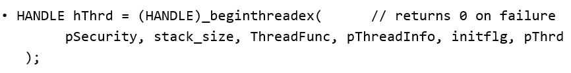
Creating Win32 Threads
SECURITY_ATTRIBUTES *pSecurity – null for user priviledges
unsigned int stack_size—size of stack to use, 0 gives default size
ThreadFunc—the function executed by the new thread
unsigned _stdcall ThreadFunc(void *pThreadInfo); // returns exit code

Slide 4
Creating Win32 Threads (cont.)
void *pThreadInfo—pointer to input parameter structure for use by ThreadFunc
Enum initflg—0 to start running or CREATE_SUSPENDED to start suspended
Int32 *pThrdID—returns pointer to threadID if non-null on call, otherwise not used
For threads created with _beginthreadex, the thread function, ThreadFunc, must be a global function or static member function of a class. It cannot be a non-static member function.

Slide 5
Thread Priority
You use thread priority to balance processing performance between the interfaces and computations.
  If UI threads have insufficient priority, the display freezes while computation proceeds.
  If UI threads have very high priority, the computation may suffer.
  We will look at an example that shows this clearly.

Slide 6
Thread Priority (cont.)
Thread priorities take the values:
  THREAD_PRIORITY_IDLE
  THREAD_PRIORITY_LOWEST
  THREAD_PRIORITY_BELOW_NORMAL
  THREAD_PRIORITY_NORMAL
  THREAD_PRIORITY_ABOVE_NORMAL
  THREAD_PRIORITY_HIGHEST
  THREAD_PRIORITY_TIME_CRITICAL

Slide 7
Creating Threads Using C++11
std::thread t(f)
  f is a callable object; e.g., function pointer, functor,
  or lambda that takes no arguments and has void
  return type.
std::thread t(g,a1, a2, …)
  g is a callable object that takes arguments a1, a2, … and has void return type.

Slide 8
C++11 Thread Functions
t.get_id() returns thread id—unique among all running threads.
t.join() blocks until thread t completes; e.g., exits its thread function.
t.detach() disassociates thread object t from underlying OS thread.
All threads must be joined or detached (not both) before thread object goes out of scope.
std::this_thread::sleep_for(chrono::duration);

Slide 9
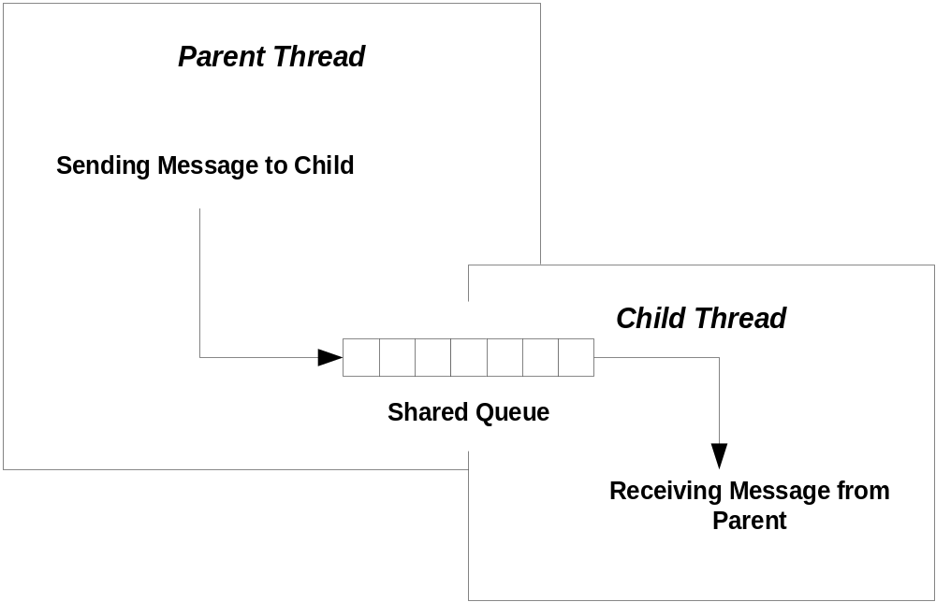
Shared Resources
A child thread often needs to communicate with its parent thread. It does this via some shared resource, like a queue.

Slide 10
Synchronization
A program may need multiple threads to share
some data.
If access is not controlled to be sequential, then shared data may become corrupted.
  One thread accesses the data, begins to modify the data, and then is put to sleep because its time slice has expired. The problem arises when the data is in an incomplete state of modification.
  Another thread awakes and accesses the data, that is only partially modified. The result is very likely to be corrupt data.
The process of making access serial is called serialization or synchronization.

Slide 11
Wait For Objects
WaitForSingleObject makes one thread wait for:
  Termination of another thread
  An event
  Release of a mutex
  Syntax: WaitForSingleObject(objHandle, dwMillisec)
WaitForMultipleObjects makes one thread wait for the elements of an array of kernel objects; e.g., threads, events, mutexes.
      Syntax: WaitForMultipleObjects(
      nCount, lpHandles, fwait, dwMillisec
      )

Slide 12
Wait For Objects (cont.)
    nCount: number of objects in array of handles
    lpHandles: array of handles to kernel objects
    fwait: TRUE => wait for all objects, FALSE => wait for first object
    dwMillisec: time to wait, can be INFINITE

Slide 13
Win32 Thread Synchronization
Synchronizing threads means that every access to data shared between threads is protected so that when any thread starts an operation on the shared data, no other thread is allowed access until the first thread is done.
The principle means of synchronizing access to shared data within the Win32 API are:
  Interlocked increment
    Only for incrementing or decrementing integral types
  Critical Section
    Good only inside one process

Slide 14
Win32 Thread Synchronization (cont.)
  Mutex (kernel object)
    Named mutexes can be shared by threads in different processes.
  Event (kernel object)
    Useful for synchronization as well as other event notifications
  Semiphore (kernel object)
    Allows a specified number of threads to use a resource
  SlimReaderWriter lock
    Supports concurrent reads while making writes and reads sequential
  Condition variable (kernel object)
    Used in conjunction with a Critical Section or Mutex to signal an event that allows one or more threads to proceed

Slide 15
C++11 Synchronization
std::mutex
  Wraps an OS mutex
  methods lock(), try_lock(), unlock()
Variations on std::mutex:
  std::timed_mutex, std::recursive_mutex, std::shared_mutex, std::shared_timed_mutex
std::lock_guard<mutex>
  Constructor calls mutex.lock() and destructor calls mutex.unlock()
  Thrown exceptions will unlock()
std::unique_lock<mutex>
  Movable but not copyable

Slide 16
C++11 Synchronization (cont.)
std::shared_lock<mutex>
  Reference counted, movable, but not copyable
std::condition_variable
  Manages access to mutable values—see Cpp11-BlockingQueue
std::atomic<T>
  Supports atomic operations on trivially copyable types; e.g., ints of all sizes, chars, and bools
  Methods are store(t), load(), exchange(t)
std::future
  Get() returns value that may be set asynchronously, blocks until value is set

