Slide 1
Benefits and Liabilities

Slide 2
Benefits of Using Threads
Keep user interfaces responsive even if required processing takes a long time to complete.
  Handle background tasks with one or more threads
  Service the user interface with a dedicated UI thread
Your program may need to respond to high priority events, so you can assign that event handler to a high priority thread.
Take advantage of multiple cores available for a computation.
Avoid low CPU activity when a thread is blocked waiting for response from a slow device or human, allowing other threads to continue.

Slide 3
More Benefits
Support access to server resources by multiple concurrent clients.
For processing with several interacting objects, the program may be significantly easier to design by assigning one thread to each object.

Slide 4
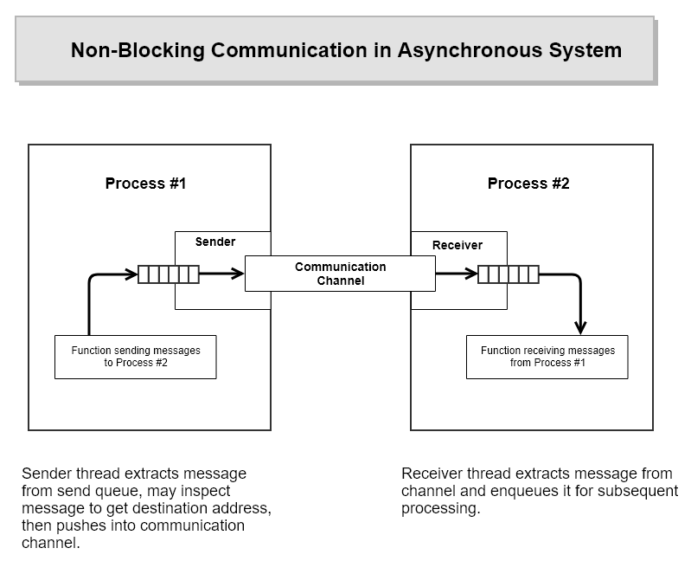
Using Threads to Avoid Blocking

Slide 5
Potential Problems With Threads
Conflicting access to shared memory
  One thread begins an operation on shared memory, is suspended, and leaves the memory region incompletely transformed.
  A second thread is activated and accesses the shared memory in the incomplete state, causing errors in its operation and potentially errors in the operation of the suspended thread when it resumes.
Race conditions occur when:
  Correct operation depends on the order of completion of two or more independent activities.
  The order of completion is not deterministic due to use of threads.

Slide 6
More Problems With Threads
Starvation
  A high priority thread dominates CPU resources, preventing lower priority threads from running often enough or at all.
Priority Inversion
  A low priority task holds a resource needed by a higher priority task, blocking it from running.
Deadlock
  Two or more tasks each own resources needed by the other, preventing either one from running, so neither ever completes and never releases its resources.

Slide 7
UI and Worker Threads
User interface (UI) threads create windows and process messages sent to those windows.
Worker threads receive no direct input from the user.
  Worker threads must not directly access a window’s member functions. This will cause exceptions.
  Worker threads communicate with a program’s windows by calling the Win32 API PostMessage and SendMessage functions.
  With modern GUI frameworks, that is handled by calling Form.Invoke or Dispatcher.Invoke passing a delegate to the UI thread bound to a function that handles the worker’s data.

Slide 8
In the next segment, we turn to programming details.

