Slide 1
Threads and Locks

Slide 2
Windows API
Create, style, and manage Windows
Manage files and directories
Create and manage processes, threads, and synchronizers
Load and unload dynamic link libraries
Create and manage timers
Read and write to the registry

Slide 3
Windows Resources—MSDN
Windows System Services
Processes and Threads
Synchronization
  Using Synchronization
  Synchronization Reference

Slide 4
Other Threading Resources
Evolution of Threads and I/O in Windows
Evolution of Synchronization in Windows and C++
CppReference.com

Slide 5
Windows Processes and Virtual Memory
Windows Processes are containers for:
  Threads—one primary thread at process start
  File handles
  Other Windows objects
  Allocated memory
  Process Diagram
Windows uses a paged virtual memory system
  Virtual Memory Diagram

Slide 6
Windows Objects
Windows supports internal objects and provides an API to access and manage them through handles.
Kernel Objects—named, secured, system-wide
  Devices, Files, Symbolic links, Registry keys, Threads and Processes, Events, Mutexes, Semiphores, Memory-mapped files, Callbacks, pipes
User Objects—GUI objects
  Window, Menu, Icon, Hook, …
GDI Objects—Drawing objects
  Brush, Pen, DeviceContext, Bitmap, Metafile, …

Slide 7
Windows Objects and Handles
A Windows object is a data structure that represents a system resource; e.g., file, thread, bitmap.
  Windows objects are created and accessed using the Win32 API.
  They reside in Kernel32.dll, User32.dll, or GDI32.dll.
An application accesses those resources through a handle, usually returned from a Create function.
Each handle refers to an entry in an internal object table that contains the address of a resource and means to identify the resource type.

Slide 8
Object API
The Windows API provides functions which:
  Create an object, returning a handle
  Get an object handle using other information
  Get and set information about an object
  Close the object handle, possibly destroying the internal object
    Objects are reference counted and will be destroyed when all referring handles have been closed
  Kernel objects have security functions that manage ACLs

Slide 9
Kernel Objects
Kernel objects are operating system resources like processes, threads, events, mutexes, semaphores, shared memory, and files.
Kernel objects have security attributes and signaled state.
  A kernel object is always either signaled or unsignaled.
  An object in the unsignaled state will cause any thread that waits on the object’s handle to block.
  An object in the signaled state will not block a thread that called wait on its handle.

Slide 10
Threads
A thread is a path of execution through a program’s code, plus a set of resources (stack, register state,
etc.) assigned by the operating system.
A thread lives in one and only one process. A process may have one or more threads.
Each thread in the process has its own call stack, but it shares process code and global data with other threads in the process.
  Thus, local data is unique to each thread.
Pointers are process specific, so threads can share pointers.

Slide 11
Starting A Process
Every time a process starts, Windows creates a primary thread.
  The thread begins execution with the application’s startup code that initializes libraries and enters main.
  The process continues until main exits and library code calls ExitProcess.
You will find demo code for starting a Windows process here:
  http://www.ecs.syr.edu/faculty/fawcett/handouts/Coretechnologies/ThreadsAndSynchronization/code/ProcessDemoWin32/
Here is a demo for starting up a process using C#:
  http://www.ecs.syr.edu/faculty/fawcett/handouts/Coretechnologies/ThreadsAndSynchronization/code/ProcessDemoDotNet/

Slide 12
Scheduling Threads
Windows is a preemptive multi-tasking system. Each task is scheduled to run for some brief time period before another task is given control of a CPU core.
Unlike Unix and Linux, in Windows, threads are the basic unit of scheduling. A thread can be in one of three possible states:
  Running
  Blocked or suspended, using virtually no CPU cycles, but consuming about 1 MB of memory per thread
  Ready to run, using virtually no CPU cycles

Slide 13
Scheduling Activities
A running task is stopped by the scheduler if:
  It is blocked waiting for some system event or resource
  Its time slice expires and is placed back on the queue of ready to run threads
  It is suspended by putting itself to sleep for some time; e.g., waiting on a timer
  It is suspended by some other thread
  It is suspended by Windows while the OS takes care of some critical activity
Blocked threads become ready to run when an event or resource they wait on becomes available; e.g., its handle becomes signaled.
Suspended threads become ready to run when their suspend count is zero.

Slide 14
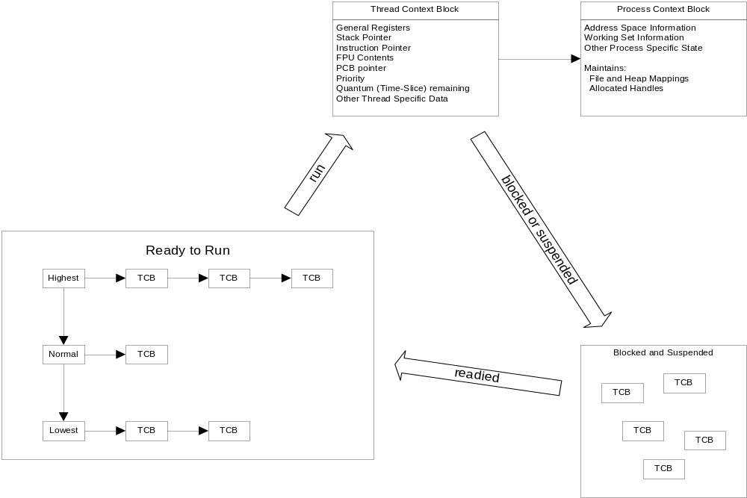
Scheduling Threads

Slide 15
We next discuss some of the benefits and liabilities of using threads.

