Slide 1
Inheritance

Slide 2
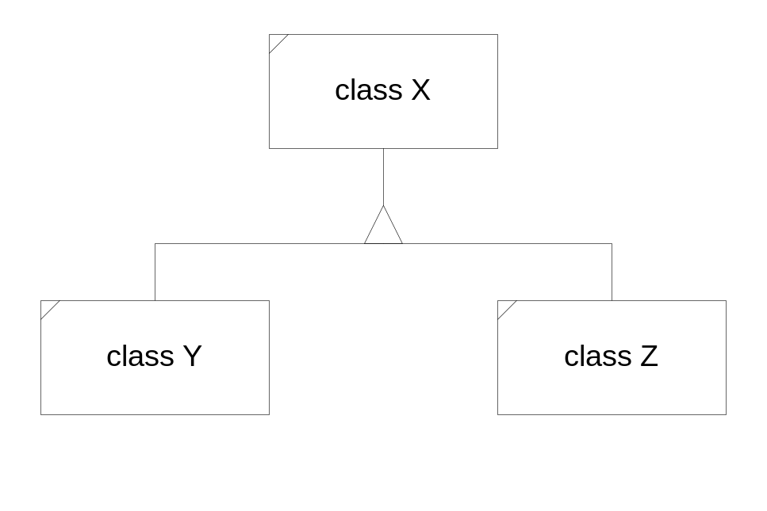
Inheritance
Inheritance models an “is-a” semantic relationship. Here, classes Y and Z inherit from class X.
class Y : public X { … }
class Z : public X { … }
That means that class Y “is-a” class X and the same must be true for class Z. The “is-a” relationship is always a specialization. That is, both classes Y and Z must have all attributes and behaviors of class X, but they may also extend the attributes and extend and modify the behaviors of class X.

Slide 3
Hierarchy via Inheritance
Inheritance enables the derivation of a new class with almost all the existing methods and data members of its base class.
Derived class functions have access to protected data and functions of the base class.
The derived class “is a” base class object with additional capabilities, creating a new specialized object.
public interface functions
base class
protected functions
protected data
protected data
derived class

Slide 4
Derived Class Access Privileges
 | public members | protected members | private members
public derivation models is-a relationship client sees all base and derived class behaviors | public members of base class become public members of derived class (stay the same) | protected members of base class become protected members of derived class (stay the same) | private members of base class are not accessible to derived class
protected derivation models uses relationship client sees only derived behaviors | public members of base class become protected members of derived class | protected members of base class become protected members of derived class (stay the same) | private members of base class are not accessible to derived class

Slide 5
Derived Class Access Privileges (cont.)
 | public members | protected members | private members
private derivation models uses relationship client sees only derived behaviors | public members of base class become private members of derived class | protected members of base class become private members of derived class | private members of base class are not accessible to derived class

Slide 6
Inheritance Example
The inheritance diagram on a subsequent page represents an architecture for a graphics editor. The display list refers to graphics objects, which because of the “is-a” relationship, can be any of the derived objects. Presumably, a client of the display list creates graphic objects based on user inputs and attaches them to the list. The display list and its clients do not need to know about the types of each of the objects. They simply need to know how to send messages defined by the graphics object base class.

Slide 7
Inheritance Example (cont.)
The base class graphics object provides
a protocol for clients like the display list to use; e.g., draw(), erase(), move(), etc. Clients do not need to know any of the details that distinguish one of the derived class objects from another.
The absence of a diamond shape on the list class indicates that the list does not manage the creation or destruction of the graphics objects it refers to.
This example illustrates why the inheritance relationship is considered to represent an “or” relationship between objects on the same level. Display list members are either lines or circles or polygons or ...

Slide 8
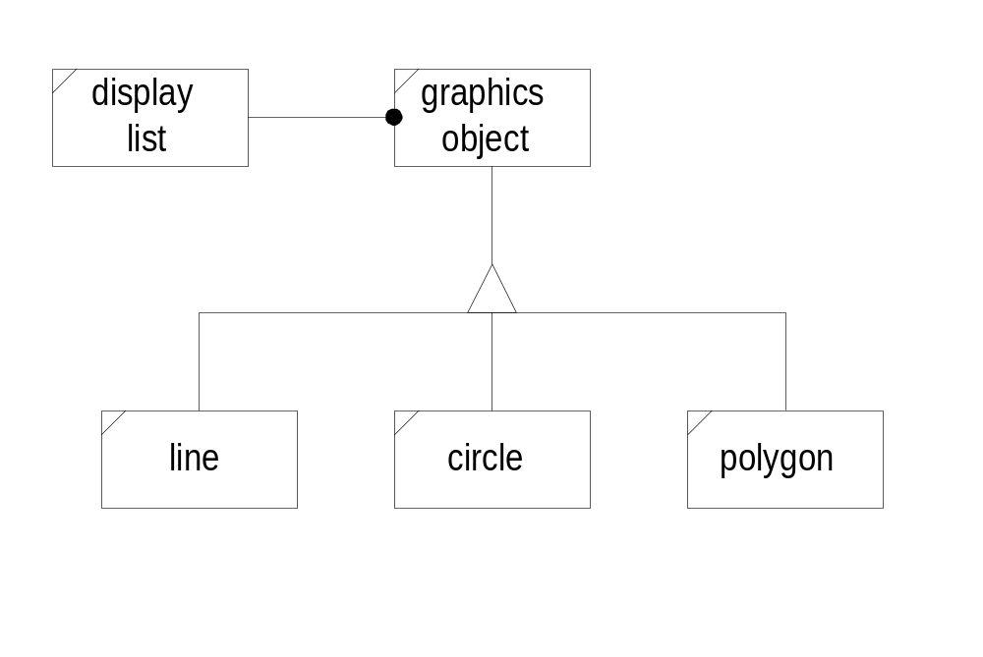
Graphics Editor Classes

Slide 9
Public Inheritance—“is-a”
Syntax: class derived : public base {...};
Public derivation makes all of the base class functionality available to derived class objects. This has two very important consequences:
  Clients interpret the derived object as a base class object with either specialized, or new capabilities, or both.
  A derived class object, since it is a base class object, can be used anywhere a base class object can be used. For example, a function typed to accept a base class pointer, or reference, will accept a derived class pointer, or reference in its place.
New capabilities occur when the derived class adds new member functions or new state members which give the derived object richer state and functional behaviors.

Slide 10
Public Inheritance—“is-a” (cont.)
Specialized capabilities occur when the derived class modifies a base class virtual function.
  The base class object and derived class object respond to the same message, but in somewhat different ways, determined by the implementations of the virtual function in each class.
  Because the modified function is qualified in the base class by the keyword “virtual,” which function is called is determined by the type of object invoking it.

Slide 11
Private Inheritance—“part of”
Syntax: class derived : private base { ... };
Private derivation hides all of the base class interface from clients. By default, none of the base class member functions are accessible to derived class clients.
The base class object is “part of” the derived class. All of its attributes are attributes of the derived class.
Public and protected member functions are available to derived class functions to support their implementation.
Clients of the derived class see base class functionality only as manifested through derived class interface operations.

Slide 12
Private Inheritance—“part of” (cont.)
From the client’s point of view, private derivation creates an aggregation.
The only difference is that, using private inheritance, the derived class has access to protected members of the base class.
In private inheritance, any class derived again from the derived class has no more access privileges to the base than any other client of the derived class.

Slide 13
Protected Inheritance—“part of”
Syntax: class derived : protected base {...};
Protected inheritance is just like private
inheritance from client’s perspective. Clients
have no access to base class functionality
except through the derived class interface.
Protected inheritance is just like public
inheritance from the derived class’s point of
view. Derived class member functions have
access to all the base class public and
protected members. The derived class
members can use a derived class object
anywhere a base class object is expected.
Protected inheritance, unlike private
inheritance, passes on to all subsequent
protected derived classes access privileges
to the base public and protected members.

Slide 14
Initialization Sequences
C++ provides constructors specifically to initialize a newly created object so that its state will assume some correct values.
In the body of the constructor we can allocate needed resources and assign values to data members of the class.
However, it is preferable to use an initialization sequence:
  Initialization sequences are more efficient than void construction and assignment.
  Use of an initialization sequence is the only way to choose which constructor will be called for base classes and set member reference values.
  We will see in the demonstration code that this is critically important.

Slide 15
Initialization Sequence Syntax
An initialization sequence is part of the
syntax of a constructor definition:
class D : public B
{
// public interface
private:
ostream &_out;
int _size;
double *darray;
};
// This syntax assumes that D’s base B can
// be initialized with a std::string, e.g.,
// it has a constructor that takes a string
// as its only argument.
D::D(ostream &out, int size, std::string &s)
: B(s), // initialize base class
_out(out), _size(size),
darray(new double[size]) {}

