Slide 1
Composition

Slide 2
The Object Model
Abstraction
  Application analysis: class or object model extracts the essential features of a real class or object.
  Software design: public interface supports simple logical model. Implementation complexity hidden from client view.
Modularity
  Application analysis: objects provide a more expressive and fine-grained structuring capability than decomposition by processing activity alone.
  Software design: objects are information clusters which can be declared as often and wherever needed.

Slide 3
The Object Model (cont.)
Encapsulation
  Classes build “firewalls” around objects, forcing all access through public interfaces, preventing access to private implementation.
  Objects intercept errors before they propagate outward throughout system.
Hierarchy
  Form aggregations by class compositions; e.g., one class uses objects of another as data elements. Supports “part-of” semantic relationship between contained and containing objects.
  Define subclasses of objects through inheritance from base class. Supports an “is-a” semantic relationship between derived classes and base class.

Slide 4
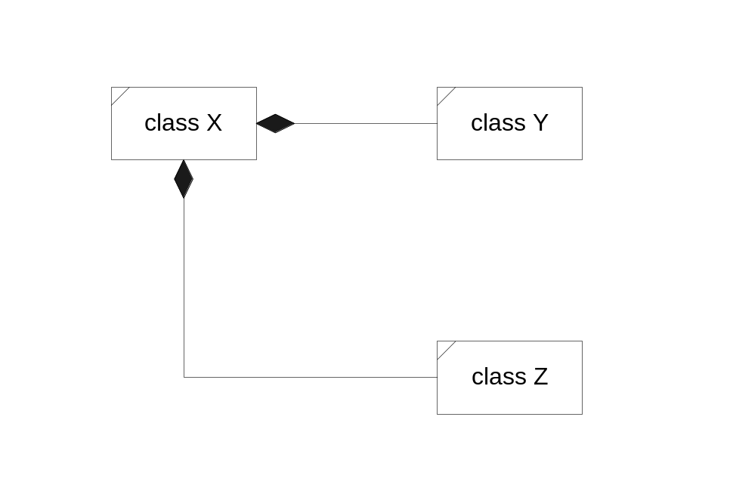
Composition
Compositions are special associations which model a “part-of” or “contained” semantic relationship.
Class X {
// public declarations here
private:
Y y;
Z z;
};
In this diagram, class X contains objects of classes Y and Z. Classes Y and Z are part-of class X.
Composition is transitive. That is, if class A contains B and class B contains C, then A also contains C.

Slide 5
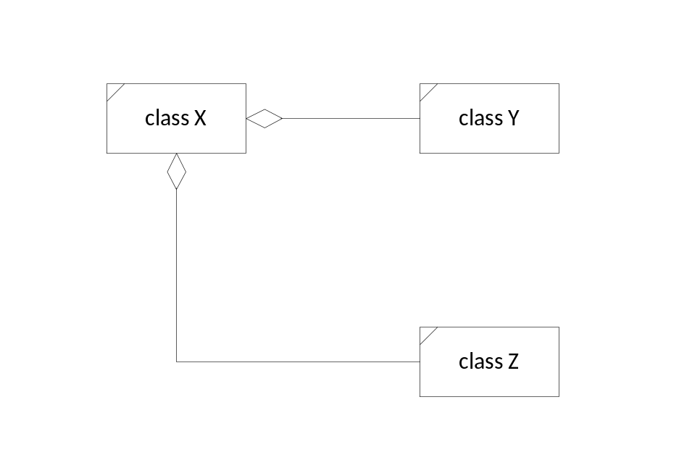
Aggregation
Aggregations are special associations which model a weak “part-of” or “contained” semantic relationship.
Class X {
// public declarations here
private:
Y* pY; // created in member function
Z* pZ; // with new only if needed.
};
In this diagram, class X holds references to objects of classes Y and Z. Those instances may be part-of class X.

Slide 6
Hierarchy via Composition
An object of one class may be used as a data element of another.
This is called composition. Member objects are used to implement a “part of” relationship.
The containing class has no special access to contained object’s private data unless it is made a friend. But an object of the containing class can pass initialization data to the contained object during construction.
public interface functions
private functions
private functions
private data
private data

Slide 7
Composition—“part of”
Incorporating an object inside another by making the contained object a private or protected data member of the containing class creates a “part-of” relationship, called a composition.
Containing class has no special privileges regarding access to contained objects internals. It has access only to public interfaces of contained objects, just like any other client.
Since the contained object lies in the private or protected parts of the containing object, clients cannot call its functions and do not see its functionality, except as manifested by the containing object’s behaviors; that is, the contained object helps to implement the outer object’s functionality.

Slide 8
Composition—“part of” (cont.)
The “part-of” relationship can be made explicit by providing a member function which returns a reference to the contained part. In this way, clients can get direct access to the public interface of the part.
“Part-of” relationships can also be implemented by private derivations. The semantics of a private derivation are the same as aggregation except that the derived class now has access to the base class’s protected (but not private) members.

Slide 9
Demonstration Programs
A series of simple demonstration programs are included in code/DEMCOMP for composition, and code/DEMINHER for inheritance.
The demos don’t do much of anything useful, but they are all designed to illustrate points about the way C++ does its job.
Each demo has a prologue which gives a very brief description of what the demo is about. Comments in the code are intended to draw your attention to specific details.

Slide 10
Demonstration Programs (cont.)
Output for each demo is included at the end of each program, along with comments about how you might interpret the code and its output.
One of the goals of these demos is to illustrate operations that occur under different design strategies. Some of the things that happen may surprise you.
It is very important that you understand all the things that happen in a C++ implementation. A lot of things happen silently unless you specifically instrument your code to see them. That is exactly what these demo programs do.

