Slide 1
Windows Presentation Foundation
Software Modeling
Jim Fawcett, Copyright © 1999-2017

Slide 2
References
Pro C# 5 and the .Net 4.5 Platform, Andrew Troelsen, Apress, 2012
Programming WPF, 2nd edition, Sells & Griffiths, O’Reilly, 2007
Windows Presentation Foundation Unleashed, Adam Nathan, SAMS, 2007
Essential Windows Presentation Foundation, Chris Anderson, Addison-Wesley, 2007
http://msdn2.microsoft.com/en-us/library/aa970268.aspx
http://msdn2.microsoft.com/en-us/library/ms754130.aspx

Slide 3
WPF Blogs
Josh Smith Blog
WPFpedia
Mike Taulty’s Blog

Slide 4
Introduction
What is WPF?
  A graphical user interface technology
    Desktop
    Little brother Silverlight is used for web applications
Uses markup and code
  Together or separately, much like ASP.Net
Easy to produce different styles
  Web browser like navigation and placement
  Traditional forms
  Animated graphics

Slide 5
Markup
XAML
  eXtensible Application Markup Language
  Tags are names of .Net 3.5 classes
  Attributes are class properties and events
<Grid>
<Ellipse Fill=“blue” />
<TextBlock>
Name: <TextBlock Text=“{Binding Name}” />
</TextBlock>
</Grid>

Slide 6
Code Behind
Often, code provides processing for control events, bound in XAML, like this:
  XAML in Window.Xaml
  <Button
  x:Name=“button”
  Width=“200”
  Height=“25”
  Click=“button_Click”>Submit</Button>
C# code in Window.Xaml.cs
  Void button_Click(object sender, RoutedEventsArgs e) {
  MessageBox.Show(…) }

Slide 7
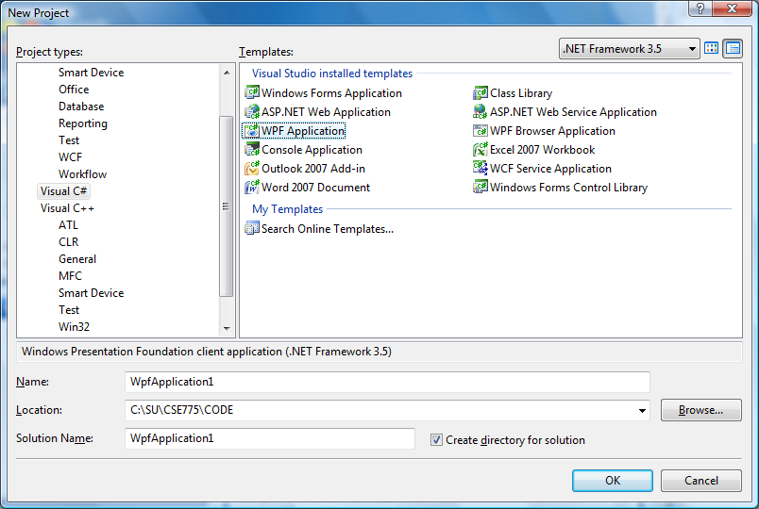
C# Wizard

Slide 8
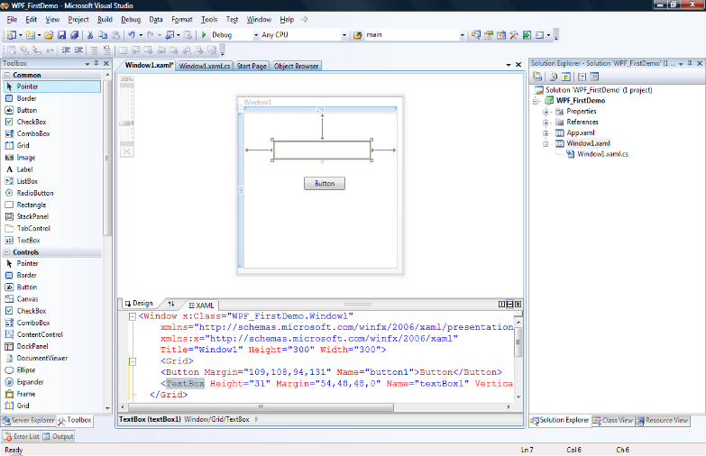
Default Grid Panel

Slide 9
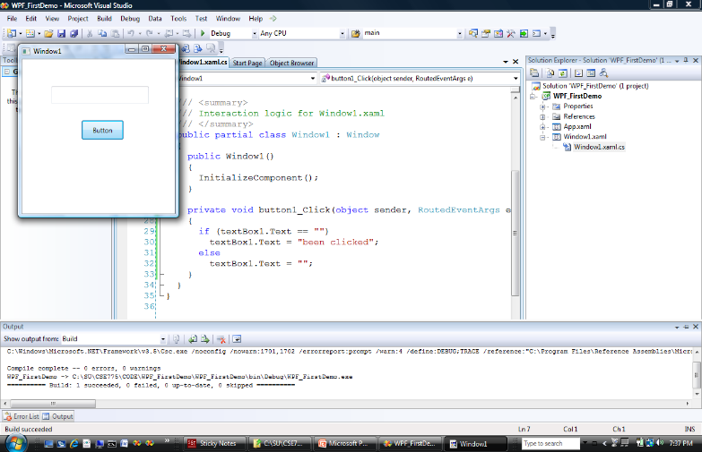
Like WinForms, But …

Slide 10
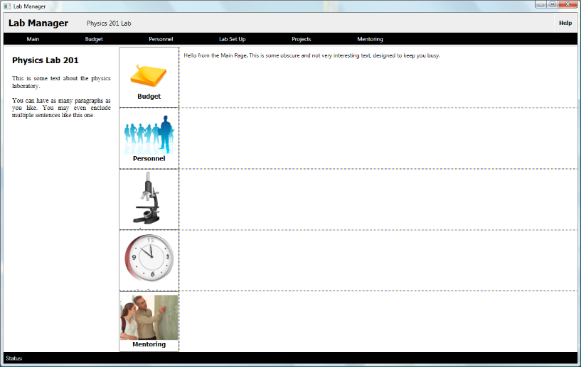
It’s Easy to Do More Interesting Things

