Slide 1
Socket Systems
Discuss how sockets are used in software systems

Slide 2
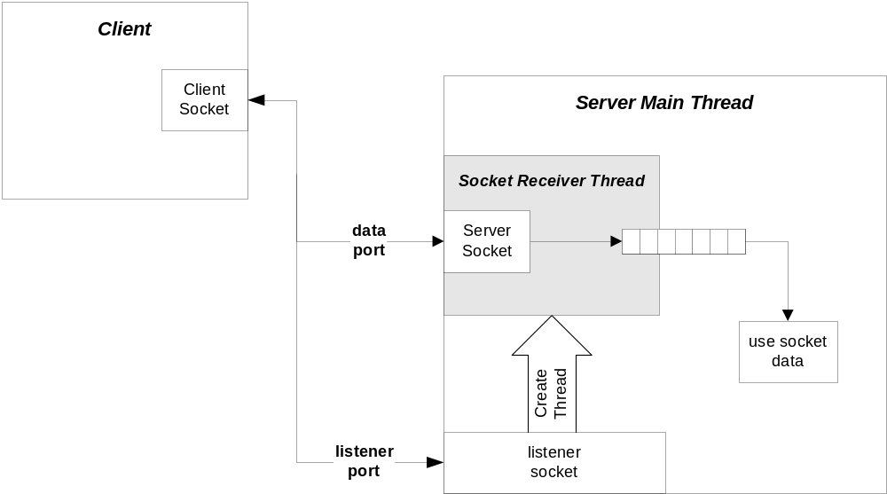
Client/Server Configuration

Slide 3
A Word of Caution
With stream-oriented sockets, send does not guarantee transfer of all bytes requested in a single call.
That’s why send returns an int, the number of bytes actually sent.
It’s up to you to ensure that all the bytes are actually sent.
  See my code example—socks.cpp

Slide 4
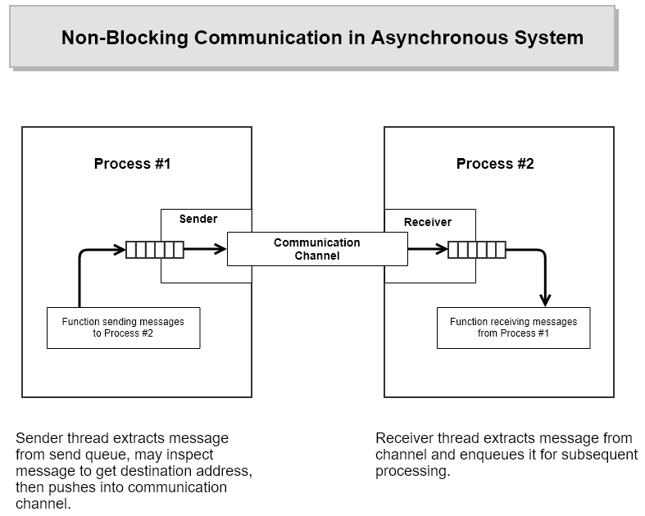

Slide 5
Talk Protocol
The hardest part of a client/server socket communication design is to control the active participant.
  If single-threaded client and server both talk at the same time, their socket buffers will fill up and they both will block; e.g., deadlock.
  If they both listen at the same time, again, there is deadlock.
  Often the best approach is to use separate send and receive threads.

Slide 6
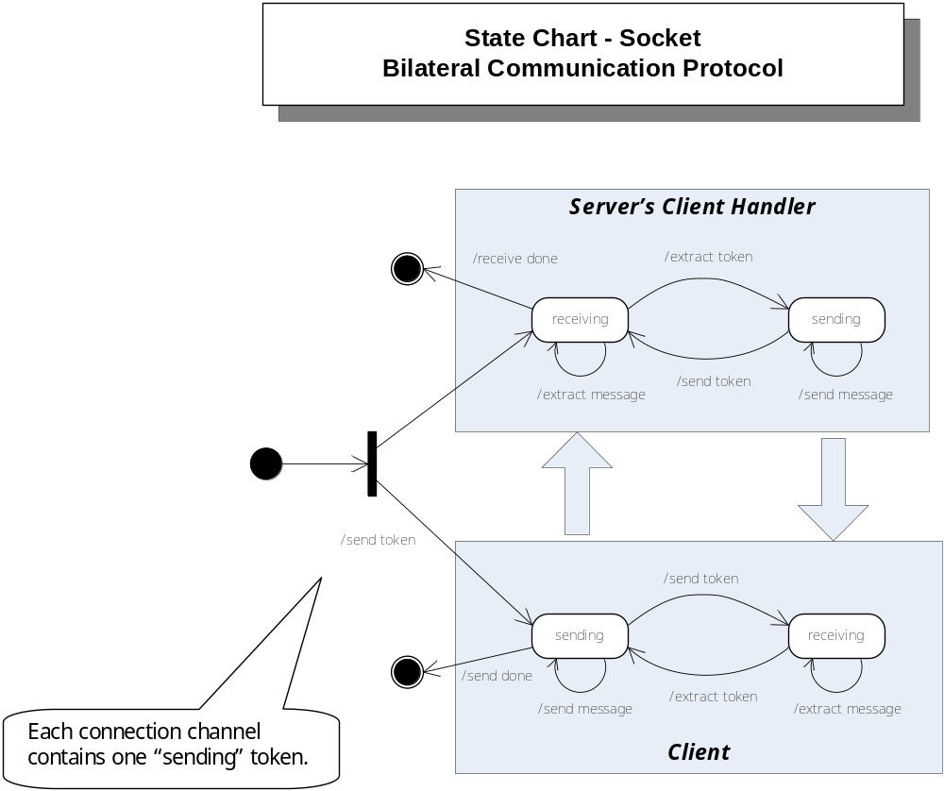

Slide 7
Message Length
Another vexing issue is that the receiver may not know how long a sent message is.
  So the receiver doesn’t know how many bytes to pull from the stream to compose a message.
  Often, the communication design will arrange to use message delimiters, fixed-length messages, or message headers that carry the message length as a parameter.
  For examples, see:
    Repository/CppStringSocketServer // uses string delimiter
    Repository/CommWithFileXfer // uses messages with headers

Slide 8
Message Framing
Sockets only understand arrays of bytes.
  Don’t know about strings, messages, or objects
In order to send messages, you simply build the message string, probably with XML.
  String msg = “<msg>message text goes here</msg>”
  Then send(sock,msg,strlen(msg),flags)
Receiving messages requires more work.
  Read socket one byte at a time and append to message string:
  recv(sock,&ch,1,flags); msg.append(ch);
  Search string msg from the back for </
  Then collect the msg>
You will find a more sophisticated approach in the CommWithFileXfer, cited on the previous slide.

Slide 9
They’re Everywhere
Virtually every network and Internet communication method uses sockets, often in a way that is invisible to an application designer.
  Browser/server
  ftp
  SOAP
  Network applications

Slide 10
What We Didn’t Talk About
udp protocol
socket select(…) function
non-blocking sockets

