Slide 1
Help for dotnet Command
Jim Fawcett
CSE686 – Internet Programming
Spring 2019

Slide 2
dotnet
dotnet is a command line utility that has commands for creating, building, and running Net Core projects.
You can do, in Visual Studio and (I think) Visual Studio for Mac, everything that dotnet does, but often dotnet is quicker and easier.
dotnet is especially convenient when using Visual Studio Code.
We’ll talk about VS Code in a follow-on presentation.

Slide 3
The Command Line
The dotnet command runs from the command line. On Windows, That means either:
Cmd.exe
The default shell.
Developer’s cmd prompt
Cmd with added environment variables to support code tool chains.
PowerShell
A powerful, but complex, shell.

Slide 4
Cmd.exe

Slide 5
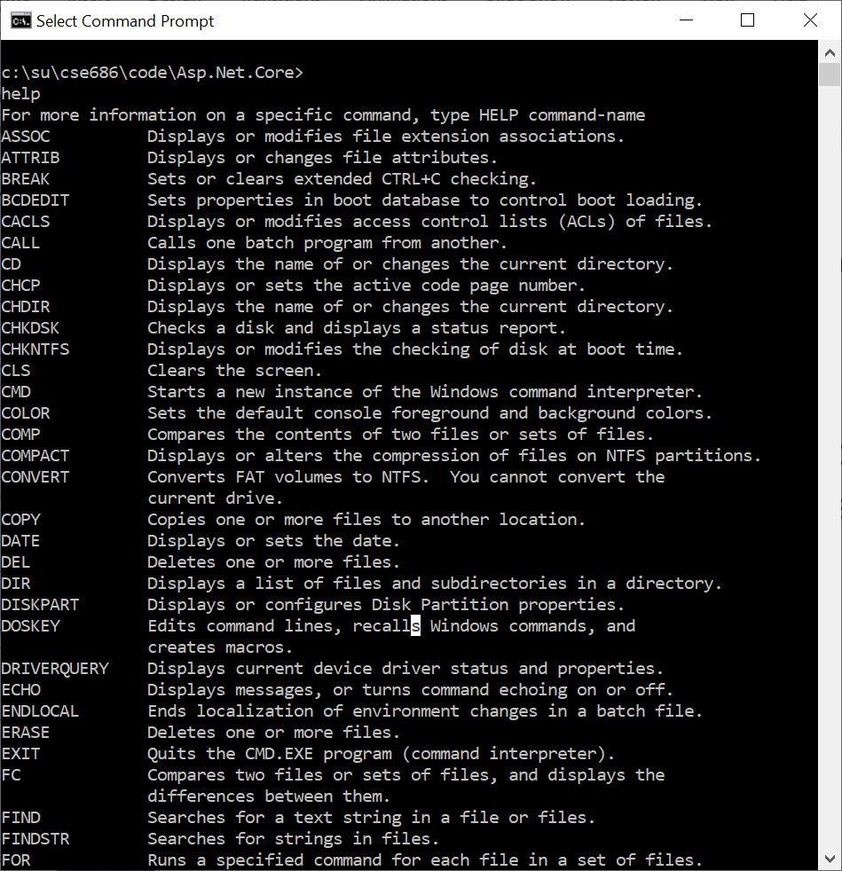
Functionality
Cmd.exe
Create files and directories
Run shell commands
Run batch files and executables on your path
Run dotnet command

Slide 6
Developer’s Command Prompt

Slide 7
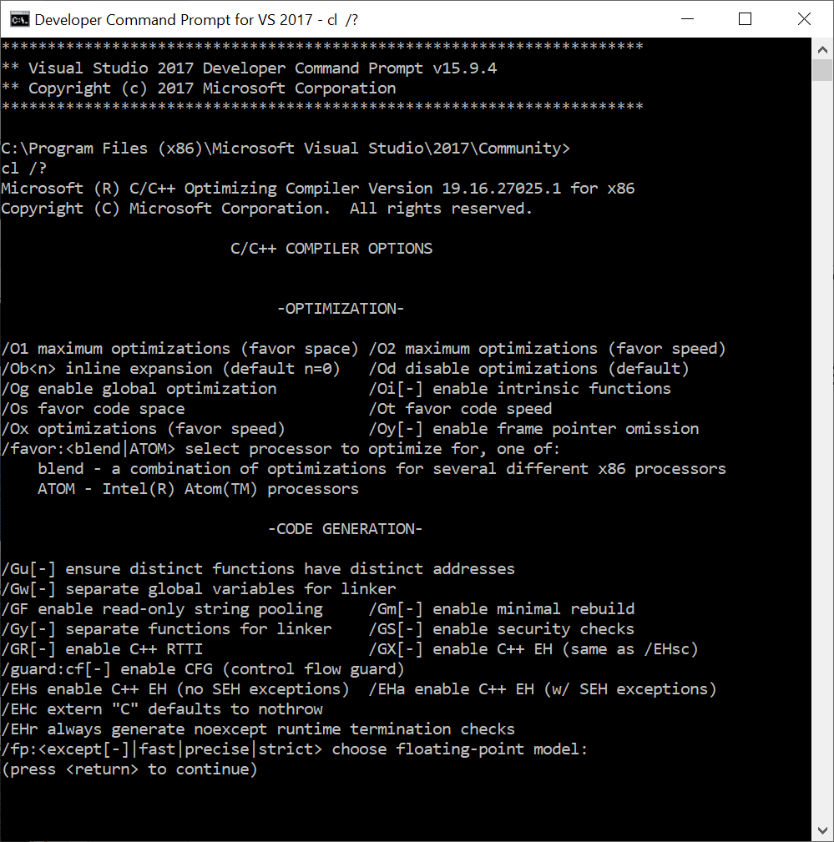
Functionality
Developer Command ….
A superset of the Cmd.exe functionality
Specifically, has environment variables to access C++ tool chain.
We won’t need that capability in this course, but do in CSE687-OOD.

Slide 8
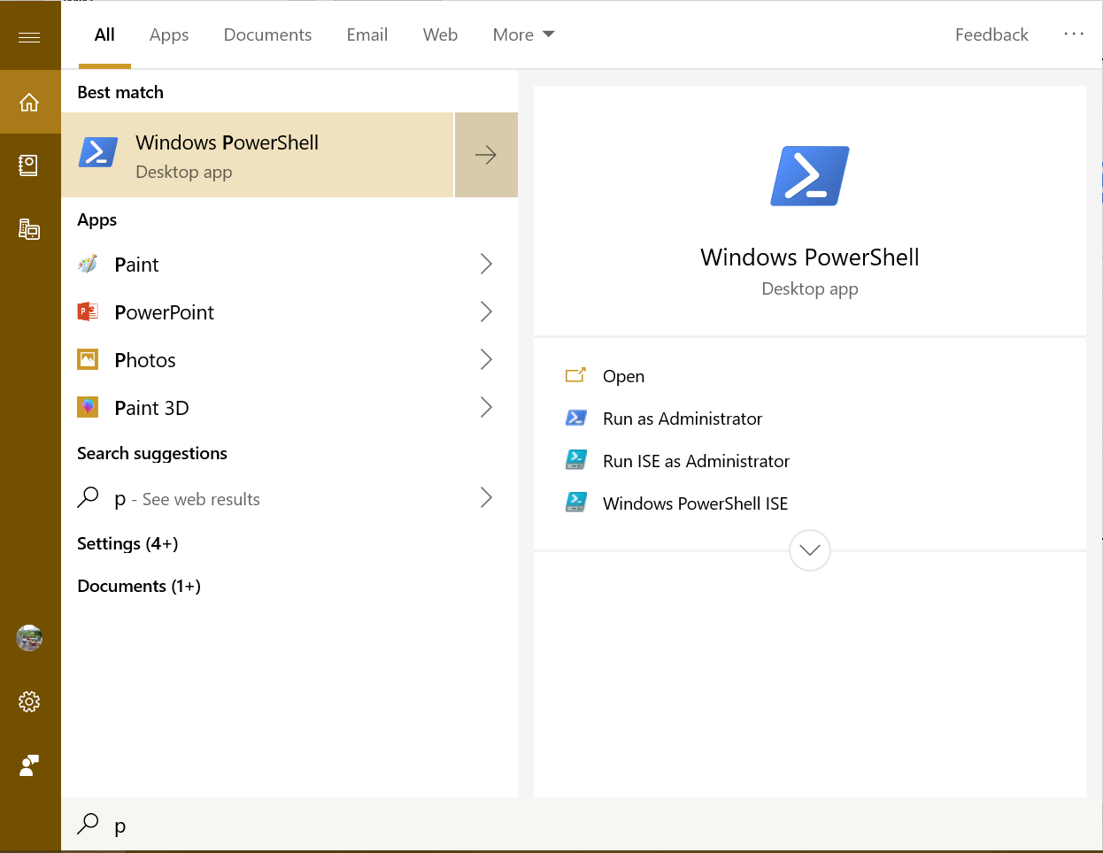
PowerShell

Slide 9
Functionality
PowerShell.exe
A superset of the Cmd.exe functionality
Has a lot of operations for system administration.
Does not have environment variables to access C++ tool chain.
We can add those by opening a cmd prompt, executing vcvarsall.bat, and then opening powershell from within the cmd shell.

Slide 10
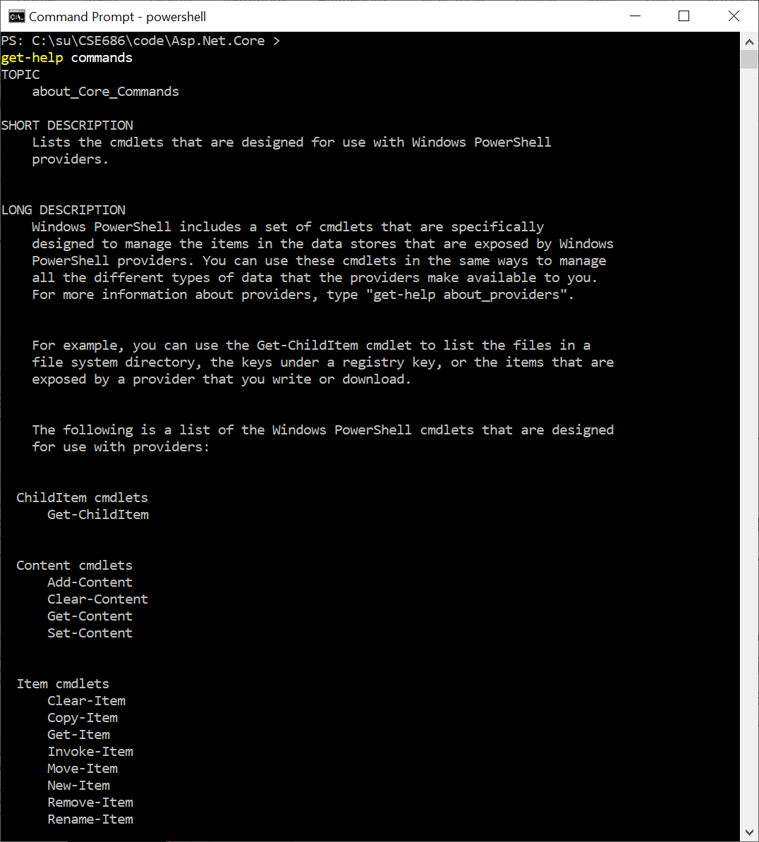
PowerShell Operations
PowerShell.exe
Syntax for commands is:
Verb Noun
Example: get-Help commands
Useful exploratory commands:
Get-help
Get-Help commands
Get-Help objects
Get-help About_Methods
Get-help About_Properties
Get-help About

Slide 11
Examples

Slide 12
Now: dotnet command

Slide 13
dotnet command

Slide 14
So What?
If we use Visual Studio Code:
VS Code can’t create .net core projects
So we create a project folder, call dotnet new console (or whatever)
Open Visual Studio Code
Open the newly created folder
When you do this VS Code will ask if you want to create resources to work with that folder.
Select yes – that builds a json settings file to manage builds and debugging
Start editing files and running

Slide 15
That’s all Folks!

