Slide 1
Xamarin Overview CSE 686 (Internet Programming) Spring 2019
Mike Corley

Slide 2
Background
Microsoft supported open source .Net based (multiplatform) mobile development framework
Android
iOS
Mac
Windows (UWP)
Enables (native) cross platform application development on Android and iOS
Originated in 2011 as an open source framework, Microsoft owned and supported since 2016
Available for free
ships with every edition of Visual Studio (we use the free community edition).
https://visualstudio.microsoft.com/xamarin/
https://blogs.microsoft.com/blog/2016/02/24/microsoft-to-acquire-xamarin-and-empower-more-developers-to-build-apps-on-any-device/
https://www.theregister.co.uk/2016/03/31/xamarin_tools_code_free_and_open_source/

Slide 3
Why Xamarin?
Developing for multiple platforms: Android, iOS, UWP
Mobile Platforms are different!
Tools and developer expertise
Development environment
Android Studio Versus Xcode
Java versus Objective-C (programming languages)
Android SDK versus Cocoa (User Interface frameworks)
ART (Android Runtime) versus iOS runtime
Platform constraints: app deployment/management/look and feel
Absolutely separate code bases
No portability or reuse between code / platform
Higher developer cycle/overhead to develop/maintain/manage
Xamarin solves many of these issues by a single paradigm (C#), while enabling (native) Android and iOS application development

Slide 4
Source: https://www.slideshare.net/iamsharper/overview-to-xamarin-understanding-xamarin-architecture

Slide 5
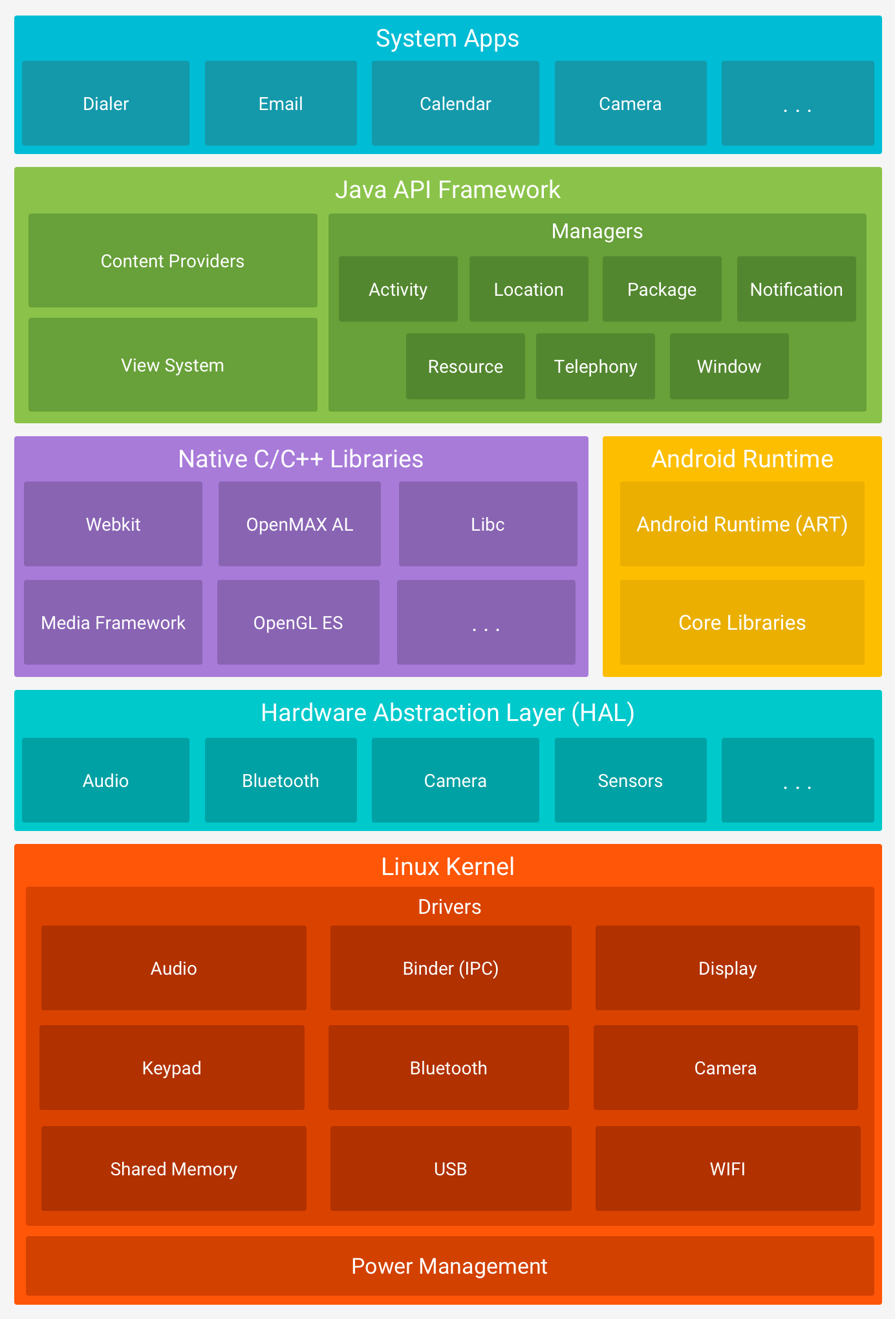
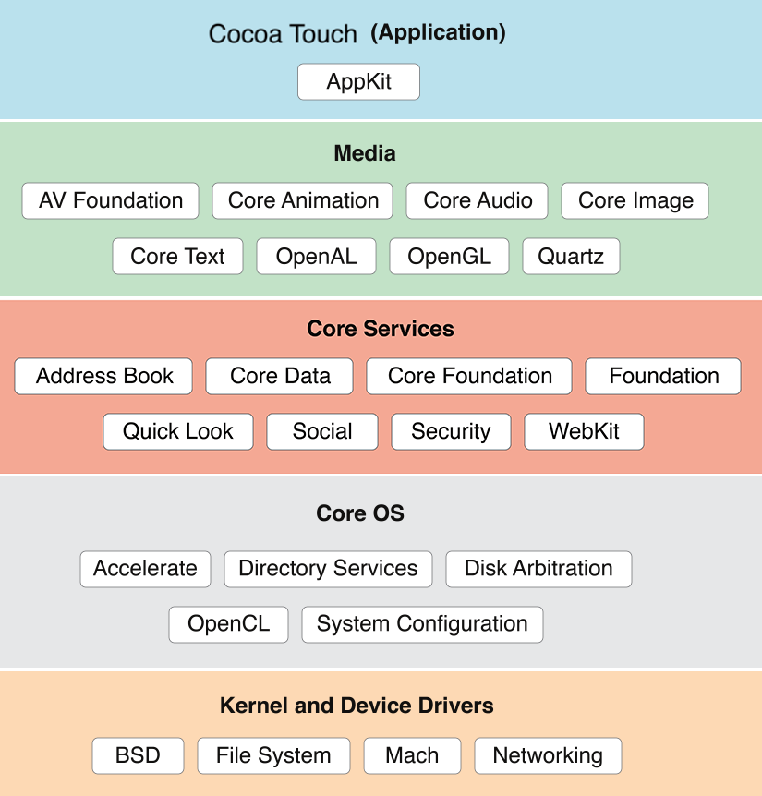
Android Versus iOS (Architecture)
Portability / reuse??
https://developer.android.com/guide/platform/images/android-stack_2x.png
https://www.dotnettricks.com/learn/xamarin/understanding-xamarin-ios-build-native-ios-app

Slide 6
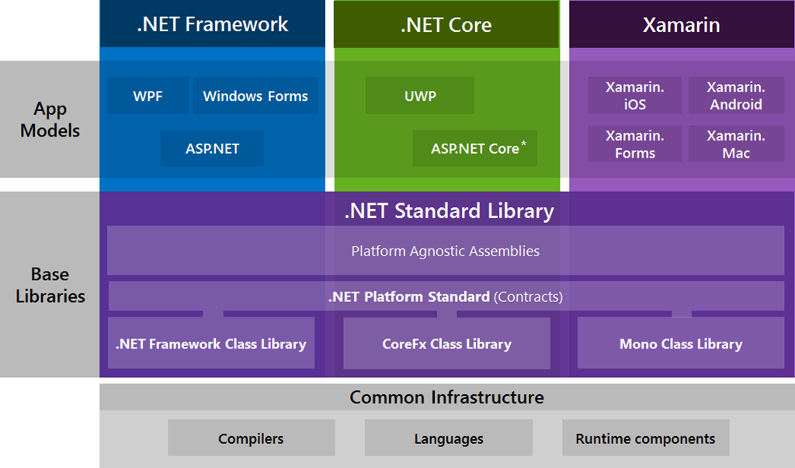
.Net Implementations: Architecture Overview
https://blogs.msdn.microsoft.com/cesardelatorre/2016/06/27/net-core-1-0-net-framework-xamarin-the-whatand-when-to-use-it/

Slide 7
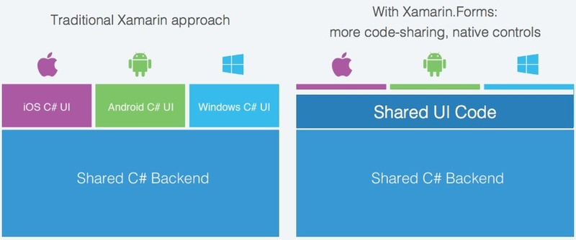
Xamarin Overview
Xamarin supports two foundational App development approaches
Xamarin Native
https://docs.microsoft.com/en-us/xamarin/cross-platform/get-started/introduction-to-mobile-development
Xamarin Forms
https://docs.microsoft.com/en-us/xamarin/get-started/
https://applikeysolutions.com/blog/xamarin-forms-vs-xamarin-native-what-fits-you-best

Slide 8
1. Xamarin Native
Develop native Android and iOS mobile applications!
How??
Xamarin provides complete Bindings and Interop for the underlying platform SDKs
Xamarin iOS.dll -- compiles into native iOS using the native tools and runtime
Objective-C, etc.
Xamarin.Android.dll -- compiles into native Android assembly code using the native tools and runtime,
Java, etc
Interop enables access full spectrum of the underlying platform and device libraries
Xamarin apps are 100% native, consumed/installed/managed on the native platform with native tools
https://docs.microsoft.com/en-us/xamarin/android/internals/architecture

Slide 9
2. Xamarin Forms
Portable UI framework for mobile apps.
Uses native libraries to enable front ends development using portable/shared code.
How??
Shared application code is built as shared (.Net standard) library
.Net standard is formal API specification supported by all .Net framework implementations “write once run everywhere”.
Android and iOS “native” projects consume the shared library as the portable mobile application.
Interop services enable access full spectrum of the underlying platform and device libraries
Xamarin Native apps allow for between (80-95%) cross-platform code [1]
https://docs.microsoft.com/en-us/dotnet/standard/net-standard

Slide 10
Xamarin Native versus Xamarin Forms
https://images.app.goo.gl/rJG6mqommi9ePNyn9

Slide 11
Android app
Xamarin.Android SDK assemblies
Shared
UI Code
Native apps consume shared code
Backend Code
iOS app
.Net standard (shared library)
Xamarin.iOS SDK assemblies

Slide 12
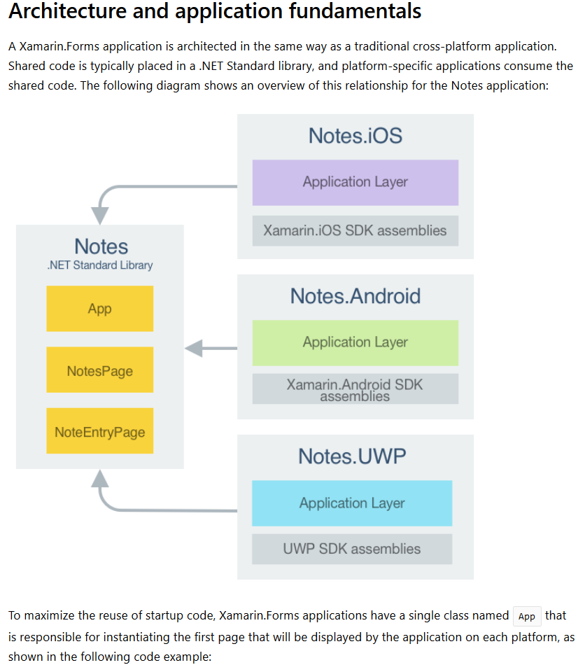
https://docs.microsoft.com/en-us/xamarin/cross-platform/app-fundamentals/code-sharing

Slide 13
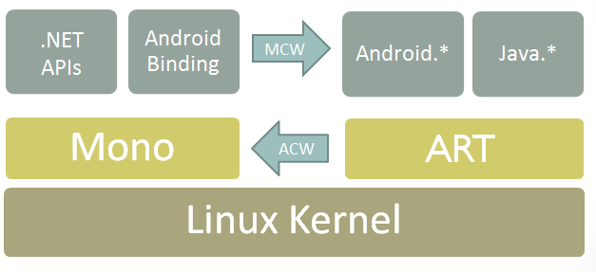
Xamarin Architecture (Android SDK bindings)
https://docs.microsoft.com/en-us/xamarin/android/internals/architecture

Slide 14
Benefits?
Different platforms use different code, different development paradigms/frameworks, different tool sets, and provide different environments with constraints on deployment and use.
No portability/sharing across platforms
More expensive: need skilled resources with expertise in respective tools and environments
Longer development cycles and maintenance of multiple code bases
Xamarin solves much of these issues
Lots of code reuse and portability
Single (shared) code base
Single set of development tools/environment
Shorter development cycles.
Access to advanced development constructs: e.g. dependency injection
Xamarin Native offers a high degree of “code reuse” – (75-80%) [1]
Xamarin Forms offers a high degree of “code portability” – (80-95%) [1]
https://arctouch.com/blog/xamarin-forms-more-capable-than-you-think/

Slide 15
Risks?
Xamarin Native
SDK bindings and interop utilize the native Android and iOS platform SDKs
Lots of reported code reuse (75-80%) [1]
Similar App performance to native tools/environments
Larger App footprint
Xamarin Forms
Traditionally, performance/responsiveness constraints for certain applications with high graphics requirements (games), highly dynamic content (animation etc.)
Performance had much improved with Xamarin Forms [2]
Applications that require minimalist App size requirements
Xamarin Forms Apps and larger than Native Apps
Shared Code is Not boxed in!
Shared code and can access native platform SDKs.
https://docs.microsoft.com/en-us/xamarin/android/deploy-test/app-package-size

Slide 16
Useful Links
https://docs.microsoft.com/en-us/xamarin/
https://docs.microsoft.com/en-us/xamarin/android/get-started/
https://docs.microsoft.com/en-us/xamarin/xamarin-forms/enterprise-application-patterns/mvvm
https://docs.microsoft.com/en-us/xamarin/cross-platform/app-fundamentals/building-cross-platform-applications/understanding-the-xamarin-mobile-platform
https://docs.microsoft.com/en-us/xamarin/cross-platform/app-fundamentals/building-cross-platform-applications/architecture
https://docs.microsoft.com/en-us/xamarin/cross-platform/app-fundamentals/code-sharing
https://docs.microsoft.com/en-us/xamarin/xamarin-forms/user-interface/map

Slide 17
Sources for additional information
[1] https://applikeysolutions.com/blog/xamarin-forms-vs-xamarin-native-what-fits-you-best
[2] https://arctouch.com/blog/xamarin-forms-more-capable-than-you-think/
https://insanelab.com/blog/mobile-development/xamarin-mobile-application-development/
https://www.altexsoft.com/blog/mobile/pros-and-cons-of-xamarin-vs-native/
https://hackernoon.com/the-pros-and-cons-of-xamarin-for-cross-platform-development-2a31c6610792

Slide 18
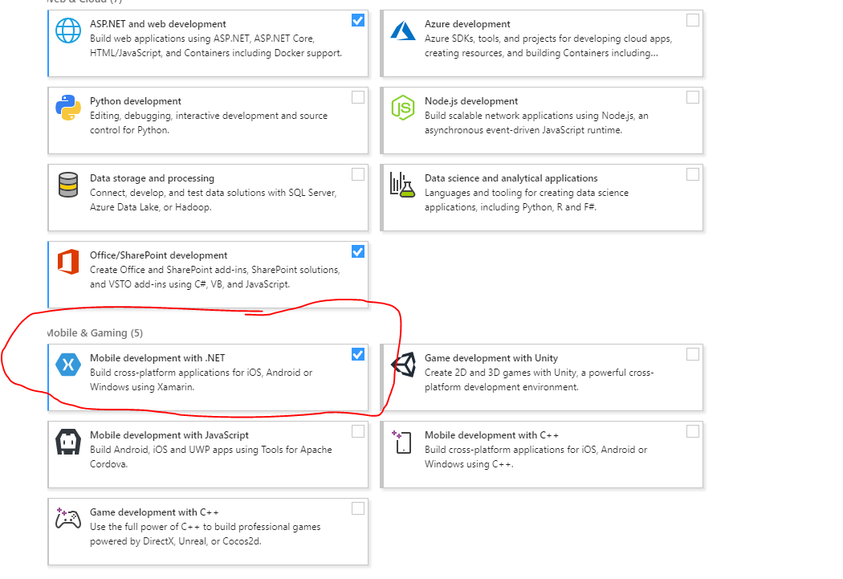
Visual Studio 2017 (latest update)
Start->Run: Type “Visual Studio Installer

Slide 19
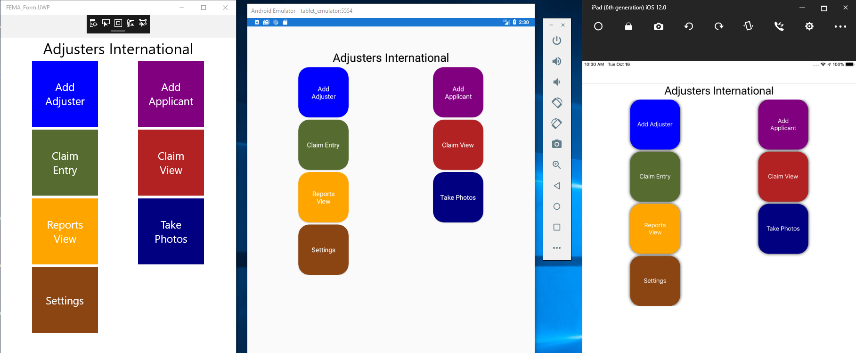
Live Demo: Cross platform Prototype (UWP, Android, iOS)

