Slide 1
Android WebService Demo
Naga Rama Krishna
Prof. Jim Fawcett

Slide 2
Android – not indepth
Lecture 12 demo – FileList

Slide 3
Problem statement
Make web service calls to a Web API
Get data
Post data

Slide 4
URLs
https://localhost:44381/api/Files
http://localhost:57644/api/Files

Slide 5
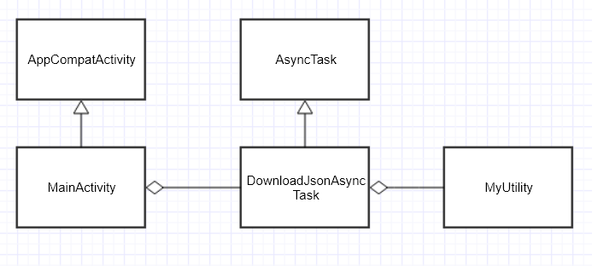

Slide 6
Android App
User Interface
Button
Text area (TextView)
Actual class(MainActivity)
Initiate action
Display of data
Action
Tigger via HttpURLConnection

Slide 7
Other Changes
Changes in FileList
Disable HttpsRedirection
Changes in applicationhost.config (“…\FileList\.vs\config”)
Change <binding protocol="http" bindingInformation="*: 57644 :localhost" /> to <binding protocol="http" bindingInformation=":57644:" />
Firewall changes – add port
Control Panel --> Windows Firewall --> Advances Settings --> Inbound Rules --> New Rule

Slide 8
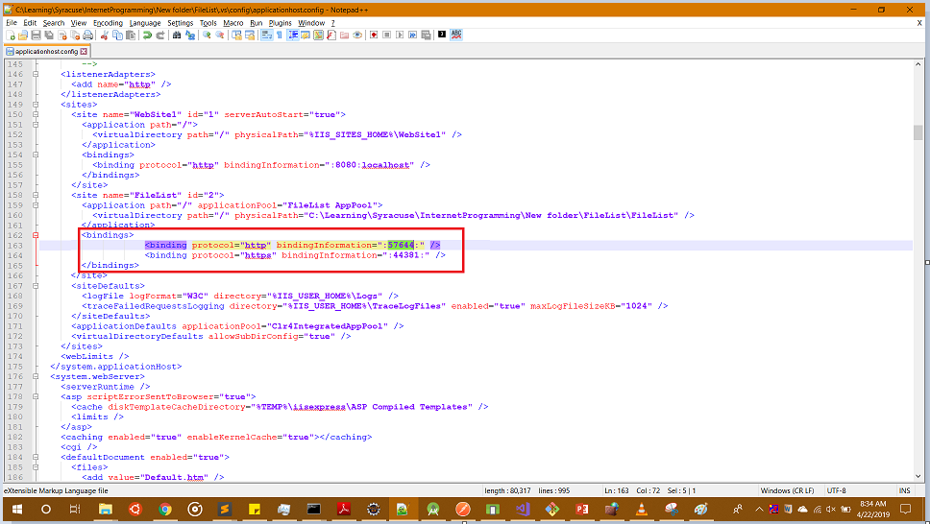
applicationhost.config

Slide 9
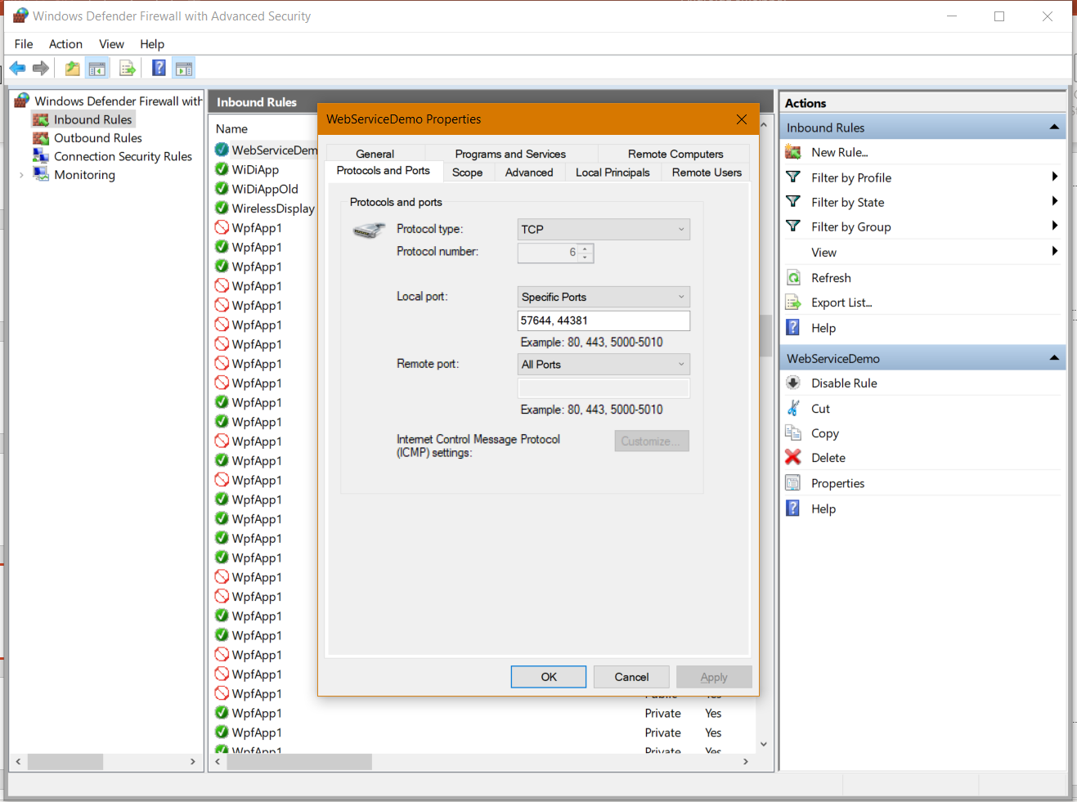

Slide 10
Troubleshooting
Test in browser/postman
Status code
WebAPI app not starting
Change port and try

Slide 11
References
https://stackoverflow.com/questions/45986621/visual-studio-2017-giving-remote-users-access-to-website-in-iis-express (Answer 2 for firewall binding)
https://www.mkyong.com/java/how-to-send-http-request-getpost-in-java/

