Slide 1
code dependency visualizer
CSE 690 – Independent Study
Instructor: Prof. Jim Fawcett
Submitted By: Prateek Sharma
Fall 2014

Slide 2
Dependency Visualizer
Application to visualize the dependencies among C++ source code files
Aim is to create a 2D spring based system for source code files where vertices will repel each other and try to move away for center
Based on the force on each vertex, we need to find a position in 2D dimension where sum of all the forces will be zero.
Contains of two separate parts:
  C++ application to build the dependency file
  C# WPF application to visualize the dependencies.

Slide 3
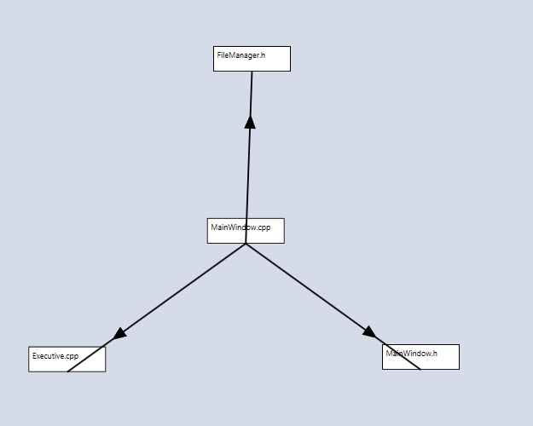
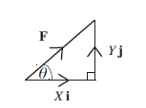

Basic physics

Slide 4
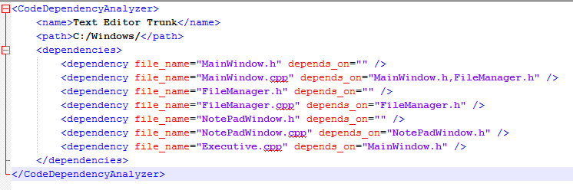
Analyzing dependencies
  Dependency graph created by the C++ application

Slide 5
Dependency Visualizer
  To draw the visual dependency graph, C# application uses following steps:
    Create a graph canvas where Vertices are files and edges are dependencies among files.
    Decide the random position for vertices on Canvas.
    Calculate the Vector Force for each file.
    F = Xi + Yj
    Solve the linear algebraic equation of vector forces iteratively.
      F₁V₁ + F₂V₂ + …..= 0

Slide 6
demo

Slide 7
Important Design decisions
Net force for the whole system:
Practically, in real world scenario, it is very difficult to achieve the net force Zero for the overall system.
F₁V₁ + F₂V₂ + ….. F_{N}V_{N} will never be zero.
So, we take constant C which is very close to zero.
F₁V₁ + F₂V₂ + ….. F_{N}V_{N} = C
Based on the sample test cases, value of C is chosen is be 100.

Slide 8
Important design decisions
Iteration count to solve the linear force algebraic equation
  To solve the linear algebraic equation, we use iterative algorithm where vertices are moved proportional to their forces (Step size is calculated for the movement and vertices force decides the step size)
  If we don’t use any terminating condition to solve the equation, algorithm might keep on running indefinitely.
  So, based on sample tests, we have chosen MAX_ITERATION_COUNT as 30.
  If after the MAX_ITERATION_COUNT , application is not able to solve the equation, first best result which is less than ERROR_THRESHOLD will be chosen.
  Here ERROR_THRESHOLD is the max allowed deviation from the C.

Slide 9
Important design decisions
Arrangement of vertices in 2D space
  Since vertices are drawn randomly, it is hard to achieve the obvious.
  For ex: application is not going to give the same result every result show here.
  So, addition capability is provided so that user can change the position of the vertices and again run the force equilibrium using with custom iteration count.

Slide 10
Thank you !!!

