Slide 1
Force Balance Algorithm Implementation
Charanjit Singh

Slide 2
Goals
Depict the dependencies between source code files through a dynamic graph
  Individual files are the vertices in the graph
  Edges between the vertices/files show the dependencies
Implement the Force Balance Algorithm that calculates the attractive and repulsive forces between the vertices of the graph
Explore Microsoft’s WPF technology, C# and C++ languages to analyze and show the dependencies

Slide 3
Technologies Used
Windows Presentation Foundation (WPF) – WPF has been used to render the graph on the screen
Languages used:
  C# has been used to implement the Force Balance Algorithm and draw the graph on the WPF canvas
  C++ has been used to analyze the dependencies between the C++ source code files and create an XML of those dependencies

Slide 4
Force Balance Algorithm
This algorithm has two parts:
Two vertices exert both attractive and repulsive forces on each other if there’s an edge between them
Two vertices exert repulsive forces on each other if there’s no edge between them

Slide 5
Force Balance Algorithm Cont’d
Attractive forces between the two vertices are given by the following equation:
F_{ax} = K * (V_{1x} - V_{2x} )
F_{ay} = K * (V_{1y} - V_{2y} ), where K is attraction constant
Repulsive forces between the two vertices are given by the following equation:
F_{rx} = G / (V_{1x} - V_{2x} )
F_{ry} = G / (V_{1y} - V_{2y} ), where G is repulsion constant

Slide 6
Force Balance Algorithm Cont’d
Net force on a vertex in both X and Y directions is given by the following equation:
F = K * (V₁ - V₂ ) – (G / (V₁ - V₂))
If there is no edge between two vertices, they shall only exert a repulsive force on each other. So, the net force on the vertex is given by the following equation:
F = – (G / (V₁ - V₂))

Slide 7
Force Balance Implementation
For each vertex in the graph, I have calculated the net force on that vertex, which will be a sum of all the attractive and repulsive forces acting on it
Greater distances between the vertices will result in net attractive forces, and they will be pulled together
As the distances between the vertices get smaller, the repulsive forces will increase and counter the attractive forces

Slide 8
Net Force Calculation
Net force calculation for non-neighboring vertices is calculated as follows:
yForceMagnitude += (G / (Y1 - Y2));
xForceMagnitude += (G / (X1 - X2));
Net force calculation for neighboring vertices is calculated as follows:
yForceMagnitude += -(K * (Y1 - Y2)) + (G / (Y1 - Y2));
xForceMagnitude += -(K * (X1 - X2)) + (G / (X1 - X2));

Slide 9
Force Balance Implementation Cont’d
At a certain distance, these forces will balance each other and the net force on each vertex will be zero
The graph at this point will become static

Slide 10
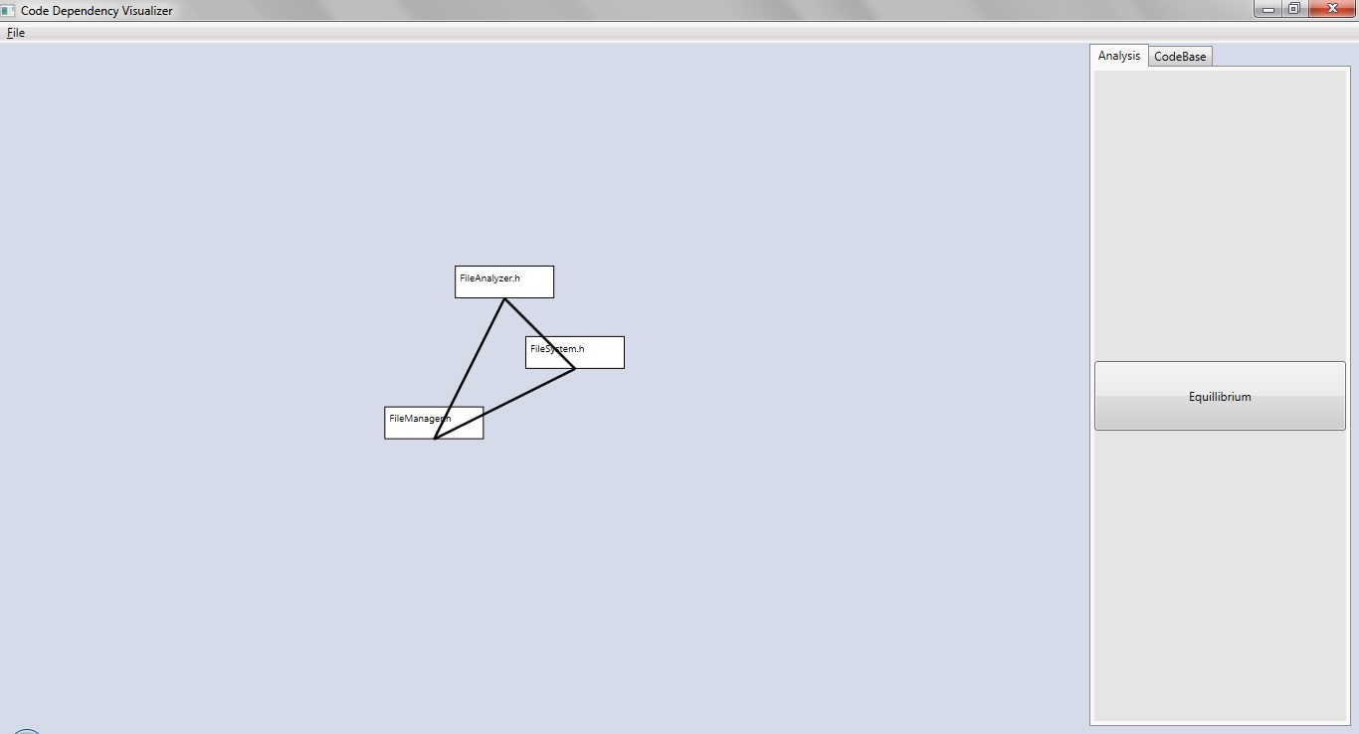
Demo

Slide 11
Technologies Explored
Used the Windows Presentation Foundation (WPF) to create the User Interface of the application
  Drew the graph on the Canvas object provided by WPF
  Used the Windows.shapes objects to depict the files as rectangular vertices in the graph and draw lines between them to show the dependencies
  Learned to write asynchronous methods in C# that did not impact the responsiveness of the application

Slide 12
Technologies Explored Cont’d
Created a separate thread to run the Force Balance Algorithm in C# and updated the UI with the new calculation results after every 0.3 sec
Learned to do multithreading in C# that would run the UI and the backend calculations on separate threads
Assigned a dispatcher to the UI that would be invoked by the backend to update the UI with new results of the calculations

Slide 13
Technologies Explored Cont’d
Used LINQ to parse the xml file containing the dependency data:
from dependency in document.Descendants("dependencies").Elements()
select dependency

Slide 14
Technologies Explored Cont’d
Learned to use the Canvas in Javascript to draw shapes on it. Created individual vertices as circles on the Javascript canvas
var canvas = document.getElementById('graphCanvas');
var ctx = canvas.getContext('2d');
ctx.arc(x,y,radius,0,2*Math.PI);
Learned to parse an XML file in Javascript:
xmlDoc=xhttp.responseXML;
var elem = xmlDoc.getElementsByTagName("dependency");

Slide 15
Technologies Explored Cont’d
Sent an HTTP request from the Javascript function to the server and responded with an xml file in the HTTP response from the server:
xhttp=new XMLHttpRequest();
xhttp.open("GET","getxml",false);
xhttp.send();
HttpServletResponse resp;
resp.setContentType("application/xml");
PrintWriter writer = resp.getWriter();

Slide 16
Thank you

