Slide 1
Help for Visual Studio Code
Jim Fawcett
CSE686 – Internet Programming
Spring 2019

Slide 2
Visual Studio Code (VS Code)
VS Code is a text editor build with the Electron.js JavaScript framework.
It is easy to use for building static web pages.
In conjunction with the dotnet command, and a default C# plugin, it is a capable Integrated Development Environment (IDE) for working with Asp.Net Core applications.
Visual Studio has more facilities, and, once you learn how it works, it is a very effective tool for building static pages and working with Asp.Net Core projects.
VS Code will do everything we need for the first half of the course.

Slide 3
Using VS Code
The first thing to do is download the latest version – it’s free. Just ask Dr. Google to take you to VS Code download.
That will download an installer in your Download directory. Run it – that takes just a minute or so - then start up VS Code.

Slide 4
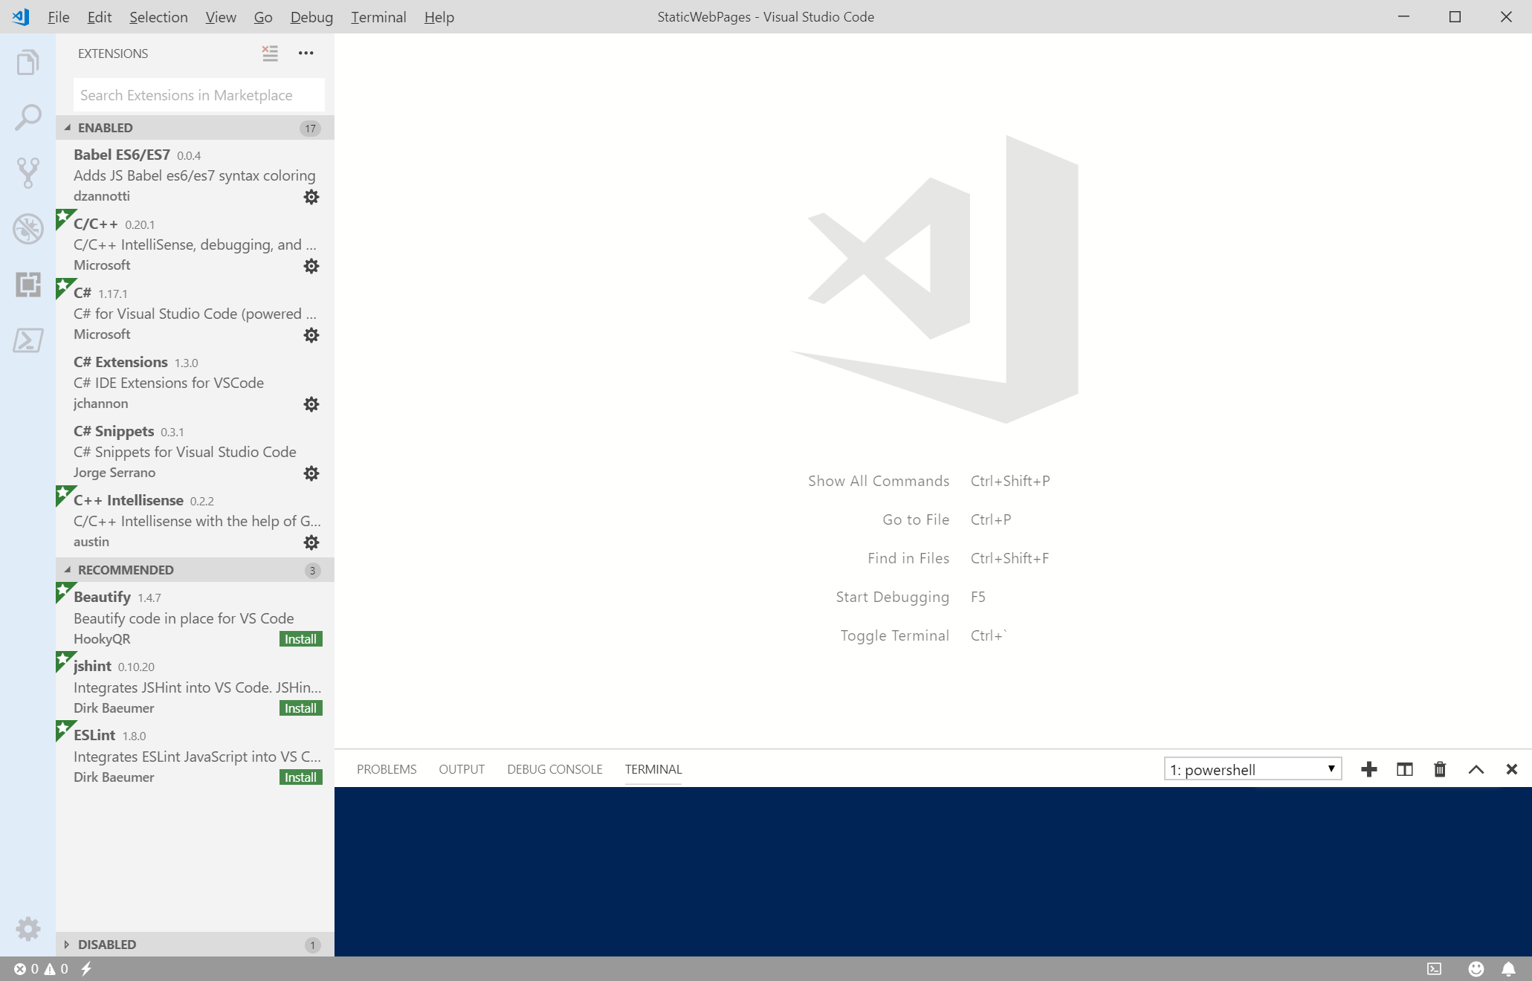
Visual Studio Code Window
Extensions
Terminal

Slide 5
Building Static Web Pages
File > Open Folder > select a folder in dialog
File > New File > Enter opens editor on an un-named text file
Enter some small amount of text
File > Save As > Enter File name > Save
File > Save As > right-click on dialog > new > folder > CSS
File > Save As > right-click on dialog > new > folder > JS

Slide 6
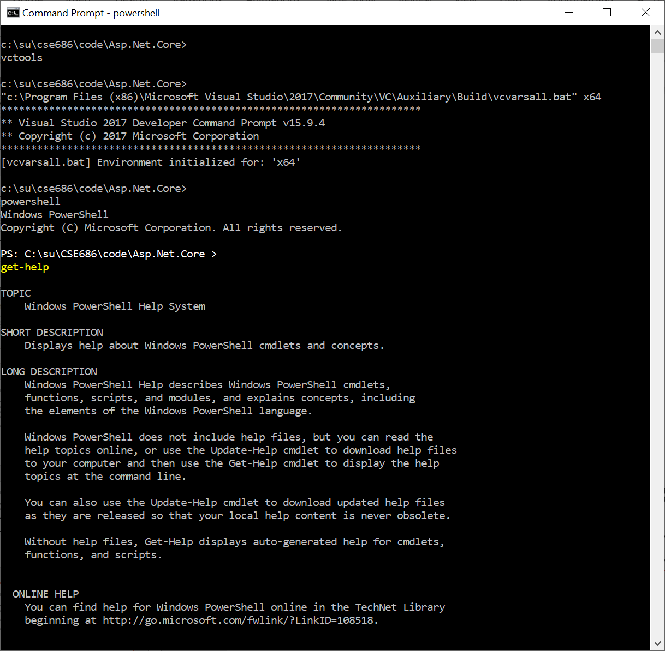
Functionality
PowerShell.exe
A superset of the Cmd.exe functionality
Has a lot of operations for system administration.
Does not have environment variables to access C++ tool chain.
We can add those by opening a cmd prompt, executing vcvarsall.bat, and then opening powershell from within the cmd shell.

Slide 7
So What?
If we use Visual Studio Code:
VS Code can’t create .net core projects
So we create a project folder, call dotnet new console (or whatever)
Open Visual Studio Code
Open the newly created folder
When you do this VS Code will ask if you want to create resources to work with that folder.
Select yes – that builds a json settings file to manage builds and debugging
Start editing files and running

Slide 8
That’s all Folks!

