Slide 1
Asp.Net mvc
Jim Fawcett
CSE686 – Internet Programming
Spring 2014

Slide 2
What is Asp.Net MVC?
Framework for building web applications
Based on Model-View-Controller pattern
  Model manages the application data and enforces constraints on that model.
    Often accessed through persistent objects
  Views are mostly passive presentations of application state.
    Views generate requests sent to a controller based on client actions.
  Controllers translate requests into actions on the data model and generate subsequent views.

Slide 3
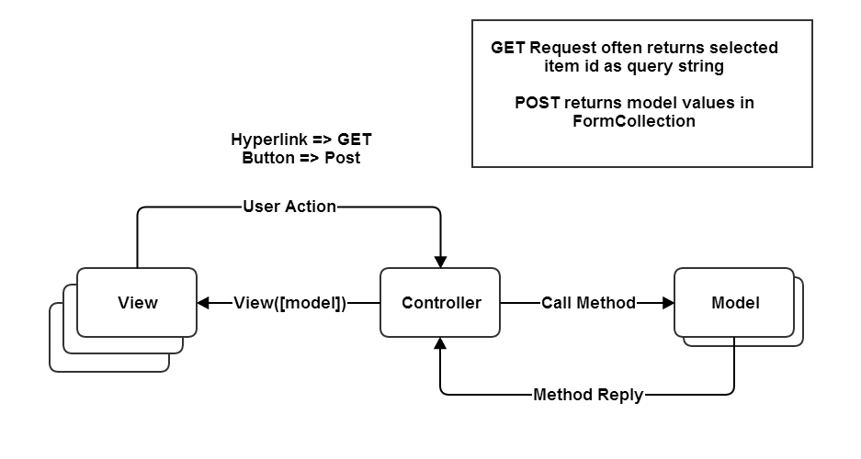
MVC Structure

Slide 4
MVC Life Cycle
Clients request a named action on a specified controller, e.g.:
  http://localhost/aController/anAction
The request is routed to aController’s anAction method.
  That method decides how to handle the request, perhaps by accessing a model’s state and returning some information in a view.

Slide 5
What is a Model?
A model is a file of C# code and often an associated data store, e.g., an SQL database or XML file.
  The file of C# code manages all access to the application’s data through objects.
  Linq to SQL and Linq to XML create queries into these data stores
    This can be direct
    More often it is done through objects that wrap db tables or XML files and have one public property for each attribute column of the table.

Slide 6
One MVCGridDemos Model
namespace MvcApplication2.Models
{
public class FileHandler
{
public string path { get; set; }
public string[] files { get; set; }
public bool GetFiles(string pattern)
{
try
{
int pos = path.LastIndexOf("Home");
path = path.Substring(0, pos) + "Views\\Home";
files = System.IO.Directory.GetFiles(path);
return true;
}
catch { return false; }
}
}
}

Slide 7
Adding a Model
Right-click on Model folder and select Add Class.
  Populate the model class with public properties that represent data to be managed.
  Usually the model is persisted to an XML file or SQL database using LINQ or the Entity Data Framework.

Slide 8
What is a View?
Views are usually aspx files with only HTML and inline code, e.g., <% … C# code here … %>.
  Code is used just to support presentation and does no application processing.
  The HTML is augmented by HTML Helpers, provided by Asp.Net MVC that provide shortcuts for commonly used HTML constructs.
  Asp.Net MVC comes with jQuery (Javascript) libraries to support reacting to client actions and doing AJAX communication with the server.

Slide 9
Views are results of actions
class myController : controller
{
ActionResult someMethod(ModelClass model)
{
// possibly do something to model
ViewData[“key”] = “a message”;
return View(model);
}
}

Slide 10
Script Blocks
<% code to execute %>
<%= string to write to Response %>
<%: string to write to Response, gets HTML encoded %>
<%$ AppSettings:Key %>
<%# Eval(“Value”) %> renders bound property
http://weblogs.asp.net/scottgu/archive/2010/04/06/new-lt-gt-syntax-for-html-encoding-output-in-asp-net-4-and-asp-net-mvc-2.aspx
http://michielvoo.net/blog/expressions-vs-statements-part-2-asp-net-code-block-types/

Slide 11
Html Helpers
ActionLink:
links to an action method
CheckBox
DropDownList
EditTextBox
Hidden
ListBox
Password
RadioButton
TextArea
TextBox

Slide 12
Adding a View
Right-click on View folder select Add View and configure view from the resulting dialog.
  It’s easy to generate tables and lists that can be edited and posted back to the controller to effect changes to its model.
  The HTML helpers on the previous page make building a view a fairly simple process.
  The wizard for Strongly Typed views does most of the work in rendering model details.

Slide 13
What is a Controller?
A controller is a C# class that derives from the class Controller.
  A controller defines some category of processing for the application.
  Its methods define the processing details.
  Routing to a controller is defined in the Global.Asax.cs file. Its default processing is usually what you need.
  You need to change the controller name to match the name of the default controller.

Slide 14
Data Binding
If a controller method takes a model class as a parameter, then the MVC infrastructure will instantiate an instance and pass to the controller method when requested via a url.
On postback, if View parameters have the same names as model names, then the MVC infrastructure uses reflection to bind current view values to the model.

Slide 15
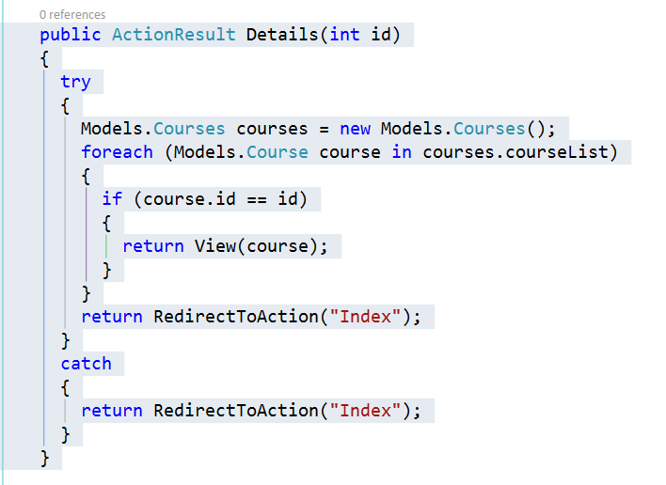
MvcCRUDwithXML Controller
Action methods

Slide 16
Action returns ActionResult
ActionResult: base class
ContentResult: user defined object to Response
EmptyResult: Nothing to Response
FileResult: Send binary file to Response
RedirectResult: redirect to url
RedirectToRouteResult: redirect using routes
JasonResult: send json to Response
JavaScriptResult: send Javascript to Response
ViewResult: Render a view

Slide 17
Adding a Controller
Right-click on the Controller folder and select Add Controller.
  Populate controller with methods whose names will become views and that take model parameters to supply views with data and react on postback to data changes made in view.

Slide 18
Web Application Development
Create a new Asp.Net MVC project
  Delete any part of that you don’t need
Add a controller for each category of processing in your application:
  A category is usually a few pages and db tables that focus on some particular application area
Add methods to each controller for each request you wish to handle.
Add views as needed for each controller action
Add Model classes to support the application area:
  Each model class has public properties that are synchronized with data in the model db or XML file.

Slide 19
An Opinion
This Asp.Net MVC structure is very flexible:
  You can have as many application categories as you need, simply by adding controllers.
  The controllers keep the application well organized.
  You can have as many views as you need. The navigation is simple and provided mostly by the MVC infrastructure, e.g., routing in Global.asax.cs.
  You can have as many models as you need. Just add classes and use Linq to access the data.

Slide 20
Things you need to know
LINQ – Language integrated query
  Linq to XML and Linq to SQL are commonly used by models to provide data needed by a controller for one of its views.
Jquery – Javascript Query library
  Jquery is frequently used by views to react to client actions in the browser.
  Jquery has facilities to use AJAX to retrieve small amounts of information from the server without loading a new view.

Slide 21
References
Class Text: “Professional Asp.Net MVC 4”
Asp.Net MVC Tutorials
  http://weblogs.asp.net/scottgu/archive/2007/11/13/asp-net-mvc-framework-part-1.aspx
  http://nerddinnerbook.s3.amazonaws.com/Intro.htm
Linq:
  http://dotnetslackers.com/articles/csharp/introducinglinq1.aspx
Jquery
  http://docs.jquery.com/Tutorials:How_jQuery_Works#jQuery:_The_Basics

