Slide 1
WPF Controls
Jim Fawcett
CSE775 – Distributed Objects
Spring 2011

Slide 2
References
Programming WPF, 2nd Edition, Sells and Griffith, O’Reilly, 2007
Silverlight 4 Unleashed, Bugnion, SAMS, 2011
MSDN: Data Binding Overview

Slide 3
WPF - The Parts
Rendering Model
Dispatcher
INotifyChange
DependencyObject
Change notification
Attached Properties
ObservableCollection
Data Binding
Markup Extensions
Control Template
Data Template
Resource Dictionaries
Markup Extensions

Slide 4
Rendering Model
WPF Graphics Rendering
Visual class is base for all FrameworkElement classes.
Holds the Hwnd of the underlying Win32 Application Window.
Supports:
Rendering serialized, persisted drawing content
Transformations and clipping
Hit testing
Bounded Boxes
Uses Retained Graphics Mode
Drawing information is persisted in a serialized state by application, but WPF is responsible for rendering – you never call invalidate().
Uses Painter’s Algorithm

Slide 5
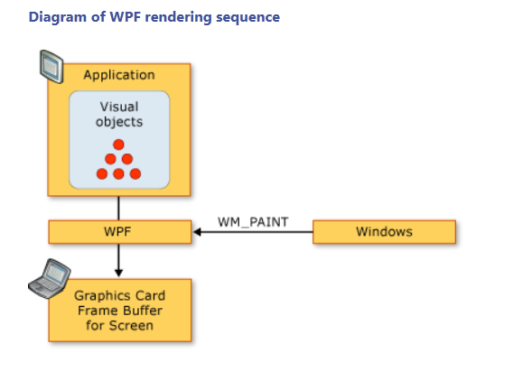

Slide 6
Dispatcher
WPF_DispatcherDemo
MSDN: WPF Threading Model
WPF uses a message loop, similar to Win32 programs
Adds priority queuing
All WPF applications have at least two threads
Message pump thread, managed by Dispatcher
Rendering thread
Windows have thread affinity, e.g., the STA model.
Worker threads return results to the UI thread for display
They use UIElement.DispatcherObject.Dispatcher.Invoke(…)
DispatcherObject, base for UIElements, holds the UI Dispatcher as a property and provides CheckAccess() and VerifyAccess() methods to see if the operation needs to be dispatched through Dispatcher.Invoke(…)

Slide 7
Change Notification
WPF_ChangeNotification
Implement Change Notification
All WPF property binding works through change notification:
Every UIElement derives from DependencyObject
DependencyObject implements INotifyPropertyChanged
One element, the PropertyChanged event
Binding:
Subscriber uses UIElement.DataContext.Source as Publisher
Subscribes to its PropertyChanged event
Compiled Xaml provides a handler for the subscription that handles the property change.

Slide 8
Dependency Object
All UIElements derive indirectly from DependencyObject
DependencyObject provides:
Facilities for one-way and two-way property change notification, based on the INotifyPropertyChanged interface
A property dictionary used to hold values of properties, including values for container properties, called attached properties.
A UIElement registers its dependency properties using Register method.
UIElement registers its attached properties using RegisterAttached.
Values returned from the property system are evaluated in a multistep process:
Coercion, animation, local value, parent template properties, implicit style, style triggers, template triggers, style setters, default style, inheritance, default value defined in dependency property metadata

Slide 9
Observable Collection
Observable Collections
A dynamic data collection that provides notifications when items are:
Added
Removed
List is refreshed
Implemented by:
ObservableCollection<T>
List<T>
Collection<T>
BindingList<T>

Slide 10
Data Binding
WPF_DemoPanels
MSDN Data Binding Overview
The markup extension: targetProp = “{Binding Path=PropName}” attempts to subscribe to the PropertyChange event of the object listed as source in the closed DataContext.

Slide 11
Control Template
WPF_ControlTemplateDemo
MSDN: ControlTemplate Class
Awaiting more slide content

Slide 12
Data Template
WPF_DataTemplateDemo
MSDN: DataTemplate Class
Awaiting more slide content

Slide 13
Resource Dictionaries
WPF_DemoPanels
MSDN: WPF Resources
Slide awaiting more content

