Slide 1
LINQ
Jim Fawcett
CSE681 – Software Modeling and Analysis
Fall 2016

Slide 2
References
C# 6.0 in a Nutshell, 6th Edition, Albahari & Albahari
Pro C# 5.0 and the .Net 4.5 Framework, Sixth Edition, Andrew Troelsen
Programming C# 5.0, Ian Griffiths
http://msdn.microsoft.com/en-us/library/vstudio/bb397926.aspx
http://en.wikipedia.org/wiki/Language_Integrated_Query
http://code.msdn.microsoft.com/101-LINQ-Samples-3fb9811b
http://msdn.microsoft.com/en-us/library/system.xml.linq.aspx

Slide 3
Language INtegrated Query (LINQ)
LINQ is an extension to C#, VB, and F# and has been ported to other languages as well.
The extension is based on:
LINQ Providers
Query Operators
Extension Methods
Language Features
Anonymous types using var keyword
Lambda expressions
delegates
Expression Trees
SQL Provider

Slide 4
LINQ Providers
A LINQ provider publishes:
library of Query operators which are implemented as extension methods
Each kind of data requires its own implementation
The .Net Framework has several LINQ providers and facilities:
LINQ to Objects
Works with IEnumerable<T> collections
LINQ to SQL
Works with IQueryable<T> data
LINQ to XML is not an LINQ provider
It is an API for creating and parsing XML documents
Works with XDocument class
Others: LINQ to Entities, WCF Data Services

Slide 5
Query Operations
IEnumerable<T>
IQueryable<T>
Source
Source<T>
Input collection
LINQ
Query
Query expression
Source<TResult>
Query result

Slide 6
LINQ Queries – Extension Syntax
Here is a typical query using extension method syntax: string[] cars = { "Boxter", "Mini Cooper", "Mustang", "Camaro", "Miata", "Z4" };
IEnumerable<string> query = cars
.Where(n => n.StartsWith("M"))
.OrderBy(n => n)
.Select(n => n);

Slide 7
LINQ Queries – Query Syntax
Here’s the same query using Query Syntax: var query =
from n in cars
where n.StartsWith("M")
orderby n select n;
Note the difference in capitalization and use of . notation

Slide 8
Query Operators
Restriction: Where
Projection: Select, SelectMany
Partitioning: Take, Skip, TakeWhile, SkipWhile
Ordering: OrderBy, OrderByDescending, ThenBy, ThenByDescending, Reverse
Grouping: Groupby
Set: Distinct, Union, Intersect, Except
Conversion: ToArray, ToList, ToDictionary, OfType
Element: First, FirstOrDefault, ElementAt
Generation: Range, Repeat,
Quantifiers: Any, All
Aggregate: Count, Sum, Min, Max, Average, Aggregate
Miscel: Concat, EqualAll
Join: Cross Join, Group Join, Cross Join with Group Join, Left Outer Join
Execution: Deferred Execution, immediate Execution, Query Reuse

Slide 9
LINQ to XML
LINQ to XML is not based on a LINQ Provider of extension methods.
LINQ to XML uses the XDocument class that builds and interrogates an XML parse tree.
Many of its methods return IEnumerable<T> objects
That supports LINQ to Objects queries
The most important classes are:
XDocument
XElement
XAttribute

Slide 10
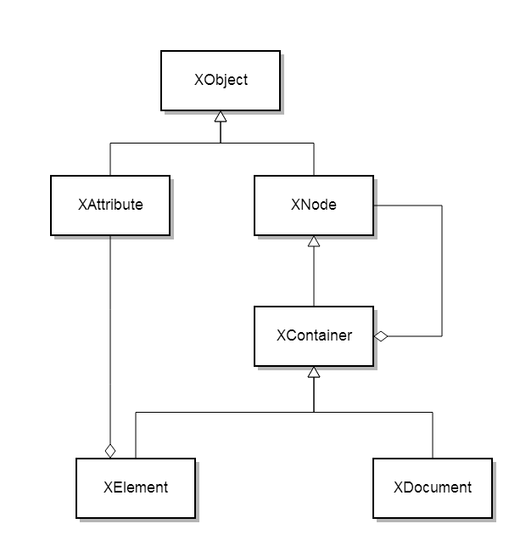
LINQ to XML Class Diagram

Slide 11
XElement and XDocument
We can build an XElement instance from an XML string: XElement elem = XElement.Parse(xmlString);
We can build an XDocument instance from a file containing XML: XDocument doc = XDocument.Load(@”..\aFile.xml”);
You can serialize an Xdocument to a File, Stream, TextWriter, or XmlWriter:
doc.save(“../anXmlFile.xml”);

Slide 12
Query Functions
XElement.Elements() returns child XElements
XElement.Elements(“name”) returns child XElements with tag “name”
XElement.Decendents() returns decendent Xelements
XElement.DecendentNodes() returns decendent XNodes
XNode.Parent returns parent Xelement
XNode.Document returns the XDocument element
XNode.Ancestors() returns XElement ancestors

