Slide 1
Role Object Pattern
Xiaohan Zhang Vishvesh Shah BohaoLi

Slide 2
Intent
Adapt an object to different client’s needs through transparently attached role objects, each one representing a role the object has to play in that client’s context.

Slide 3
Motivation
Once we want to scale up the system into an integrated suite of applications, we have to deal with different clients that need context-specific views on our key abstractions, and integrating may leads to bloated interfaces.

Slide 4
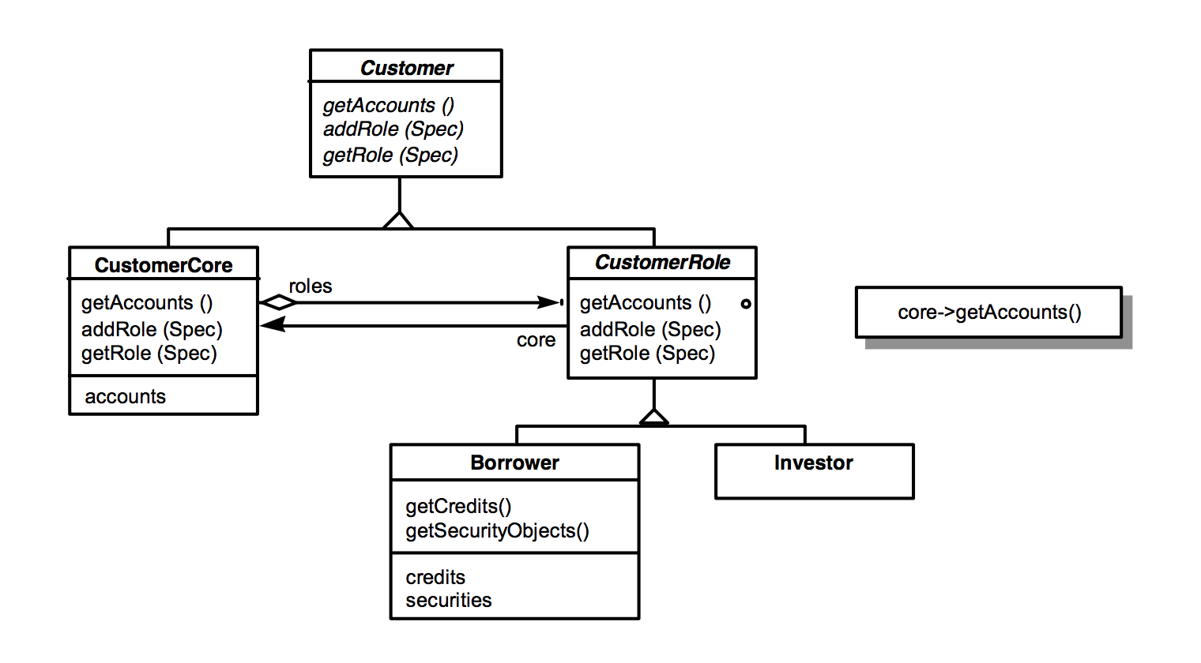
Example: Banks
Customer
Intergate context-specific views
solve bloated interfaces
Add subclasses
idendity problem
Role object pattern
The Role Object pattern suggests to model context-specific views of an object as separate role objects which are dynamically attached to and removed from the core object

Slide 5
Applicability
Use the Role Object Pattern if:
do not want to put the context- specific interfaces into the same class interface.
handle the available roles dynamically so that they can be attached and removed on demand
treat the extensions transparently and need to preserve the logical object identity of the resulting object conglomerate.
keep role/client pairs independent from each other, so changes to a role do not affect clients that are not interested in that role.

Slide 6
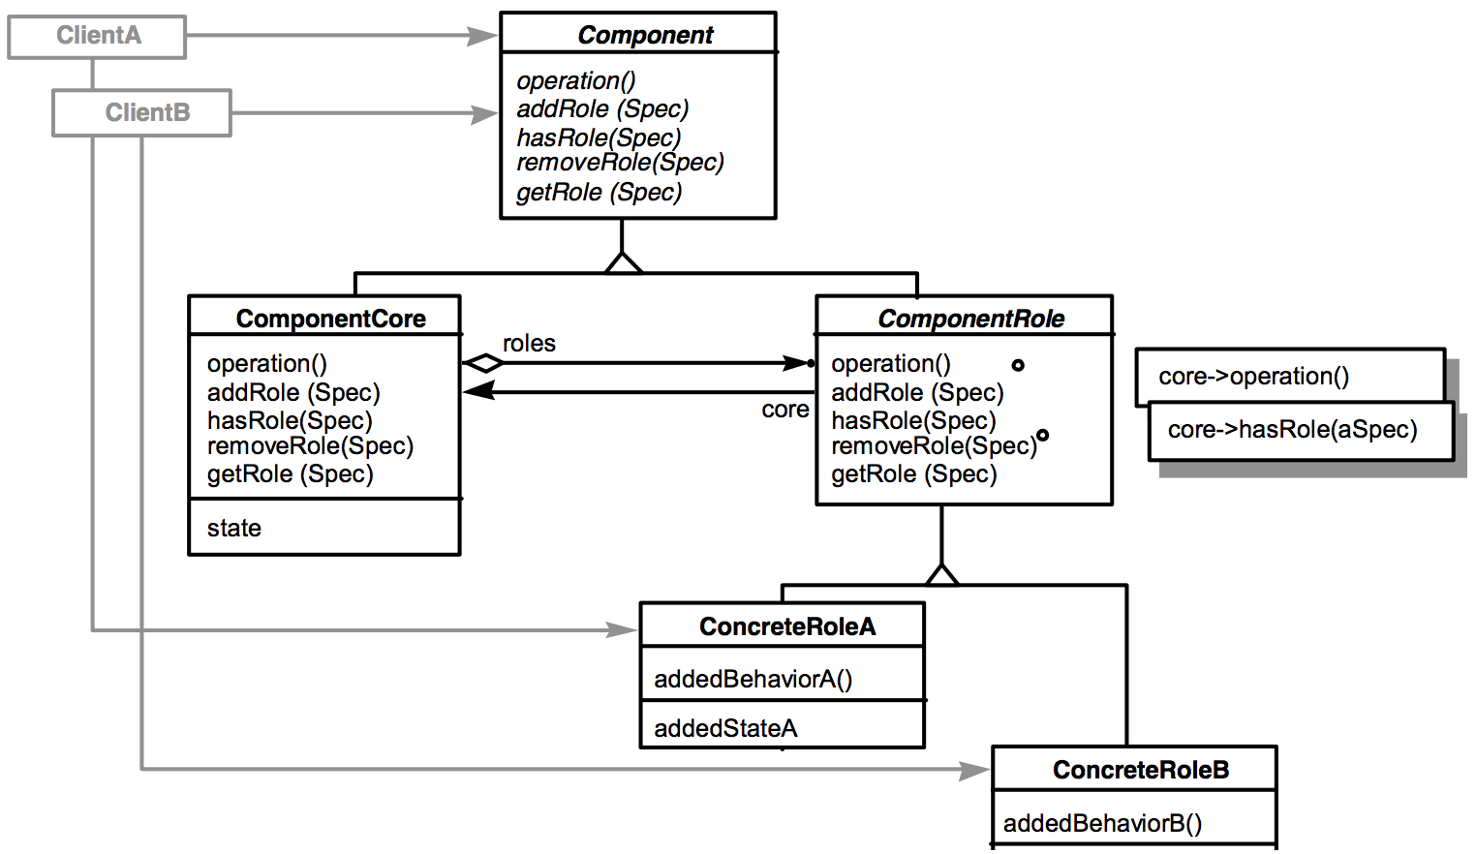
Participants
Compoents(Customer)
specifies the protocol for adding, removing, testing and querying for role objects;
a client supplies a specification for a ConcreteRole subclass.
ComponentCore(CustomerCore)
implements the Component interface including the role management protocol;
creates ConcreteRole instances; manages its role objects.
ComponentRole(CustomerRole) stores a reference to the decorated ComponentCore;implements the Component interface by forwarding requests to its core attribute.
ComponentRole(CustomerRole)
models and implements a context-specific extension of the Component interface;
can be instantiated with a ComponentCore as argument

Slide 7
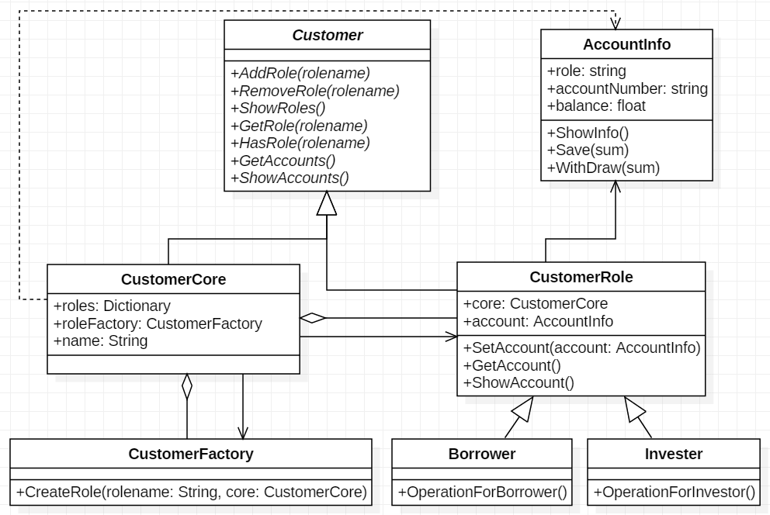
Class Diagram

Slide 8
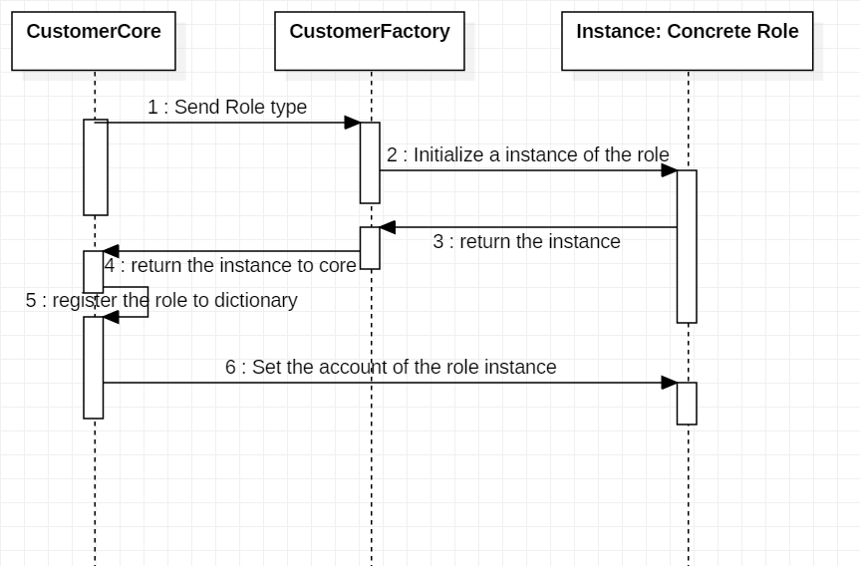
Sequence Diagram

Slide 9
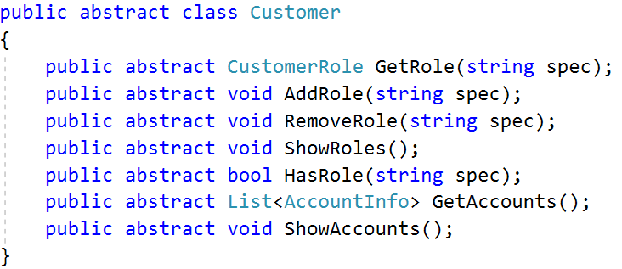
Sample Code (Customer)

Slide 10
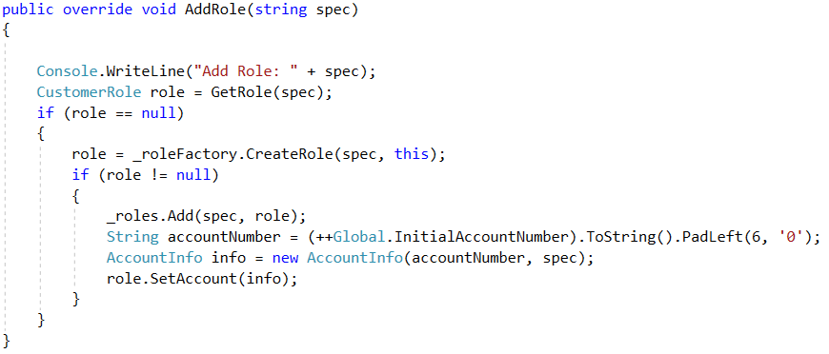
Sample Code (CustomerCore)

Slide 11
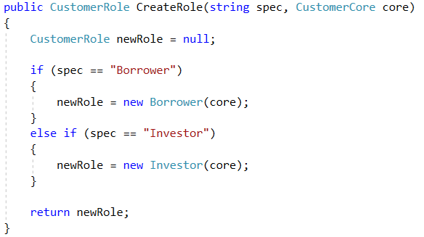
Sample Code (CustomerRoleFactory)

Slide 12
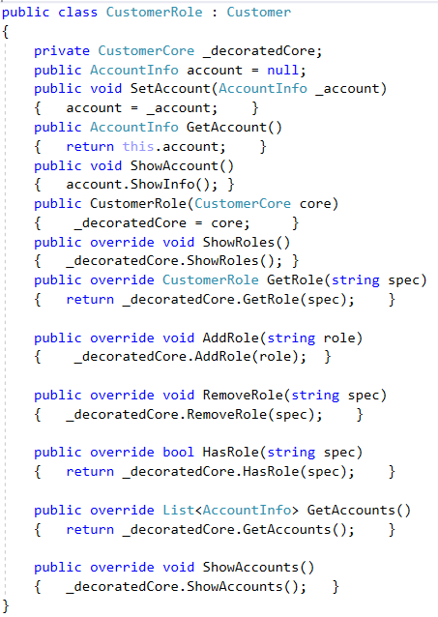
Sample Code (CustomerRole)

Slide 13
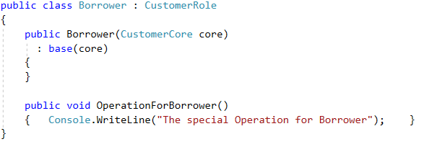
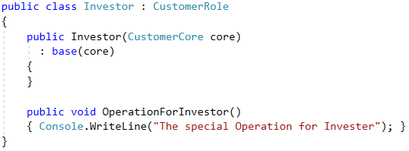
Sample Code (Subclass of CustomerRole)

Slide 14
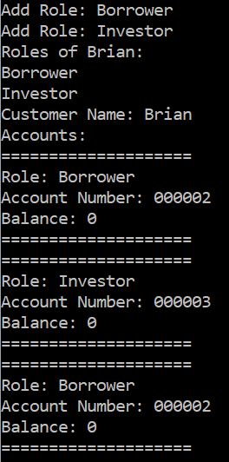
Sample Code (Test function First Part)

Slide 15
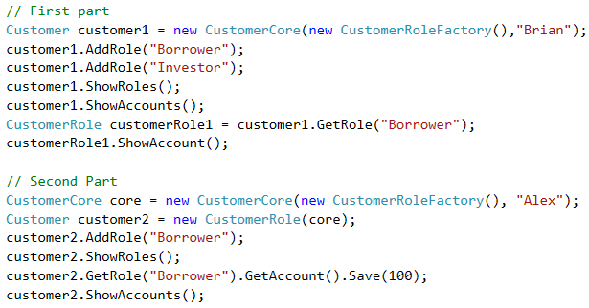
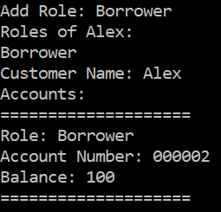
Sample Code (Test function Second Part)

Slide 16
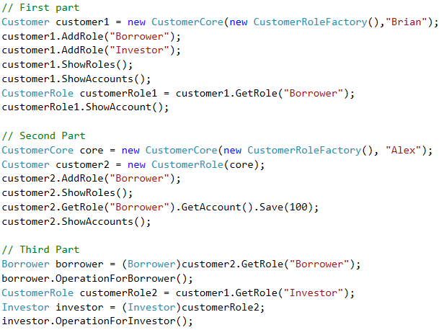
Sample Code (Test function Third Part)

