Slide 1
Memento Code
Jim Fawcett
CSE776 – Design Patterns
Fall 2016

Slide 2
www.dofactory.com

Slide 3
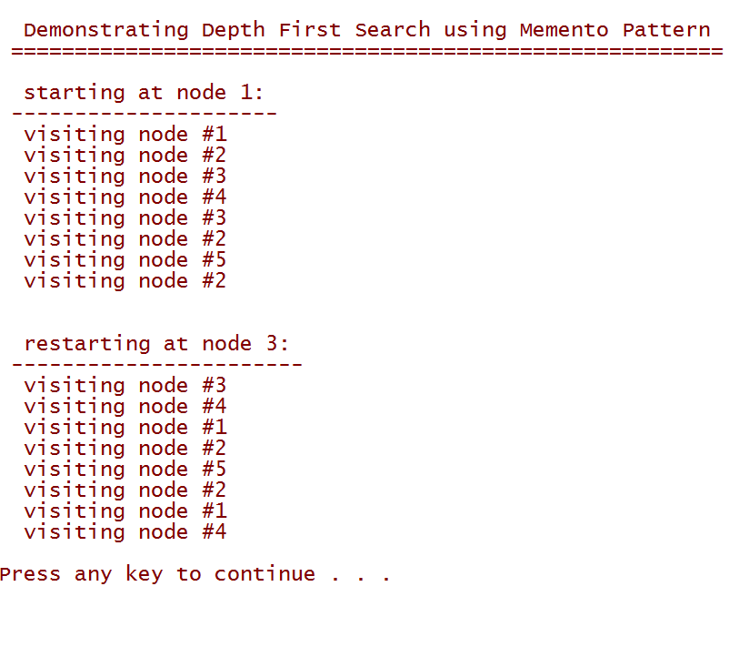
Memento Pattern: Non-Recursive Depth First Search

Slide 4
Node – used to build graph

Slide 5
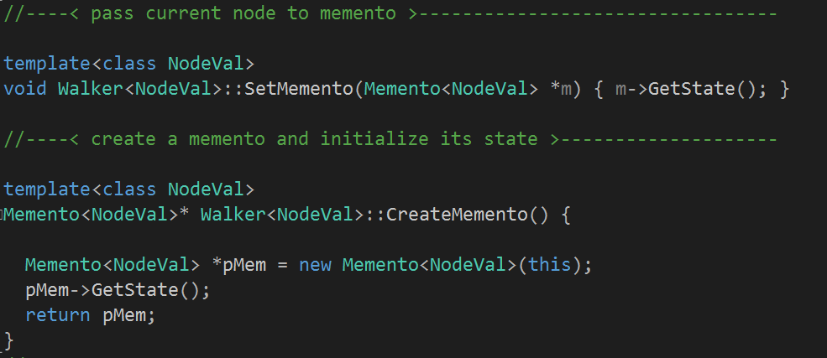
Originator – Node Walker

Slide 6
Memento - takes reference to originator - graph walker is originator - saves and returns location

Slide 7
Caretaker

Slide 8
Memento Pattern: Non-Recursive Depth First Search

Slide 9
That’s All Folks!
ArriveDerchi

