Slide 1
Memento Pattern
By Jim Fawcett and Nijeel Parekh

Slide 2
What does “Memento” mean?
An Object or item that serves to remind you of a person or past event

Slide 3
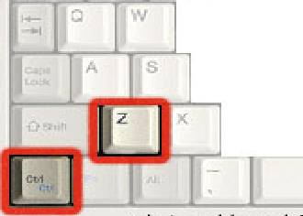
Memento In terms of Software

Slide 4
Intent
Without violating encapsulation, capture and externalize an object’s internal state so that object can be restored to this state later.

Slide 5
Motivation
Save internal state of an object
Implement checkpoints and undo mechanisms
State of objects are partially or completely encapsulated
To save state externally, violates encapsulation

Slide 6
Motivating Example

Slide 7
Motivating Example

Slide 8
Applicability
When snapshot of (some portion of) an object’s state must be saved
When you do not want to compromise encapsulation of the object
You have an Application in which you want to go back to any one of a sequence of past states.

Slide 9
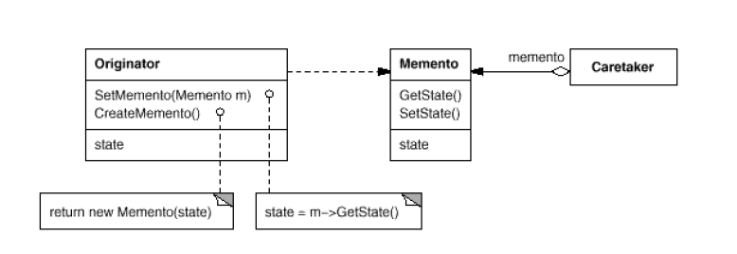
Structure

Slide 10
Participants
Memento- Object that holds one snapshot of originator state.
Originator- the source of memento’s state, usually the originator decides when to take and retrieve a memento.
Caretaker- when asked, simply adds the state (Memento) to its collection of Mementos.

Slide 11
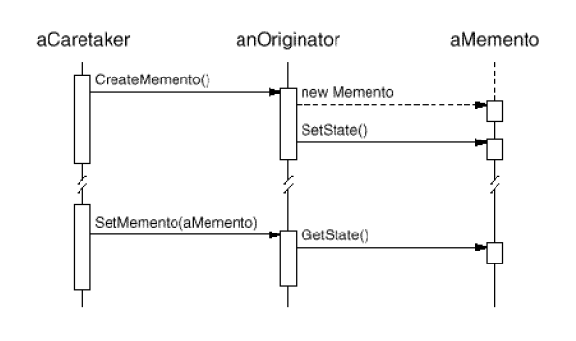
Collaborations

Slide 12
Consequences
Preventing Violation of Encapsulation boundaries
Simplifies Originator
Using mementoes could be expensive
Defining narrow and wide interfaces
Wide: Originator to and from Memento
Narrow: Caretaker to Memento
Hidden costs in caring for memento

Slide 13
Implementation
Probably need sharing relationship between Originator and Memento
friend in C++
internal declaration in C#
Caretaker Data Structure
often holds stack of mementos
However, application may need something more complex then simple linear history.

Slide 14
Implementation Issues
Language support for wide and narrow interface
Storing Incremental changes

Slide 15
Code
Skeleton
Graph walk

Slide 16
Known Uses
Unidraw’s support for connectivity through Csolver Class
Collections in Dylan provide an iteration interface that reflect memento pattern
Memento-based iteration Interface
More than one state can work on same collection
Doesn’t break collection’s encapsulation

Slide 17
Related Patterns
Command
Iterator

Slide 18
References
Design Patterns, Elements of Reusable Object-Oriented Software, Erich Gamma, et. al.

Slide 19
Questions?
Thank You

