Slide 1
Memento Code
Jim Fawcett
CSE776 – Design Patterns
Fall 2016

Slide 2
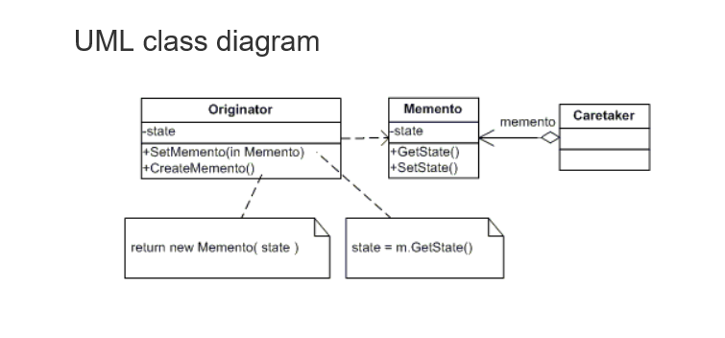
www.dofactory.com

Slide 3
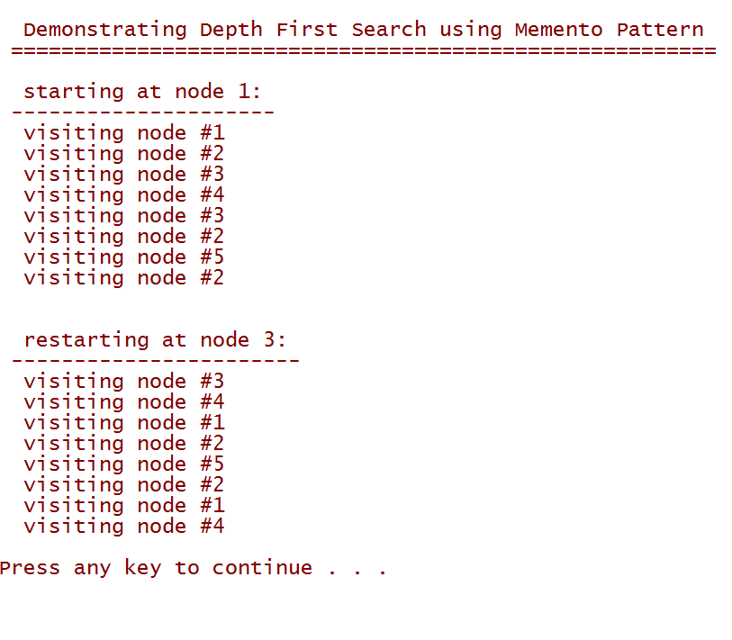
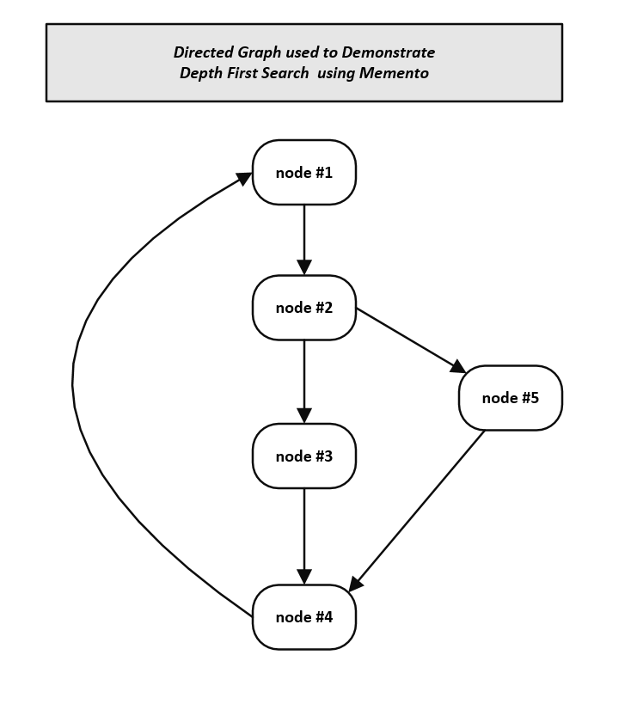
Memento Pattern:
Non-Recursive Depth First Search

Slide 4
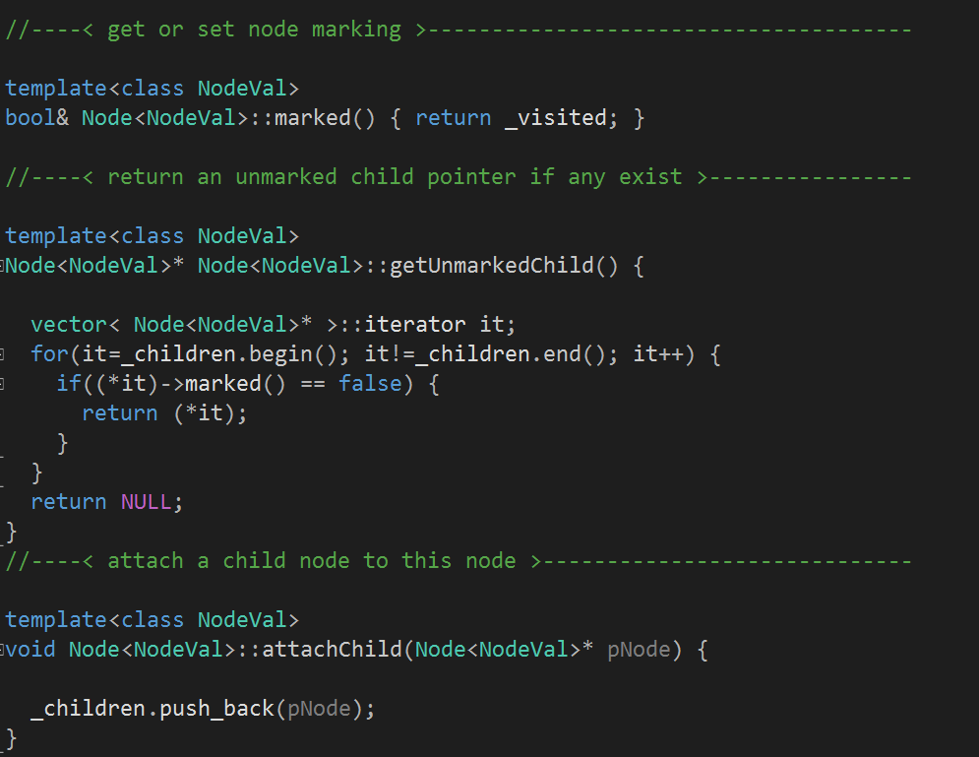
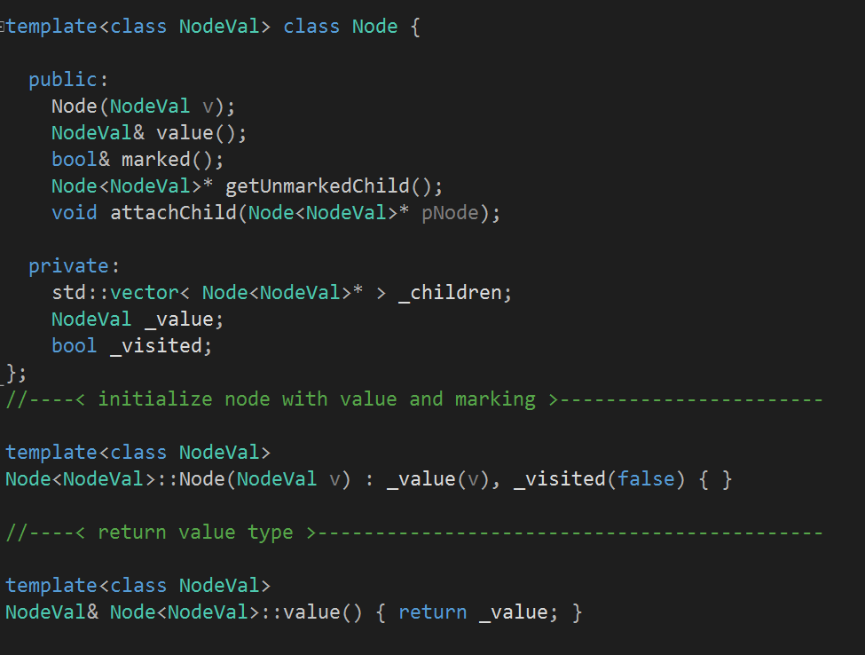
Node – used to build graph

Slide 5
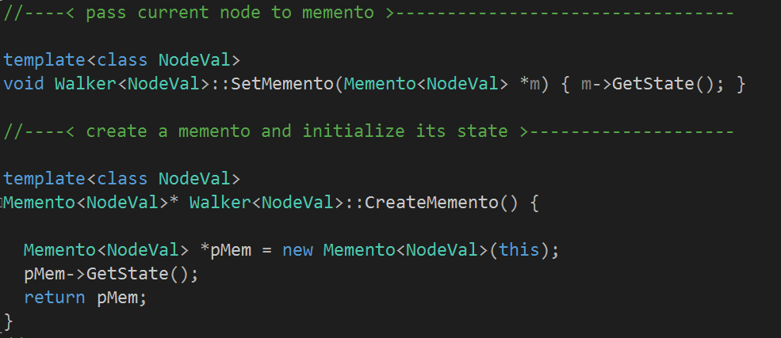
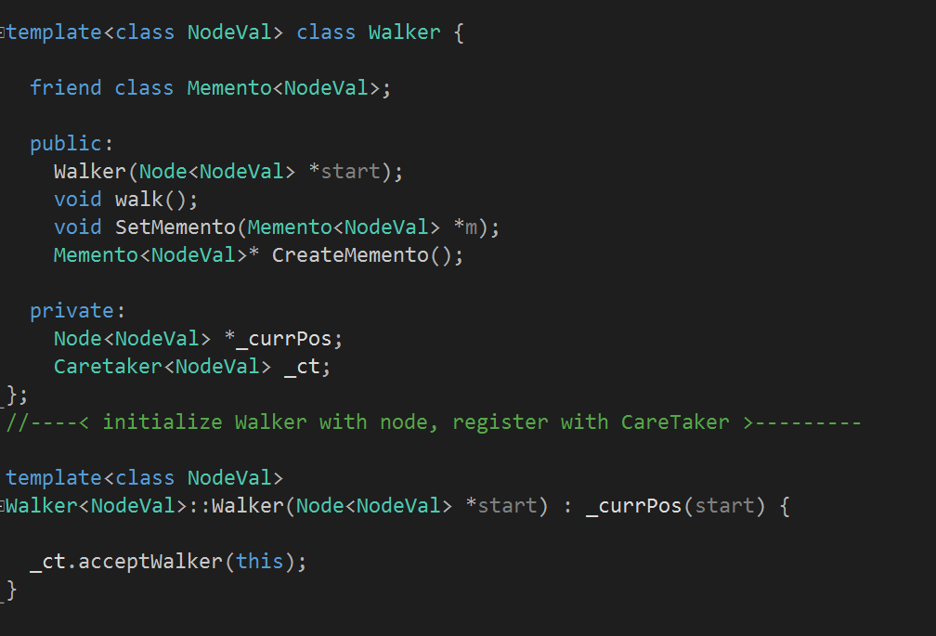
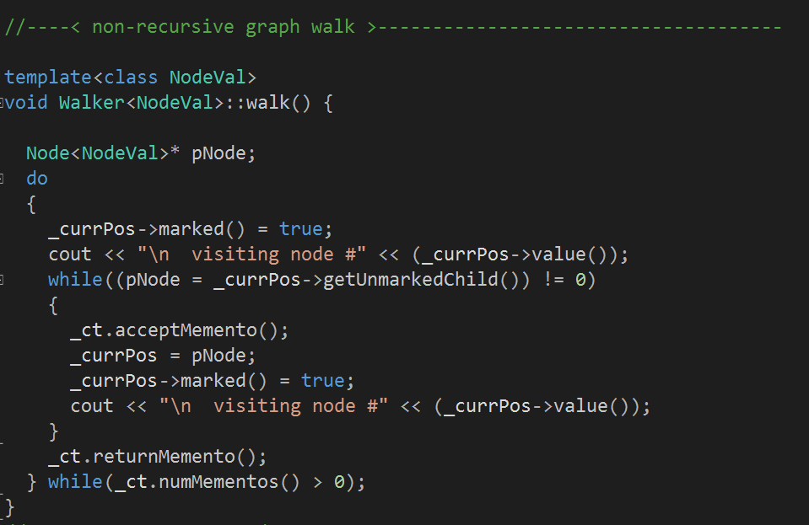
Originator – Node Walker

Slide 6
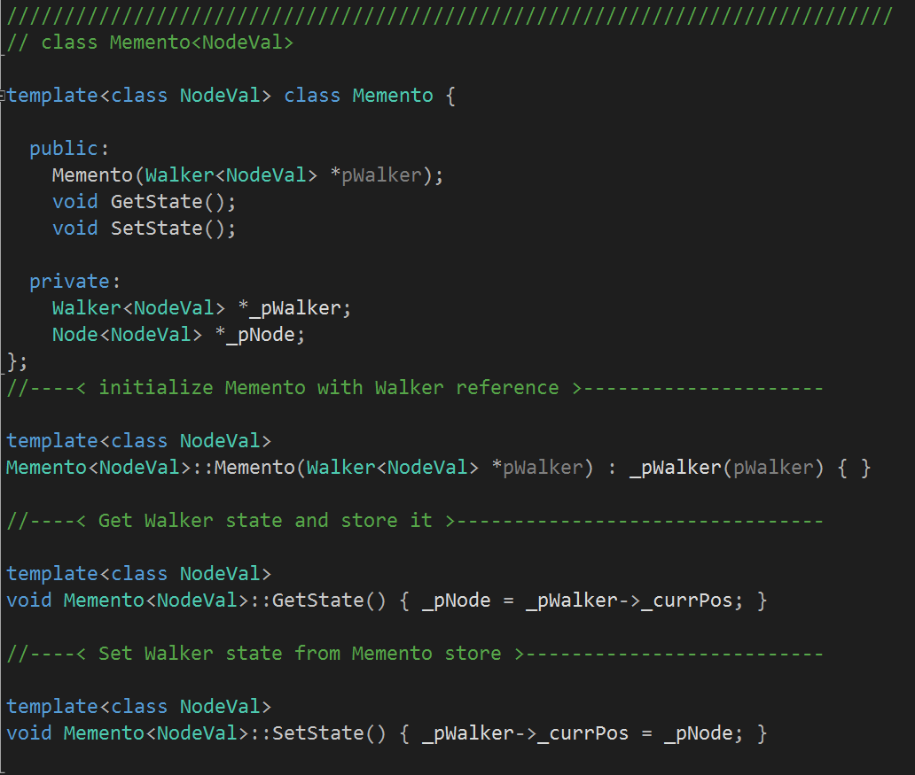
Memento
- takes reference to originator
- graph walker is originator
- saves and returns location

Slide 7
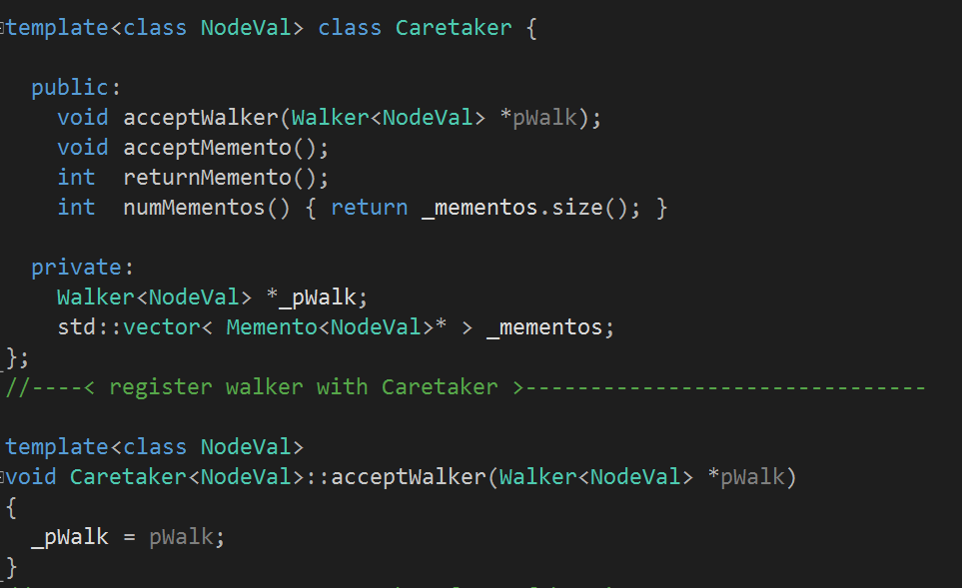
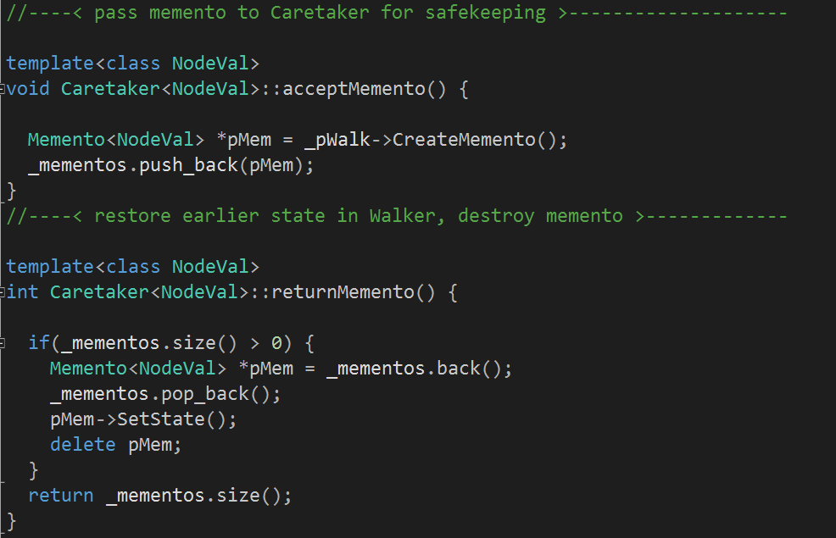
Caretaker

Slide 8
Memento Pattern:
Non-Recursive Depth First Search

Slide 9
That’s All Folks!
ArriveDerchi

