Slide 1
Iterator Pattern
By:
Dr. Jim Fawcett & Rutu Pandya
CSE 776 Design Patterns
Summer 2009

Slide 2
Roadmap
Intent
Motivation
Forces
Polymorphic Iteration
Applicability
Structure
Participants
Collaboration
Consequences
Implementation
Sample Code
Known Uses
Related Patterns
References

Slide 3
Intent
Provide a way to access the elements of an aggregate object sequentially without exposing its underlying representation
Also Known As…
Cursor

Slide 4
Motivation
Need to "abstract" the traversal of wildly different data structures so that algorithms can be defined that are capable of interfacing with each transparently
Ex. In a List

Slide 5
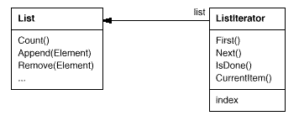
A List class would call for a ListIterator
The ListIterator class defines an interface
for accessing the list's elements
An iterator object is responsible for keeping track of the current element; that is, it knows which elements have been traversed already

Slide 6
Forces
Separating the traversal mechanism from the List object lets us define iterators for different traversal policies without enumerating them in the List interface
The iterator and the list are coupled, and the client must know that it is a list that's traversed as opposed to some other aggregate structure
It would be better if we could change the aggregate class without changing client code

Slide 7
Polymorphic Iteration
SkipList implementation of a list
We want to be able to write code that works for both List and SkipList objects

Slide 8
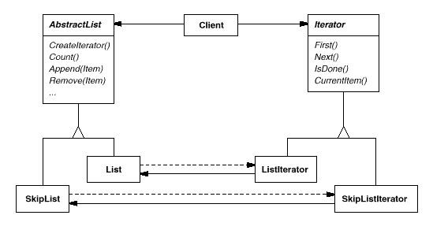
CreateIterator() is an example of a factory method
We use it here to let a client ask a list object for the appropriate iterator
The Factory Method approach give rise to two class hierarchies, one for lists and another for iterators. The CreateIterator factory method "connects" the two hierarchies

Slide 9
Applicability
Use the Iterator pattern
Access an aggregate object's contents without exposing its internal representation
Support multiple traversals of aggregate objects
Provide a uniform interface for traversing different aggregate structures (that is, to support polymorphic iteration)

Slide 10
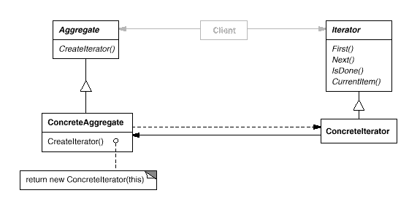
Structure

Slide 11
Participants
1. Iterator
→defines an interface for accessing and traversing elements
2. ConcreteIterator
→implements the Iterator interface
→keeps track of the current position in the traversal of the aggregate
3. Aggregate
→defines an interface for creating an Iterator object
4. ConcreteAggregate
→ implements the Iterator creation interface to return an
instance of the proper ConcreteIterator

Slide 12
Collaborations
A ConcreteIterator keeps track of the current object in the aggregate and can compute the succeeding object in the traversal

Slide 13
Consequences
The Iterator pattern has three important consequences:
It supports variations in the traversal of an aggregate
Iterators simplify the Aggregate interface
3. More than one traversal can be pending on an aggregate

Slide 14
Implementation
1. Who controls the iteration?
2. Who defines the traversal algorithm?
3. How robust is the iterator?
4. Additional Iterator operations.
5. Using polymorphic iterators in C++.
6. Iterators may have privileged access.
7. Iterators for composites
8. Null iterators.

Slide 15
Sample Code

Slide 16
Known Uses
Common in object-oriented systems.
Most collection class libraries offer iterators in one form or another.
Booch components: a popular collection class library. It provides both a fixed size (bounded) and dynamically growing (unbounded) implementation of a queue
Polymorphic iterators and the cleanup Proxy are provided by the ET++ container classes
The Unidraw graphical editing framework classes use cursor-based iterators
ObjectWindows 2.0: class hierarchy of iterators for containers

Slide 17
Related Patterns
Composite: Iterators are often applied to recursive structures such as Composites.
Factory Method: Polymorphic iterators rely on factory methods to instantiate the appropriate Iterator subclass.
Memento: often used in conjunction with the Iterator pattern. An iterator can use a memento to capture the state of an iteration. The iterator stores the memento internally.

Slide 18
References
Design Patterns
Elements of Reusable Object-Oriented Software
by Erich Gamma, Richard Helm, Ralph Johnson, John
Vlissides
http://en.wikipedia.org/wiki/Singleton_pattern
http://en.wikipedia.org/wiki/Singleton_pattern

Slide 19
Thank you

