Slide 1
Iterator Design Pattern
Jim Fawcett
CSE776 – Design Patterns
Fall 2014

Slide 2
Intent
Provide a way to access elements of an aggregate object without exposing its underlying representation
Traverse many different data structures in a uniform way
Place “bookmarks” in a large collection of data

Slide 3
Motivation
Abstract the traversal of different data structures so that algorithms can interface with each transparently

Slide 4
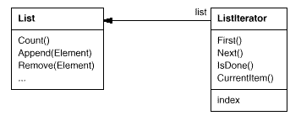
Motivation
Instance of List class is traversed with a ListIterator
ListIterator provides an interface for accessing List’s elements
An iterator is responsible for keeping track of the current element

Slide 5
Forces
Separating traversal mechanism from the aggregate object lets us define iterators for different traversal policies without enumerating them in List interface
  Forward iteration, reverse iteration, preorder, postorder, …
The iterator and aggregate are coupled
  Iterator needs to know aggregate structure
  Aggregate may need to give iterator special permissions, e.g., friend status in C++

Slide 6
Polymorphic Iteration
We want the code using iteration to be independent of the type of aggregate being used.
  C++ Standard Template Library (STL) uses, by convention, a standard interface for iteration based on pointer syntax:
    ++iter, *iter, iter->fun(arg)
  .Net provides IEnumerator interface
    Current property
    MoveNext, Reset methods

Slide 7
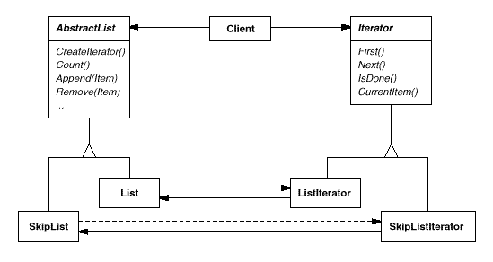
Motivation Structure
CreateIterator() is a factory method
We use it to let client ask for an iterator appropriate for the aggregate being used
.Net uses the IEnumerable.GetEnumerator()
C++ uses Container::Iterator

Slide 8
Applicability
Use the Iterator Pattern to:
  Access an aggregate object’s contents without exposing its internal representation
  Support multiple traversals of aggregate’s objects
  Provide a uniform interface for traversing different aggregate structures

Slide 9
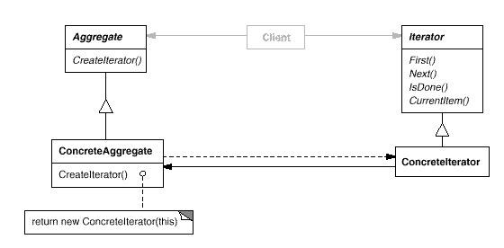
Structure

Slide 10
Participants
Iterator
  Defines interface for accessing and traversing elements
ConcreteIterator
  Implements the Iterator interface
  Keeps track of current position in traversal
Aggregate
  Defines interface for creating an Iterator object
ConcreteAggregate
  Implements the Iterator creation interface to return an instance of its associated ConcreteIterator

Slide 11
Collaborations
ConcreteIterator keeps track of the current object in the aggregate
Makes current element accessible to client
Computes the succeeding object in traversal

Slide 12
Consequences
Supports variations in the traversal of an aggregate
Simplifies the Aggregate interface
More than one traversal can be pending on an aggregate

Slide 13
Implementation
Who controls iteration?
  Client – successive steps
  Aggregate – DFS on Tree
Who defines the traversal algorithm?
  Preorder, postorder
How robust is the iterator?
Additional Iterator operations
Using polymorphic iterators in C++
Iterators may need priviledged access
Iterators for composites
Null iterators

Slide 14
Sample Code
Iterator Skeleton
STL Iterator Examples
.Net Iterator Examples

Slide 15
Known Uses
C++
  STL <vector>, <list>, <string>, <iostreams>, …
  Arrays using native pointers
.Net
  System.Collections, System.Collections.Generic
Java
  ListIterator<E>, XMLEventReader

