Slide 1
Flyweight Design Pattern
Cse 776 design patterns
Summer ‘10
Bharath setty
Dr. James fawcett

Slide 2
Intent
“Use sharing to support large numbers of fine-grained objects efficiently.”
One object instance holding shared (intrinsic) state
Unique (extrinsic) state is stored outside of the shared object

Slide 3
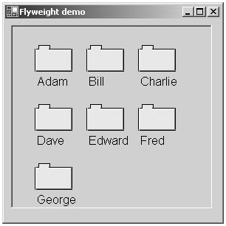
Motivation
Folder Representation

Slide 4
Forces
Problem
Context
Forces
Solution
Benefits
Consequences
Related Patterns
John Reekie (UTS)

Slide 5
Forces
To obtain a fine grained object structure
We will possibly have many objects
Cost of storing a copy of each object is high

Slide 6
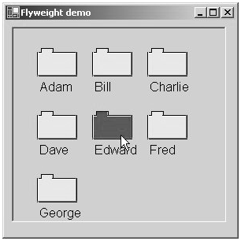
Motivation Example
Folder Representation

Slide 7
Applicability
flyweight pattern is used when all of the following are true
An application has a large number of objects
Store costs are high
Most object state can be made extrinsic???
Authors claim. I strongly disagree
You want most of object state intrinsic, e.g., shared
Many groups of objects will be replaced by few shared objects(intrinsic)
The application doesn’t depend on object identity

Slide 8
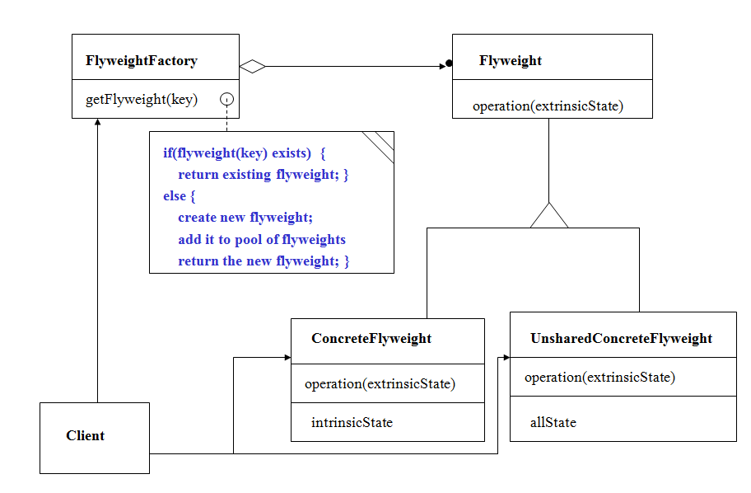
Structure

Slide 9
Participants
Flyweight (Window)
Declares interface that flyweights can use to receive and act on intrinsic state
ConcreteFlyweight (Icon)
Implements flyweight interface and adds storage for intrinsic state. Must be shareable
UnsharedConcreteFlyweight (Name, Location)
Commonly has ConcreteFlyweights as children
Flyweightfactory
Creates and manages flyweight objects
Client
Maintains references to flyweights
Computes or stores extrinsic state of flyweights

Slide 10
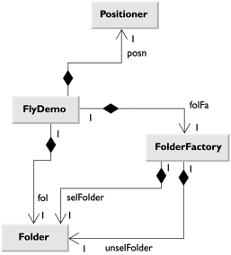
Application

Slide 11
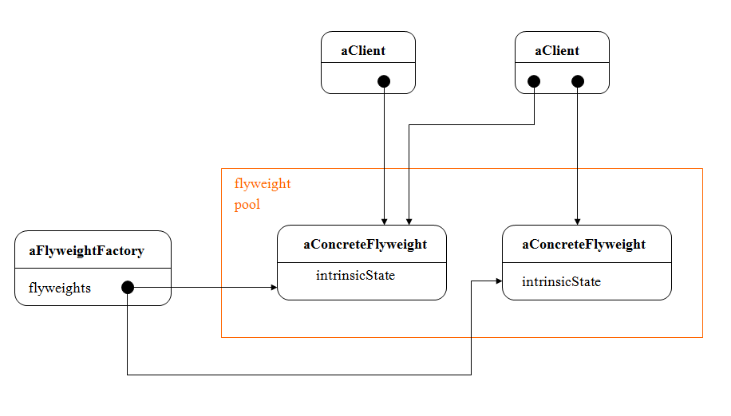
Collaborations
State of Flyweight is characterized by intrinsic and extrinsic state
Intrinsic state stored in ConcreteFlyweight
Extrinsic state stored or computed by Client Objects
Clients should not instantiate ConcreteFlyweights directly
Proper sharing will not occur

Slide 12
Consequences
Pros:
Cost saved by space savings (Function of reduction of number of instances and amount of intrinsic state per object)
Cons:
Cost increased in run-time to transfer, find or compute extrinsic state

Slide 13
Implementation
Removing Extrinsic State
Must be easily identifiable and be removed from shared objects
Pattern is only useful if state can be shared
Managing Shared Objects
Clients should not instantiate ConcreteFlyweights directly
Flyweight factory allows clients to locate a particular flyweight
Reference counting and garbage collection can be used

Slide 14
Known Uses
2D/3D Vector drawing program
2D/3D Video game
Cad applications

Slide 15
Related Patterns
Flyweight is often combined with Composite pattern to implement a logically hierarchical structure in terms of a graph with shared leaf nodes
State and Strategy can be implemented as flyweights
State: An object can alter its behavior when its internal state changes
Strategy: Define a family of algorithms and make them interchangeable

Slide 16
References
Design Patterns, Elements of Reusable Object-Oriented Software, Erich Gamma, et. al.
http://www.informit.com/articles/article.aspx?p=31563&seqnum=3
http://sourcemaking.com/design_patterns/flyweight
http://www.xml.com/pub/a/2000/01/19/feature/index.html?page=3
http://www.blackwasp.co.uk/flyweight.aspx
http://www.ecs.syr.edu/faculty/fawcett/handouts/cse776/presentations-students/flyweight/

Slide 17
Questions????

