Slide 1
FlyweightCode
Jim Fawcett
CSE776 – Design Patterns
Fall 2018

Slide 2
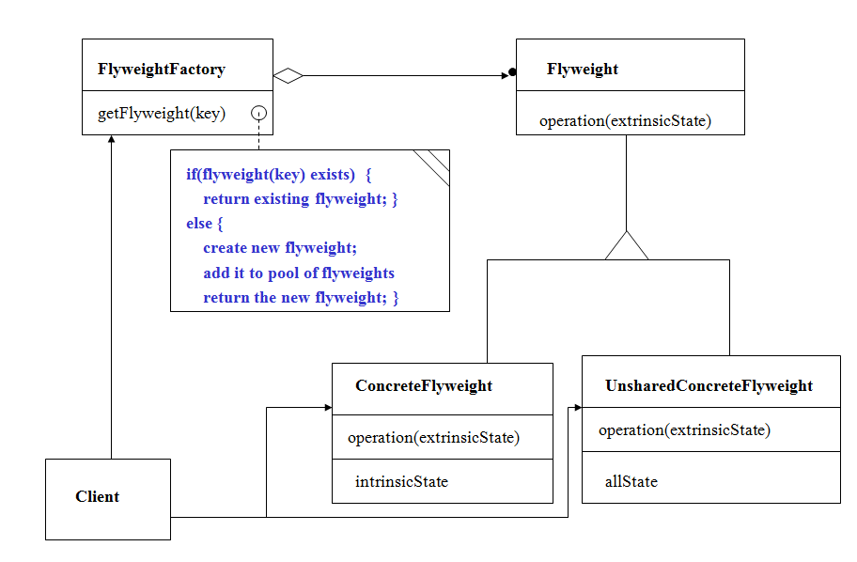
Flyweight Pattern
Flyweight instances have two kinds of state:
Large (intrinsic) shared state – same for all instances
Small (extrinsic) state unique to each object, often computed by the application and passed to its operation(extrinsicState) method.

Slide 3
Structure

Slide 4
Skeleton Code
This skeleton code is really a framework for building application specific flyweighs.
It defines its ExtrinsicState and IntrinsicState as template parameters
For some applications, these may be the only things the application has to build to represent its flyweights.
Example Application:
Game with swordsmen, archers, footsoldiers, and cavalrymen.
A game state may have hundreds of active soldiers.
Intrinsic state is the graphics lines and fills necessary to render each type of soldier.
Assumes that all characters are rendered by a single procedure that uses lines and fills.
Extrinsic state is their positions, actions, and health.

Slide 5
Flyweight classes
/////////////////////////////////////////////////////////////
// ConcreteFlyweight
template <typename ExState, typename InState, size_t key>
class ConcreteFlyweight : public Flyweight<ExState, InState>
{
friend class FlyweightFactory<ExState, InState>;
public:
ConcreteFlyweight() {}
~ConcreteFlyweight() {
std::cout << "\n destroying concrete flyweight";
}
void Operation(ExState);
private:
void SetIntrinsicState(InState ins);
InState inState;
};
//----< Flyweight Operation >--------------------------------
template <typename ExState, typename InState, size_t key>
void ConcreteFlyweight<ExState, InState, key>::
Operation(ExState exState)
{
exState.Operation();
inState.Operation();
}
template <typename ExState, typename InState>
class FlyweightFactory;
//////////////////////////////////////////////
// Flyweight
template <typename ExState, typename InState>
class Flyweight
{
public:
virtual ~Flyweight() {}
virtual void Operation(ExState)=0;
};

Slide 6
///////////////////////////////////////////////
// ConcreteUnSharedFlyweight
template <typename ExState, typename InState>
class ConcreteUnSharedFlyweight :
public Flyweight<ExState, InState>
{
friend class FlyweightFactory<ExState, InState>;
public:
~ConcreteUnSharedFlyweight() {
std::cout << "\n destroying ConcreteUnSharedFlyweight";
}
void Operation(ExState);
void SetIntrinsicState(InState);
private:
InState inState;
ExState exState;
};
//----< Flyweight Operation >-------------------------------
template <typename ExState, typename InState>
void ConcreteUnSharedFlyweight<ExState, InState>::
Operation(ExState state)
{
state.Operation();
inState.Operation();
}
/////////////////////////////////////////////////////////////
// FlyweightFactory
template <typename ExState, typename InState>
class FlyweightFactory
{
public:
FlyweightFactory() {};
~FlyweightFactory();
Flyweight<ExState, InState>* GetFlyweigth(size_t mykey);
ConcreteUnSharedFlyweight<ExState, InState>*
GetUnSharedFlyweight();
private:
std::map<size_t, Flyweight<ExState, InState>*> availableFWs;
};
//----< FlyweightFactory destructor >--------------------------
template <typename ExState, typename InState>
FlyweightFactory<ExState, InState>::~FlyweightFactory()
{
std::cout << "\n Destroying FlyweightFactory";
std::map<size_t, Flyweight<ExState, InState>*>::
iterator iter;
for(iter=availableFWs.begin(); iter!=availableFWs.end(); ++iter)
delete(iter->second);
availableFWs.clear();
}

Slide 7
//----< get shared Flyweight from factory >----------------
template <typename ExState, typename InState>
Flyweight<ExState, InState>*
FlyweightFactory<ExState, InState>::GetFlyweigth(size_t mykey)
{
std::map<size_t, Flyweight<ExState,InState>*>::iterator iter;
switch(mykey)
{
case 0:
iter = availableFWs.find(0);
if(iter != availableFWs.end())
{
return iter->second;
}
else
{
ConcreteFlyweight<ExState, InState, 0>* pFlywt =
new ConcreteFlyweight<ExState, InState, 0>();
pFlywt->SetIntrinsicState(
InState("Intrinsic state for all FWs of category #0")
);
availableFWs[0] = pFlywt;
return pFlywt;
}
case 1:
iter = availableFWs.find(1);
if(iter != availableFWs.end())
{
return iter->second;
}
else
{
ConcreteFlyweight<ExState, InState, 1>* pFlywt =
new ConcreteFlyweight<ExState, InState, 1>();
pFlywt->SetIntrinsicState(InState("Intrinsic state for all FWs of category #1"));
availableFWs[1] = pFlywt;
return pFlywt;
}
case 2:
iter = availableFWs.find(2);
if(iter != availableFWs.end())
{
return iter->second;
}
else
{
ConcreteFlyweight<ExState, InState, 2>* pFlywt =
new ConcreteFlyweight<ExState, InState, 2>();
pFlywt->SetIntrinsicState(InState("Intrinsic state for all FWs of category #2"));
availableFWs[2] = pFlywt;
return pFlywt;
}
default:
return 0;
}

Slide 8
void main()
{
std::cout << "\n Demonstrating Basic Flyweight Pattern";
std::cout << "\n =======================================\n";
FlyweightFactory<ExtrinsicState, IntrinsicState> FWfactory;
/////////////////////////////////////////////////////////////
// Shared Flyweight operations
// Factory will delete these Flyweights
Flyweight<ExtrinsicState, IntrinsicState>* pFW1 = FWfactory.GetFlyweigth(0);
pFW1->Operation(ExtrinsicState("extrinsic state for FW1 of category #0"));
std::cout << "\n";
Flyweight<ExtrinsicState, IntrinsicState>* pFW2 = FWfactory.GetFlyweigth(0);
pFW2->Operation(ExtrinsicState("extrinsic state for FW2 of category #0"));
std::cout << "\n";
Flyweight<ExtrinsicState, IntrinsicState>* pFW3 = FWfactory.GetFlyweigth(1);
pFW3->Operation(ExtrinsicState("extrinsic state for FW3 of category #1"));
std::cout << "\n";
Flyweight<ExtrinsicState, IntrinsicState>* pFW4 = FWfactory.GetFlyweigth(1);
pFW4->Operation(ExtrinsicState("extrinsic state for FW4 of category #1"));
std::cout << "\n";
/////////////////////////////////////////////////////////////
// UnShared Flyweight operations
// Client must delete these Flyweights
ConcreteUnSharedFlyweight<ExtrinsicState, IntrinsicState>* pFW5 =
FWfactory.GetUnSharedFlyweight();
pFW5->SetIntrinsicState(IntrinsicState("intrinsic state for FW5"));
pFW5->Operation(ExtrinsicState("extrinsic state for unshared FW5"));
delete pFW5;
std::cout << "\n";
}
//----< test application's intrinsic (shared) state type >-----
class IntrinsicState
{
public:
IntrinsicState() : myState("default") {};
IntrinsicState(const std::string& str) : myState(str) {}
void Operation() { std::cout << "\n " << myState; }
private:
std::string myState;
};
//---< test application's extrinsic (unshared) state type >----
class ExtrinsicState
{
public:
ExtrinsicState() : myState("default") {}
ExtrinsicState(const std::string& str) : myState(str) {}
void Operation() { std::cout << "\n " << myState; }
private:
std::string myState;
};

Slide 9
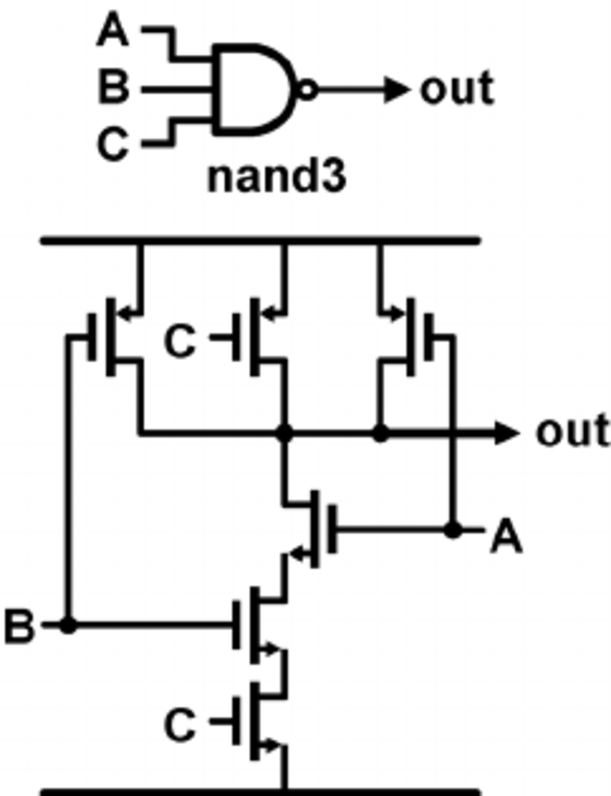
Application Code
Digital Computer-Aided Design application
Flyweights are gates
Intrinsic data are the lines and shapes necessary to render
Extrinsic data are the layout position and net list need to complete a logic schematic.

Slide 10
Flyweight classes
template <typename PlacementData, typename DrawingData>
class FW_CADFactory;
enum cellType { nandGate, norGate, latch, Register };
///////////////////////////////////////////////////////
// FW_CAD
template <typename PlacementData, typename DrawingData>
class FW_CAD
{
public:
virtual ~FW_CAD() {}
virtual void Operation(PlacementData)=0;
};
/////////////////////////////////////////////////////////////
// ConcreteFW_CAD
template <typename PlacementData, typename DrawingData, size_t cellType>
class ConcreteFW_CAD : public FW_CAD<PlacementData, DrawingData>
{
friend class FW_CADFactory<PlacementData, DrawingData>;
public:
ConcreteFW_CAD() {}
~ConcreteFW_CAD() { std::cout << "\n destroying concrete FW_CAD"; }
void Operation(PlacementData);
private:
void SetIntrinsicState(DrawingData ins);
DrawingData inState;
};
//----< FW_CAD Operation >--------------------------------
template <typename PlacementData, typename DrawingData, size_t cellType>
void ConcreteFW_CAD<PlacementData, DrawingData, cellType>::
Operation(PlacementData exState)
{
exState.Operation();
inState.Operation();
}

Slide 11
Flyweight classes
//----< Set Intrinsic state >--------------------------
template <
typename PlacementData,
typename DrawingData,
size_t cellType
>
void ConcreteFW_CAD<
PlacementData, DrawingData, cellType
>
::SetIntrinsicState(DrawingData state)
{
inState = state;
}
/////////////////////////////////////////////////////////////
// FW_CADFactory
template <typename PlacementData, typename DrawingData>
class FW_CADFactory
{
public:
FW_CADFactory() {};
~FW_CADFactory();
FW_CAD<PlacementData, DrawingData>* GetFlyweigth(size_t mycellType);
ConcreteUnSharedFW_CAD<PlacementData, DrawingData>* GetUnSharedFW_CAD();
private:
std::map<size_t, FW_CAD<PlacementData, DrawingData>*> availableFWs;
};
//----< FW_CADFactory destructor >--------------------------
template <typename PlacementData, typename DrawingData>
FW_CADFactory<PlacementData, DrawingData>::~FW_CADFactory()
{
std::cout << "\n Destroying FW_CADFactory";
std::map<size_t, FW_CAD<PlacementData, DrawingData>*>::iterator iter;
for(iter=availableFWs.begin(); iter!=availableFWs.end(); ++iter)
delete(iter->second);
availableFWs.clear();
}

Slide 12
Flyweight Factory
template <typename PlacementData, typename DrawingData>
FW_CAD<PlacementData, DrawingData>*
FW_CADFactory<PlacementData, DrawingData>::
GetFlyweigth(size_t mycellType)
{
std::map<size_t, FW_CAD<PlacementData,DrawingData>*>::
iterator iter;
switch(mycellType)
{
case nandGate:
iter = availableFWs.find(nandGate);
if(iter != availableFWs.end())
{
return iter->second;
}
else
{
std::cout << "\n -- Loading nandGate drawing list from XML file --";
ConcreteFW_CAD<PlacementData, DrawingData, nandGate>* pFlywt =
new ConcreteFW_CAD<PlacementData, DrawingData, nandGate>();
pFlywt->SetIntrinsicState(
DrawingData("Using nandGate Cell graphics list")
);
availableFWs[nandGate] = pFlywt;
return pFlywt;
}

Slide 13
Flyweight Factory
case norGate:
iter = availableFWs.find(norGate);
if(iter != availableFWs.end())
{
return iter->second;
}
else
{
std::cout <<
"\n -- Loading norGate drawing list from XML file --";
ConcreteFW_CAD<PlacementData, DrawingData, norGate>*
pFlywt =
new ConcreteFW_CAD<PlacementData, DrawingData, norGate>();
pFlywt->SetIntrinsicState(
DrawingData("Using norGate Cell graphics list")
);
availableFWs[norGate] = pFlywt;
return pFlywt;
}
case latch:
iter = availableFWs.find(latch);
if(iter != availableFWs.end())
{
return iter->second;
}
else
{
std::cout << "\n -- Loading latch drawing list from XML file --";
ConcreteFW_CAD<PlacementData, DrawingData, latch>* pFlywt =
new ConcreteFW_CAD<PlacementData, DrawingData, latch>();
pFlywt->SetIntrinsicState(
DrawingData("Using latch Cell graphics list")
);
availableFWs[latch] = pFlywt;
return pFlywt;
}
default:
return 0;
}

Slide 14
Application Code
void main()
{
std::cout << "\n Demonstrating Basic FW_CAD Pattern";
std::cout << "\n =======================================\n";
FW_CADFactory<PlacementDataFromCAD_Editor, DrawingDataFromFile>
FWfactory;
/////////////////////////////////////////////////////////////
// Shared FW_CAD operations
// Factory will delete these FW_CADs
FW_CAD<PlacementDataFromCAD_Editor, DrawingDataFromFile>*
pFW1 = FWfactory.GetFlyweigth(nandGate);
pFW1->Operation(
PlacementDataFromCAD_Editor("Draw nandGate at (120,245)")
);
std::cout << "\n";
FW_CAD<PlacementDataFromCAD_Editor, DrawingDataFromFile>*
pFW2 = FWfactory.GetFlyweigth(nandGate);
pFW2->Operation(
PlacementDataFromCAD_Editor("Draw nandGate at (250,245)")
);
std::cout << "\n";
--- rest elided ---
//----< test application's intrinsic (shared) state type >-----
class DrawingDataFromFile
{
public:
DrawingDataFromFile() : myState("default") {};
DrawingDataFromFile(const std::string& str) : myState(str) {}
void Operation() { std::cout << "\n " << myState; }
private:
std::string myState;
};
//---< test application's extrinsic (unshared) state type >----
class PlacementDataFromCAD_Editor
{
public:
PlacementDataFromCAD_Editor() : myState("default") {}
PlacementDataFromCAD_Editor(const std::string& str) :
myState(str) {}
void Operation() { std::cout << "\n " << myState; }
private:
std::string myState;
};

Slide 15
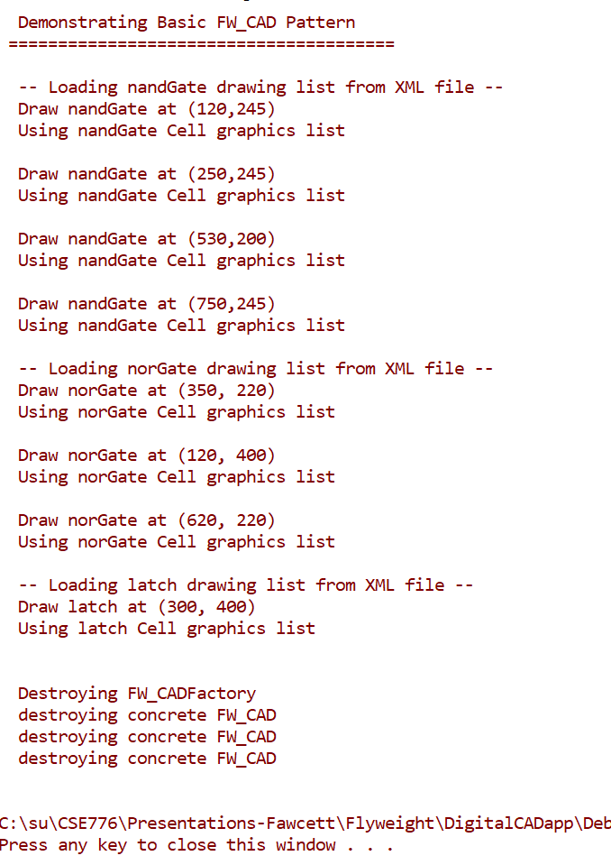
Application Output
Flyweights:
nandGate, norGate, Latch
Intrinsic data:
Lines and fills read from XML file or database
Extrinsic data:
Position passed to draw (operation)
Connections drawn from netlist.
Potentially large savings in memory and processing
Layout and netlist have to be computed anyway, so we just use them for editor rendering.

