Slide 1
Flyweight Design Pattern
Ravi Nagendra, Pramukh Bantwal, Jim Fawcett

Slide 2
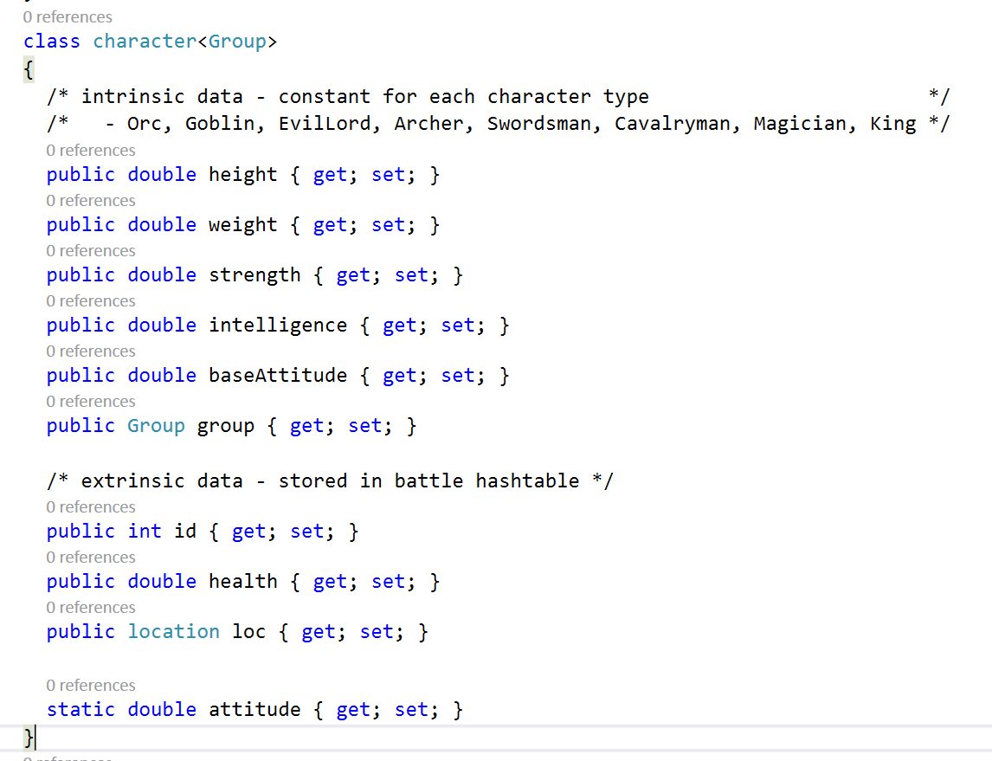
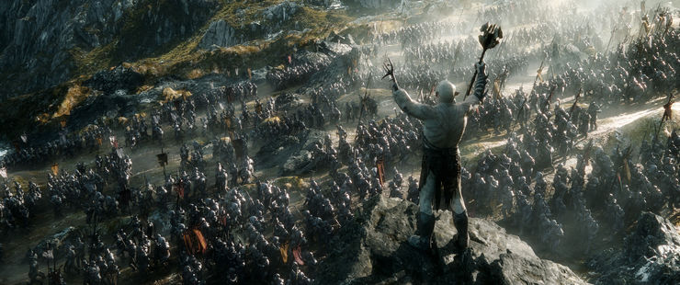
Motivation – Battle of the Three Armies

Slide 3
Forces
We want to represent thousands of characters
Storing a unique object for each character will consume a lot of resources:
CPU cycles to create
Memory to store
Many of the objects properties may be shared among many instances, e.g.:
Orcs are large, angry, stupid, very strong, not very agile
Humans are smaller, annoyed, intelligent, not so strong, very agile

Slide 4
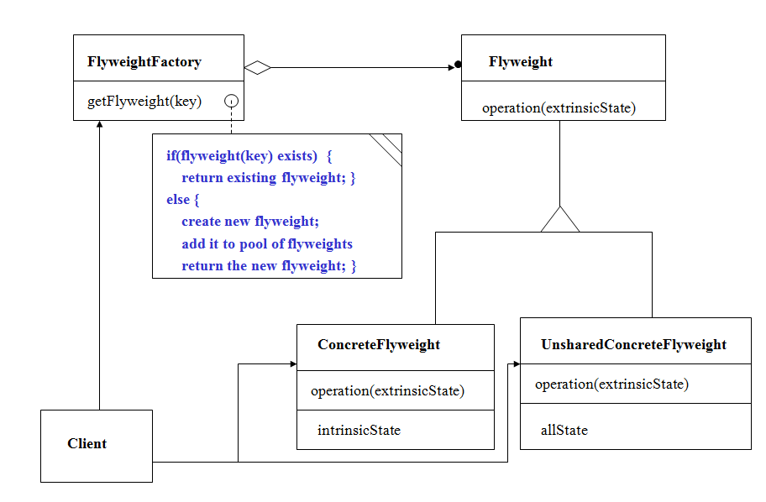
Structure

Slide 5
Participants
Flyweight (character)
Declares interface that flyweights use to receive and act on intrinsic state
Concrete Flyweight (Orc, archer, …)
Implements Flyweight interface and adds storage for intrinsic state (height, weight, …)
Must be sharable
Unshared Concrete Flyweight (King, Evil Lord)
Commonly has Concrete Flyweights as children
Flyweight Factory
Creates and manages flyweights
Client
Maintains references to flyweights
Computes or stores extrinsic state of flyweights (health, location, attitude)

Slide 6
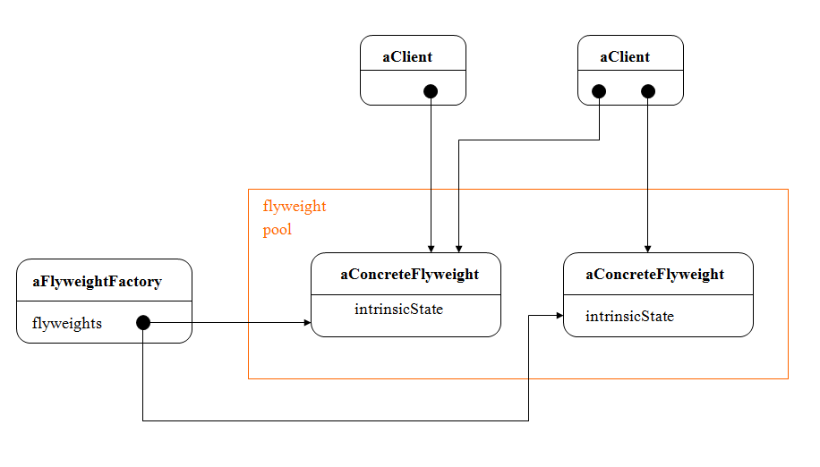
Collaborations
State of flyweight is combination of intrinsic and extrinsic state
Intrinsic state stored in the shared Concrete Flyweight
Extrinsic state is stored or computed by clients.
Clients should not instantiate Concrete Flyweights directly
That’s managed by Flyweight factory to share the shareables and create the unshared instances.

