Slide 1
Composite Pattern Code
Jim Fawcett
CSE776 – Design Patterns
Fall 2018

Slide 2
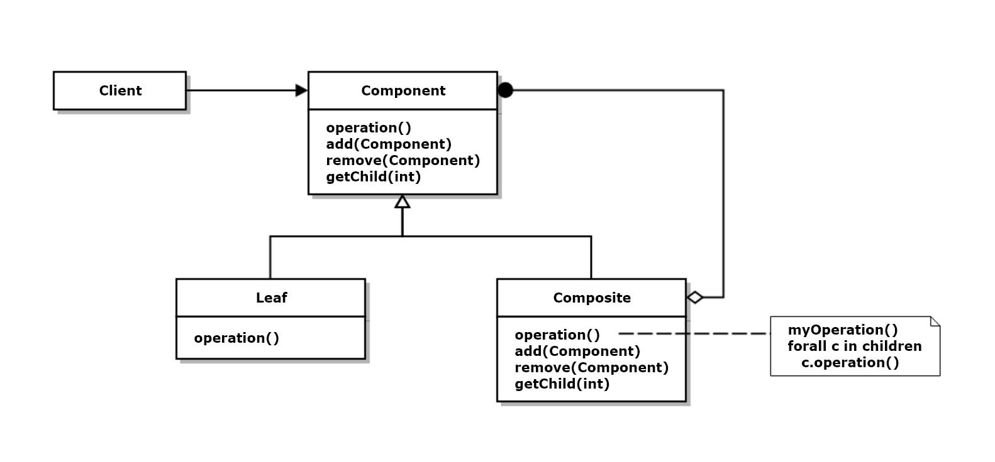
Composite Structure – from “Design Patterns”

Slide 3
Composite Classes
#include <vector>
class Component
{
public:
virtual ~Component() {}
virtual void Operation()=0;
virtual bool Add(Component* pComp) { return false; }
virtual bool Remove(Component* pComp) { return false; }
virtual Component* GetChild(int) { return 0; };
};
class Leaf : public Component
{
public:
Leaf();
void Operation();
private:
static size_t leafCount;
size_t myCount;
};
class Composite : public Component
{
public:
Composite();
~Composite();
void Operation();
bool Add(Component* pComp);
bool Remove(Component* pComp);
Component* GetChild(size_t i);
private:
std::vector<Component*> children;
static size_t compositeCount;
size_t myCount;
};

Slide 4
Partial Implementation
void Leaf::Operation()
{
std::cout << "\n Leaf #" << myCount << " here";
}
void Composite::Operation()
{
std::cout << "\n Composite #" << myCount << " here";
std::vector<Component*>::iterator iter;
for(iter=children.begin(); iter!=children.end(); ++iter)
(*iter)->Operation();
}

Slide 5
Client
class Client
{
public:
static void BuildAndRun();
};
/*
c2
| |
+---+ +---+
| |
l3 c1
|
+---+---+
| |
l1 12
*/
void Client::BuildAndRun()
{
Leaf l1, l2, l3;
Composite c1;
c1.Add(&l1);
c1.Add(&l2);
Composite c2;
c2.Add(&l3);
c2.Add(&c1);
c2.Operation(); // DFS walk on Component tree
}

Slide 6
Client Operation
///////////////////////////////////////////////////////
// Test Stub
void main()
{
std::cout << "\n Demonstrating Composite Pattern";
std::cout << "\n =================================\n";
Client::BuildAndRun();
std::cout << "\n\n";
}
Demonstrating Composite Pattern
=================================
Composite #2 here
Leaf #3 here
Composite #1 here
Leaf #1 here
Leaf #2 here
Press any key to continue . . .
/*
c2
| |
+---+ +---+
| |
l3 c1
|
+---+---+
| |
l1 12
*/

Slide 7
Application Code - XmlElement
XmlDocument is a Façade
XmlElement is a Composite

Slide 8
XmlDocument – Façade for XmlElements
class XmlDocument
{
public:
using sPtr = std::shared_ptr < AbstractXmlElement > ;
enum sourceType { file, str };
XmlDocument(sPtr pRoot = nullptr) : pDocElement_(pRoot)
{
if (!pRoot)
pDocElement_ = makeDocElement();
}
XmlDocument( const std::string& src, sourceType srcType=str );
XmlDocument(const XmlDocument& doc) = delete;
XmlDocument(XmlDocument&& doc);
XmlDocument& operator=(const XmlDocument& doc) = delete;
XmlDocument& operator=(XmlDocument&& doc);
std::shared_ptr<AbstractXmlElement>& docElement() { return pDocElement_; }
std::shared_ptr<AbstractXmlElement> xmlRoot();
bool xmlRoot(sPtr pRoot);
XmlDocument& element(const std::string& tag);
XmlDocument& elements(const std::string& tag);
XmlDocument& descendents(const std::string& tag = "");
std::vector<sPtr> select(); // returns found_
bool find( const std::string& tag, sPtr pElem, bool findall = true );
size_t size();
std::string toString();
template<typename CallObj> void DFS(sPtr pElem, CallObj& co);
private:
sPtr pDocElement_;
std::vector<sPtr> found_; // query results
};

Slide 9
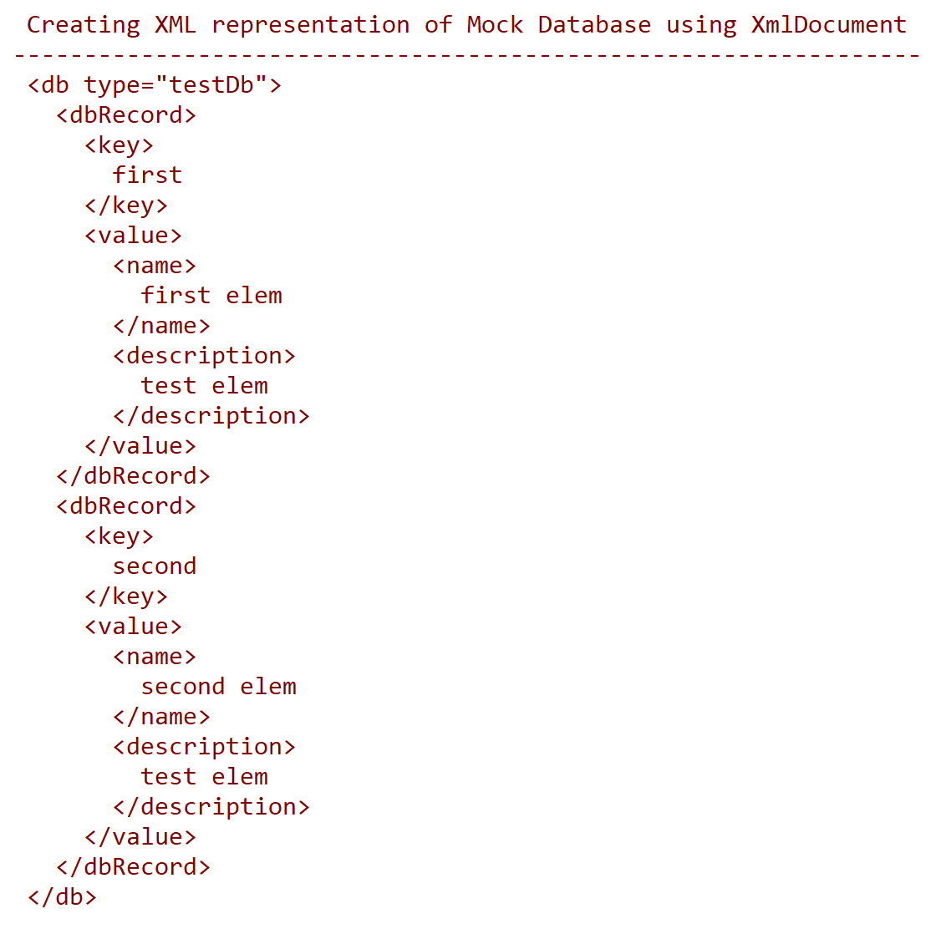
XmlDocument Output

Slide 10
AbstractXmlElement - Component
inline bool AbstractXmlElement::
addChild(std::shared_ptr<AbstractXmlElement> pChild) { return false; }
inline bool AbstractXmlElement::
removeChild(std::shared_ptr<AbstractXmlElement> pChild) { return false; }
inline std::vector<AbstractXmlElement::sPtr> AbstractXmlElement::
children()
{
return std::vector<sPtr>(); // return empty child collection
}
inline AbstractXmlElement::Attributes AbstractXmlElement::attributes()
{
return AbstractXmlElement::Attributes(); // return empty attributes coll
}
inline std::string AbstractXmlElement::attributeValue(const std::string& name)
{
return "";
}
inline bool AbstractXmlElement::
addAttrib(const std::string& name, const std::string& value) { return false; }
inline bool AbstractXmlElement::removeAttrib(const std::string& name) { return false; }
inline AbstractXmlElement::~AbstractXmlElement() {}
class AbstractXmlElement
{
public:
using sPtr = std::shared_ptr < AbstractXmlElement > ;
using Attribute = std::pair<std::string, std::string>;
using Attributes = std::vector<Attribute>;
virtual bool addChild(std::shared_ptr<AbstractXmlElement> pChild);
virtual bool removeChild(std::shared_ptr<AbstractXmlElement> pChild);
virtual std::vector<sPtr> children();
virtual bool addAttrib(const std::string& name, const std::string& value);
virtual bool removeAttrib(const std::string& name);
virtual std::string attributeValue(const std::string& name);
virtual Attributes attributes();
virtual std::string tag() { return ""; }
virtual std::string value() = 0;
virtual std::string toString() = 0;
virtual ~AbstractXmlElement();
protected:
static size_t count;
static size_t tabSize;
};

Slide 11
TaggedElement – Composite
class TaggedElement : public AbstractXmlElement
{
public:
TaggedElement(const std::string& tag) : tag_(tag) {};
TaggedElement(const TaggedElement& te) = delete;
virtual ~TaggedElement() {}
TaggedElement& operator=(const TaggedElement& te) = delete;
virtual bool addChild(std::shared_ptr<AbstractXmlElement> pChild);
virtual bool removeChild(std::shared_ptr<AbstractXmlElement> pChild);
virtual std::vector<sPtr> children();
virtual bool addAttrib(const std::string& name, const std::string& value);
virtual bool removeAttrib(const std::string& name);
virtual AbstractXmlElement::Attributes attributes();
virtual std::string attributeValue(const std::string& name);
virtual std::string tag();
virtual std::string value();
virtual std::string toString();
private:
std::string tag_;
std::vector<std::shared_ptr<AbstractXmlElement>> children_;
AbstractXmlElement::Attributes attribs_;
};
inline std::vector<AbstractXmlElement::sPtr> TaggedElement::children()
{
return children_;
}
inline AbstractXmlElement::Attributes TaggedElement::attributes()
{
return attribs_;
}
inline std::string TaggedElement::attributeValue(const std::string& name)
{
for (auto attrib : attribs_)
{
if (attrib.first == name)
return attrib.second;
}
return "";
}
inline std::string TaggedElement::tag() { return tag_; }
std::shared_ptr<AbstractXmlElement> makeTaggedElement(const std::string& tag, const std::string& body = "");

Slide 12
TextElement – Leaf
class TextElement : public AbstractXmlElement
{
public:
TextElement(const std::string& text) : text_(text) {}
virtual ~TextElement() {}
TextElement(const TextElement& te) = delete;
TextElement& operator=(const TextElement& te) = delete;
virtual std::string value();
virtual std::string toString();
private:
std::string text_;
};
inline std::string TextElement::value() { return text_; }
std::shared_ptr<AbstractXmlElement> makeTextElement(const std::string& text);

Slide 13
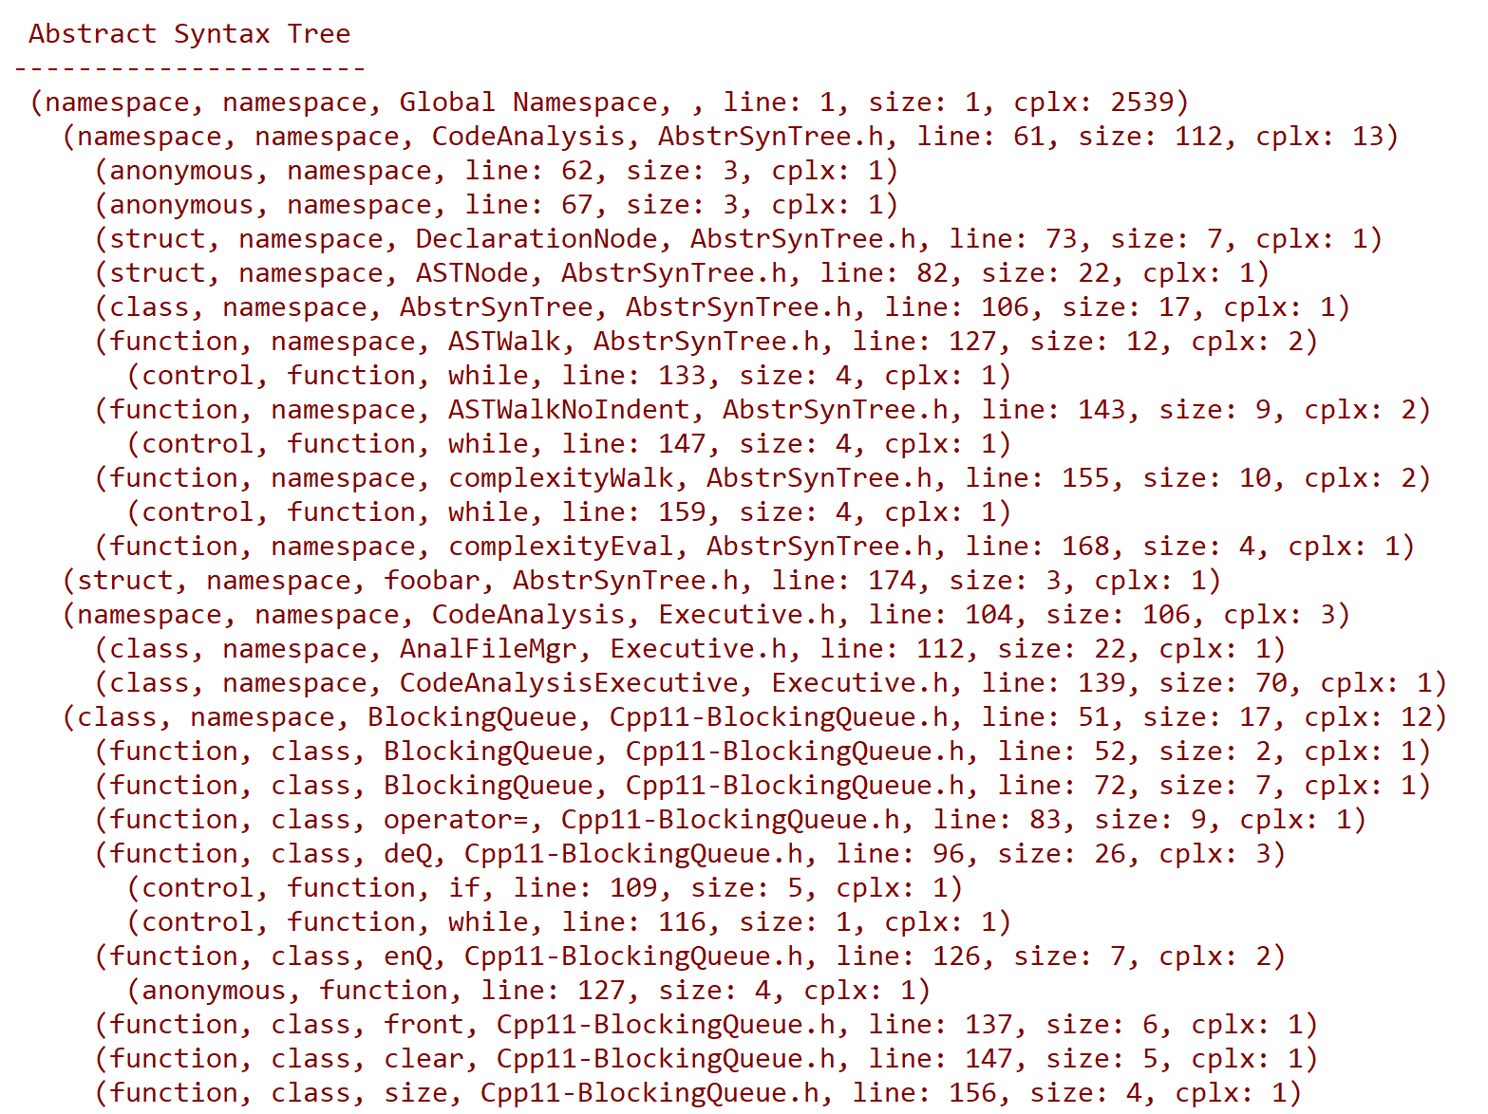
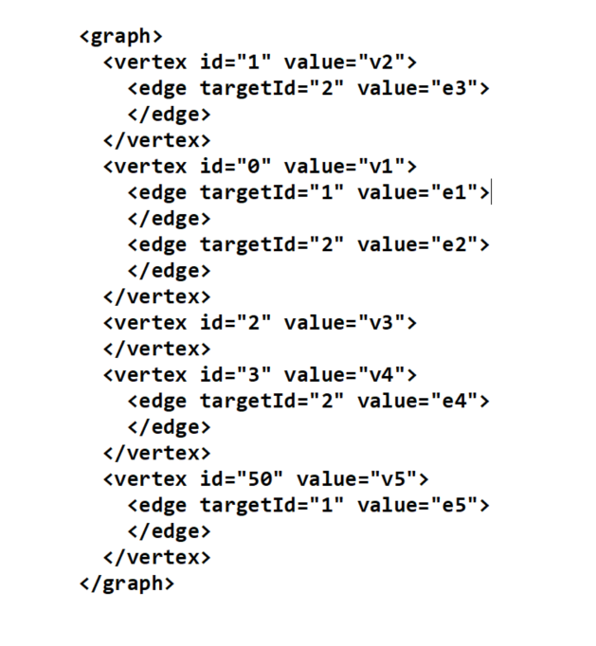
That’s all for the Code
Other Composites:
Graph
Abstract Syntax Tree

