Slide 1
Command Pattern
Jim Fawcett
CSE776 – Design Patterns
Fall 2014

Slide 2
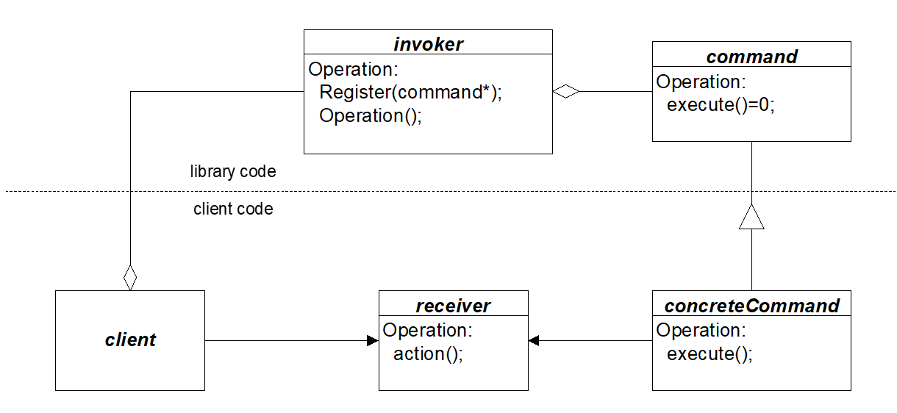
Library Events

Slide 3
Command Pattern Intent
A command encapsulates a request as an object. A reference to the command is given to an invoker for later invocation.
Intent:
decouple the event triggering a command from the processing associated with the command.
The invoker of a command knows about the trigger event but does not need to know anything about command’s processing. The creator of the command class knows about the processing but nothing about the invoker’s event.
With commands, you can control their selection, sequencing, queue them, undo them, and otherwise manipulate them.
Commands are an object-oriented replacement for function pointers.

Slide 4
Motivation
Command addresses the need to issue requests to objects without knowing anything about the objects themselves.
At instantiation, the Command is given any information it will need to later carry out its task.
The actual order to carry out that request is given at a later time.
The key to this pattern is an abstract Command Class.

Slide 5
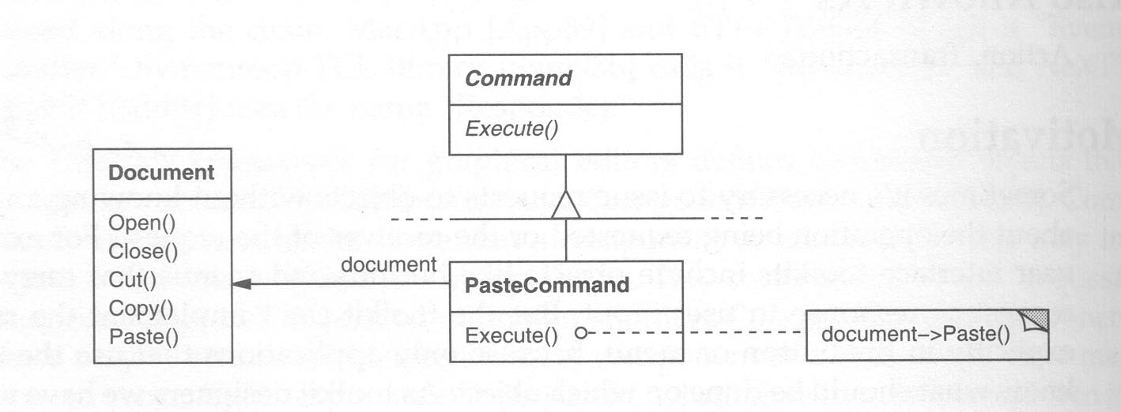

Slide 6
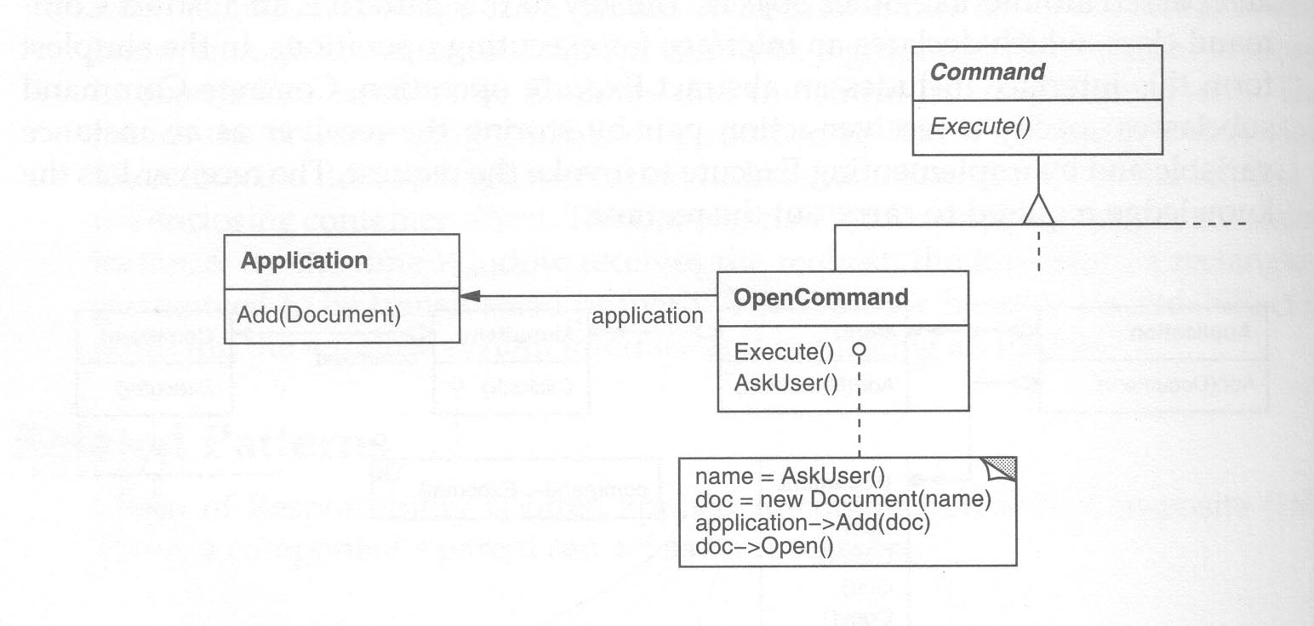

Slide 7
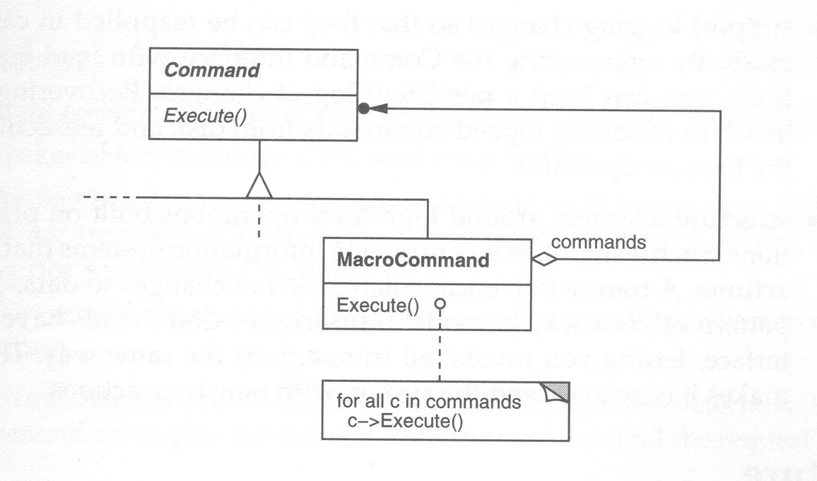

Slide 8
Method
A client encapsulates a request, along with needed state, by deriving a specialized command from the invoker’s abstract base command class.
Client associates command with a receiver (by the processing it encapsulates) and sends it to the invoker.
The invoker simply uses the command interface to cause execution in the receiver

Slide 9
Command Structure

Slide 10
Command Participants
Command provides an interface for executing commands
ConcreteCommand provides binding between a receiver and command. It implements execution by calling receiver methods.
Client creates a concreteCommand object, sets its receiver, and registers command with invoker
Invoker issues command when an invoker event occurs
Receiver actually performs the command processing

Slide 11
Collaborators
Client creates concreteCommand and specifies receiver
Invoker stores concreteCommand for later use
Invoker issues request by calling execute() on command
ConcreteCommand object invokes operations on its receiver to carry out the request

Slide 12
Command Event Trace
Don’t call us, we’ll call you

Slide 13
Applicability
Use the command when you want to:
parameterize objects by an action to perform (menu items)
specify, queue, and execute requests at different times (a command object can have lifetime independent of the original request)
respond to library events in client code (library calls client functions even though the library knows nothing of client code)

Slide 14
Applicability
As an object-oriented replacement for callback functions. Such functions are typically useful when designing menus and other user interfaces.
Specify, queue, and then execute requests at different times. Command objects have lifetimes independent of their original request.
Respond to library events in client code (library calls client functions even though the library knows nothing of client code).
Supporting undo-able transactions. If the Command stores the relevant state of the receiver, it can reverse its own effects upon the receiver.
Defining the structure of a system such that a broad class of high-level operations are built out of primitives. The Command allows various types of transactions to be invoked in the same way.

Slide 15
Consequences
Command decouples the object that invokes an operation from the one that knows how to perform it.
Commands are first-class objects. They can be manipulated and extended like any other object.
You can assemble commands into a composite command.
It’s easy to add new commands, because you don’t have to change existing classes.

Slide 16
Known Uses
Office – Word, Excel, …
Virtually every graphical user interface known to mankind uses either callbacks, delegates, or commands. The object oriented ones use commands. MFC uses callbacks. .Net uses delegates.
.Net delegates are a limited form of command

Slide 17
Navigator - Part of Code Analyzer

Slide 18
Related Patterns
The relationships to other patterns as mentioned in the class text are rather tenuous.
The command pattern is similar to the observer pattern. In both patterns an interested party can register to be notified of an event.

Slide 20
Sample Code: Catalog Program

Slide 21
Application to Graph Algorithms
Many graph algorithms are based on a traversal process
Breadth First Search
Shortest paths
Diameter
Depth First Search
Strong components
Topological sorting
All of the above may be evaluated by executing functions on the graph nodes during search.

Slide 22
Command Pattern Applied to Graphs

Slide 23
End of Presentation

