Slide 1
Active Template Library
Library support for building COM components
CSE775 - Distributed Objects, Spring 2012
Jim Fawcett
copyright © 1998-2012

Slide 2
Library Support for COM
One of the difficulties with designing COM components with no support other than C++ is that COM does not support reuse through inheritance.
This means that either you implement all the interfaces you need yourself, even the standard COM interfaces, or:
You make your server a client of the standard COM component and use aggregation to provide access to the standard interface through COM aggregation – a very messy process.
COM has addressed this problem with two types of support:
The Microsoft Foundation Classes (MFC) provide extensive support for creating COM clients and servers.
The Active Template Library (ATL) also provides a lot of support for creating COM servers and is generally preferred over MFC.
Both libraries make it relatively easy to uses standard COM components without re-implementing them yourself.

Slide 3
Active Template Library (ATL)
A diagram showing the structure of an ATL generated server is shown on the next page.
The ATL CComObjectRootEx and CComObject classes, using templatized arguments you provide, implements the IUnknown interface and provides COM aggregation where needed.
CComCoClass implements the server’s class factory.
Classes with the name I…Impl implement standard COM components for you.
Your code only needs to:
provide template arguments for these classes
Create a class that implements your server’s functionality, shown as CMyClass, and provide declarations for its interfaces, shown as IMyInterface
Note that the ATL wizard will lead you through all this, so the process becomes quick and easy, if you understand how ATL works.

Slide 4
ATL Class Hierachy
You won’t see this if you ask for a dual interface. You only see IDispatchImpl templatized on IMyInterface.

Slide 5
ATL Support for QueryInterface
QueryInterface is implemented with map macros, much like the macros used in MFC programming:
BEGIN_COM_MAP(myclass) COM_INTERFACE_ENTRY(IMyInterface) COM_INTERFACE_ENTRY(IDispatch) // here for dual interface END_COM_MAP()
If you saw the expansion of these macros after preprocessing you would see a table-based process that supports QueryInterface via enumeration through table elements, one element for each interface.

Slide 6
ATL Support for COM Servers
COM servers provide the following services:
Register and unregister all classes in the server and the server and its type library.
Provide the Service Control Manager (SCM) access to the class factories hosted by the server.
Manage server lifetime.

Slide 7
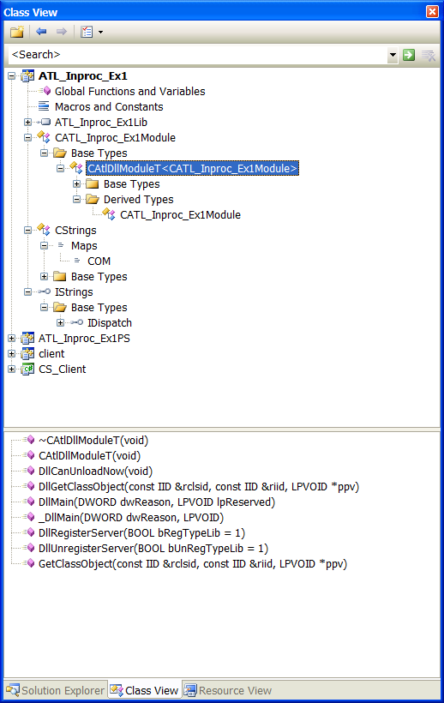
CAtlDllModuleT

Slide 8
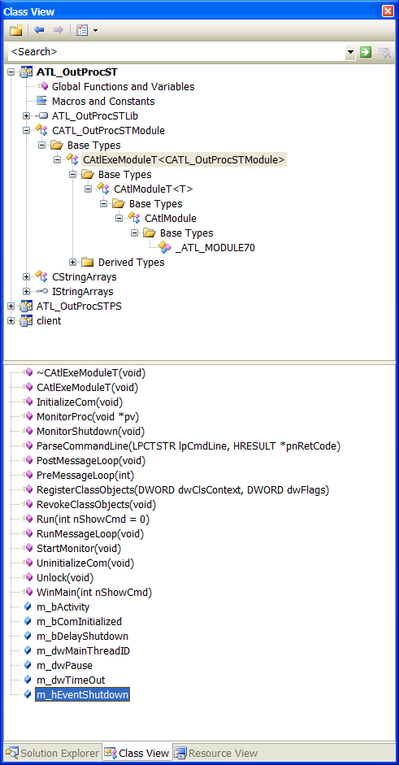
CAtlExeModuleT

Slide 9
ATL Support for Building Clients
CComQIPtr<class T, const IID* piid = &__uuidof(T)>()
Provides instance creation, lifetime management, query for interfaces
CComBSTR(LPCSTR pStr)
Wraps BSTRs, providing string manipulation functions, and memory management
CComVariant(Type, VARTYPE)
Wraps variants, used in Idispatch and for automation
CComSafeArray<class T, VARTYPE>(count)
Wraps arrays of variants

Slide 10
ATL Support for Windows Interfaces
ATL provides, natively, support for creating both Frame and Dialog windows interfaces.
When augmented with the wrappers in the (undocumented and unsupported) atlctrls.h, they provide a very useful framework for creating user interfaces.
You have to know some Win32 windows programming, but they provide a lot of help.
The classes used are shown in the diagram on the next page.
If you want to create a highly functional, complex interface, then using WinForms or the MFC framework are good alternatives.
However, ATL now provides additional support in the form of an add-on library call the Windows Template Library (WTL), available from sourceforge.
We may discuss the WTL in more detail later in the semester.

Slide 11
ATL Windows

Slide 12
Active Template Library
Microsoft has developed the Active Template Library (ATL) to support reuse of existing designs for many of the standard COM interfaces.
IUnknown, IClassFactory, IDispatch, IMarshal
ActiveX Controls interfaces
event notification
properties and property pages
ATL provides source composition, not binary composition. Once built, however, ATL components, like any other, can be composed as binary objects. (we can add a binary control to a window, for example)

Slide 13
Some of the ATL Files
AtlBase.h | Low level type and class definitions
AtlCom.h | COM object management
AtlConv.h | Convert strings to/from unicode
AtlCtl.h, AtlCtl.cpp | ActiveX control support
AtlComCli.h | Smart pointers and BSTR wrapper
AtlSafe.h | SafeArray wrapper
AtlSync.h | Defines classes for locks
Atlimpl.cpp | Implementation of pieces too big to inline
AtlWin.h, AtlWin.cpp | Support for frame and dialog windows
Statreg.h, Statreg.cpp | Support for registry code

Slide 14
End of ATL Presentation

