Slide 1
Repository using Pluggable Components (REPO)
Webify C\C++ code using COM
Yilin Cui
ycui21@syr.edu

Slide 2
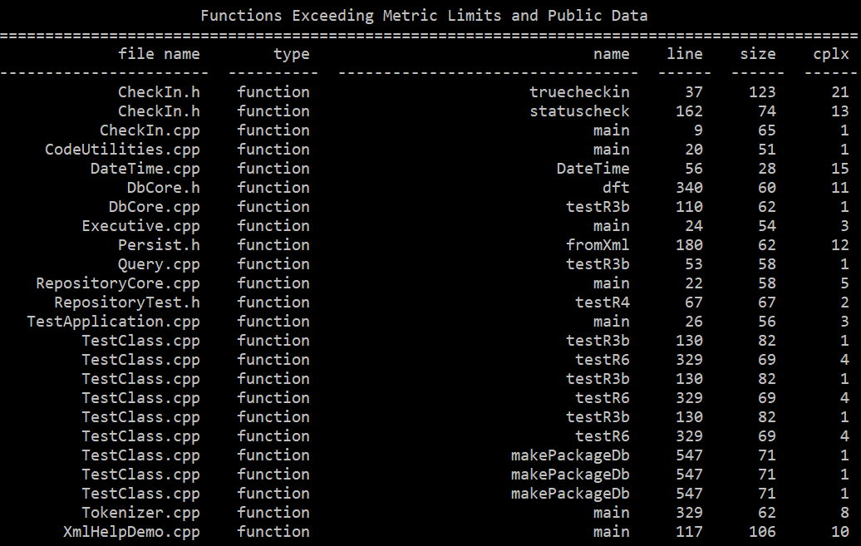
Original Story
It was a Friday morning in May, 2018
When I met Dr. Fawcett for the second time in this very classroom ...

Slide 3
Rethinking Code Repository
Not Only For Code Storage
Tools for Continuous Integration
WEB
Cross Platform
Extensible

Slide 4
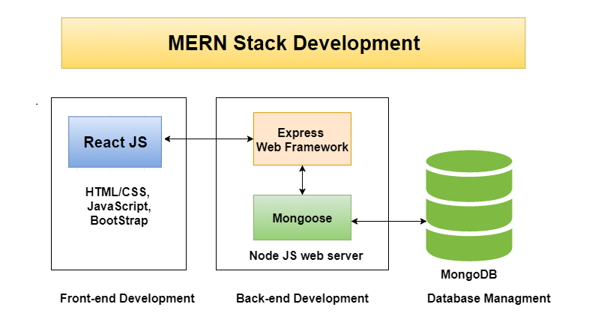
MERN Stack
MongoDB: Document-oriented NoSQL database.
Express: Back-end framework, configure route and middleware.
React: Front-end framework, build reusable UI element inside JavaScript.
Node.js: Runtime environment for WEB application.
source: https://www.topzenith.com/2018/04/top-10-best-mern-stack-video-tutorials.html

Slide 5
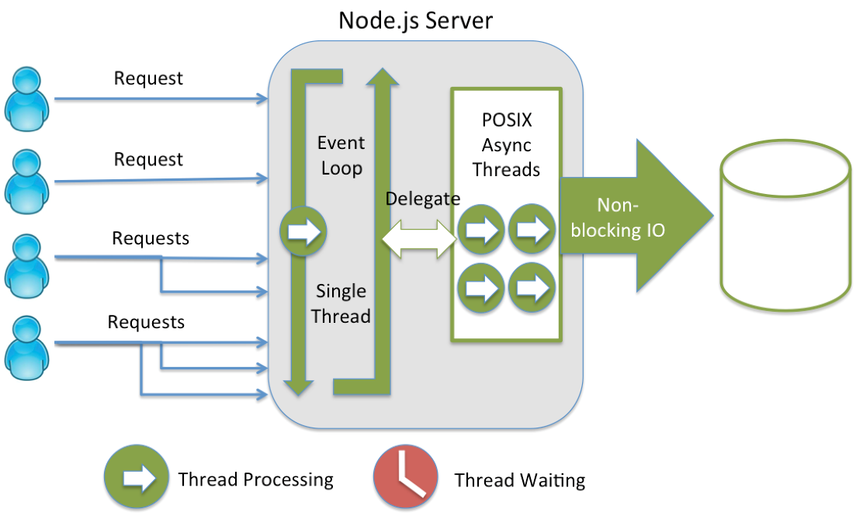
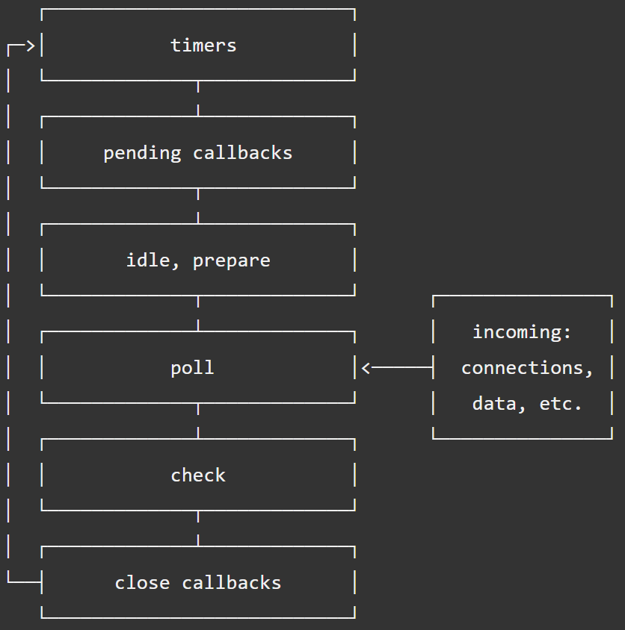
Node.js
Magic “single threaded” event loop. achieve high-concurrency.
Each event phase has queue for Callback.
Inexpensive event is handled by Node
I/O operations are delegated to OS kernel.
However, it still owns a thread pool (using Libuv library).
source: https://nodejs.org/en/docs/guides/event-loop-timers-and-nexttick/

Slide 6
Foreign Function Interface (FFI)
myLib.cFunc(args…)
var myLib=ffi.Library(
comPath,{
‘cFunc’:[‘returnType’:[‘argTypes’,……]
...
})
Based on C++ Addons
Dynamically-linked shared objects written in C++
Provide interface for Node to talk to native code
FFI is easier to use than Addons it self
Take care of garbage collection by itself
extern ’C’{
__declspec(dllexport) returnType cFunc( argTypes arg…){…}
}
Some CPP functions

Slide 7
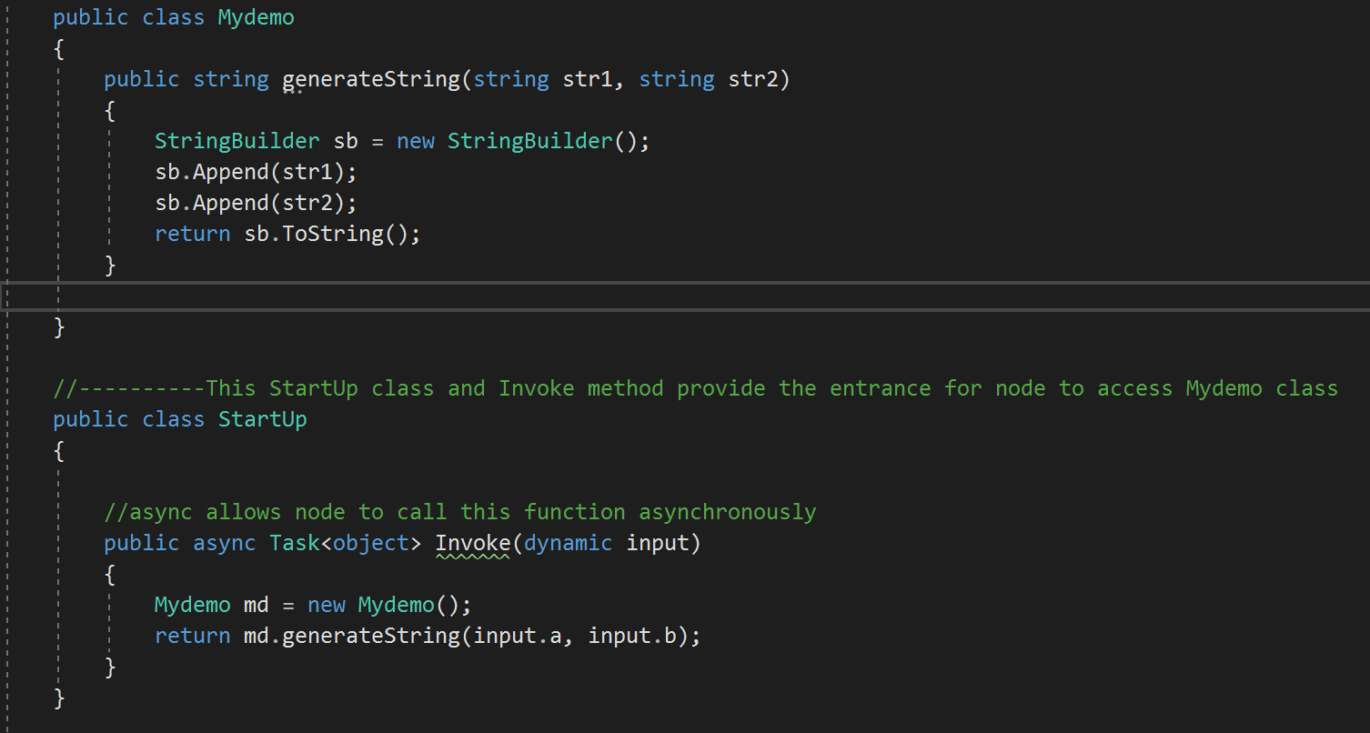
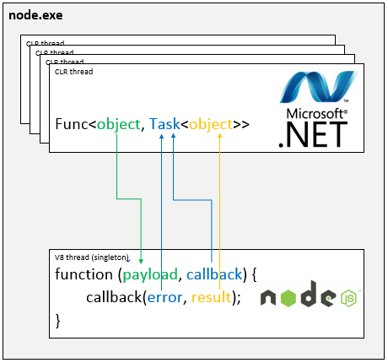
Edge-js
source: https://www.npmjs.com/package/edge-js?activeTab=readme

Slide 8
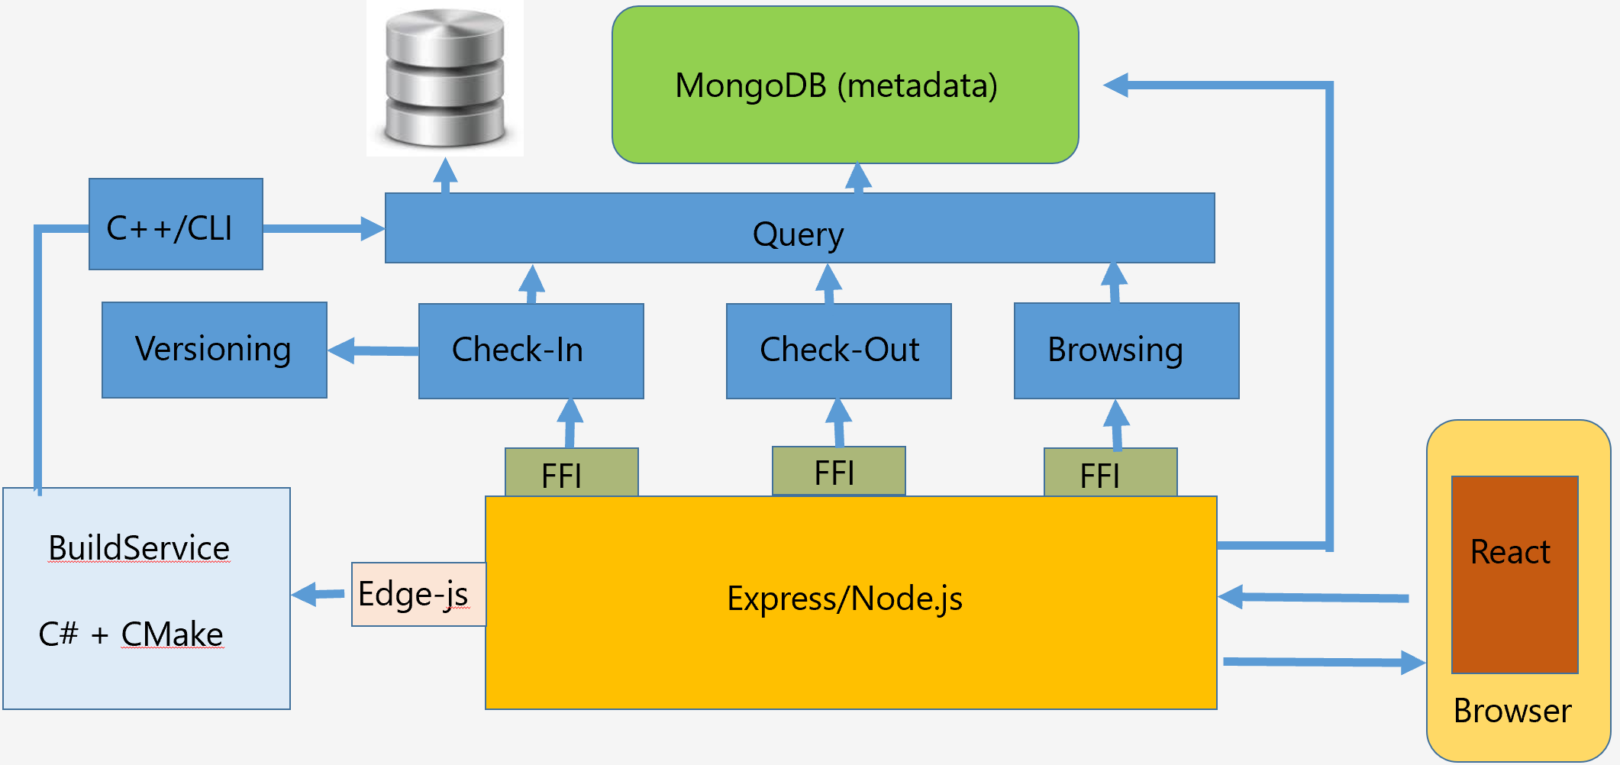
Keep It Silly and Simple!
No branching! Author based check-in
Query part isolate the component and host from database
CMake for build server

Slide 9
TimeLine
Query + MongoDb
3/8/2019
Versioning + Check-in
3/17/2019
Check-out + Browsing
3/25/2019
Frontend
(React)
4/27/2019
Backend Host Framework
(Express.js)
4/12/2019
BuildServer
4/5/2019

Slide 10
Thank you!

