Slide 1
Development team collaboration tool A Micro services Based web application
For Course CSE 775 Distributed Objects (Spring 2019)
By: Vaibhav Kumar
Mentor: Dr. Jim Fawcett
Presentation 1: Technology
Date: 03/07/2019

Slide 2
Content
Overview of the application.
Introduction.
Project description.
Project goals.
Architecture.
Microservices.
Monolith vs Microservices architecture.
Why Microservices?
Technology
Description.
Background.
Issues.
Project Tasks.
Milestones
Timeline

Slide 3
Project Overview

Slide 4
Introduction
This project is about developing a web based collaboration tool for a software development team, providing all the essential facilities for the team to communicate, coordinate and monitor progress of the task in hand. Following are the primary functionalities that the collaboration tool should have:
Team Management
Communication (chat, posts and webinars)
File Management (document sharing and archiving, reusable components)
Task Management (assigning and monitoring progress of tasks)

Slide 5
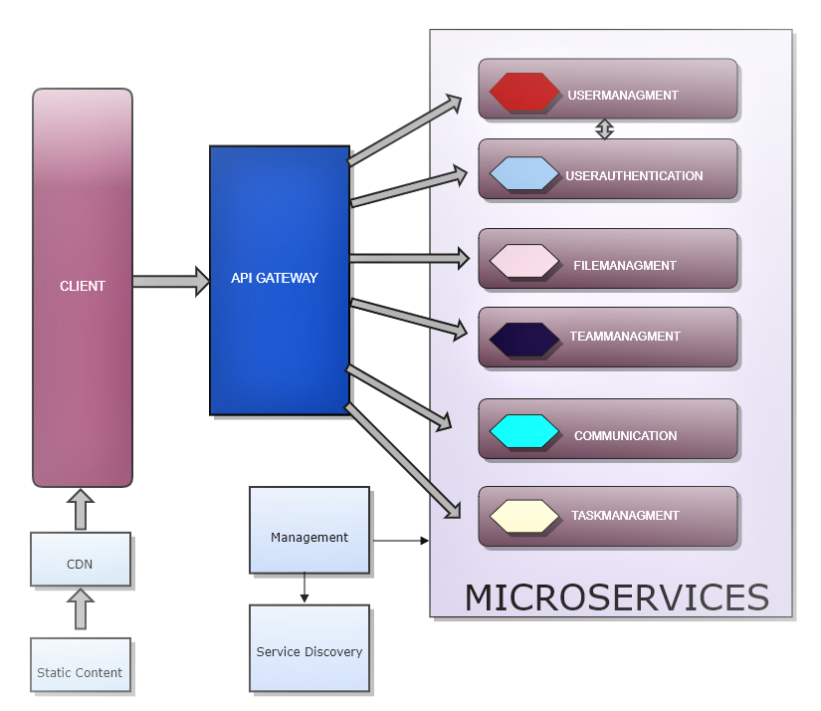
Project description
This is a microservices based web application.
All the mission critical and supporting tasks are logically segregated into individual microservice.

Slide 6
Project goal
To develop a collaboration tool for a software development team which provides core facilities that can be further scaled with added features without affecting the already functional system by following below mentioned ideas:
Building individual microservice with clear objectives.
Easily developable, testable, and deployable modules (services).
Choosing the best possible technologies to provide cost efficient solution.

Slide 7
Architecture.

Slide 8
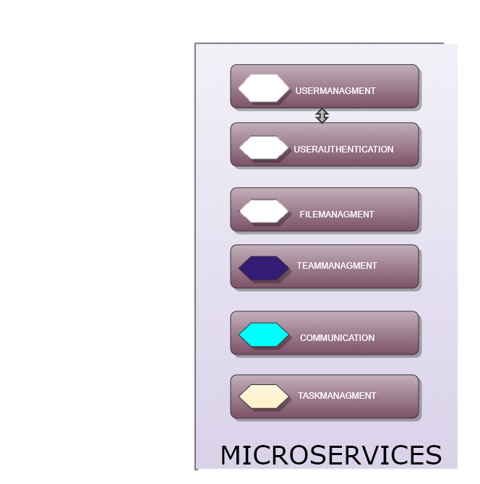
Microservices.
Distinctive method of developing software which focus on building single-focus modules.
Essentially a collection of self contained services where each service is implementing a single business functionality.
Services are “mostly” independent and loosely coupled.
Each service can be deployed independently.
Supports usage of completely different technology stack in each service.
Services are usually classified as either functional or infrastructural (non-functional).

Slide 9
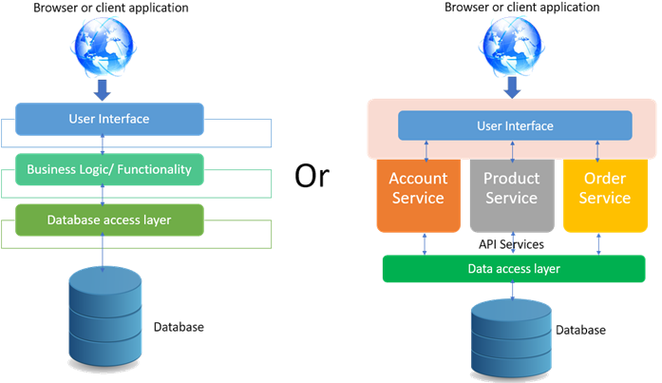
Monolithic vs Microservices based application.
Monolithic systems have all the components encapsulated in one deployable package.
On the other hand, each microservice is a single deployable package, mostly using its own database.
It is not completely true to say that a monolith is deployed on a single server. A monolith can be deployed onto multiple server as multiple instances but all the instances contain all the components encapsulated together.
Monolithic vs Microservices application
Image source: https://www.codeproject.com/Articles/1276639/Microservice-using-ASP-NET-Core

Slide 10
Why Microservices?
Easy deployment: simple deployment without affecting other services
Reusability of basic services: Some microservices can be reused within the organization. E.g User Authentication, payment.
Faster defect isolation: Easier to identify the defect.
Better segregation of developmental roles.
Simplicity.

Slide 11
Technology.

Slide 12
Technology Stack
Client Web Application:
.NET core
ASP.NET Core MVC
HTML5, CSS3 and Javascript.
Bootstrap
Microservices
ASP.NET Core Web API Project
Entity Framework Core
Microsoft SQL Server
Docker Containers.
Communication Technology
Advance Message Queueing Protocol (AMQP) using RabbitMQ

Slide 13
.NET Core
Microsoft’s move to .Net based application platform agnostic.
It is a free, open source software platform for windows, Linux and Mac OS.
Currently .NET core version 2.2 is out and version 3 is awaited in 2019.
Full support for C# and F#, partial support for visual basic.

Slide 14
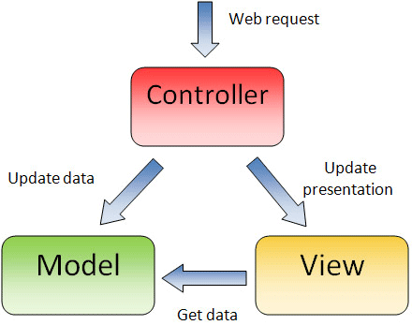
ASP.NET Core MVC
Framework for building MVC based web application.
Model: Model essentially contains business objects (Data).
Controller translates request and passes the model (data) to the view.
Views processes the markup (HTML) and data together and render it to client display.
Image source: https://stackoverflow.com/questions/27950039/in-mvc-should-the-view-know-the-model

Slide 15
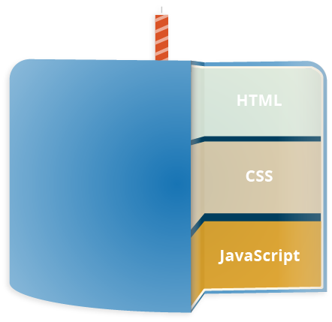
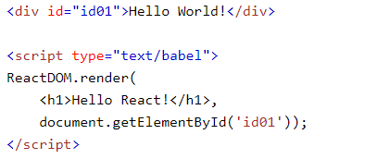
HTML, CSS3 and JavaScript
HTML: Hypertext Markup Language which defines the structure of a web page.
CSS3: Cascading stylesheet used to provide styling to the webpage
JavaScript : JavaScript is a scripting language that is used to create dynamically updating content.
Other JavaScript libraries:
React.js: JavaScript library, managed by Facebook, which is used to build UI components.
Image source: https://developer.mozilla.org/en-US/docs/Learn/JavaScript
Image source: https://www.w3schools.com/

Slide 16
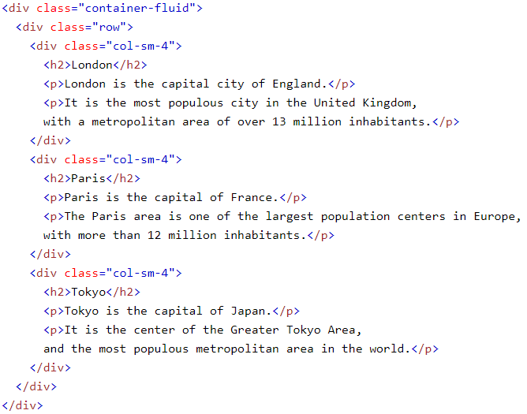
Bootstrap:
Bootstrap is one of the most popular CSS framework used for developing responsive UI.
A responsive design means the UI should adjust itself depending upon the device it is being accessed on.
Column based approach where each component is divided in 12 components with the width of the screen.
Image source: https://www.w3schools.com/whatis/whatis_bootstrap.asp

Slide 17
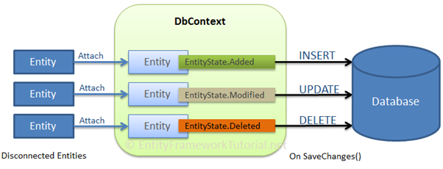
Entity Framework Core:
It is Microsoft’s official ORM (Object Relational Mapping).
It allows .NET objects to interact with database objects.
Eliminates the need of most of data access code.
Sync between the disconnected entity and the database is established on SaveChanges()
Image source:http://www.entityframeworktutorial.net/images/efcore/save-data-in-disconnected-scenario.png

Slide 18
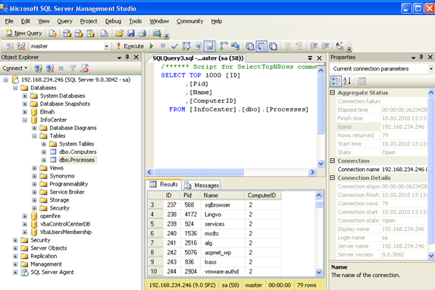
Microsoft SQL Server
Relational Database Management System.
Every database contains tables, view and stored procedures.
Structured Query Language (SQL) is used to interact with the databases.
Image source: https://www.progress.com/connectors/microsoft-sql-server

Slide 19
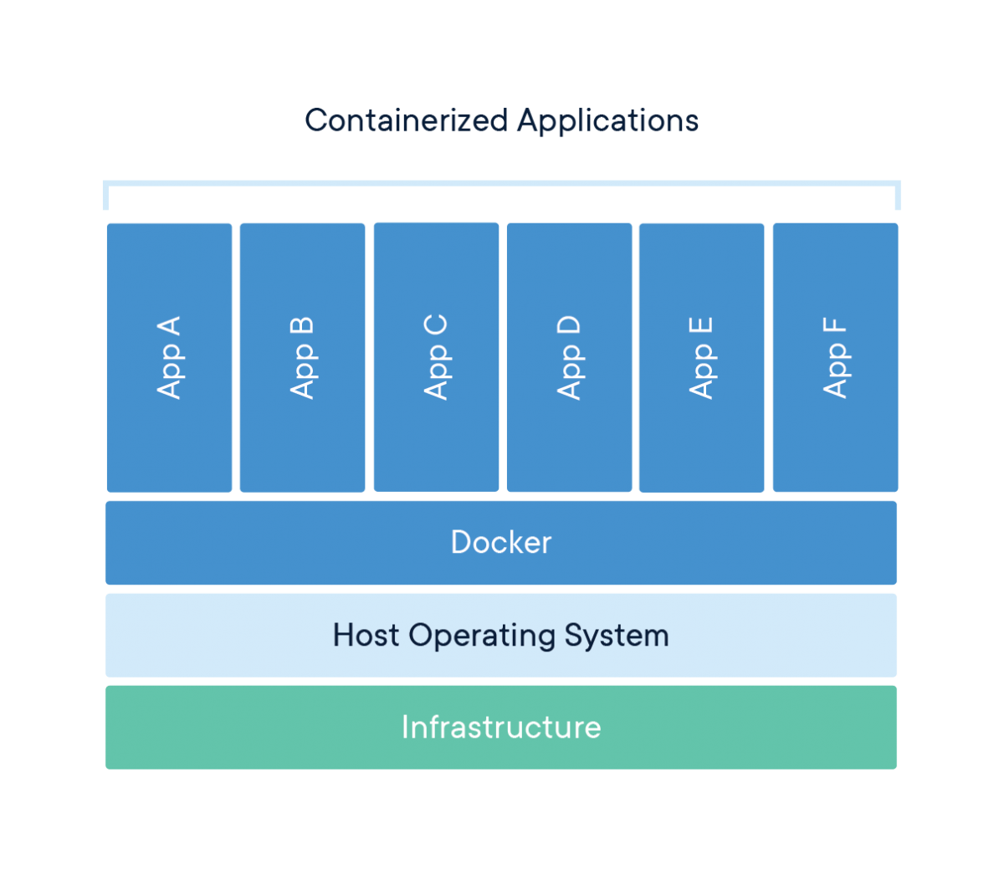
Docker Containers.
A container is a standard unit of software that packages up code and all its dependencies so the application runs quickly and reliably from one computing environment to another.
A Docker container image is a lightweight, standalone, executable package of software that includes everything needed to run an application: code, runtime, system tools, system libraries and settings.
Container images become containers at runtime and in the case of Docker containers - images become containers when they run on docker engine.
Available for both Linux and Windows-based applications, containerized software will always run the same, regardless of the infrastructure.
Image and content source: https://www.docker.com/resources/what-container

Slide 20
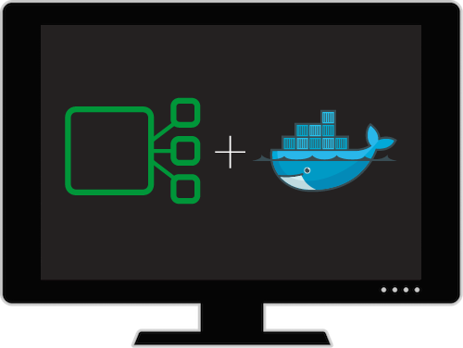
Docker+Microservices
Image source: https://www.nginx.com/resources/webinars/building-applications-with-microservices-and-docker/

Slide 21
Communication Technology
RabbitMQ will be used for the communication between client and microservices.
RabbitMQ is a message broker system that implements Asynchronous Message Queueing Protocol (AMQP).
Image source: https://www.rabbitmq.com/tutorials/tutorial-one-dotnet.html

Slide 22
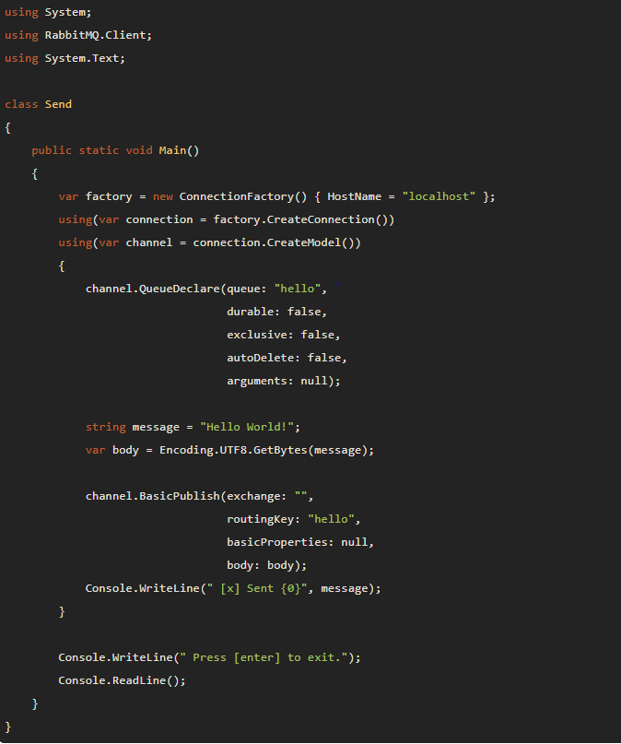
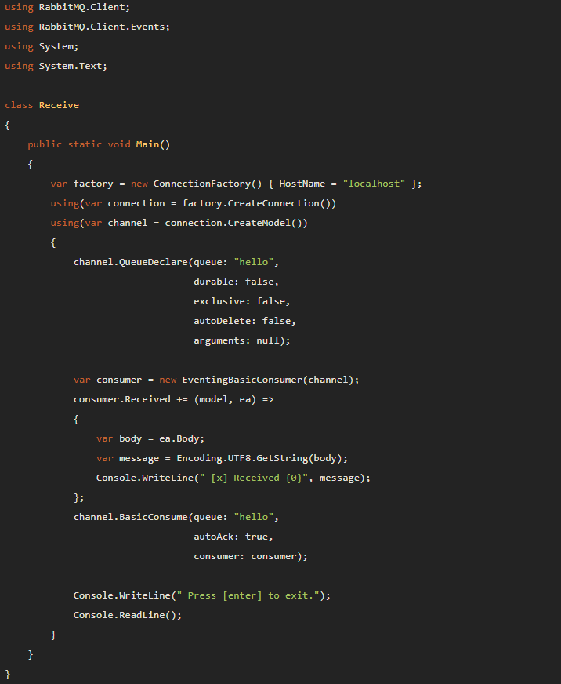
Sender
Receiver
Source: https://www.rabbitmq.com/tutorials/tutorial-one-dotnet.html

Slide 23
Project Tasks.

Slide 24
Milestones.
Milestone 1: Functional Web application + API Gateway + UserManagement microservice + UserAuthentication Microservice+ established communication channel.
Milestone 2: TaskManagement microservice.
Milestone 3: FileManagement microservice.
Milestone 4: Communication microservice.
Milestone 5: Metadata Management microservice.
Milestone 6: Implementation of Container orchestration using Microsoft Azure Service Fabric.

Slide 25
Timeline.
Task | Start Date | End Date
Requirement Specification | 02/20/2019 | 02/23/2019
Prototyping with one microservice and containers | 02/24/2019 | 02/26/2019
Microservices phase 1 (Usermanagement, Userauthentication, Taskmanagement) | 03/01/2019 | 03/15/2019
Microservices phase 2 (FileManagement and communication microservices) | 03/16/2019 | 03/22/2019
Microservices phase 3 (FileManagement, Metadata Management and communication microservices)+ System testing for version 1 | 03/23/2019 | 04/04/2019
Attempt to implement ambitious goals | 04/06/2019 | 04/16/2019

Slide 26
Thank You

